Slide 1
Wavelet Rasterization
Josiah Manson and Scott Schaefer

Slide 2
Rasterization in 2D
KarensWhimsy.com

Slide 3
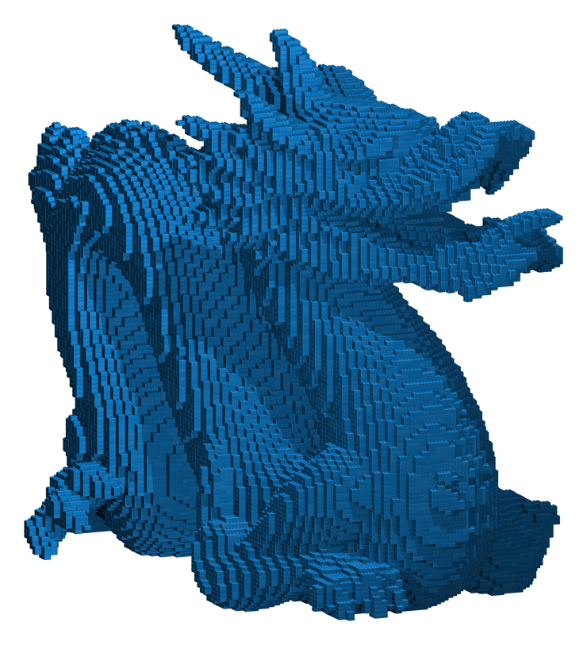
Rasterization in 3D
Drububu.com

Slide 4
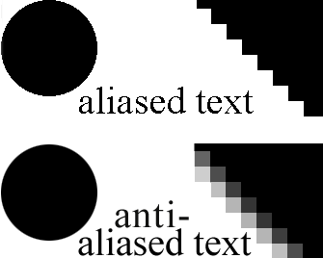
The aliasing problem
http://www.webpages.uidaho.edu/cti/photoshop/intro/anti-aliasing.htm

Slide 5
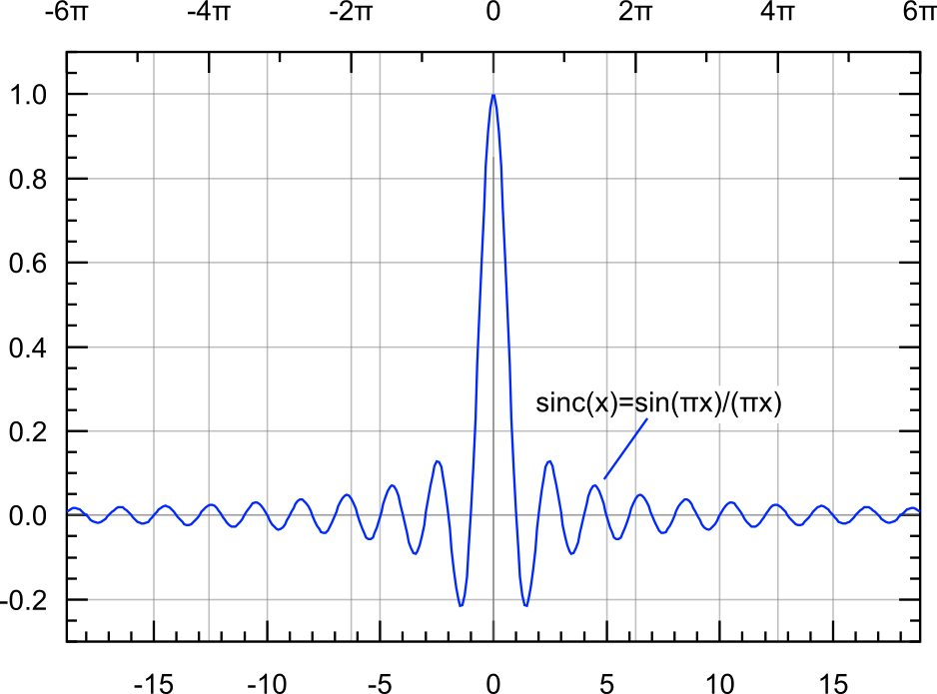
Anti-aliasing

Slide 6
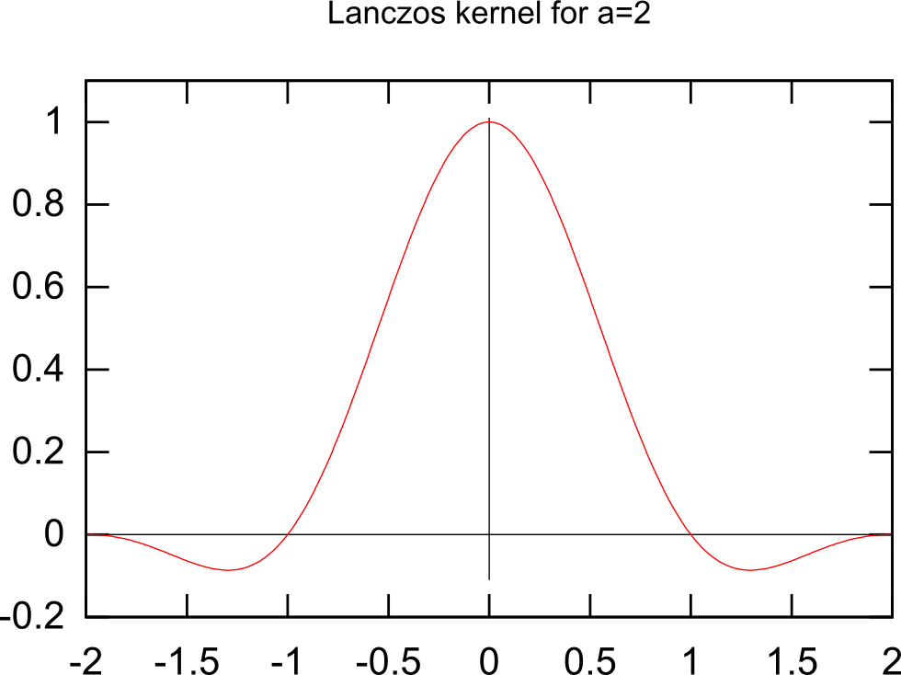
Anti-aliasing

Slide 7
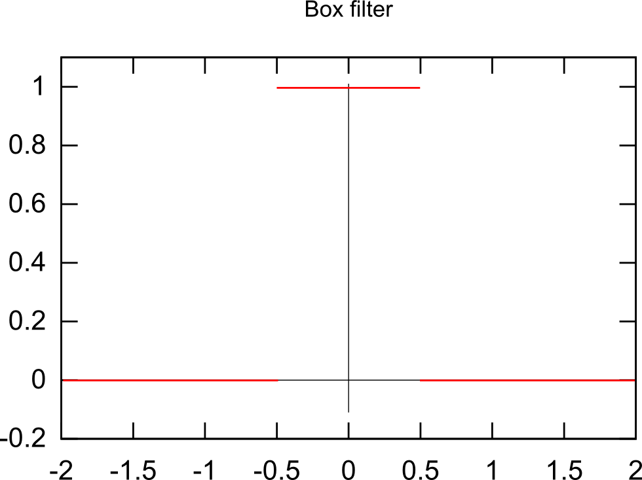
Anti-aliasing

Slide 8
Pixel Raster Equation

Slide 9
Pixel Raster Equation

Slide 10
Pixel Raster Equation

Slide 11
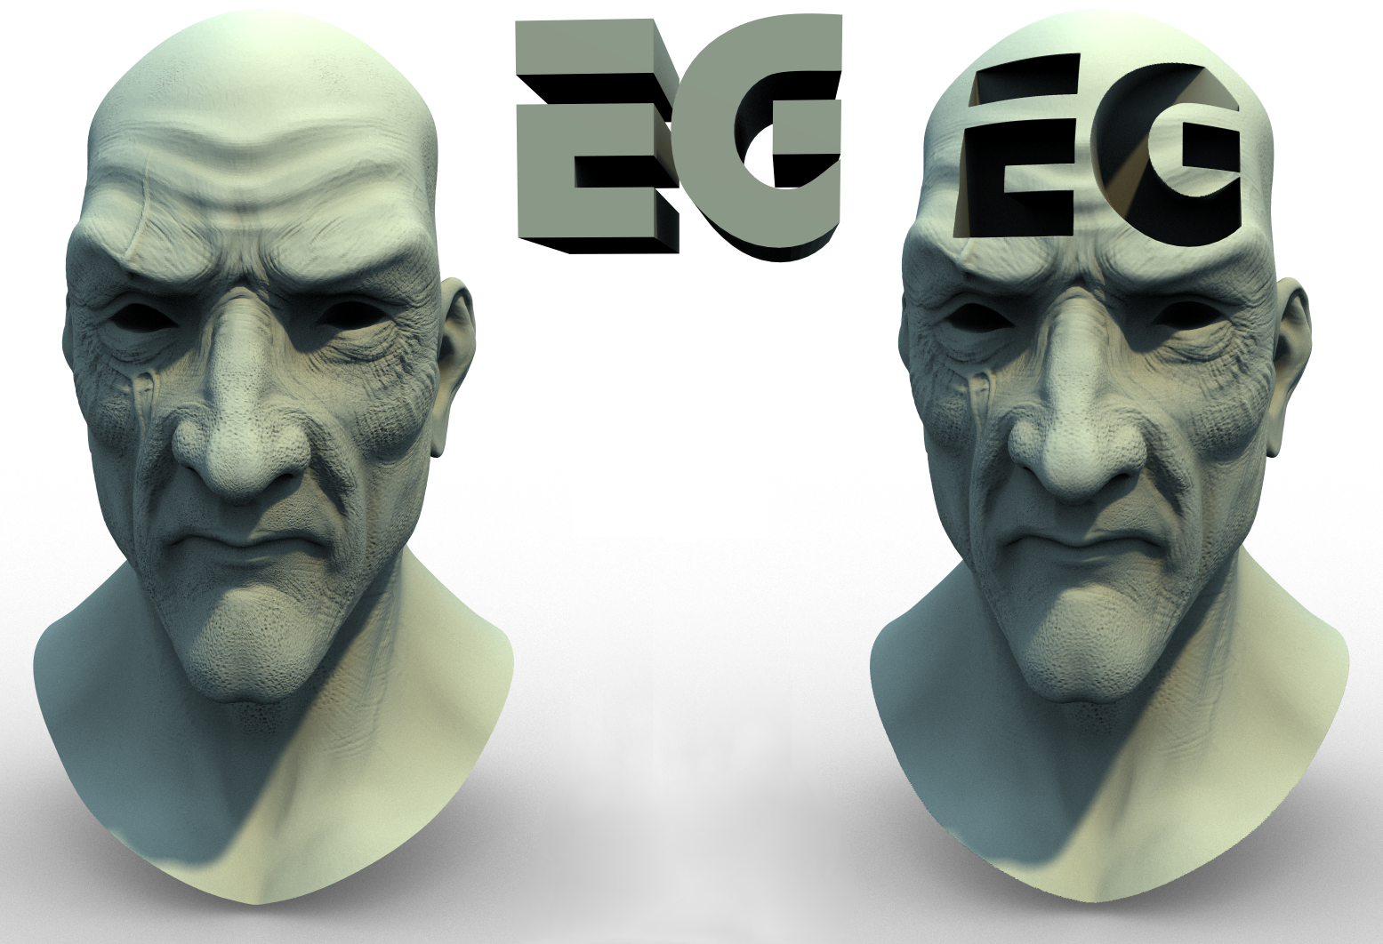
Applications

Slide 12
Applications
“A Multiscale Approach to Mesh-based Surface Tension Flows” Nils Thuerey, Chris Wojtan, Markus Gross, and Greg Turk

Slide 13
Haar Wavelets
1
0
1
-1
Φ

Slide 14
Haar Wavelets
1
1
0
1
0
1
-1
-1
Φ
Ψ

Slide 15
Haar Wavelets

Slide 16
Haar Wavelets

Slide 17
Haar Wavelets
+

Slide 18
Haar Wavelets
+
+

Slide 19
Haar Wavelets
+
+
+

Slide 20
2D Haar Wavelets

Slide 21
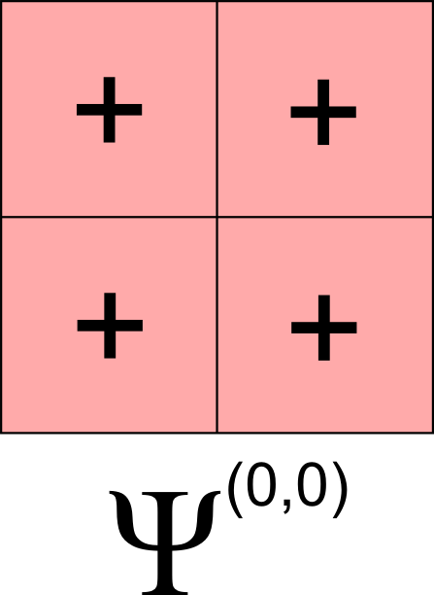
2D Haar Wavelets
=

Slide 22
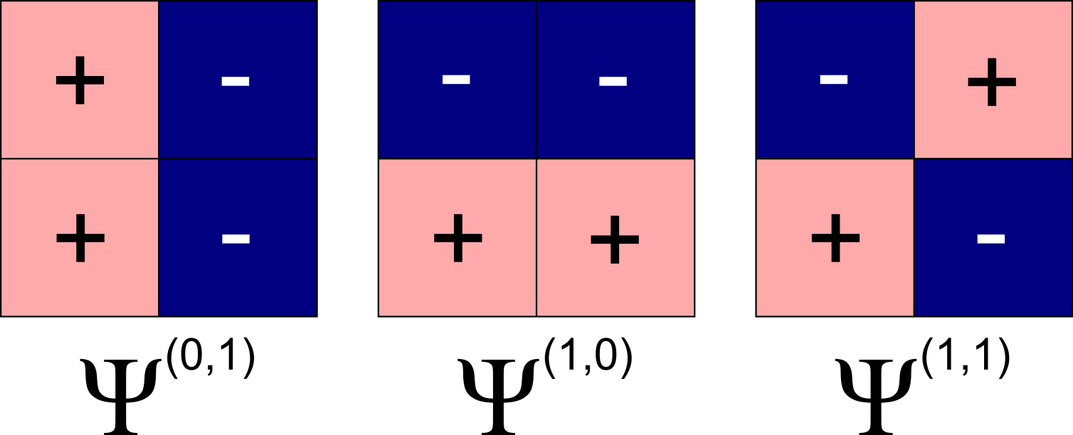
2D Haar Wavelets
=
+

Slide 23
Why Wavelets?

Slide 24
Why Wavelets?
GPU
AGG
Wavelet

Slide 25
Calculating Wavelet Coefficients

Slide 26
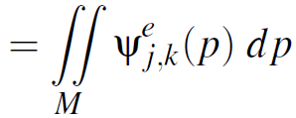
Calculating Wavelet Coefficients

Slide 27
Calculating Wavelet Coefficients

Slide 28
Calculating Wavelet Coefficients

Slide 29
Calculating Wavelet Coefficients

Slide 30
Choosing F

Slide 31
Choosing F

Slide 32
Choosing F

Slide 33
Choosing F

Slide 34
Choosing F

Slide 35
Choosing F

Slide 36
Choosing F

Slide 37
Choosing F

Slide 38
Choosing F

Slide 39
Line Segments

Slide 40
Line Segments
Details in paper

Slide 41
The Algorithm, Step-by-step

Slide 42
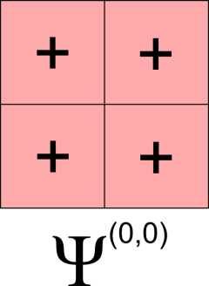
The Algorithm, Step-by-step

Slide 43
The Algorithm, Step-by-step

Slide 44
The Algorithm, Step-by-step

Slide 45
The Algorithm, Step-by-step

Slide 46
The Algorithm, Step-by-step

Slide 47
The Algorithm, Step-by-step

Slide 48
The Algorithm, Step-by-step

Slide 49
The Algorithm, Step-by-step

Slide 50
The Algorithm, Step-by-step

Slide 51
The Algorithm, Step-by-step

Slide 52
The Algorithm, Step-by-step

Slide 53
The Algorithm, Step-by-step

Slide 54
The Algorithm, Step-by-step

Slide 55
The Algorithm, Step-by-step

Slide 56
The Algorithm, Step-by-step

Slide 57
The Algorithm, Step-by-step

Slide 58
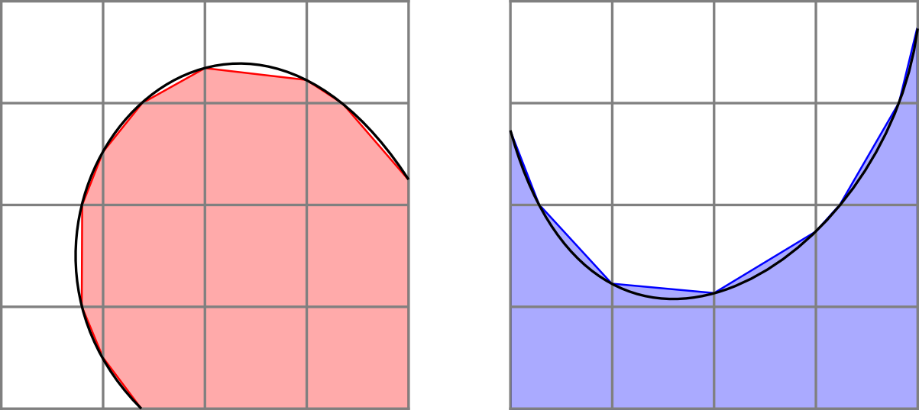
Bézier Curves

Slide 59
Bézier Curves

Slide 60
Bézier Curves

Slide 61
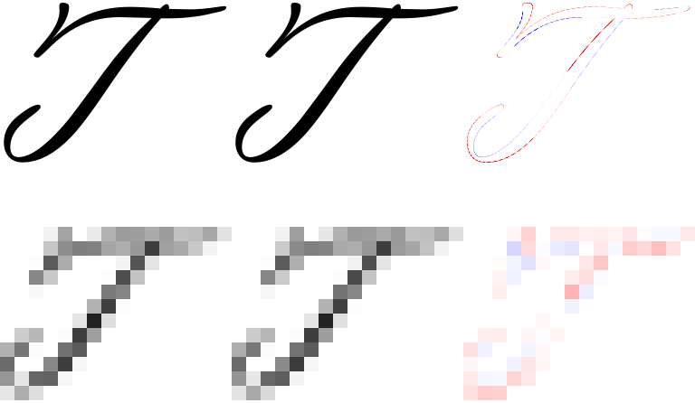
Results
FreeType
Wavelets
Difference

Slide 62
Results
2
20
10000

Slide 63
Progressive Rasterization

Slide 64
Progressive Rasterization

Slide 65
Progressive Rasterization

Slide 66
Progressive Rasterization

Slide 67
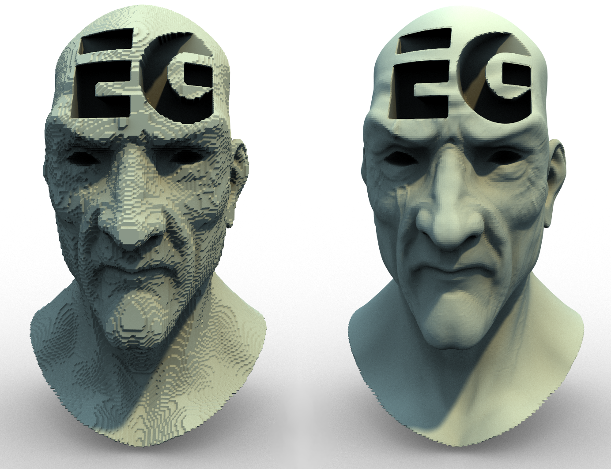
Results

Slide 68
Speed

Slide 69
The Future
Use higher order wavelets
Implement on GPU
Progressive rasterization

Slide 70
Conclusion
Accurate
Robust
Fast
Memory efficient

Slide 72
Bézier Curves

Slide 73
Bézier Curves

Slide 74
Bézier Curves
Details in paper

Slide 75
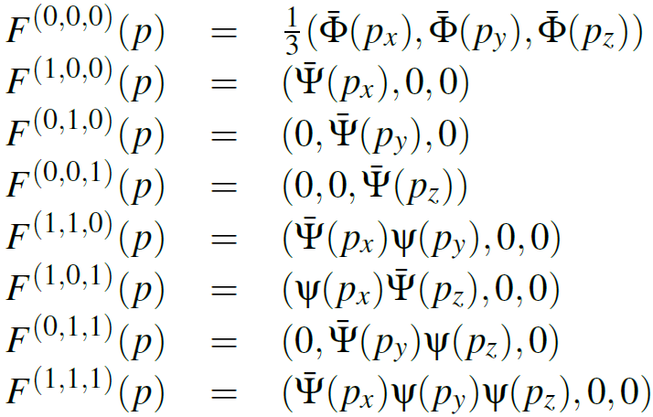
3D Formulation

Slide 76
3D Formulation

