Slide 1
Analytic Rasterization of Curves with Polynomial Filters
Josiah Manson and Scott Schaefer
Texas A&M University

Slide 2
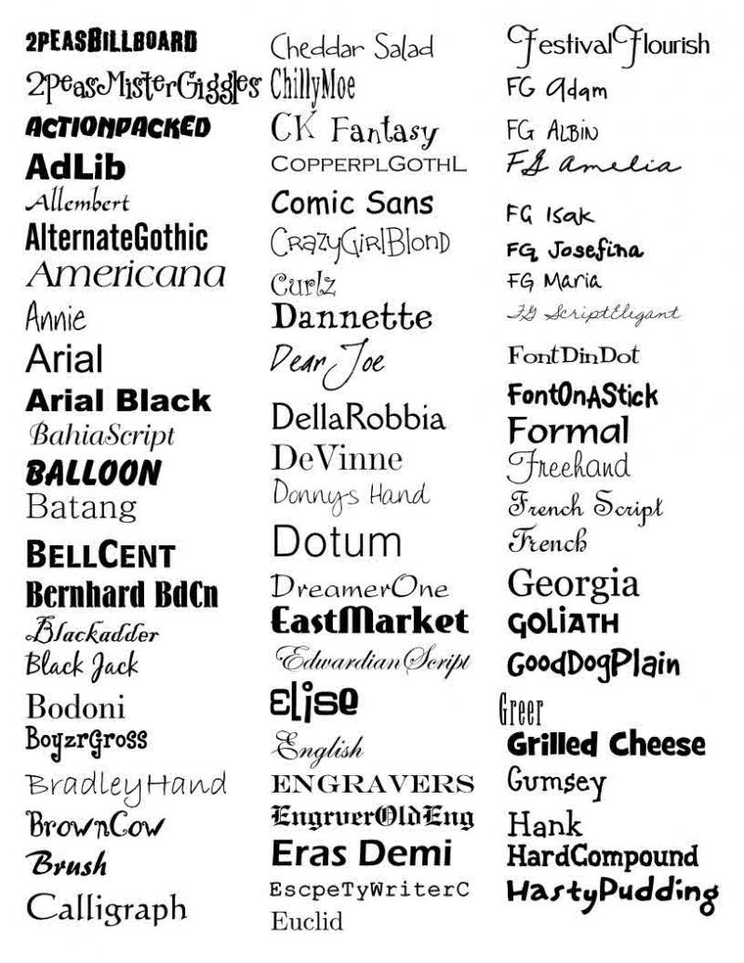
Motivation

Slide 3
Motivation

Slide 4
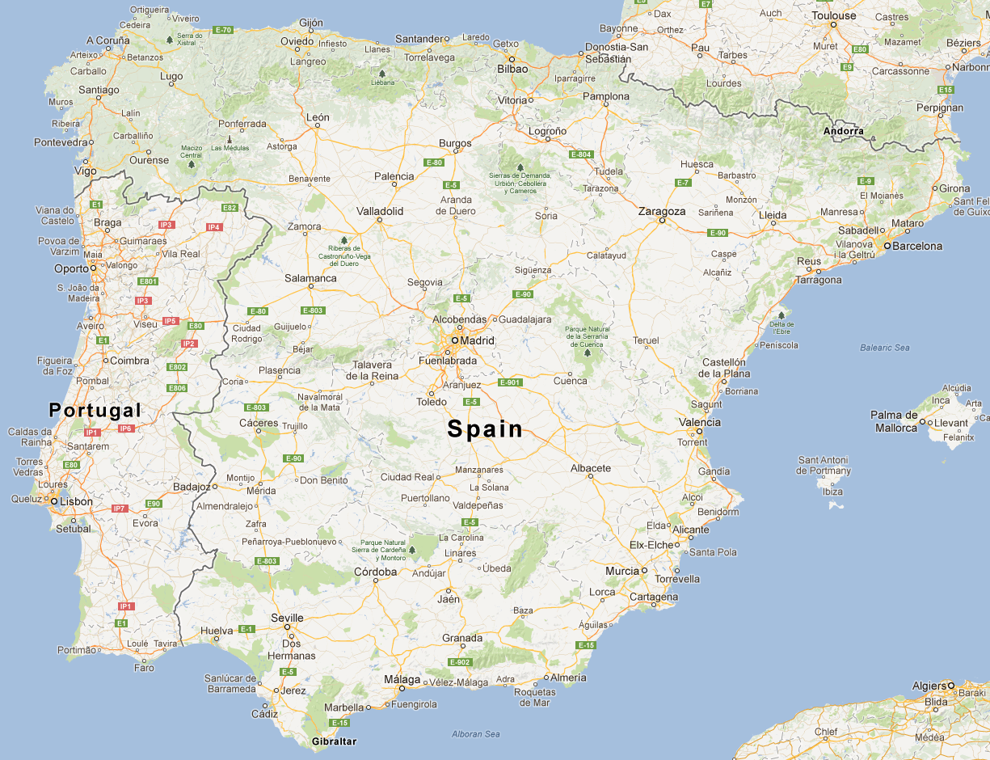
Motivation

Slide 5
Motivation

Slide 6
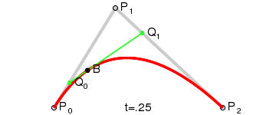
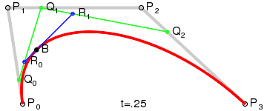
Motivation

Slide 7
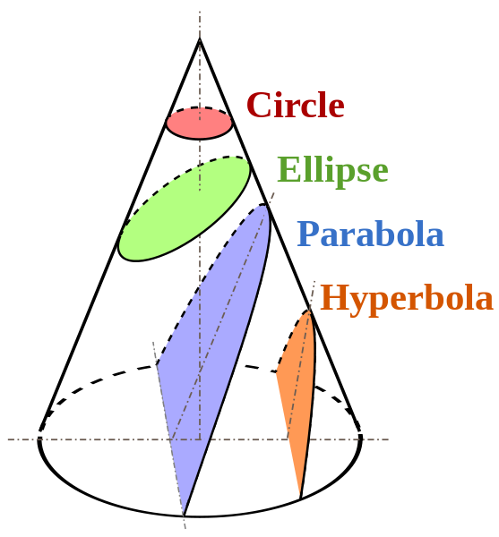
Motivation

Slide 8
Motivation
Constant colors
Color gradients

Slide 9
Motivation

Slide 10
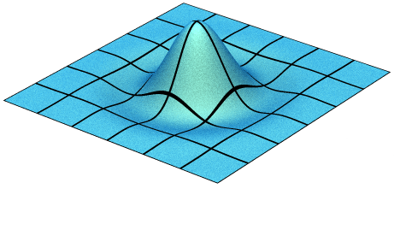
Input
Curve Boundary
Piecewise Filter

Slide 11
Input
[Duff, 1989]
“Polygon scan conversion by exact convolution”
[Manson and Schaefer, 2011]
“Wavelet Rasterization”
Curve Boundary
Piecewise Filter

Slide 12
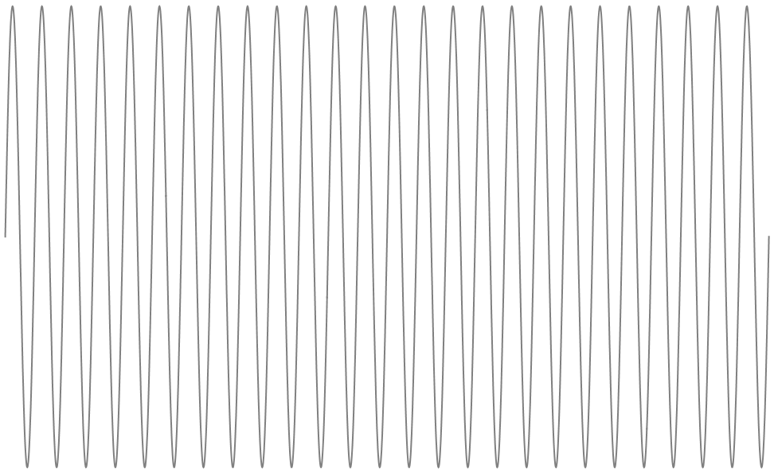
Signal Sampling

Slide 13
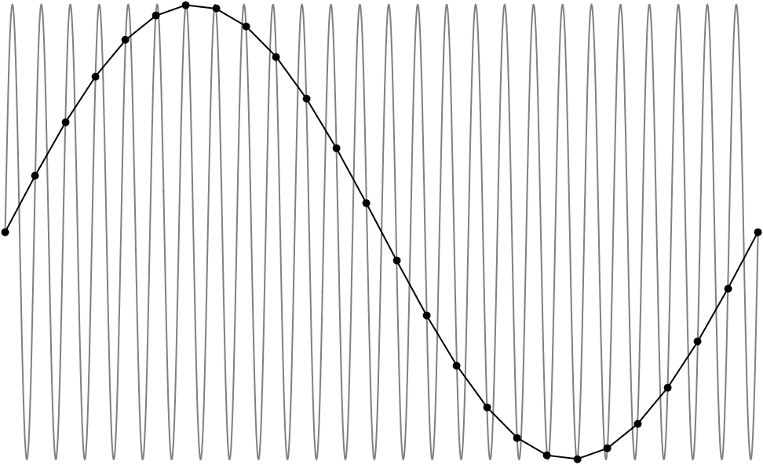
Signal Sampling

Slide 14
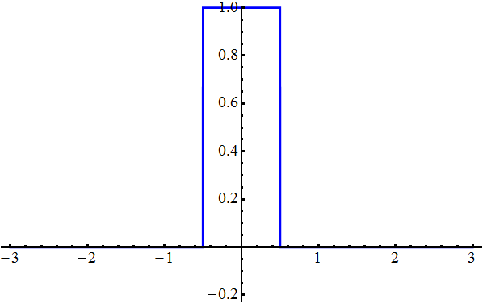
Signal Sampling

Slide 15
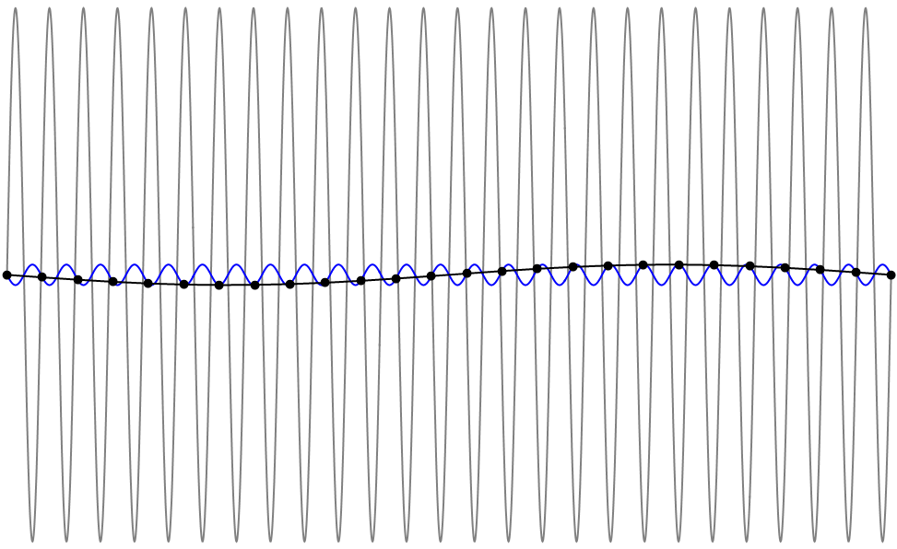
Signal Sampling

Slide 16
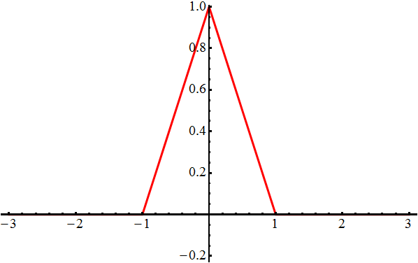
Signal Sampling

Slide 17
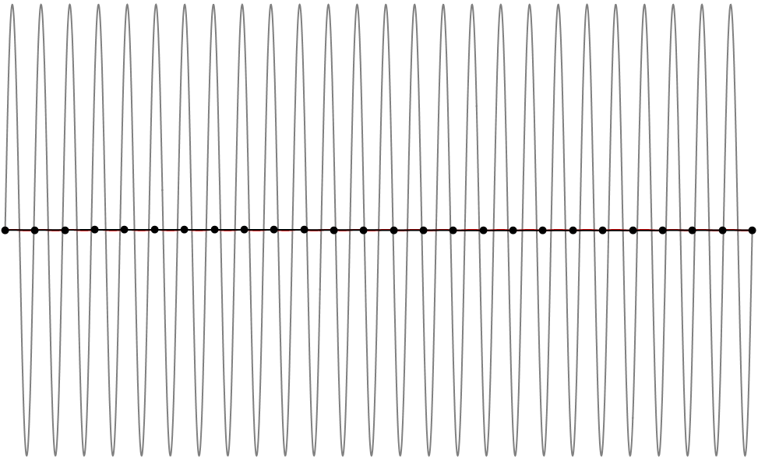
Signal Sampling

Slide 18
Image Sampling
Image

Slide 19
Image Sampling
Pixel positions

Slide 20
Image Sampling
Evaluate at point

Slide 21
Image Sampling
Center filter at point

Slide 22
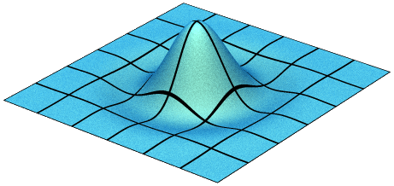
Image Sampling
Center filter at point

Slide 23
Image Sampling
Center filter at point

Slide 24
Image Sampling
Multiply

Slide 25
Image Sampling
Integrate

Slide 26
Image Sampling
Repeat for all pixels

Slide 27
Derivation

Slide 28
Derivation

Slide 29
Derivation

Slide 30
Derivation

Slide 31
Derivation

Slide 32
Derivation

Slide 33
Derivation

Slide 34
Derivation

Slide 35
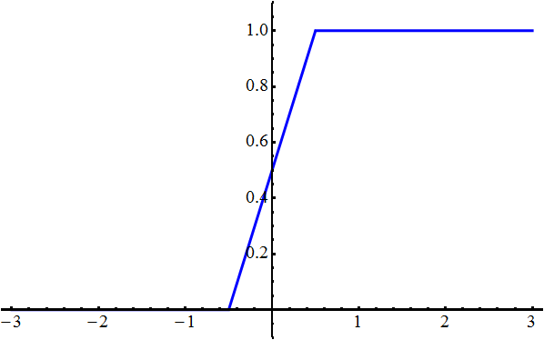
Filter Integrals

Slide 36
Filter Integrals
Zero
C
h
a
n
g
e
s
Zero
Zero
C
h
a
n
g
e
s
Constant

Slide 37
Filter Pieces

Slide 38
Scanline Rasterization
Notes:
Take shape

Slide 39
Scanline Rasterization
Notes:
Cut to pixel grid

Slide 40
Scanline Rasterization
Notes:
When evaluating a pixel, add contribution from every piece of curve in the integral’s support.

Slide 41
Scanline Rasterization
Changing
Notes:
When evaluating a pixel, add contribution from every piece of curve in the integral’s support.

Slide 42
Scanline Rasterization
Changing
Constant
Notes:
When evaluating a pixel, add contribution from every piece of curve in the integral’s support.

Slide 43
Scanline Rasterization
Notes:
Notice that computations in the green, constant regions are duplicated

Slide 44
Scanline Rasterization

Slide 45
Scanline Rasterization

Slide 46
Scanline Rasterization

Slide 47
Scanline Rasterization
+

Slide 48
Scanline Rasterization

Slide 49
Scanline Rasterization

Slide 50
Scanline Rasterization
+

Slide 51
Scanline Rasterization

Slide 52
Scanline Rasterization

Slide 53
Scanline Rasterization
+

Slide 54
Scanline Rasterization

Slide 55
Scanline Rasterization

Slide 56
Scanline Rasterization
+

Slide 57
Scanline Rasterization

Slide 58
Scanline Rasterization

Slide 59
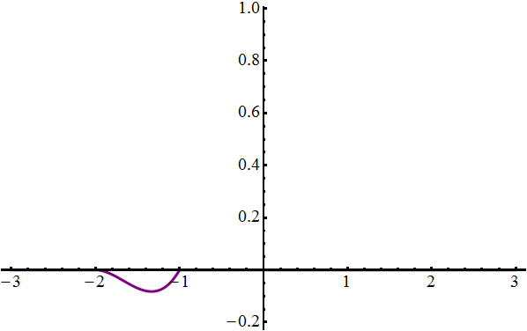
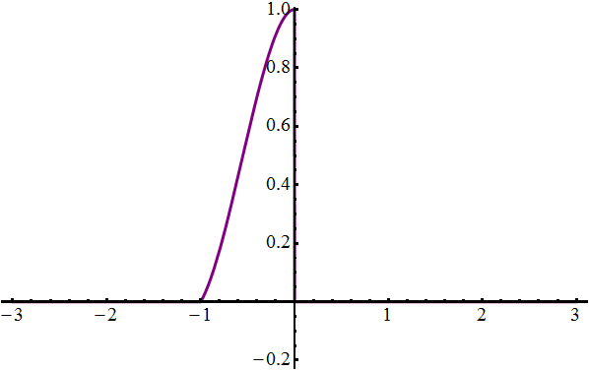
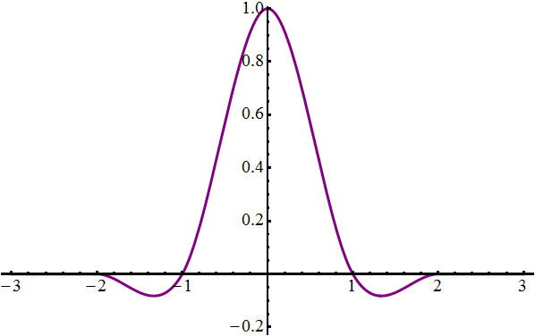
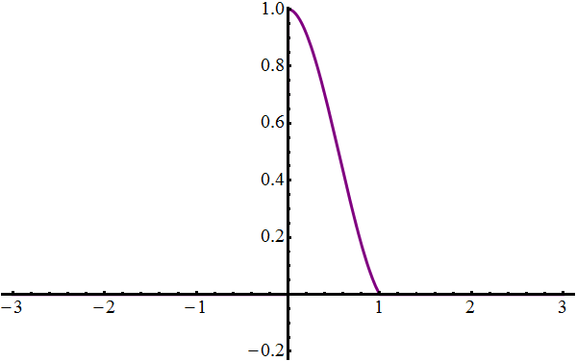
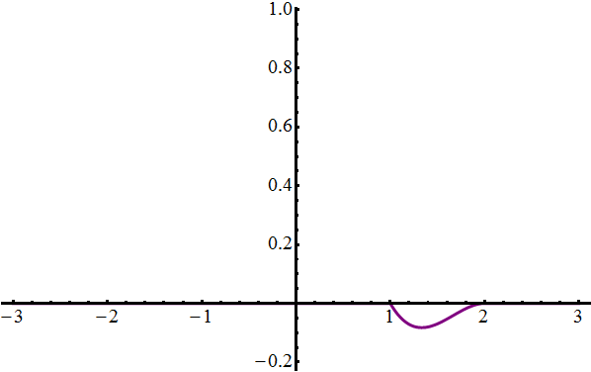
Filter Pieces
=
+

Slide 60
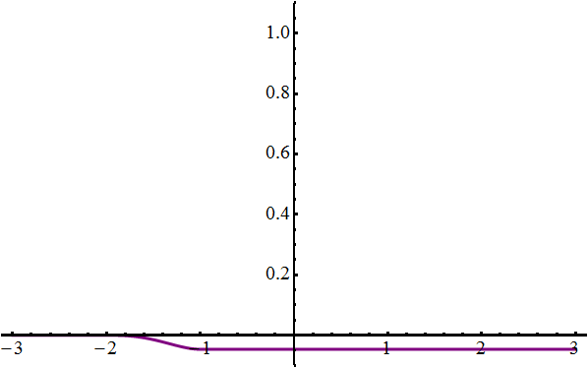
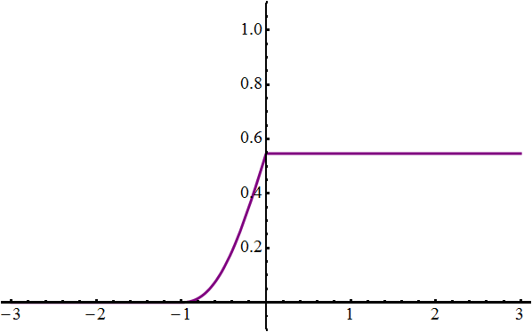
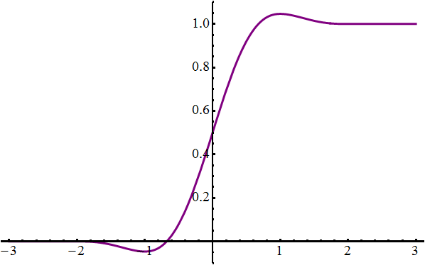
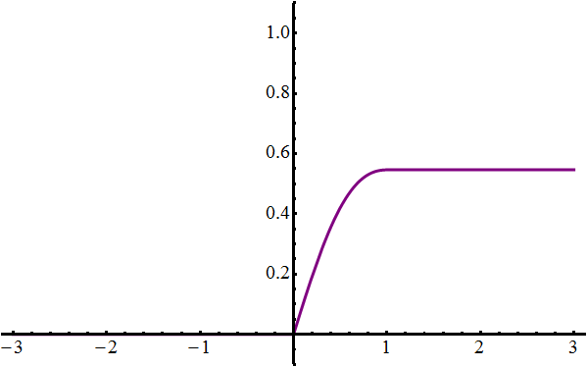
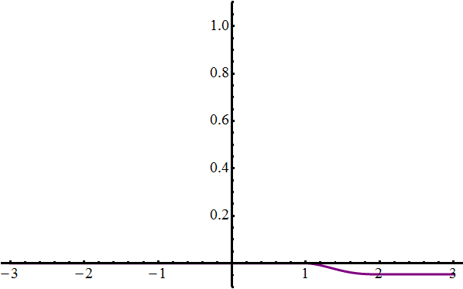
Filter Pieces
=
+

Slide 61
Rational Curves

Slide 62
Cubic Curves
Input image
Mitchell-Netravali

Slide 63
Anti-aliasing
Point sampling
16x MSAA tent
Analytic tent
ATI Radeon HD 5700

Slide 64
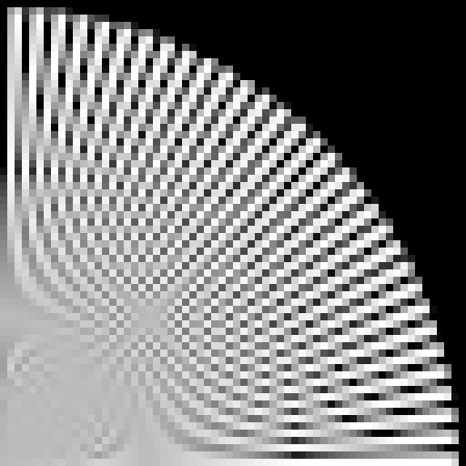
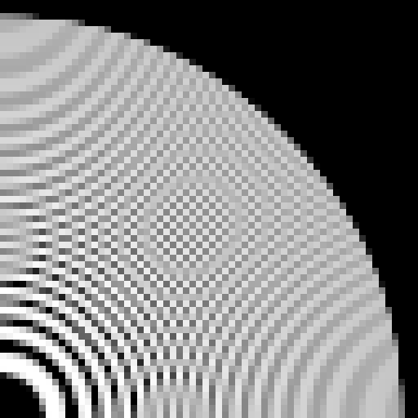
Anti-aliasing
Box

Slide 65
Anti-aliasing
Tent

Slide 66
Anti-aliasing
Lanczos 3

Slide 67
Anti-aliasing
Radial 3

Slide 68
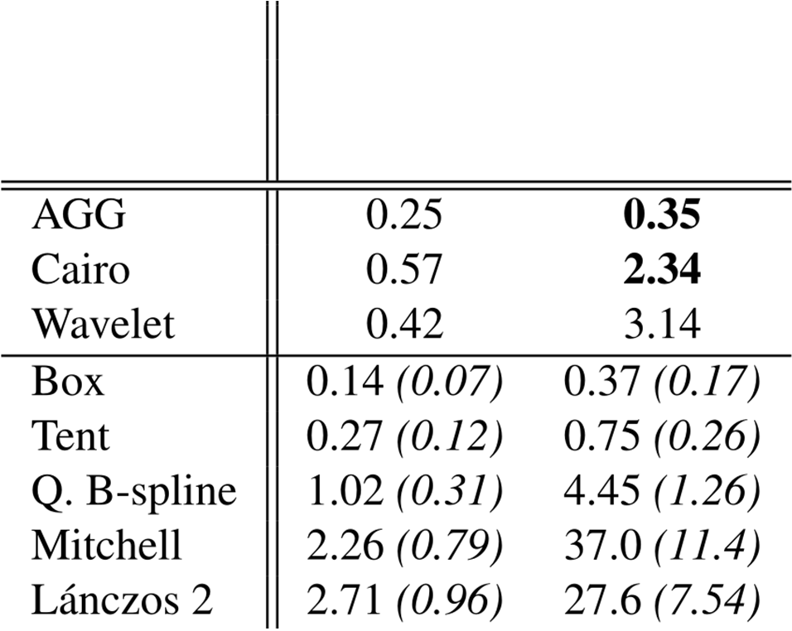
Timings (ms)

Slide 69
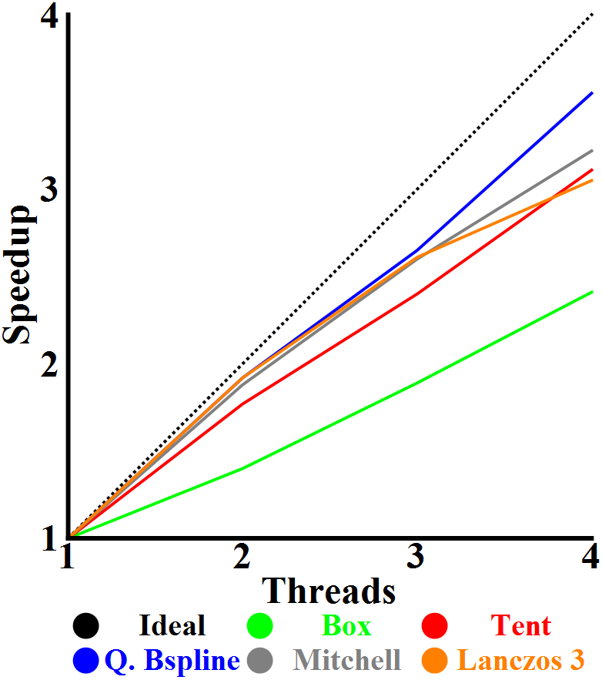
Parallelism

Slide 70
Conclusions
Analytic prefiltering
Smooth curves
High-quality filters
Color gradients
Fast algorithm
Independent curves and filter pieces
High parallelism

