Slide 1
Parameterization-Aware MIP-Mapping
Josiah Manson and Scott Schaefer
Texas A&M University
Notes:
I’m going to talk about why geometry is important in texture sampling. First I’ll start with a little background.

Slide 2
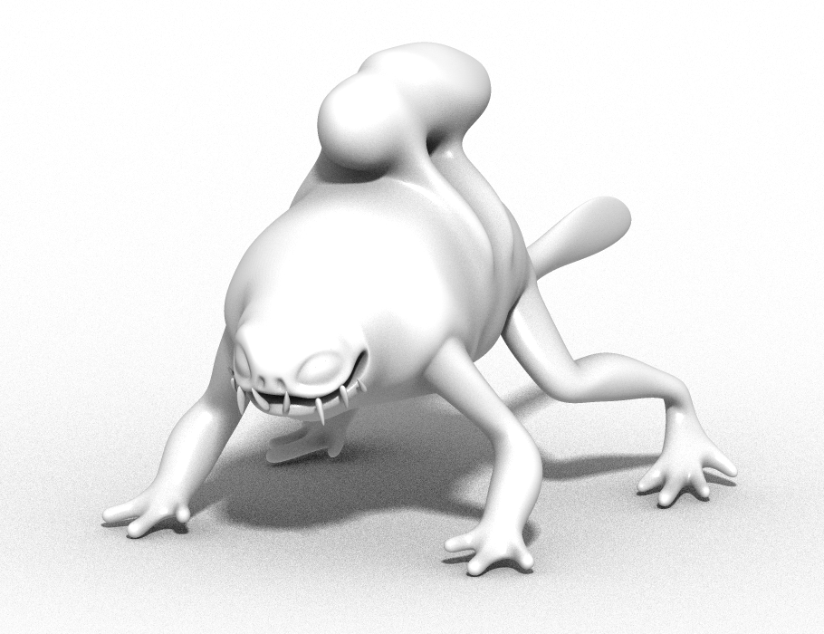
Texture Parameterization

Slide 3
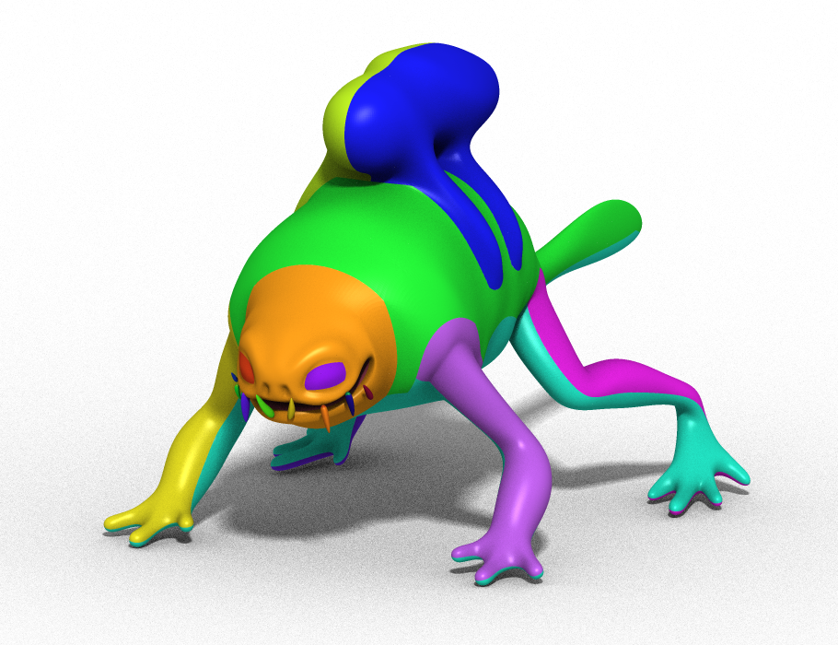
Texture Parameterization

Slide 4
Texture Parameterization

Slide 5
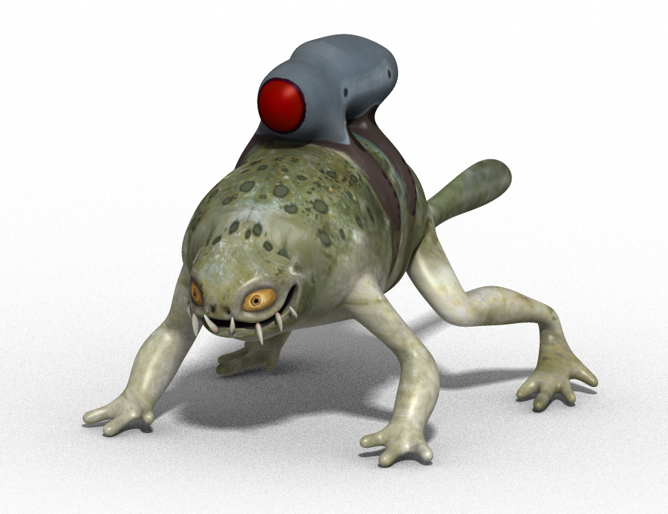
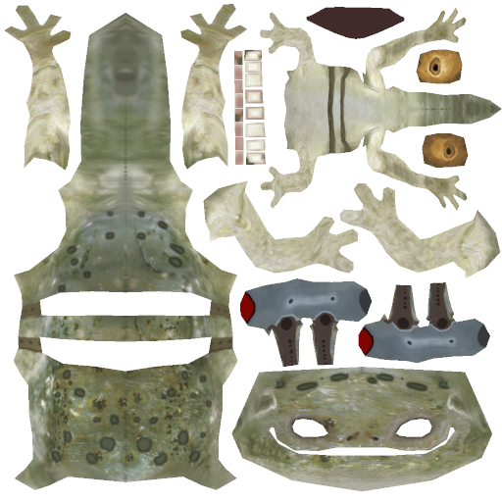
Texture Parameterization

Slide 6
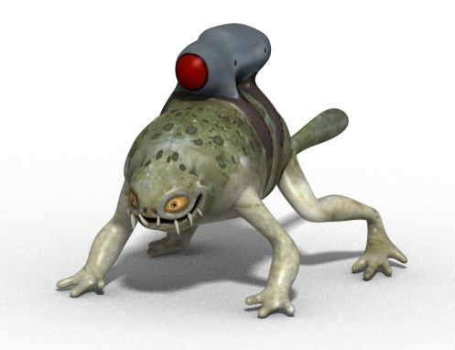
MIP-Mapping

Slide 7
MIP-Mapping

Slide 8
MIP-Mapping
Aliased

Slide 9
MIP-Mapping
Slow

Slide 10
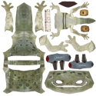
MIP-Mapping
Fast

Slide 11
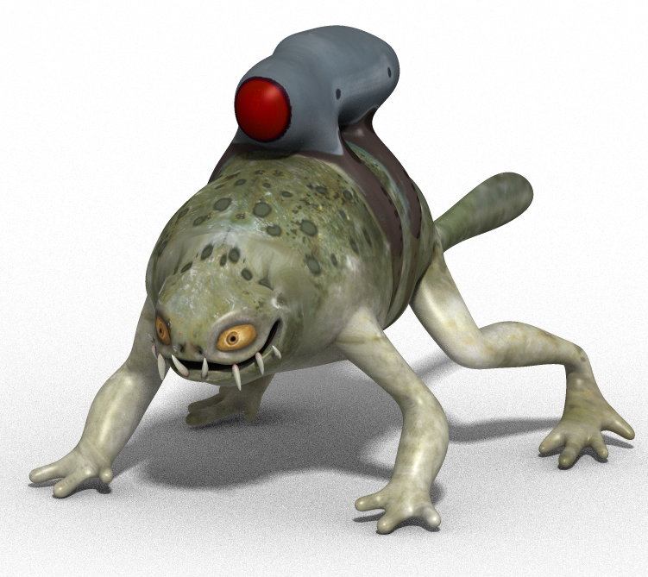
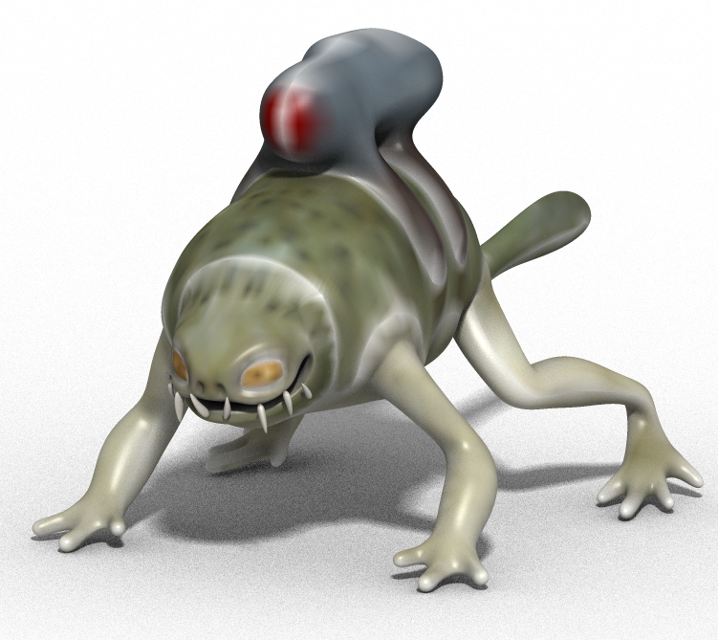
Filtering
2
2
1024
64
Original
Naïve Box

Slide 12
Filtering
2
2
1024
64
Original
Guttered Box

Slide 13
Filtering
2
2
1024
64
Original
Parameterization-Aware
MIP-Mapping

Slide 14
Naïve Filtering

Slide 15
Naïve Filtering

Slide 16
Naïve Filtering

Slide 17
Textures are NOT just images

Slide 18
Textures are NOT just images

Slide 19
Parameterization-Aware Filtering

Slide 20
Parameterization-Aware Filtering

Slide 21
Parameterization-Aware Filtering
Notes:
At end, lead into box filtering: This equation is general to different filters, but box filters are especially easy to understand and I will show how to implement one.

Slide 22
Implementation

Slide 23
Implementation

Slide 24
Implementation

Slide 25
Implementation

Slide 26
Implementation

Slide 27
Implementation
Color*Area
+
Area

Slide 28
Implementation

Slide 29
Implementation
Color*Area
+
Area
Notes:
Mention degenerate triangles in textures space: Even with zero texture area, a texel will be given weight proportional to its surface area.

Slide 30
Implementation
Σ
Color*Area
Σ
Area

Slide 31
Implementation
Σ
Color*Area
Σ
Area

Slide 32
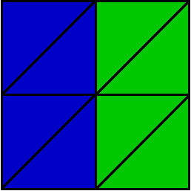
Nonuniform Plane
Object Mesh

Slide 33
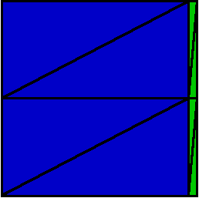
Nonuniform Plane
Object Mesh
Texture Map

Slide 34
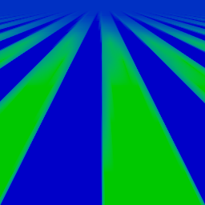
Nonuniform Plane
Naïve Box

Slide 35
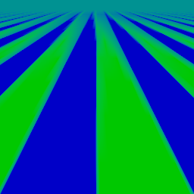
Nonuniform Plane
PAM Box

Slide 36
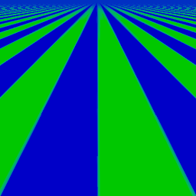
Nonuniform Plane
Naïve Box (Anisotropic 16x)

Slide 37
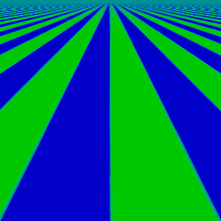
Nonuniform Plane
PAM Box (Anisotropic 16x)

Slide 38
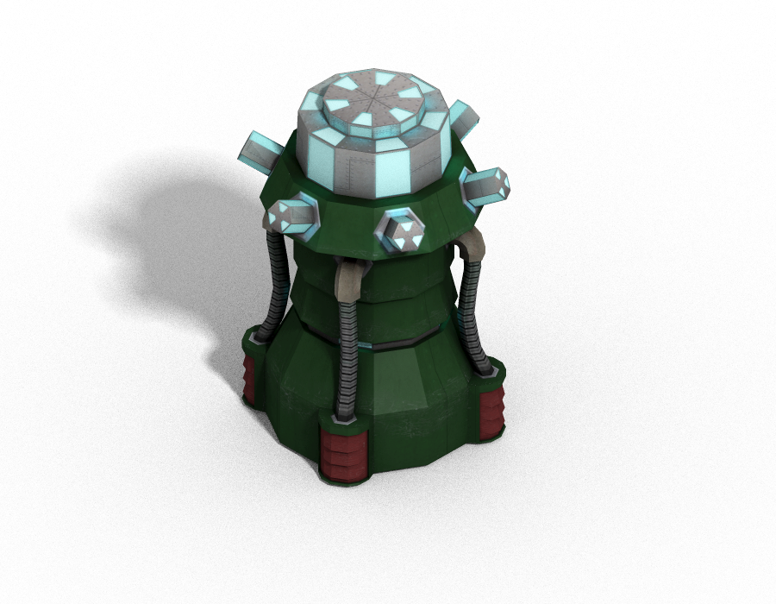
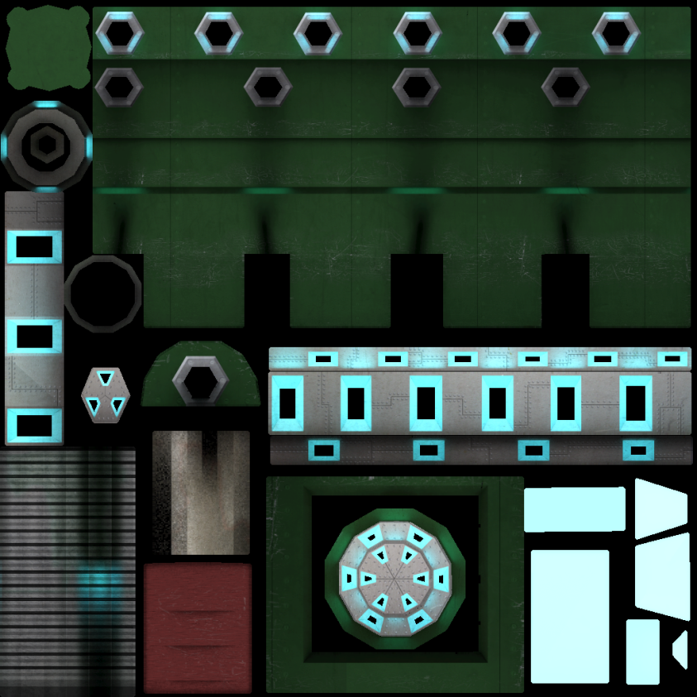
Example

Slide 39
Example

Slide 40
Example

Slide 41
Example
2
1024
Original

Slide 42
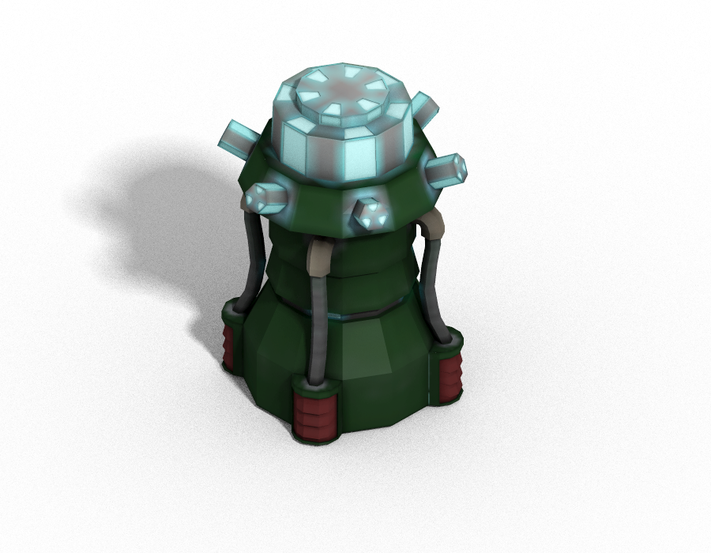
Example
2
64
Naïve Box

Slide 43
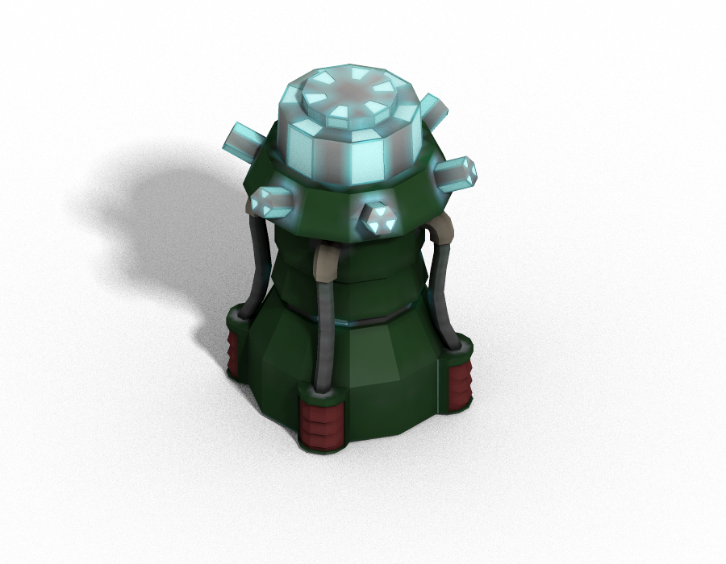
Example
2
64
Guttered Box

Slide 44
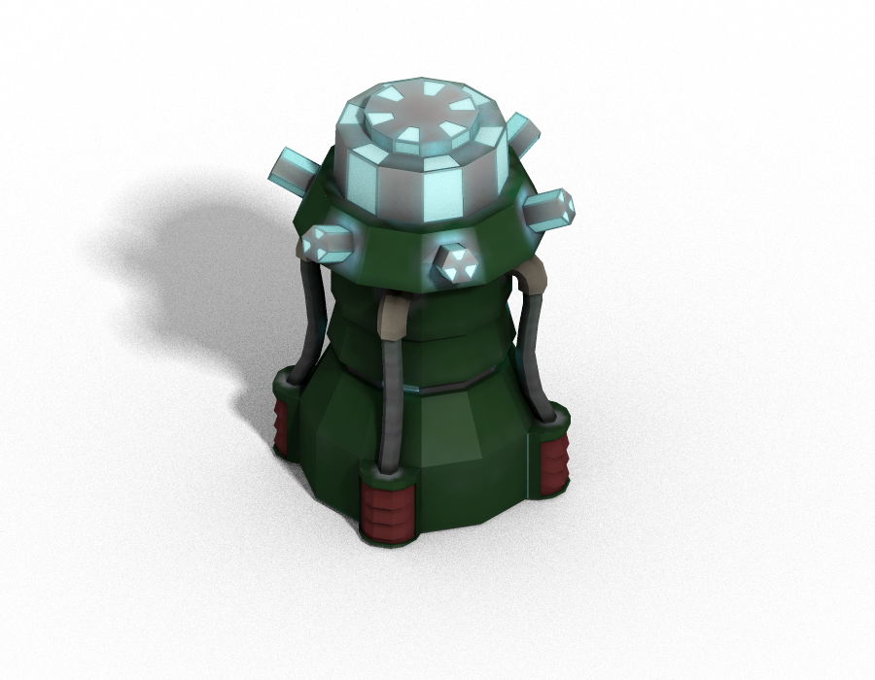
Example
2
64
PAM Box

Slide 45
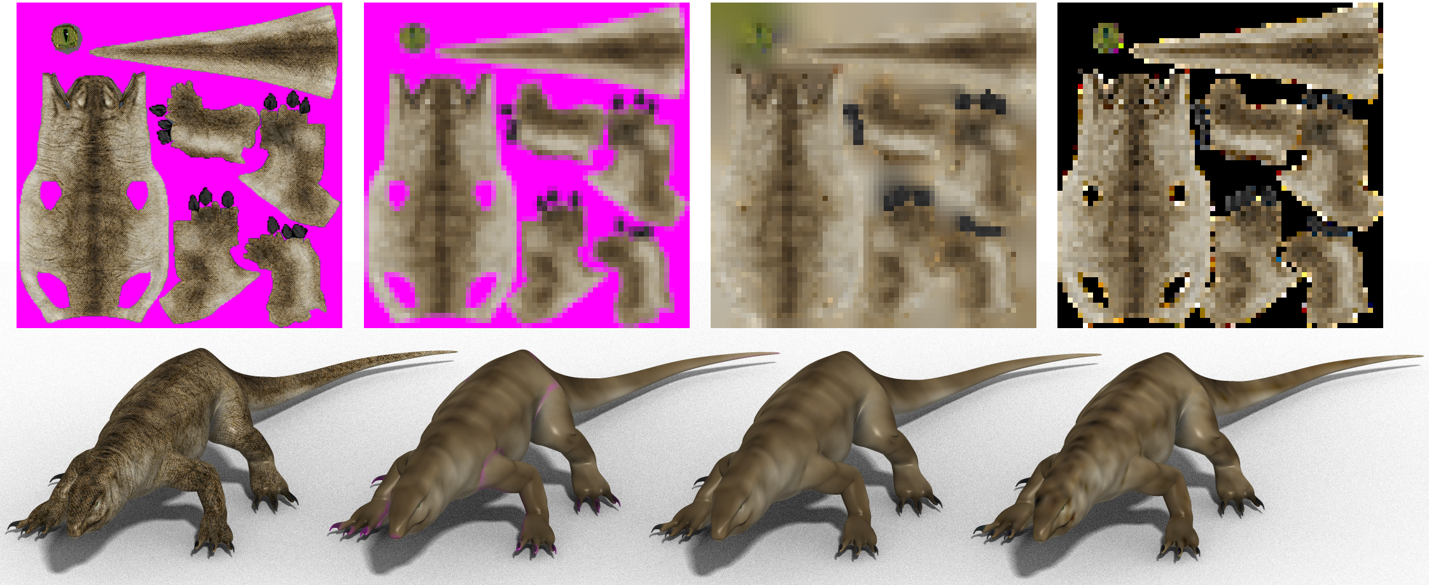
Example
Original
Naïve
Guttered
PAM

Slide 46
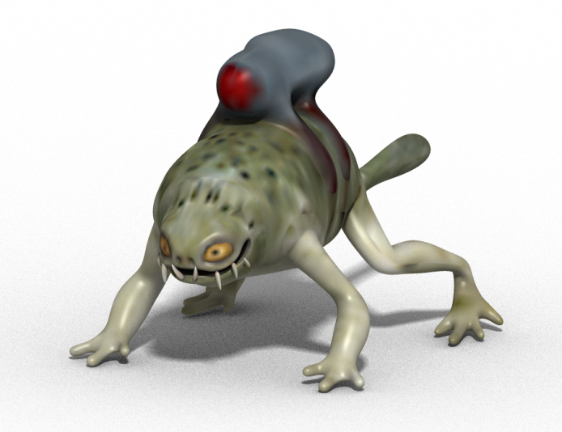
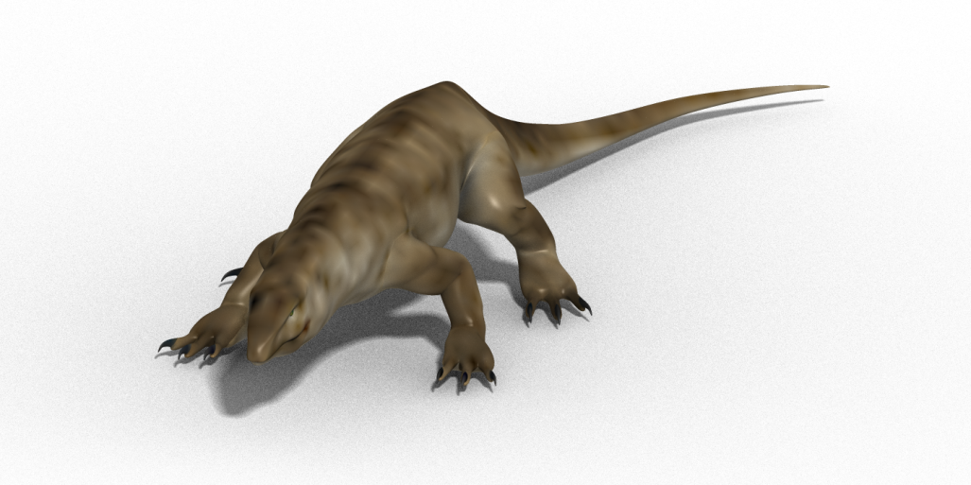
Preprocessing Times

Slide 47
Conclusion
Correct for parameterization of surface
Works with anisotropic filtering
Never decreases image quality
No changes to rendering or artwork
Try it http://josiahmanson.com

