Slide 1
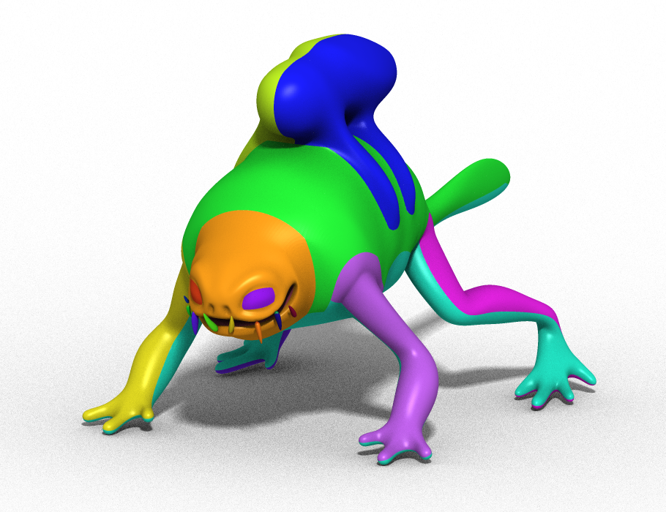
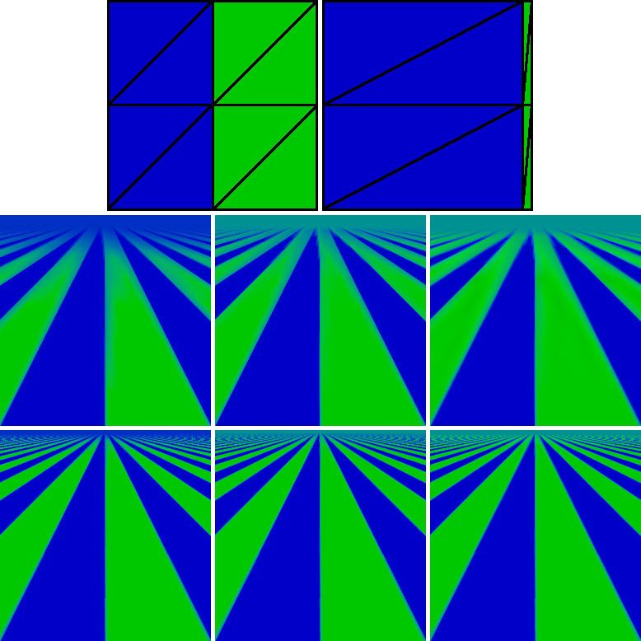
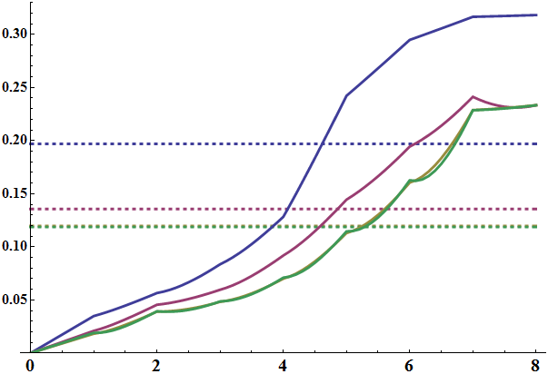
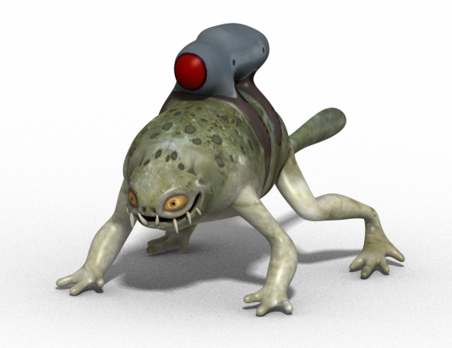
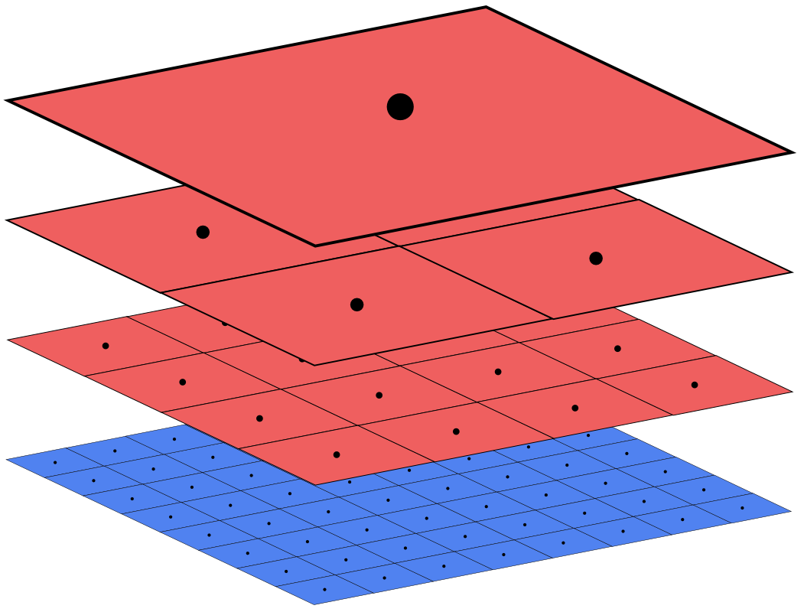
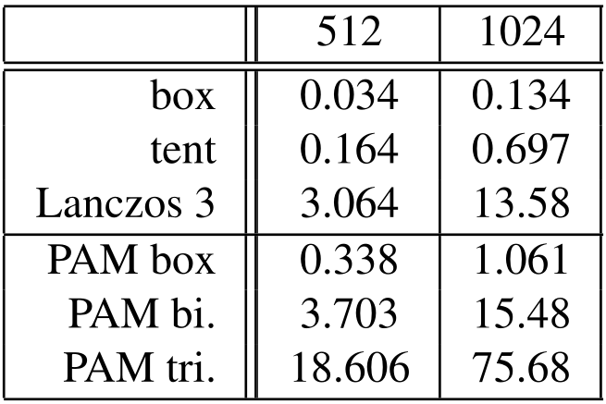
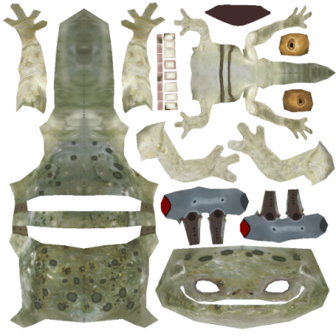
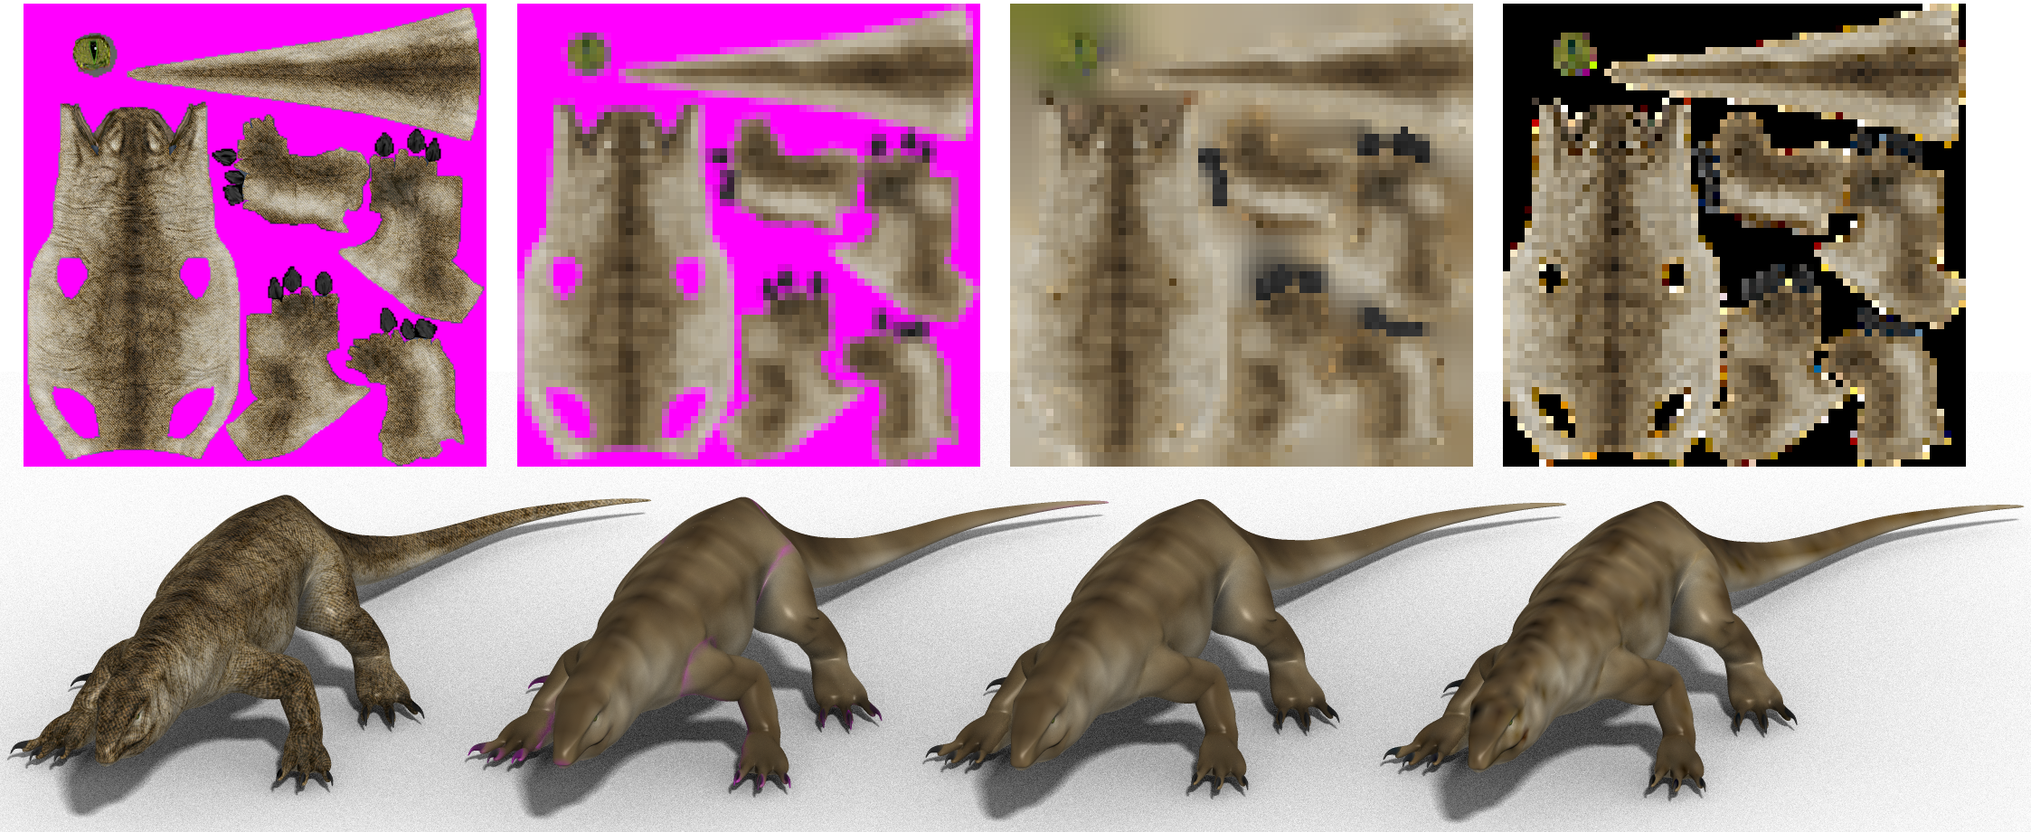
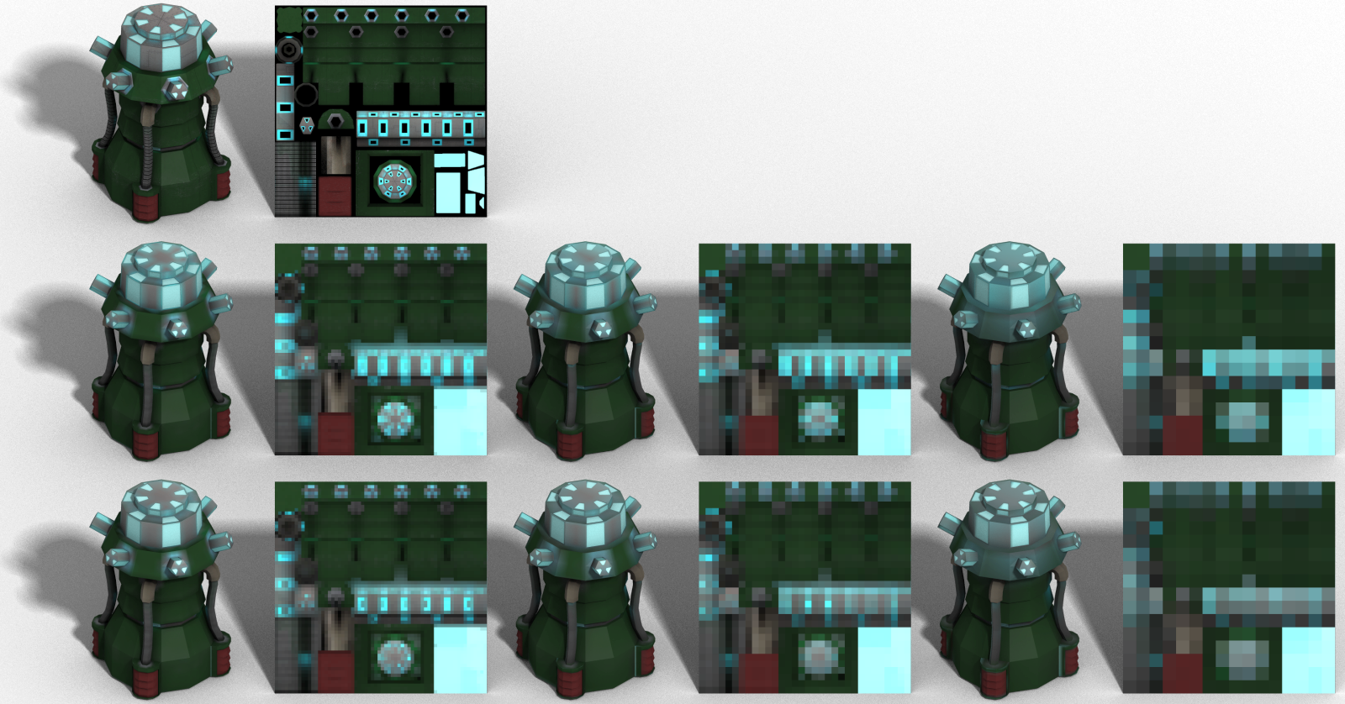
Parameterization-Aware MIP-Mapping
Josiah Manson Scott Schaefer
Theory
Case Study
Parametric
Distortion
Error
Trilinear
Parameterization maps points on a surface to a plane. In general, a surface must be cut into multiple “charts.”
Anisotropic
Power of two scale reduction
Box
PAM Bi
Box
PAM Box
PAM Tri
PAM Box
PAM Tri
We test our method (PAM) in an example with high parametric distortion.
Practical Results
Time to compute lizard texture using different methods in seconds.
Input Box Box Fill PAM Bi
Our downsampled images remove color bleeding across chart boundaries (top), bleeding from large texture areas into small areas (bottom), and increase detail (both). Our method optimizes images to look better without modifying art assets and without increasing rendering time!
For best reproduction of surface colors of a high-res image sampled at any scale, we solve for colors of low-res images. By taking the parameterization Θ into account, we remove artifacts caused by parametric distortion such as at chart boundaries.
We prevent color bleeding through seams.
PAM Box Box Input
2 2 2
Input
State-of-art
Ours
64 32 16
No bleeding from lights and more detail.

