Slide 1
Parameterization-Aware MIP-Mapping
Josiah Manson and Scott Schaefer
Texas A&M University

Slide 2
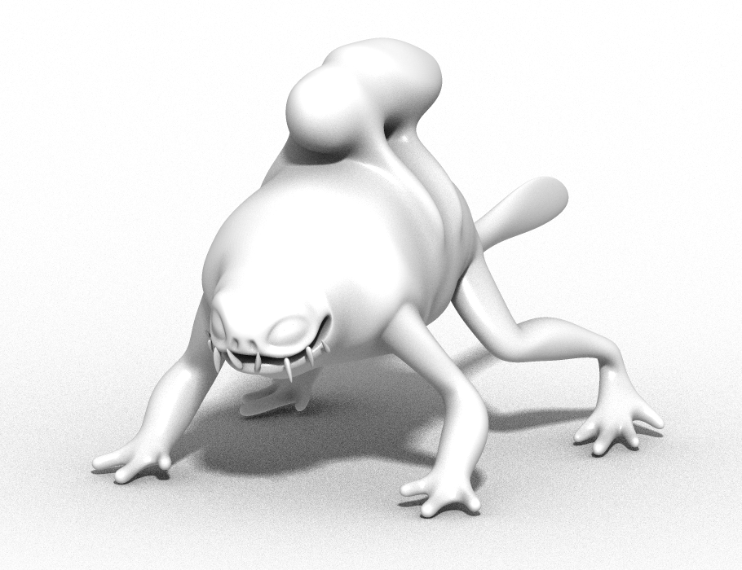
Texture Parameterization

Slide 3
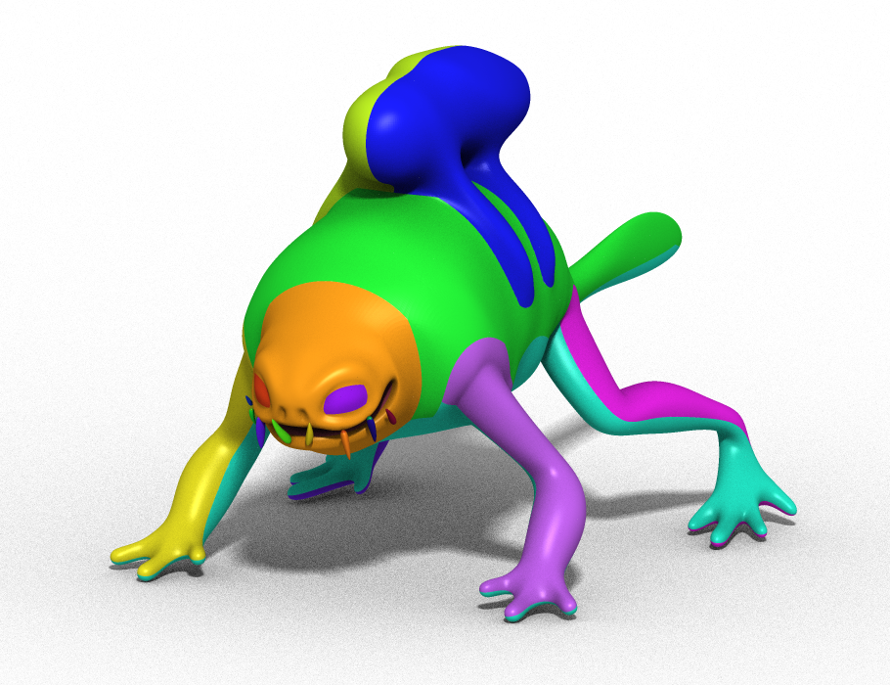
Texture Parameterization

Slide 4
Texture Parameterization

Slide 5
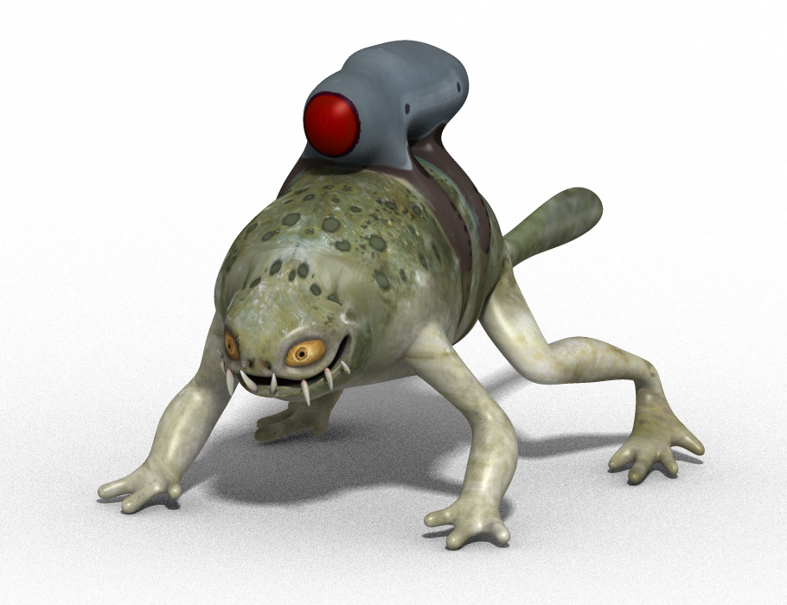
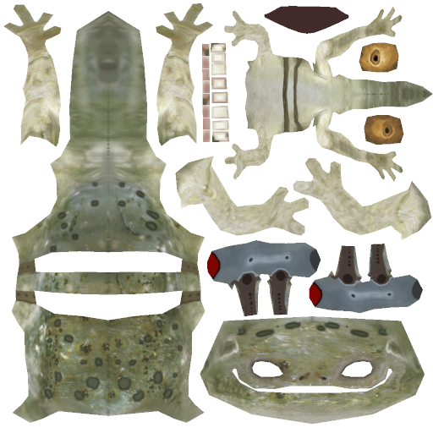
Texture Parameterization

Slide 6
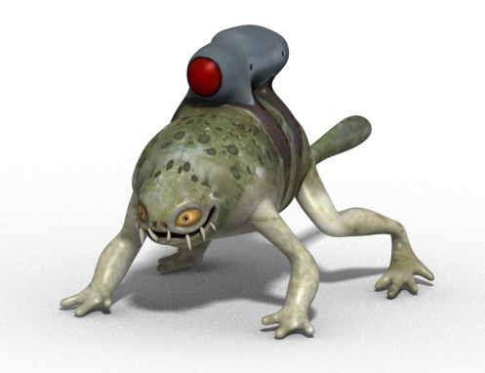
MIP-Mapping

Slide 7
MIP-Mapping

Slide 8
MIP-Mapping
Aliased

Slide 9
MIP-Mapping
Slow

Slide 10
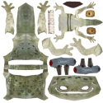
MIP-Mapping
Fast

Slide 11
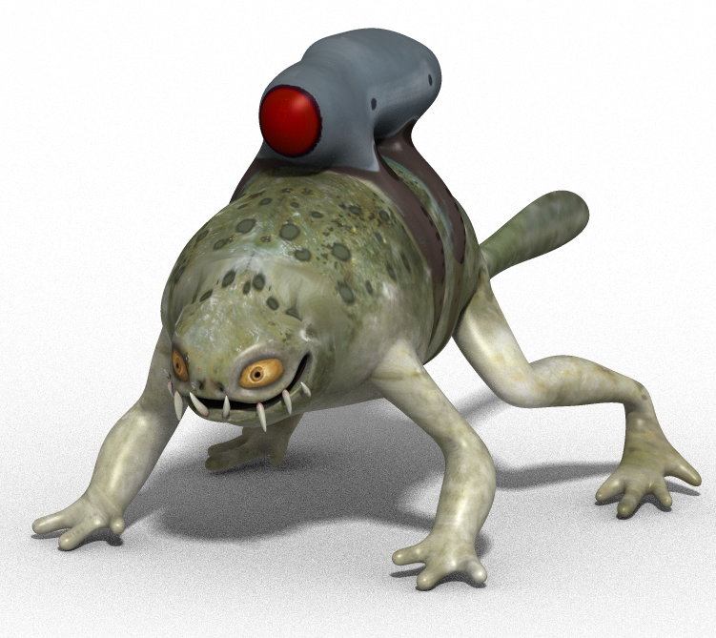
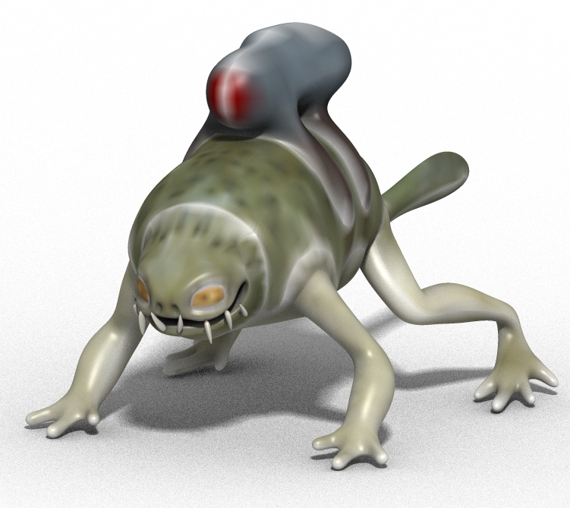
Filtering
2
2
1024
64
Original
Box

Slide 12
Filtering
2
2
1024
64
Original
Box Ignore

Slide 13
Filtering
2
2
1024
64
Original
PAM Bilinear

Slide 14
Parameterization-Aware Filtering

Slide 15
Parameterization-Aware Filtering

Slide 16
Parameterization-Aware Filtering

Slide 17
Parameterization-Aware Filtering

Slide 18
Parameterization-Aware Filtering

Slide 19
Parameterization-Aware Filtering

Slide 20
Implementation

Slide 21
Implementation

Slide 22
Implementation

Slide 23
Implementation

Slide 24
Implementation

Slide 25
Implementation
Color*Area
+
Area

Slide 26
Implementation

Slide 27
Implementation
Color*Area
+
Area

Slide 28
Implementation
Σ
Color*Area
Σ
Area

Slide 29
Implementation
Σ
Color*Area
Σ
Area

Slide 30
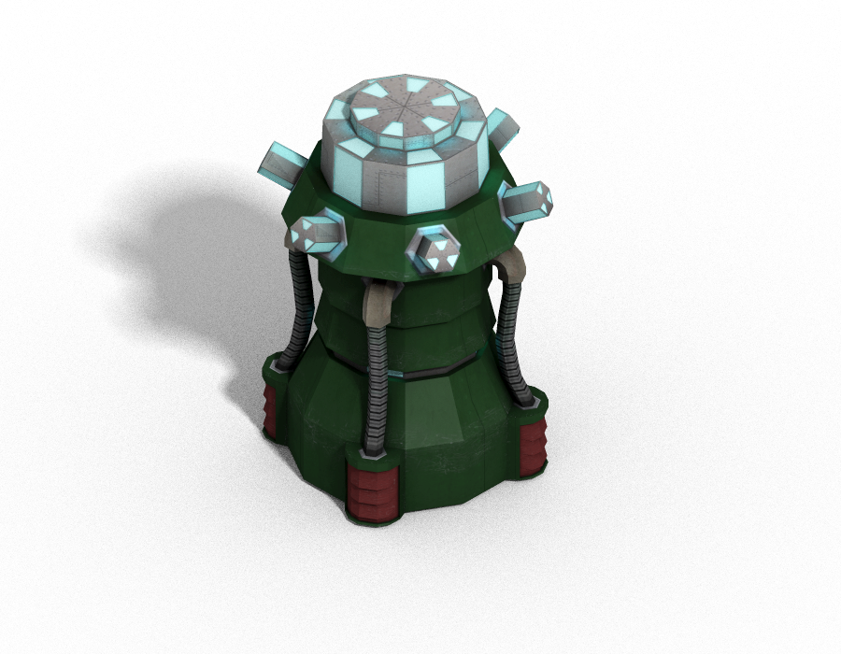
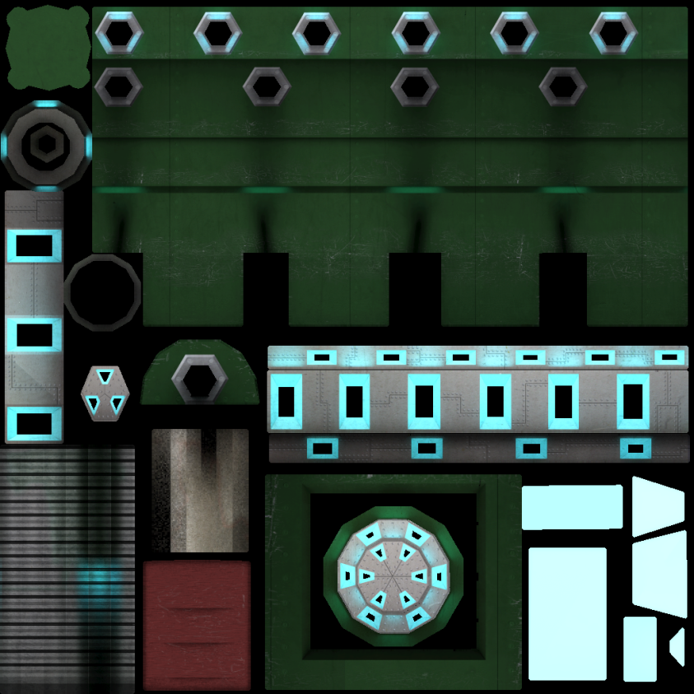
Example

Slide 31
Example

Slide 32
Example

Slide 33
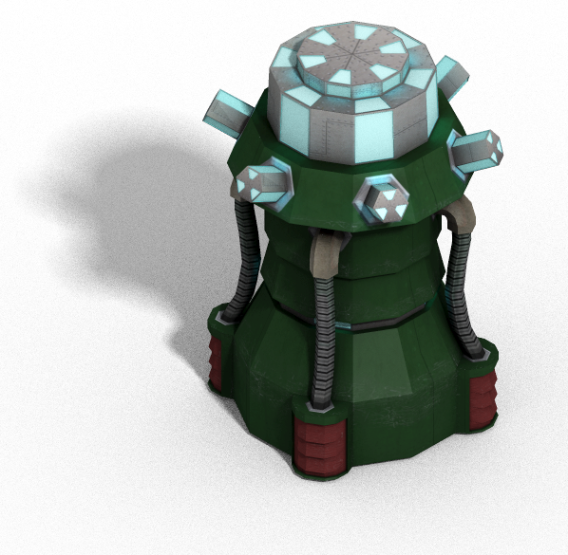
Example
2
2
1024
64
Original
Box

Slide 34
Example
2
2
1024
64
Original
Box Ignore

Slide 35
Example
2
2
1024
64
Original
PAM Box

Slide 36
Basis Projection
[Kajiya and Ullner 1981]

Slide 37
Basis Projection
[Kajiya and Ullner 1981]

Slide 38
Basis Projection
[Kajiya and Ullner 1981]

Slide 39
Basis Projection
[Kajiya and Ullner 1981]

Slide 40
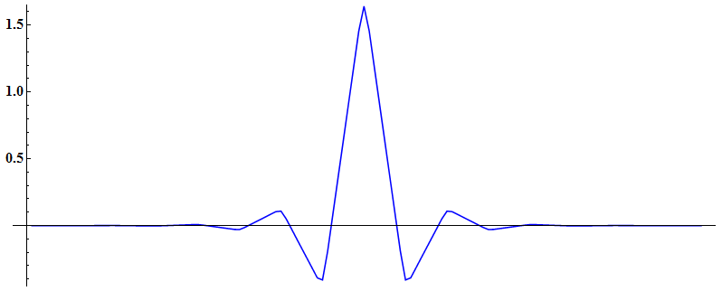
Pre/Post-filter Convolution
Real
[Kajiya and Ullner 1981]

Slide 41
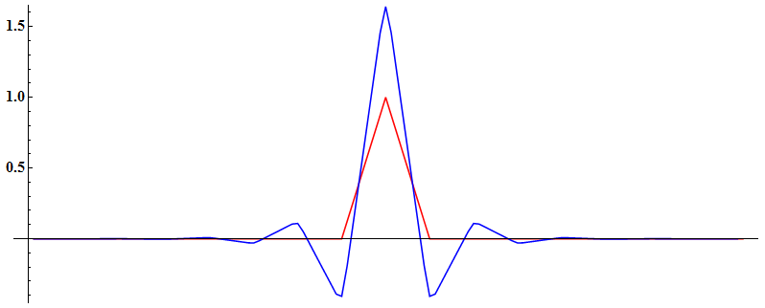
Pre/Post-filter Convolution
Real
[Kajiya and Ullner 1981]

Slide 42
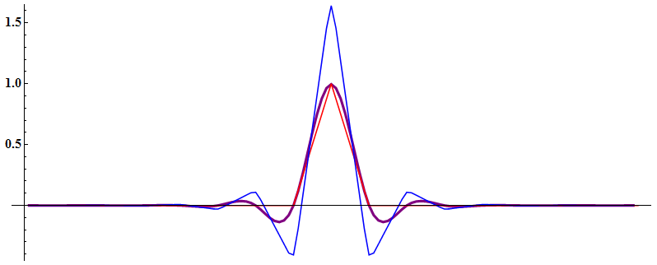
Pre/Post-filter Convolution
Real
[Kajiya and Ullner 1981]

Slide 43
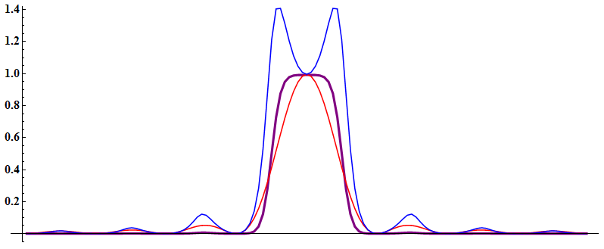
Pre/Post-filter Convolution
Real
Fourier
[Kajiya and Ullner 1981]

Slide 44
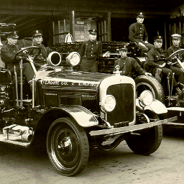
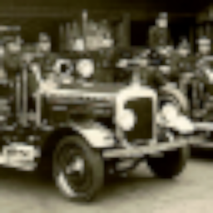
Optimized Filtering
2
2
256
64
Original
Box

Slide 45
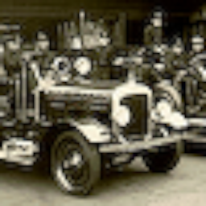
Optimized Filtering
2
2
256
64
Original
Optimized Bilinear

Slide 46
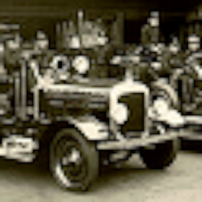
Optimized Filtering
2
2
256
64
Original
Constrained Bilinear

Slide 47
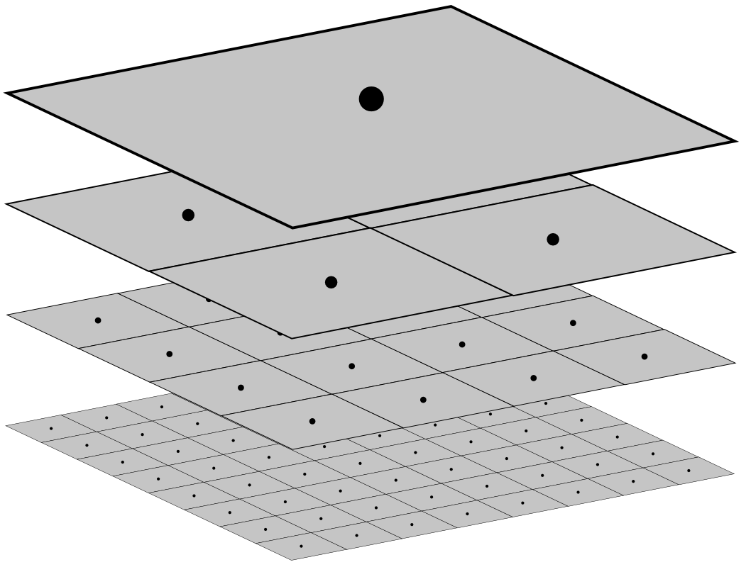
Trilinear Basis

Slide 48
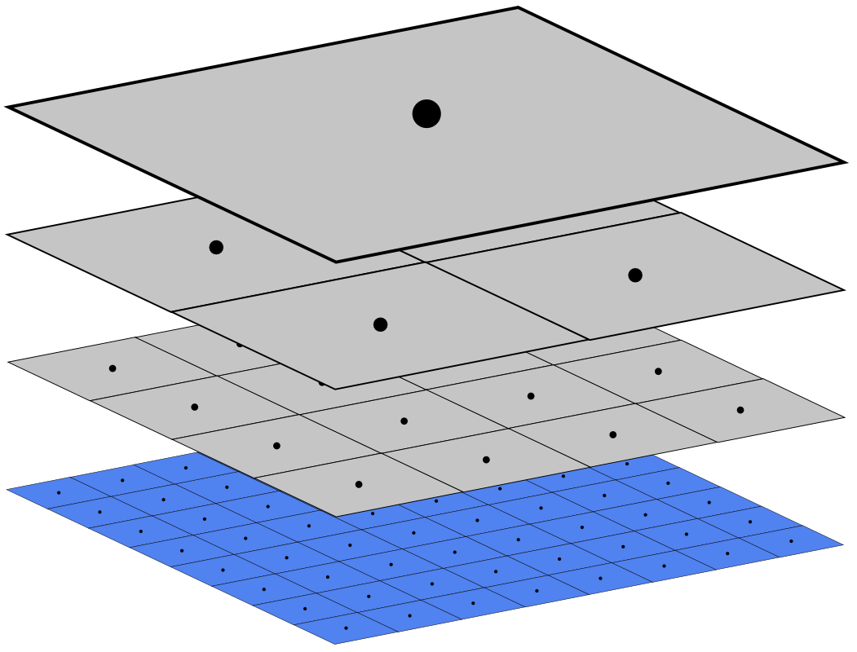
Trilinear Basis

Slide 49
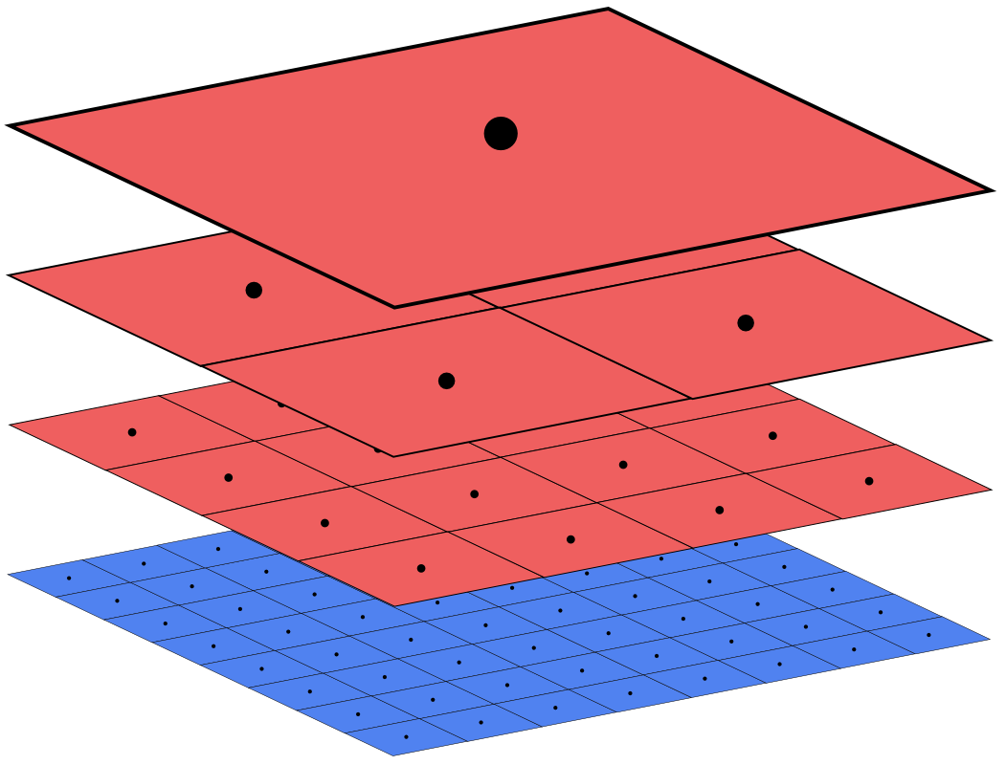
Trilinear Basis

Slide 50
Trilinear Basis

Slide 51
Trilinear Basis

Slide 52
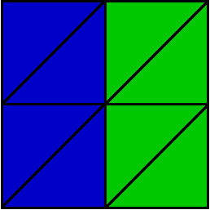
Nonuniform Plane
Object Mesh

Slide 53
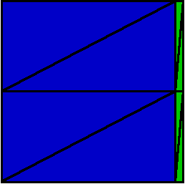
Nonuniform Plane
Object Mesh
Texture Map

Slide 54
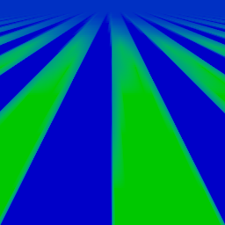
Nonuniform Plane
Box

Slide 55
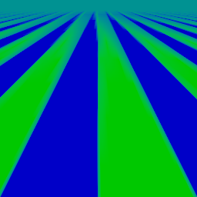
Nonuniform Plane
PAM Box

Slide 56
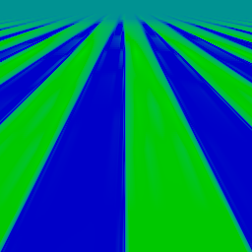
Nonuniform Plane
PAM Trilinear

Slide 57
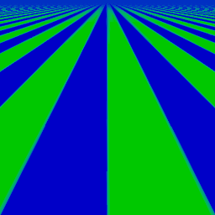
Nonuniform Plane
Box (Anisotropic 16x)

Slide 58
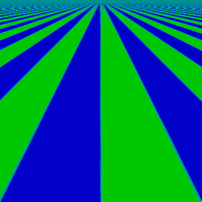
Nonuniform Plane
PAM Box (Anisotropic 16x)

Slide 59
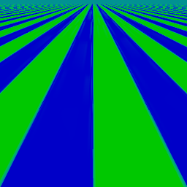
Nonuniform Plane
PAM Trilinear (Anisotropic 16x)

Slide 60
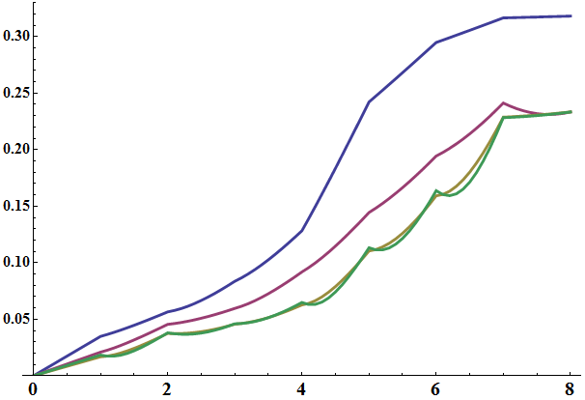
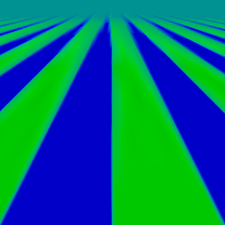
Errors
Box
PAM Box
PAM Bilinear
PAM Trilinear

Slide 61
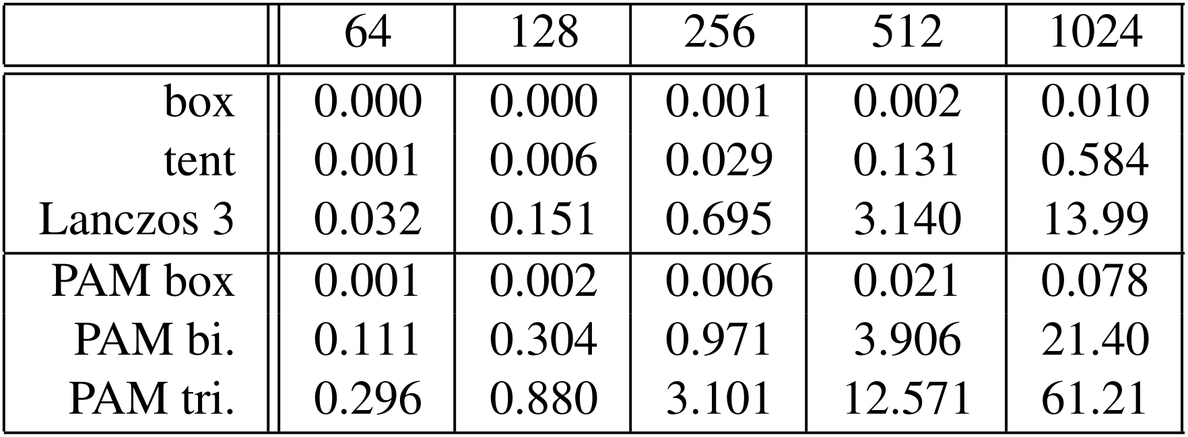
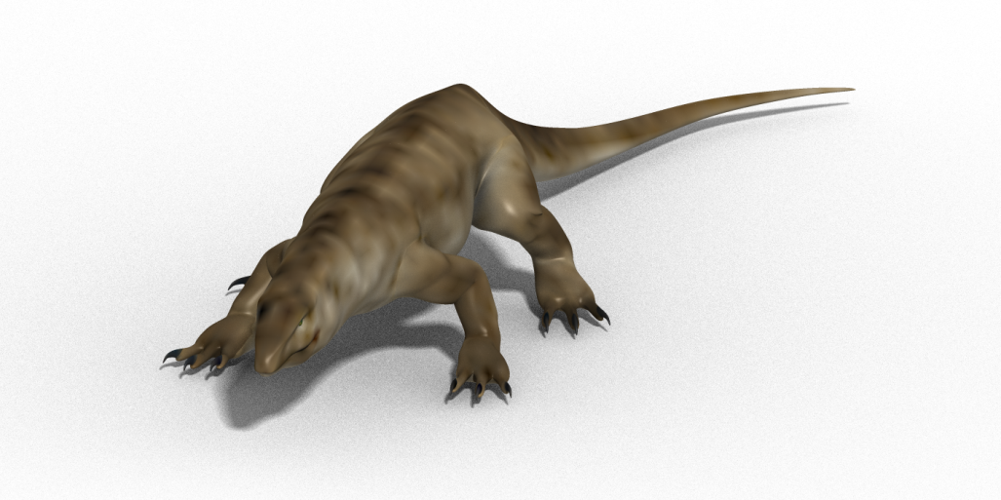
Preprocessing Times

Slide 62
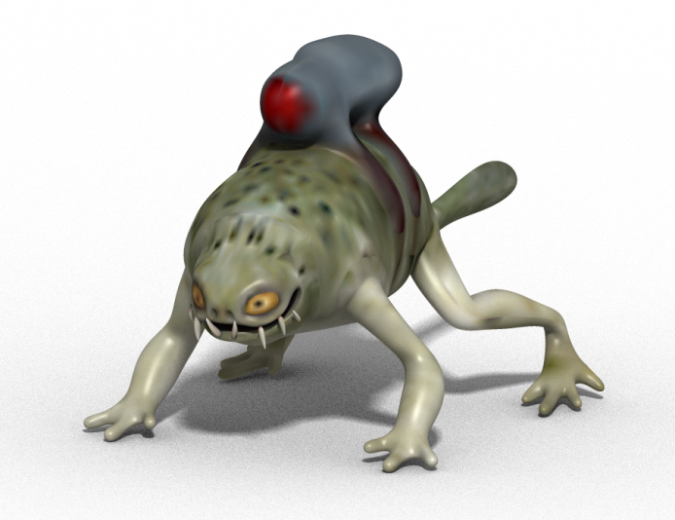
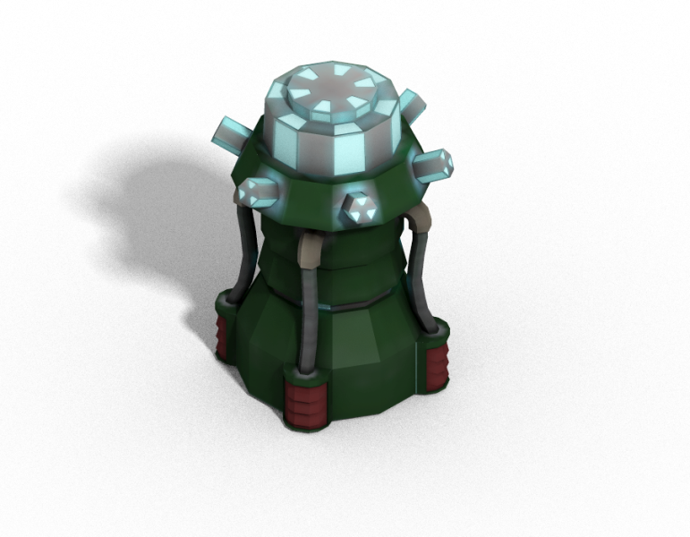
Conclusion
Correct for parameterization of surface
Project onto trilinear basis
Never decreases image quality
No changes to rendering or artwork
Less than tenth of a second for PAM box
Try it http://josiahmanson.com

