Slide 1
Moving Least Squares Coordinates
Josiah Manson and Scott Schaefer
Texas A&M University

Slide 2
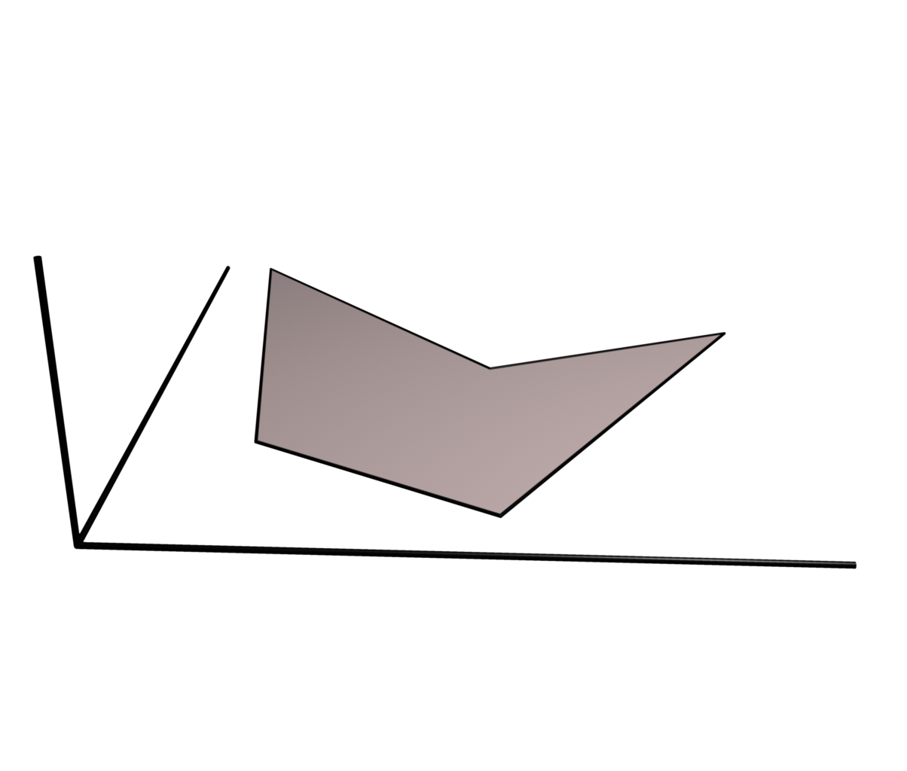
Barycentric Coordinates
Polygon Domain

Slide 3
Barycentric Coordinates
Polygon Domain

Slide 4
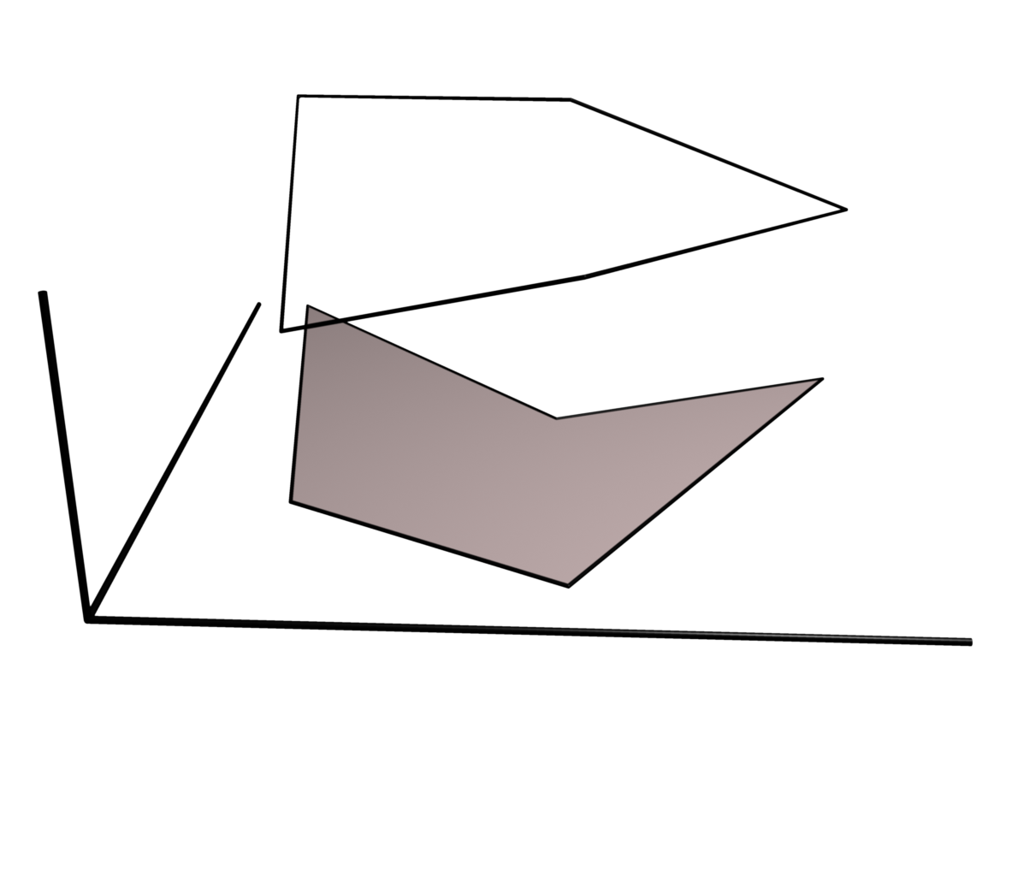
Barycentric Coordinates
Polygon Domain

Slide 5
Barycentric Coordinates
Polygon Domain

Slide 6
Barycentric Coordinates
Polygon Domain
Boundary Interpolation

Slide 7
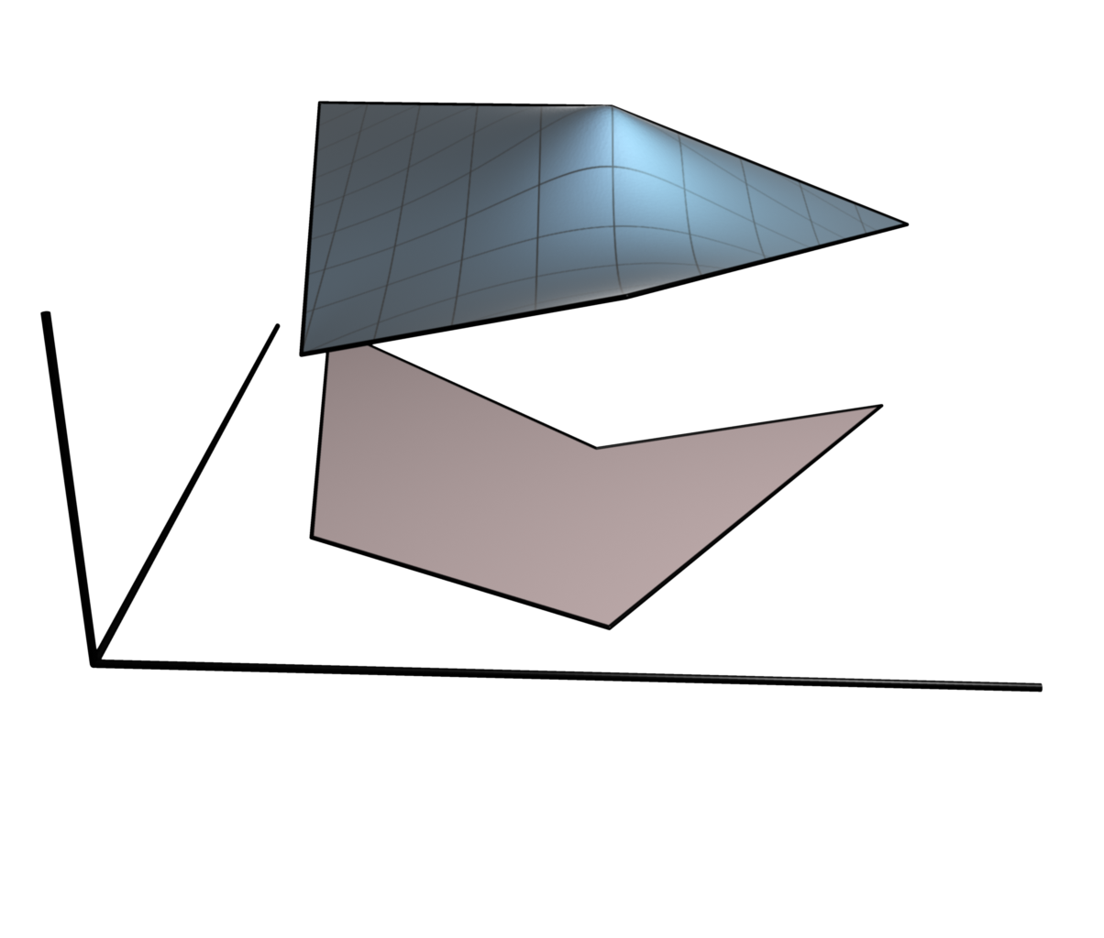
Barycentric Coordinates
Polygon Domain
Boundary Interpolation

Slide 8
Barycentric Coordinates
Polygon Domain
Boundary Interpolation
Basis Functions

Slide 9
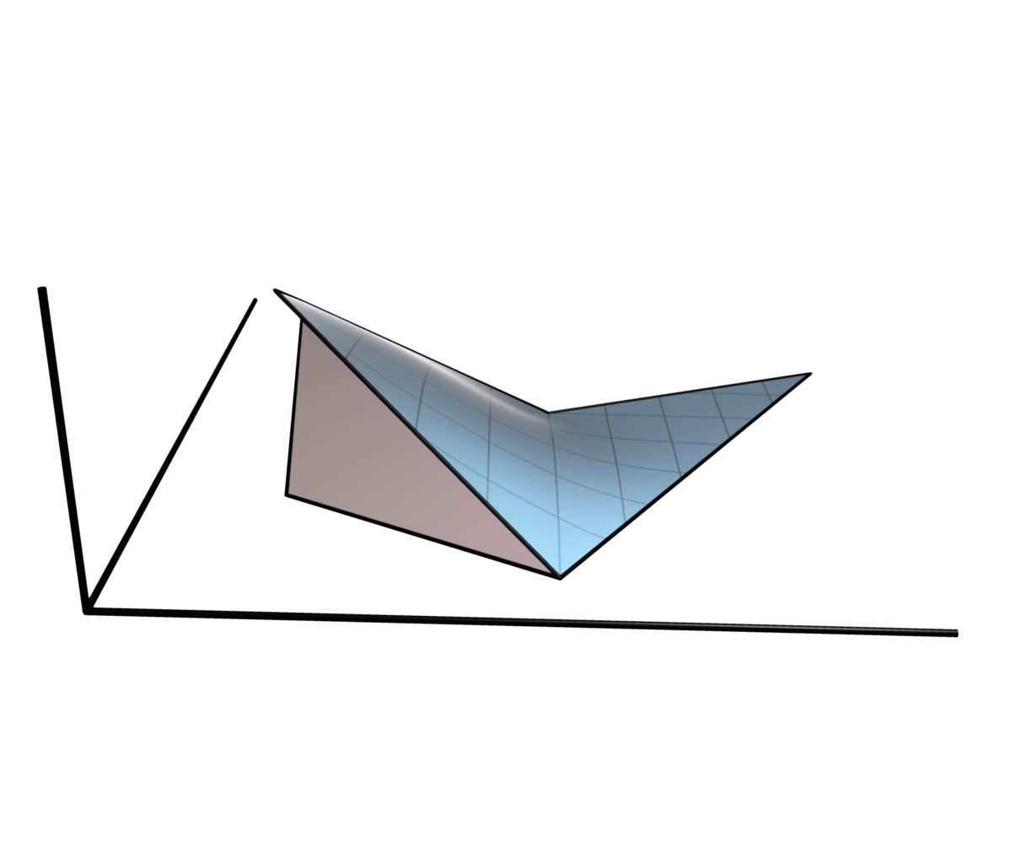
Barycentric Coordinates
Polygon Domain
Boundary Interpolation
Basis Functions

Slide 10
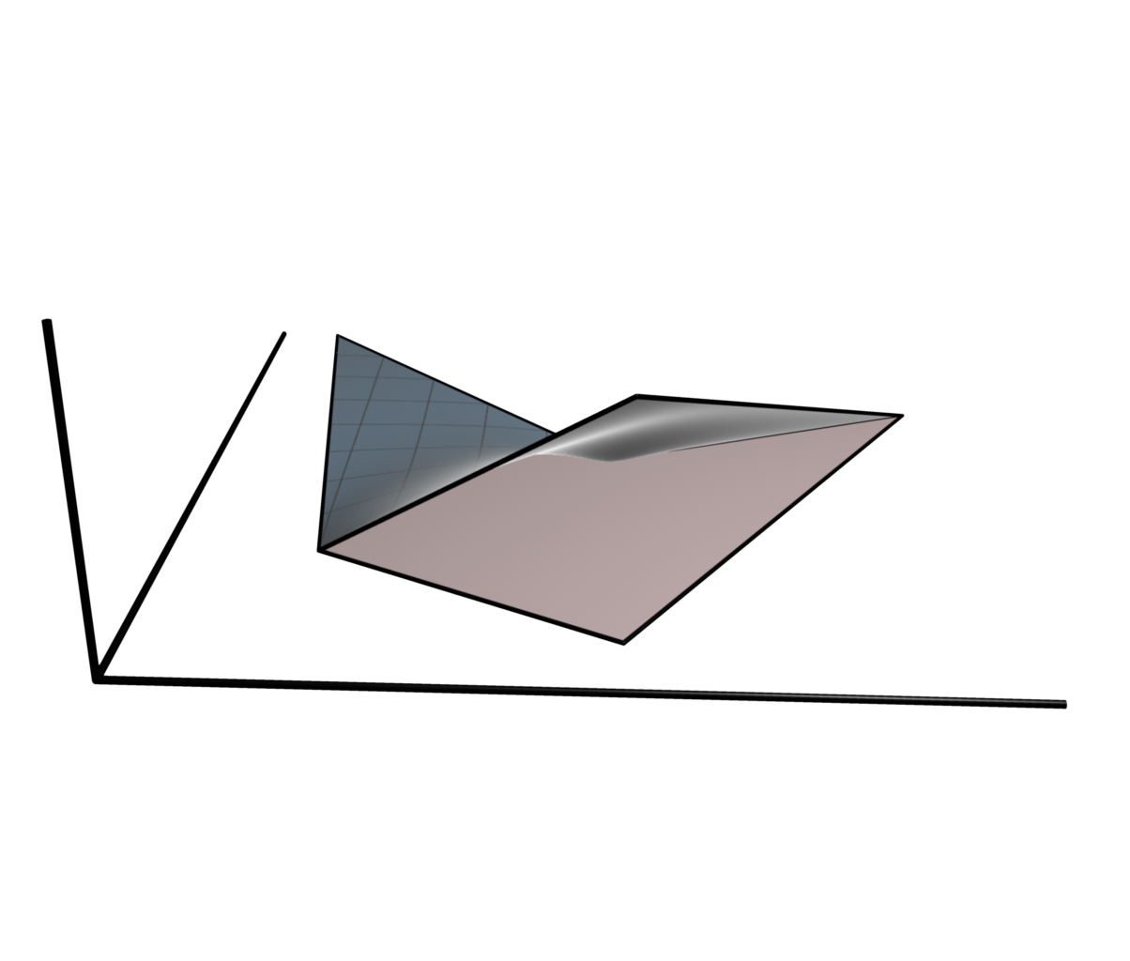
Barycentric Coordinates
Polygon Domain
Boundary Interpolation
Basis Functions

Slide 11
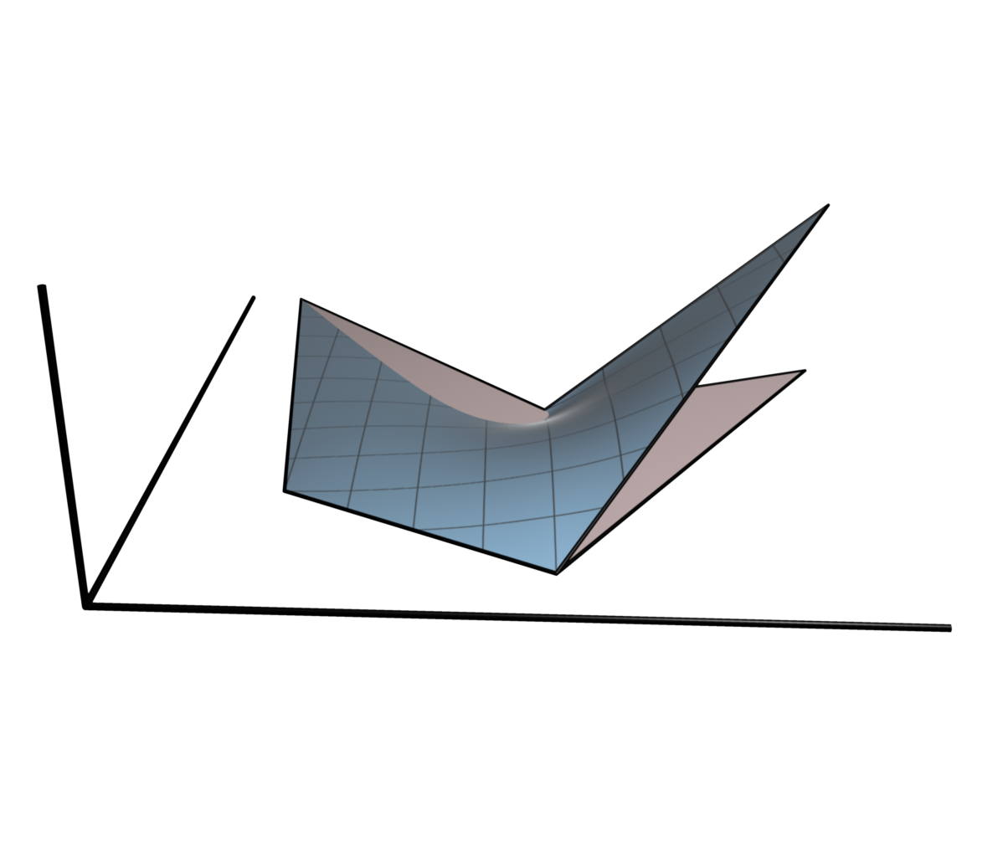
Barycentric Coordinates
Polygon Domain
Boundary Interpolation
Basis Functions

Slide 12
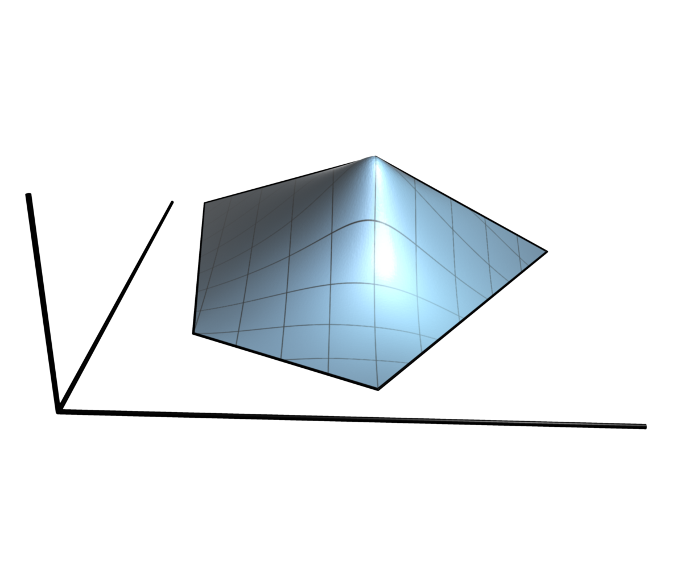
Barycentric Coordinates
Polygon Domain
Boundary Interpolation
Basis Functions

Slide 13
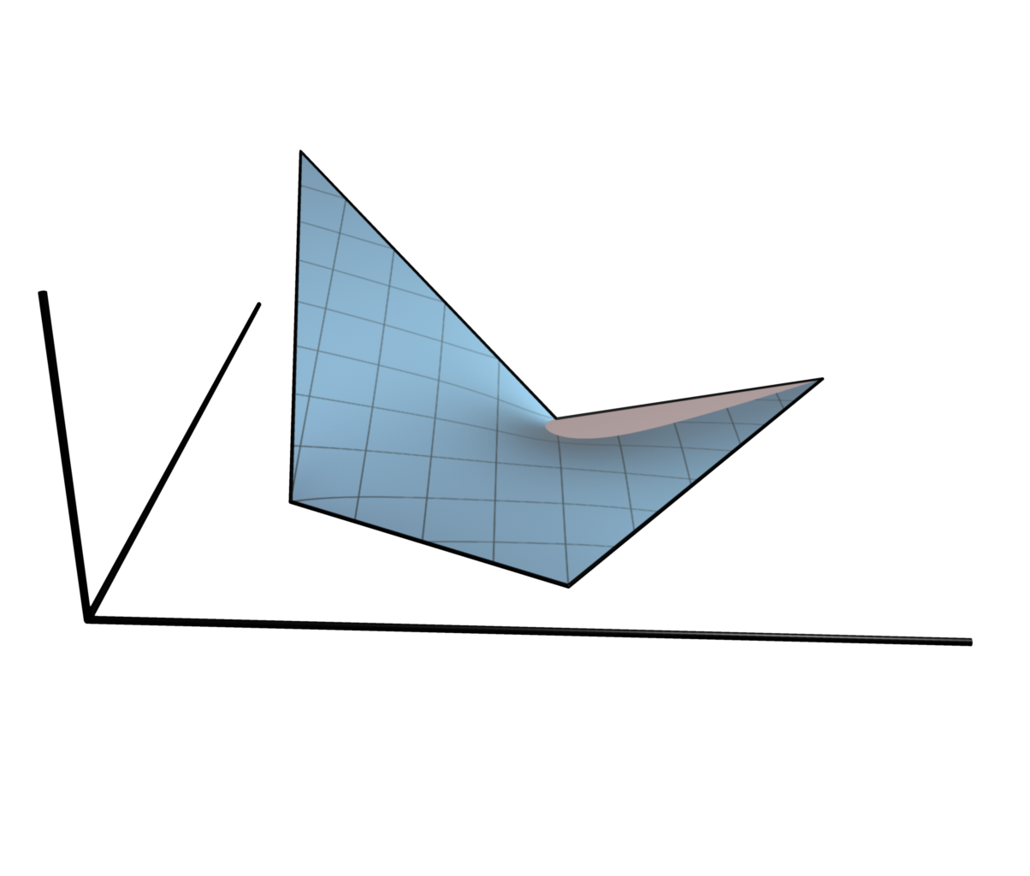
Barycentric Coordinates
Polygon Domain
Boundary Interpolation
Basis Functions

Slide 14
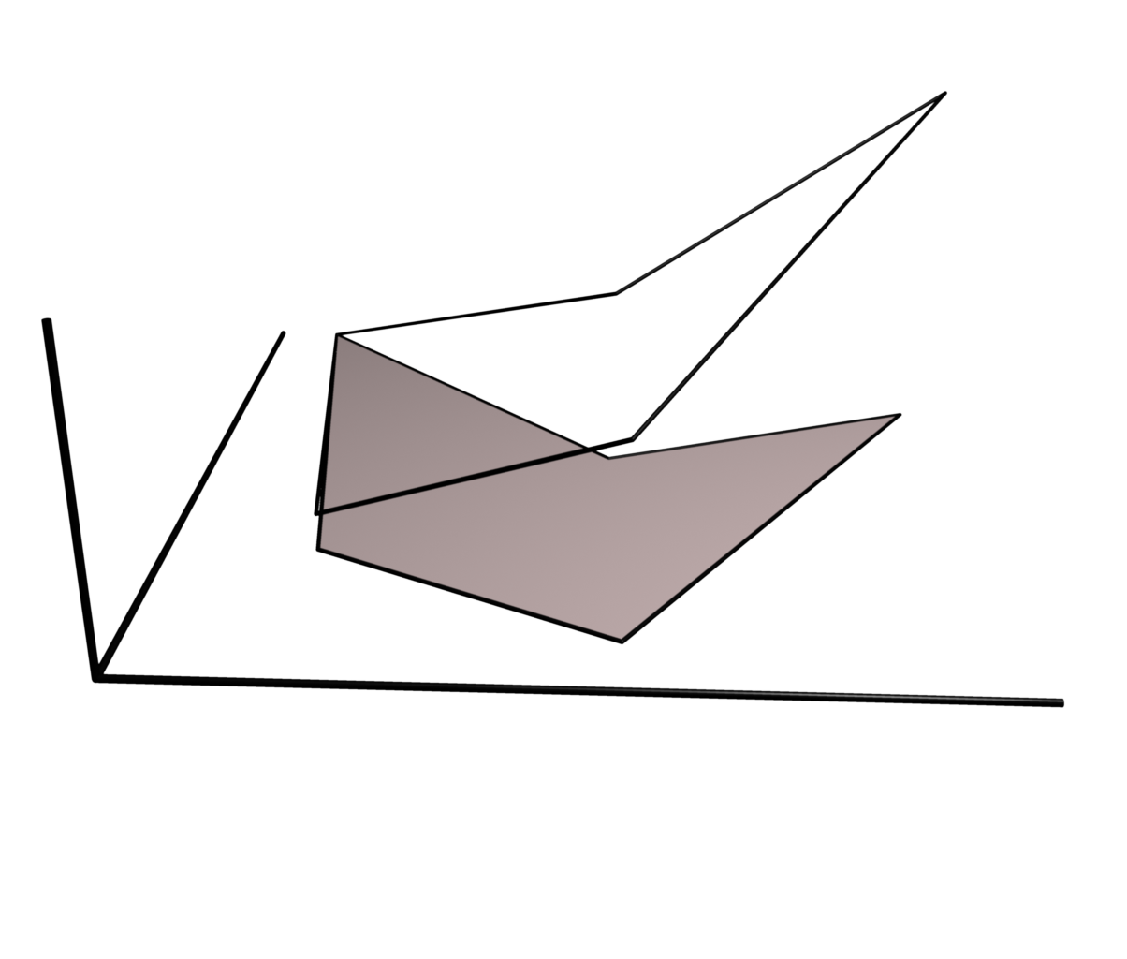
Barycentric Coordinates
Polygon Domain
Boundary Interpolation
Basis Functions
Linear Precision

Slide 15
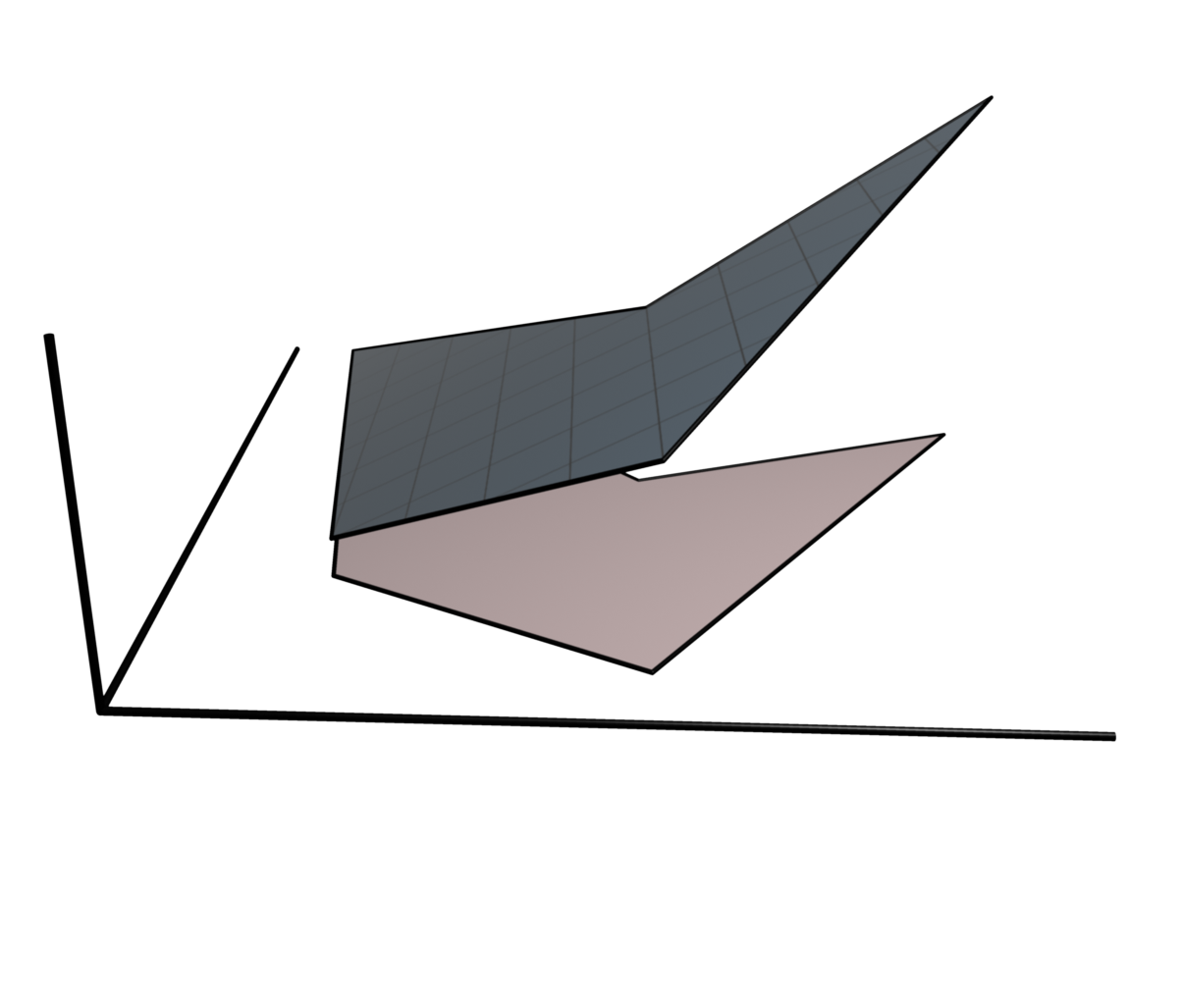
Barycentric Coordinates
Polygon Domain
Boundary Interpolation
Basis Functions
Linear Precision

Slide 16
Barycentric Coordinates
Polygon Domain
Boundary Interpolation
Basis Functions
Linear Precision

Slide 17
Other Properties
Desirable Features
Smoothness
Closed-form solution
Positivity
Extended Coordinates
Polynomial Boundary Values
Polynomial Precision
Interpolation of Derivatives
Curved Boundaries

Slide 18
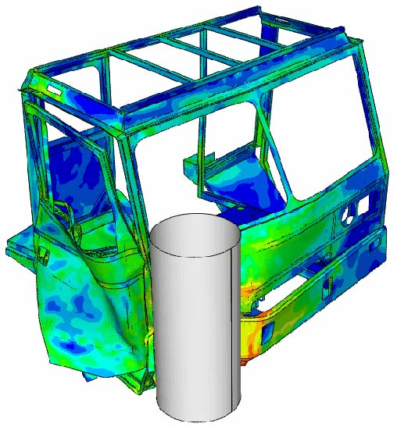
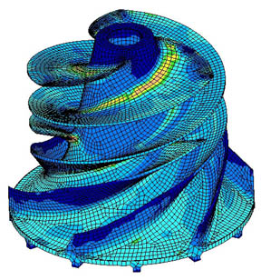
Applications
Finite Element Methods [Wachspress 1975]

Slide 19
Applications
Boundary Value Problems [Ju et al. 2005]

Slide 20
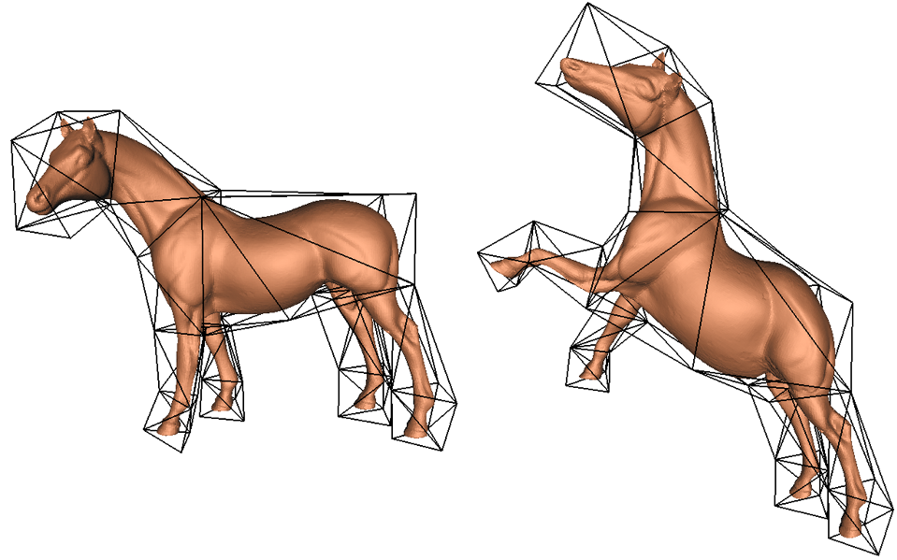
Applications
Free-Form Deformations [Sederberg et al. 1986], [MacCracken et al. 1996], [Ju et al. 2005], [Joshi et al. 2007]

Slide 21
Applications
Surface Parameterization
[Hormann et al. 2000], [Desbrun et al. 2002]

Slide 22
Comparison of Methods
Concave Shapes
Poly. Boundary
Open Boundaries
Closed-Form
Poly. Precision
Smooth
Positive
Derivatives
Wachspress
Mean Val.
Pos. Mean Val.
Max Entropy
Harmonic
Hermite MVC
Moving Least Sqr.

Slide 23
Moving Least Squares Coordinates
A new family of barycentric coordinates
Solves a least squares problem
Solution depends on point of evaluation

Slide 24
Fit a Polynomial to Points

Slide 25
Fit a Polynomial to Points

Slide 26
Fit a Polynomial to Points

Slide 27
Interpolating Points

Slide 28
Interpolating Points

Slide 29
Interpolating Points

Slide 30
Interpolating Line Segments

Slide 31
Interpolating Line Segments

Slide 32
Interpolating Line Segments

Slide 33
Interpolating Line Segments

Slide 34
Line Basis Functions

Slide 35
Line Basis Functions

Slide 36
Line Basis Functions

Slide 37
Line Basis Functions

Slide 38
Line Basis Functions

Slide 39
Line Basis Functions

Slide 40
Polygon Basis Functions

Slide 41
Polygon Basis Functions

Slide 42
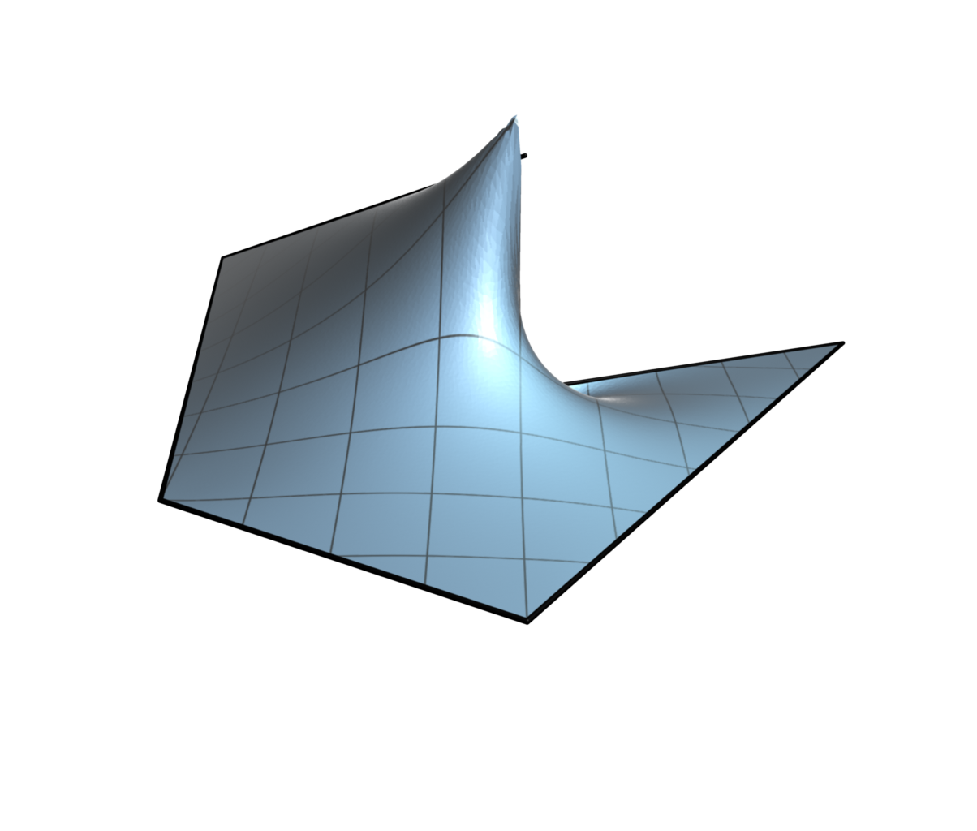
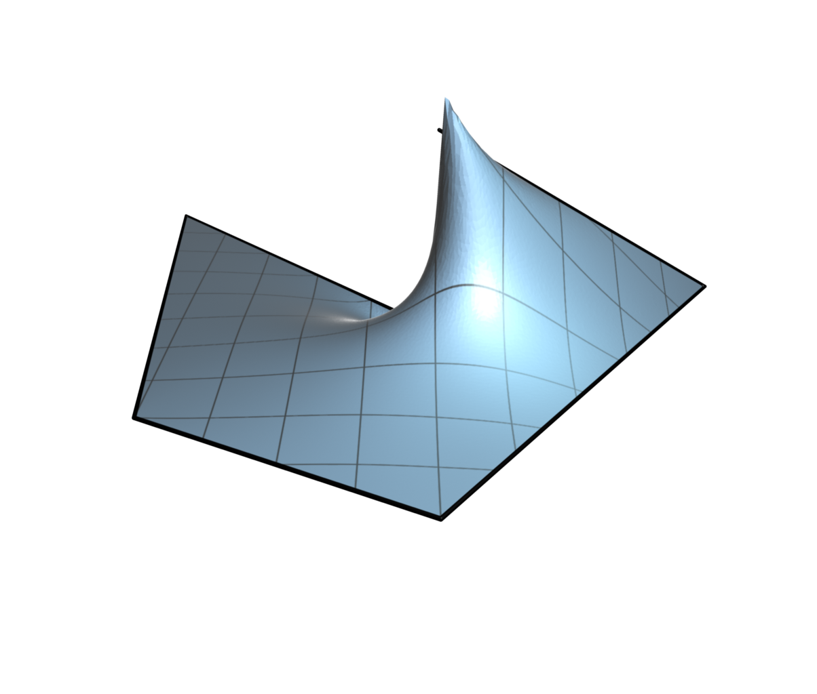
Polygon Basis Functions

Slide 43
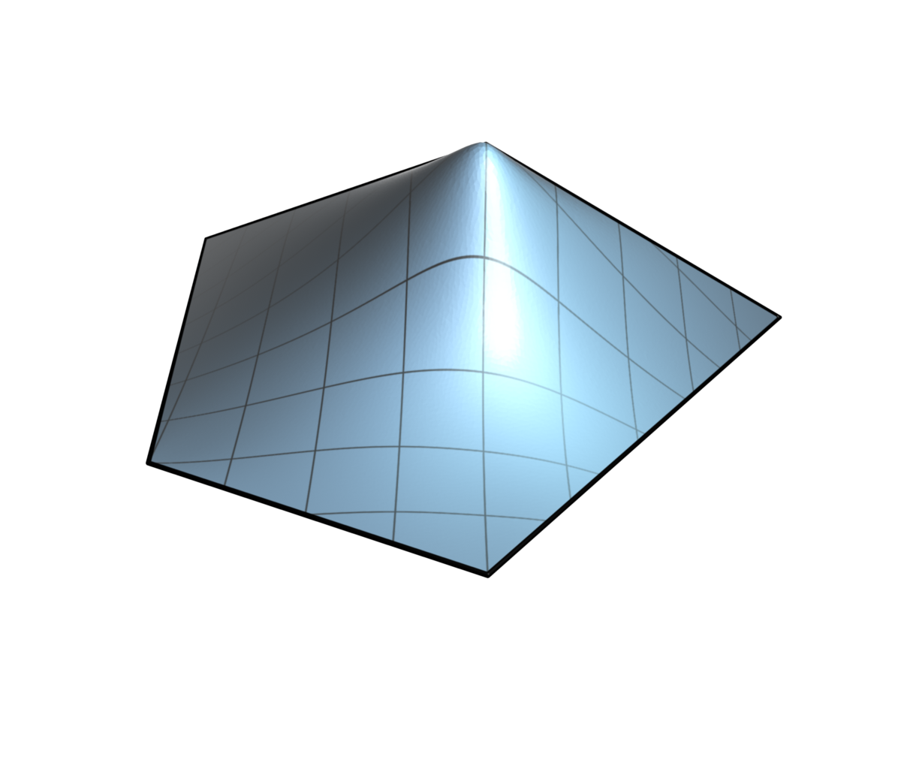
Polygon Basis Functions

Slide 44
Polygon Basis Functions

Slide 45
Polynomial Boundary Values

Slide 46
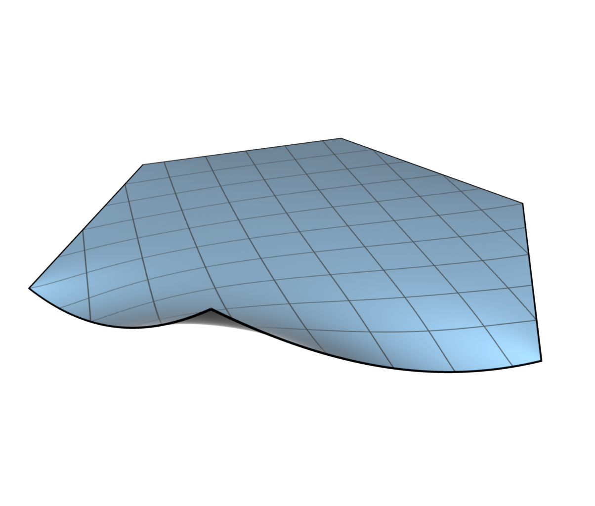
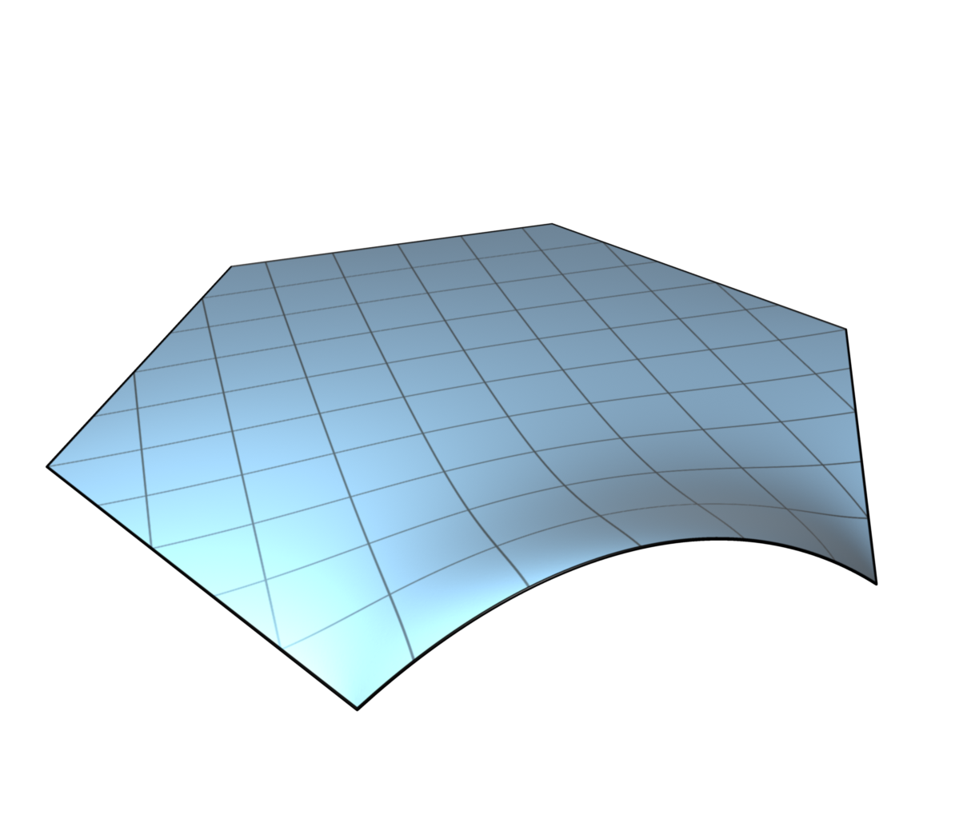
Polynomial Boundary Values

Slide 47
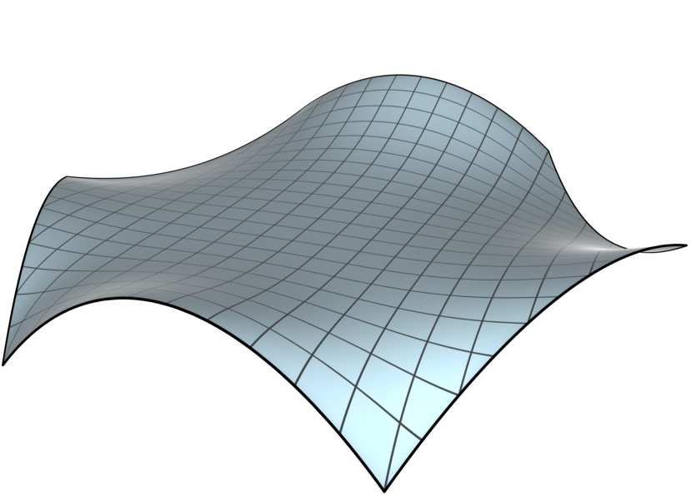
Polynomial Boundary Values

Slide 48
Polynomial Precision

Slide 49
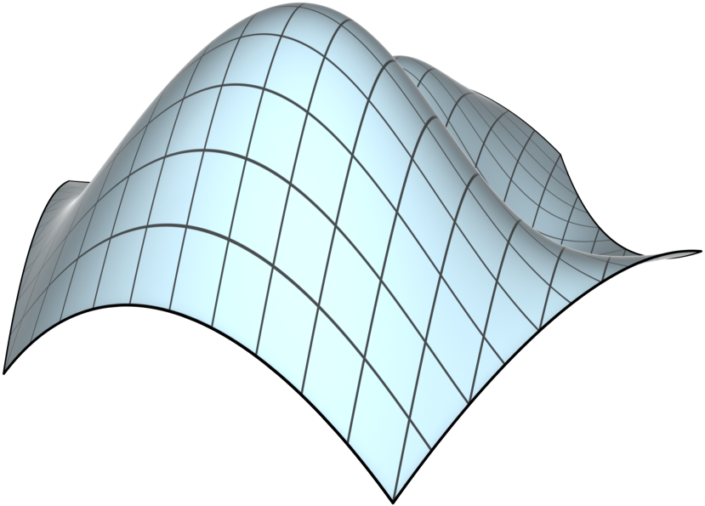
Polynomial Precision
Linear
Quadratic

Slide 50
Interpolation of Derivatives

Slide 51
Interpolation of Derivatives

Slide 52
Interpolation of Derivatives

Slide 53
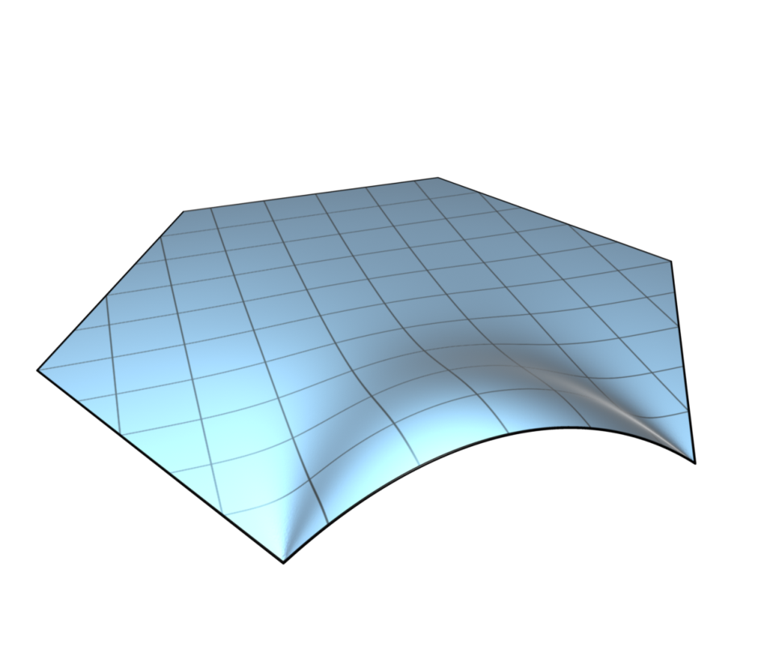
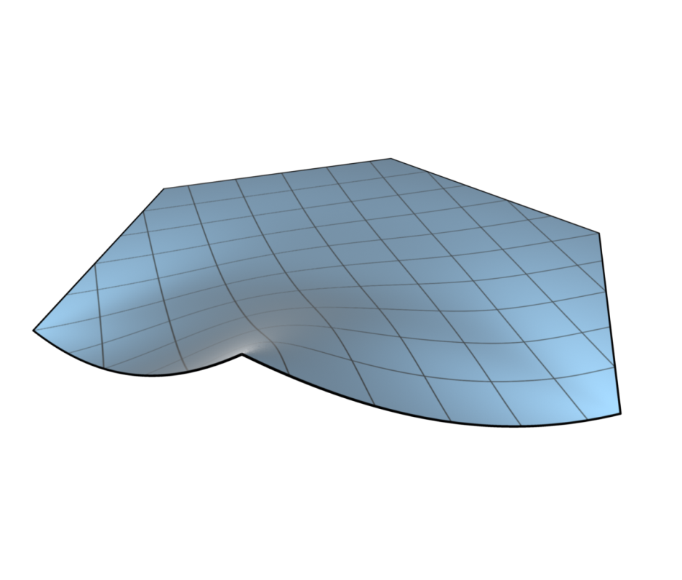
Interpolation of Derivatives

Slide 54
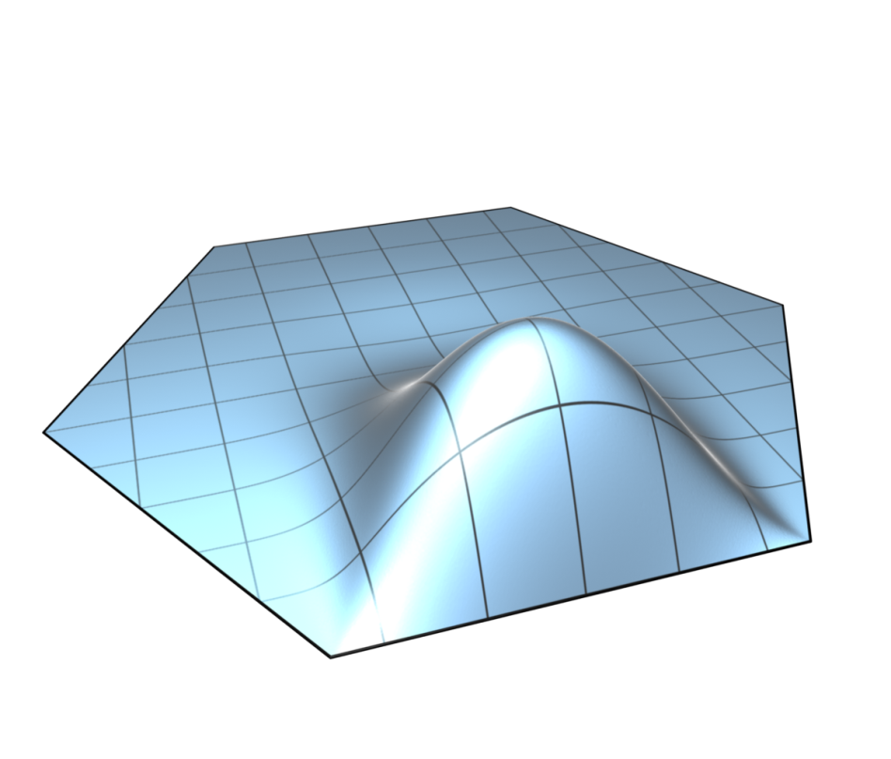
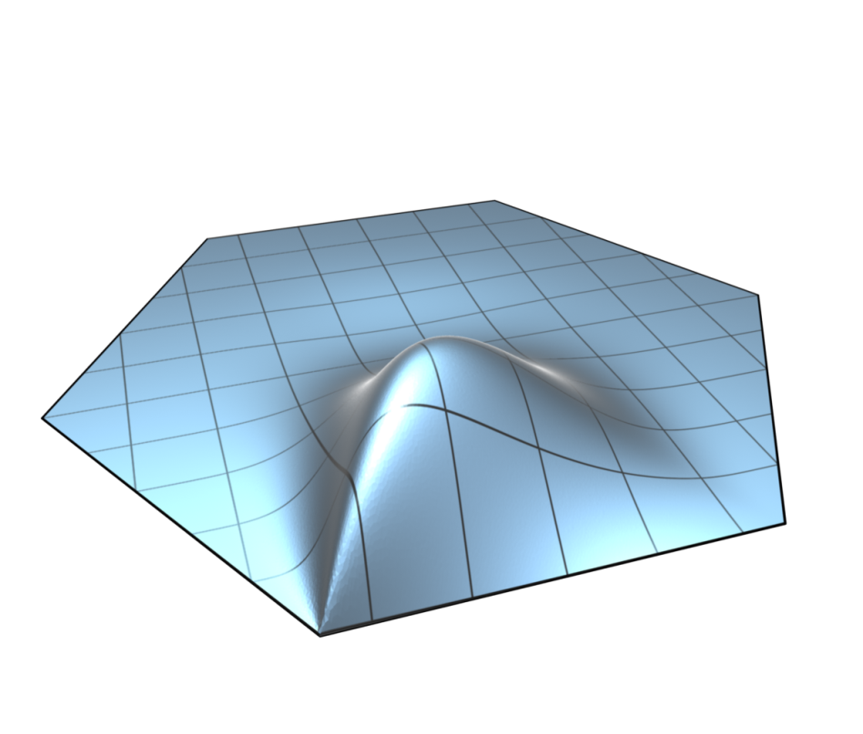
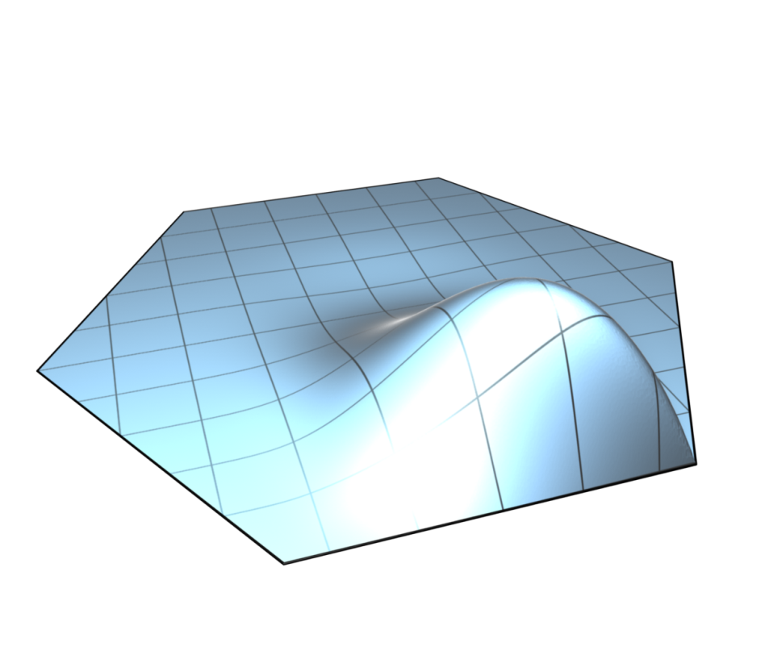
Interpolation of Derivatives

Slide 55
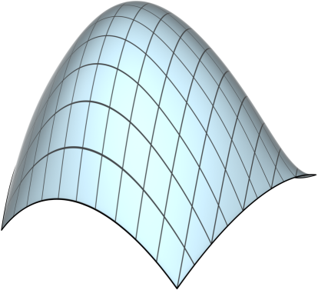
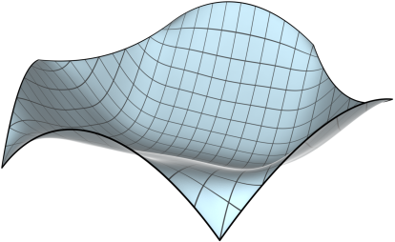
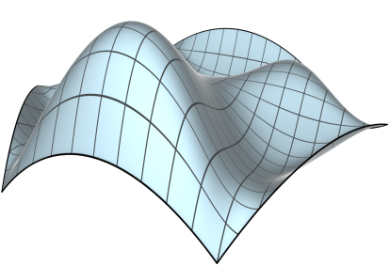
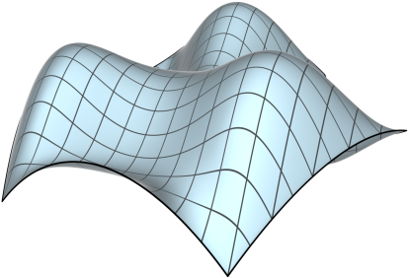
Interpolation of Derivatives

Slide 56
Solutions are Closed-Form
For polygons is linear
and are constant
Polynomial numerator
Denominator quadratic to power 2α
Integrals have closed-form solutions

Slide 57
Curved Boundaries

Slide 58
Comparison to Other Methods

Slide 59
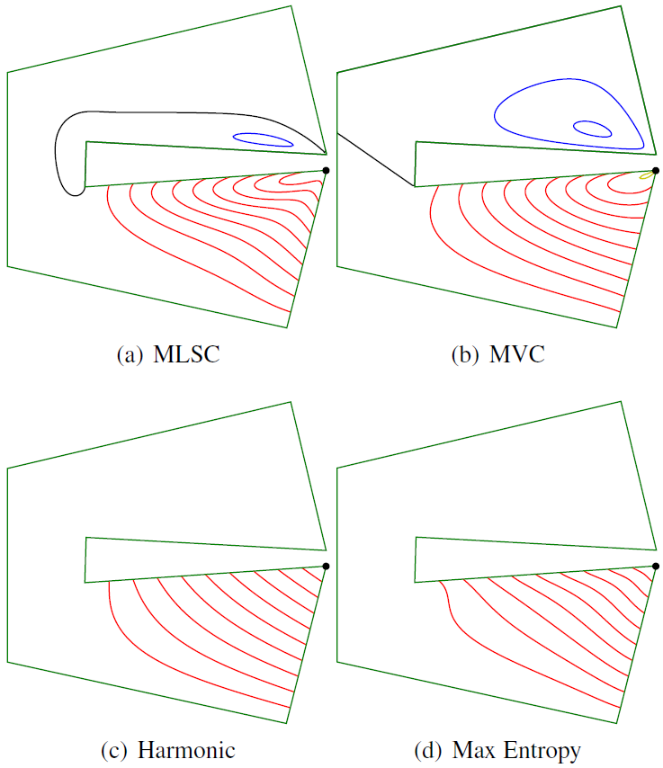
Comparison to Other Methods

Slide 60
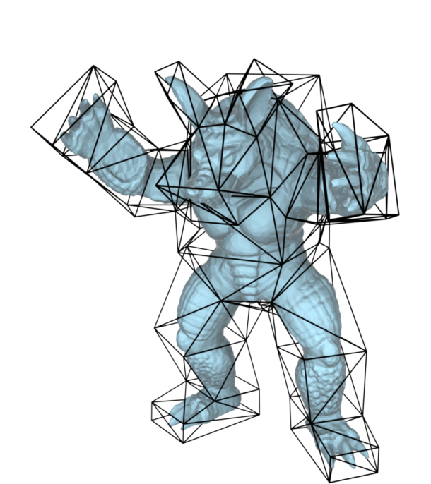
3D Deformation

Slide 61
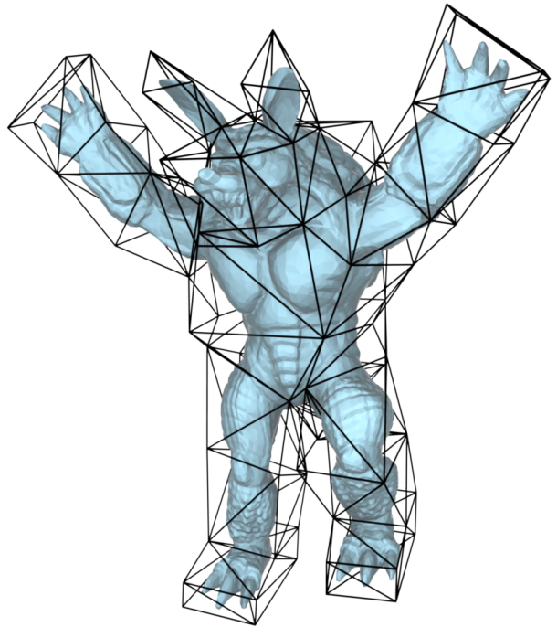
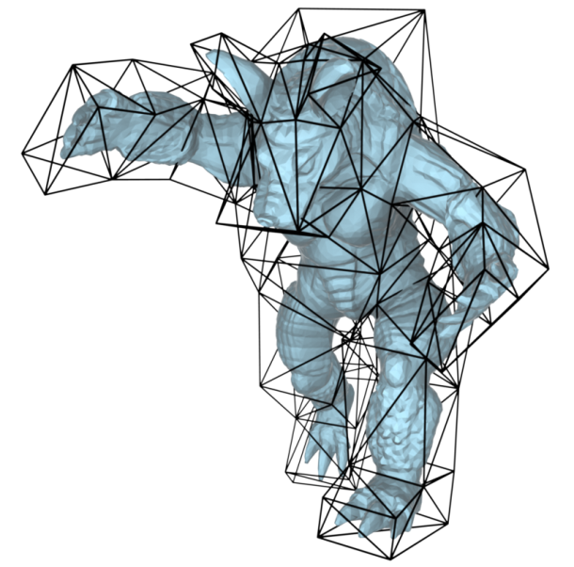
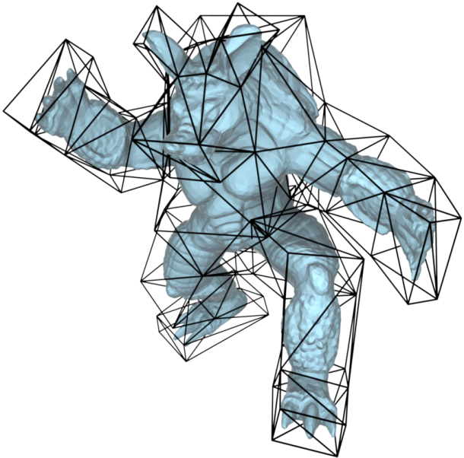
3D Deformation

Slide 62
Conclusion
New family of barycentric coordinates
Controlled by parameter α
Polynomial boundaries
Polynomial precision
Derivative interpolation
Open polygons
Closed-form

Slide 64
Extension to 3D

Slide 65
Constant Precision

