Slide 1
Isosurfaces Over Simplicial Partitions of Multiresolution Grids
Josiah Manson and Scott Schaefer
Texas A&M University

Slide 2
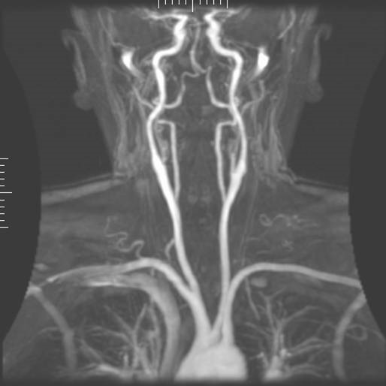
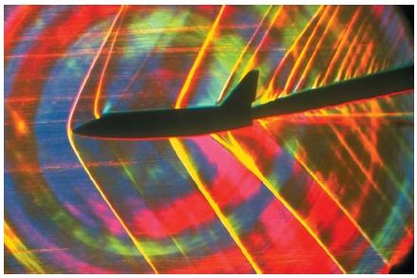
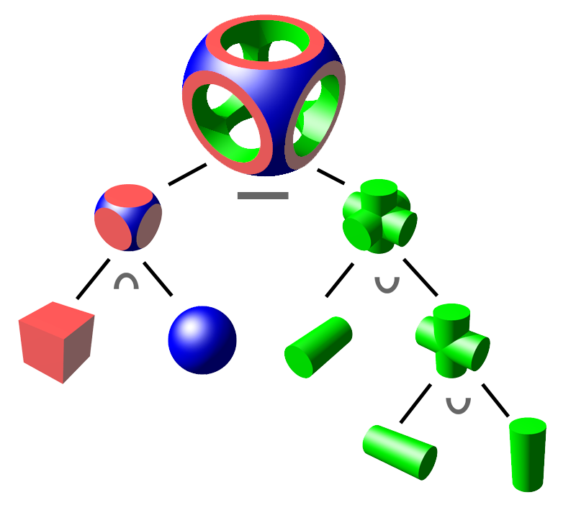
Motivation: Uses of Isosurfaces

Slide 3
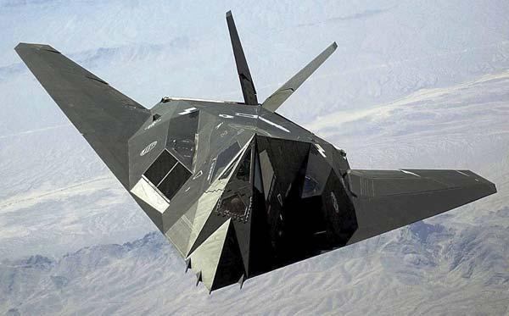
Motivation: Goals
Sharp features
Thin features
Arbitrary octrees
Manifold / Intersection-free
Notes:
SPLIT INTO 4 SLIDES WITH PIC FOR EACH BULLET

Slide 4
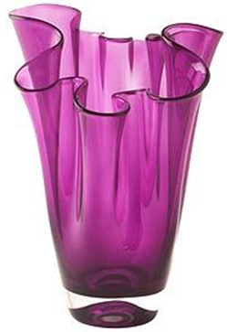
Motivation: Goals
Sharp features
Thin features
Arbitrary octrees
Manifold / Intersection-free
Notes:
SPLIT INTO 4 SLIDES WITH PIC FOR EACH BULLET

Slide 5
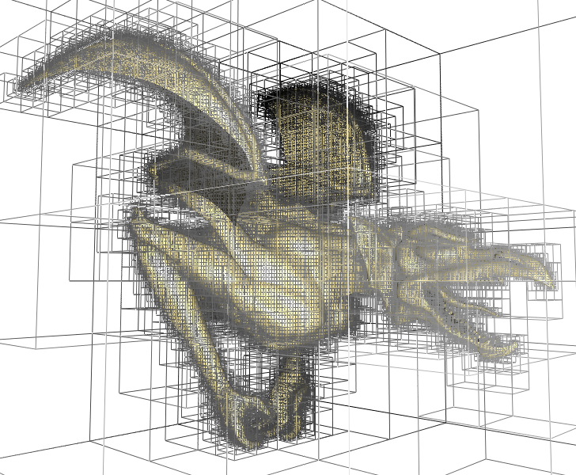
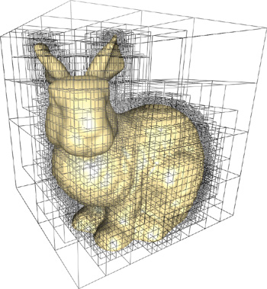
Motivation: Goals
Sharp features
Thin features
Arbitrary octrees
Manifold / Intersection-free
Octree Textures on the GPU [Lefebvre et al. 2005]
Notes:
SPLIT INTO 4 SLIDES WITH PIC FOR EACH BULLET

Slide 6
Motivation: Goals
Sharp features
Thin features
Arbitrary octrees
Manifold / Intersection-free
Notes:
SPLIT INTO 4 SLIDES WITH PIC FOR EACH BULLET

Slide 7
Related Work
Dual Contouring [Ju et al. 2002]
Intersection-free Contouring on an Octree Grid [Ju 2006]
Dual Marching Cubes [Schaefer and Warren 2004]
Cubical Marching Squares [Ho et al. 2005]
Unconstrained Isosurface Extraction on Arbitrary Octrees [Kazhdan et al. 2007]

Slide 8
Dual Contouring
+
+
+
+
-
+
+
-
-
+
+
+
+
+
Notes:
Figure of graph example

Slide 9
Dual Contouring
+
+
+
+
-
+
+
-
-
+
+
+
+
+
Notes:
Figure of graph example

Slide 10
Dual Contouring
+
+
+
+
-
+
+
-
-
+
+
+
+
+
Notes:
Figure of graph example

Slide 11
Dual Contouring

Slide 12
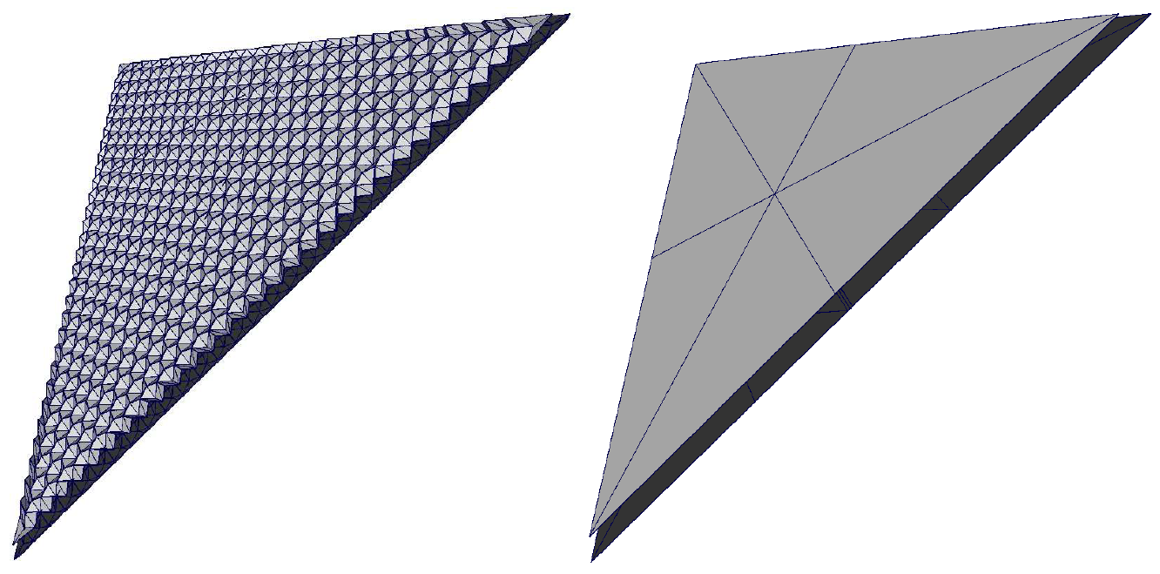
Dual Contouring
Dual Contouring [Ju et al. 2002]
Our method

Slide 13
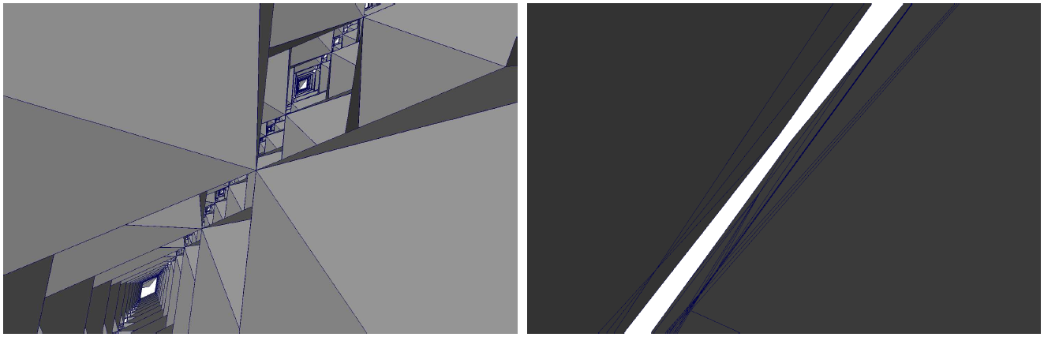
Dual Contouring
Dual Contouring [Ju et al. 2002]
Our method

Slide 14
Related Work
Dual Contouring [Ju et al. 2002]
Intersection-free Contouring on an Octree Grid [Ju 2006]
Dual Marching Cubes [Schaefer and Warren 2004]
Cubical Marching Squares [Ho et al. 2005]
Unconstrained Isosurface Extraction on Arbitrary Octrees [Kazhdan et al. 2007]

Slide 15
Dual Marching Cubes
Notes:
Figure of graph example

Slide 16
Dual Marching Cubes
+
+
+
-
-
-
+
Notes:
Figure of graph example

Slide 17
Dual Marching Cubes
+
+
+
-
-
-
+
Notes:
Figure of graph example

Slide 18
Dual Marching Cubes
+
+
+
-
-
-
+
Notes:
Figure of graph example

Slide 19
Dual Marching Cubes

Slide 20
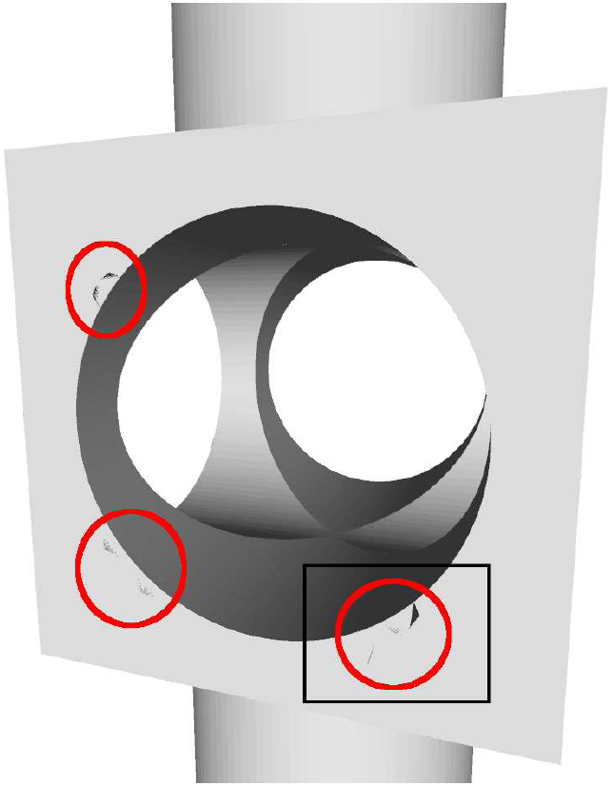
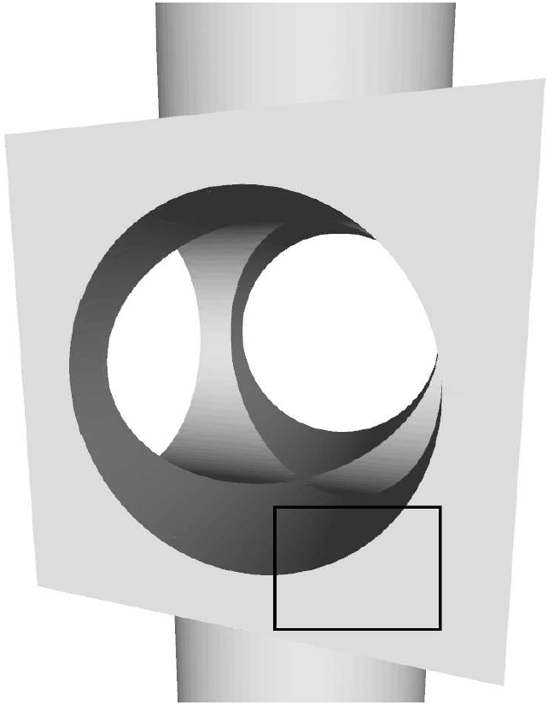
Dual Marching Cubes
Dual Marching Cubes
[Schaefer and Warren 2004]
Our method
Notes:
Make into two parts showing the zoomed out first

Slide 21
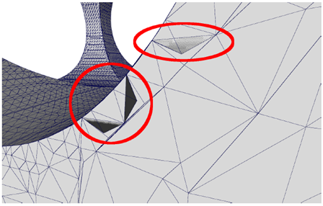
Dual Marching Cubes

Slide 22
Related Work
Dual Contouring [Ju et al. 2002]
Intersection-free Contouring on an Octree Grid [Ju 2006]
Dual Marching Cubes [Schaefer and Warren 2004]
Cubical Marching Squares [Ho et al. 2005]
Unconstrained Isosurface Extraction on Arbitrary Octrees [Kazhdan et al. 2007]

Slide 23
Our Method Overview
Create vertices dual to every minimal edge, face, and cube
Partition octree into 1-to-1 covering of tetrahedra
Marching tetrahedra creates manifold surfaces
Improve triangulation while preserving topology

Slide 24
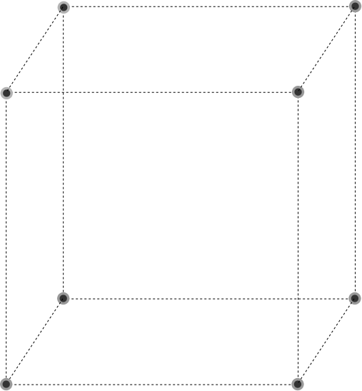
Terminology
Cells in Octree
  Vertices are 0-cells
  Edges are 1-cells
  Faces are 2-cells
  Cubes are 3-cells
Dual Vertices
  Vertex dual to each m-cell
  Constrained to interior of cell

Slide 25
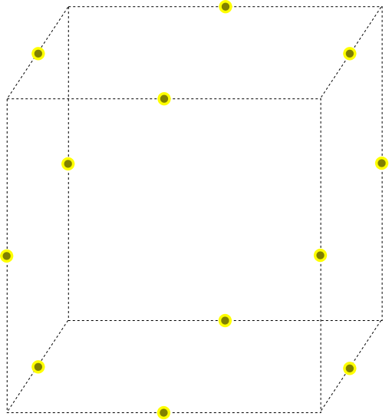
Terminology
Cells in Octree
  Vertices are 0-cells
  Edges are 1-cells
  Faces are 2-cells
  Cubes are 3-cells
Dual Vertices
  Vertex dual to each m-cell
  Constrained to interior of cell

Slide 26
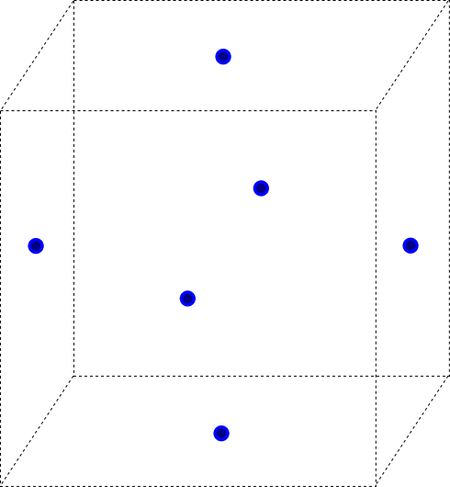
Terminology
Cells in Octree
  Vertices are 0-cells
  Edges are 1-cells
  Faces are 2-cells
  Cubes are 3-cells
Dual Vertices
  Vertex dual to each m-cell
  Constrained to interior of cell

Slide 27
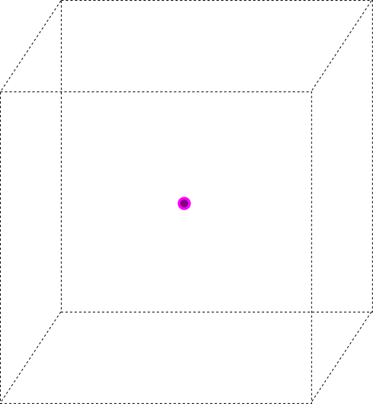
Terminology
Cells in Octree
  Vertices are 0-cells
  Edges are 1-cells
  Faces are 2-cells
  Cubes are 3-cells
Dual Vertices
  Vertex dual to each m-cell
  Constrained to interior of cell

Slide 28
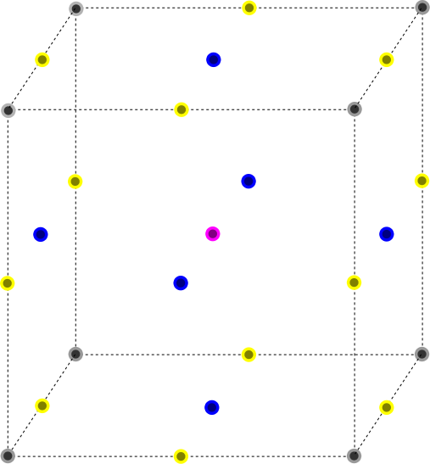
Terminology
Cells in Octree
  Vertices are 0-cells
  Edges are 1-cells
  Faces are 2-cells
  Cubes are 3-cells
Dual Vertices
  Vertex dual to each m-cell
  Constrained to interior of cell

Slide 29
Our Partitioning of Space
Start with vertex

Slide 30
Our Partitioning of Space
Build edges

Slide 31
Our Partitioning of Space
Build faces

Slide 32
Our Partitioning of Space
Build cubes

Slide 33
Minimal Edge (1-Cell)

Slide 34
Minimal Edge (1-Cell)

Slide 35
Minimal Edge (1-Cell)

Slide 36
Minimal Edge (1-Cell)

Slide 37
Building Simplices

Slide 38
Building Simplices

Slide 39
Building Simplices

Slide 40
Building Simplices

Slide 41
Building Simplices

Slide 42
Building Simplices

Slide 43
Building Simplices

Slide 44
Building Simplices

Slide 45
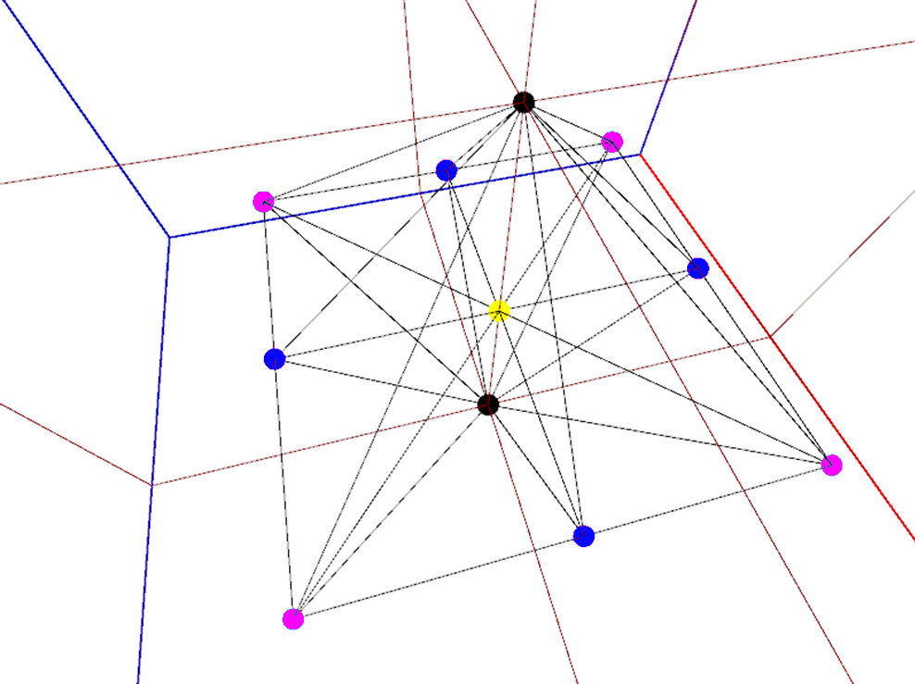
Traversing Tetrahedra

Slide 46
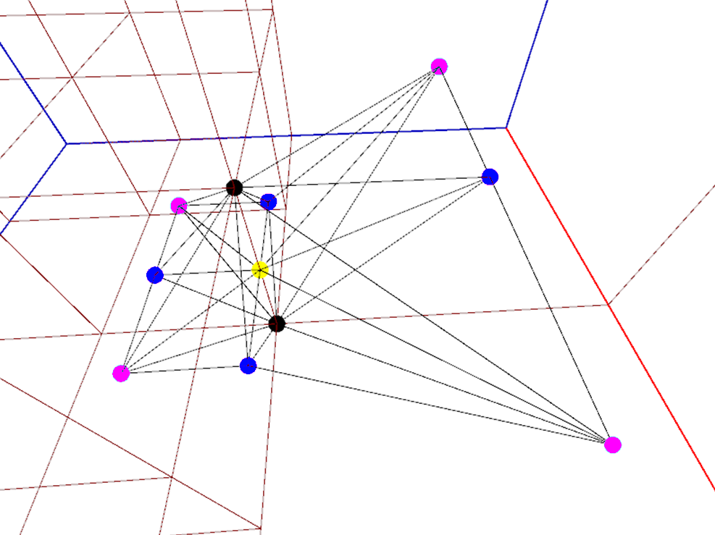
Traversing Tetrahedra

Slide 47
Traversing Tetrahedra
Octree Traversal from DC [Ju et al. 2002]

Slide 48



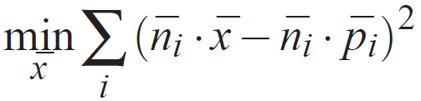
Finding Features
Minimize distances to planes

Slide 49
Surfaces from Tetrahedra

Slide 50
Manifold Property
Vertices are constrained to their dual m-cells
Simplices are guaranteed to not fold back
Tetrahedra share faces
Freedom to move allows reproducing features

Slide 51
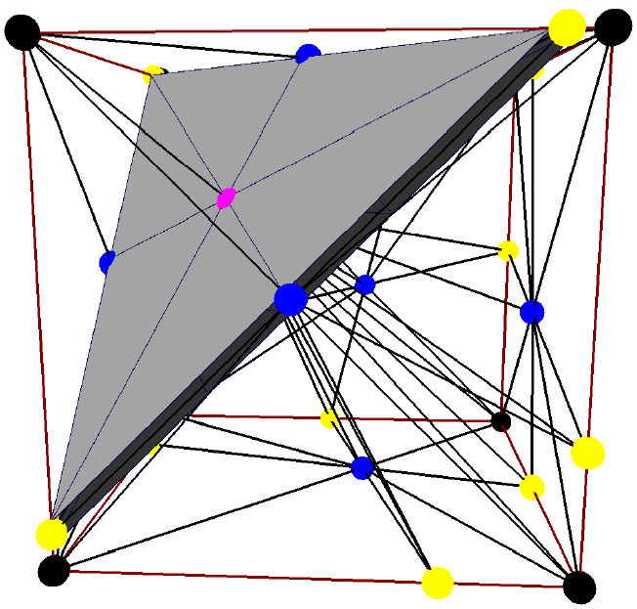
Finding Features

Slide 52
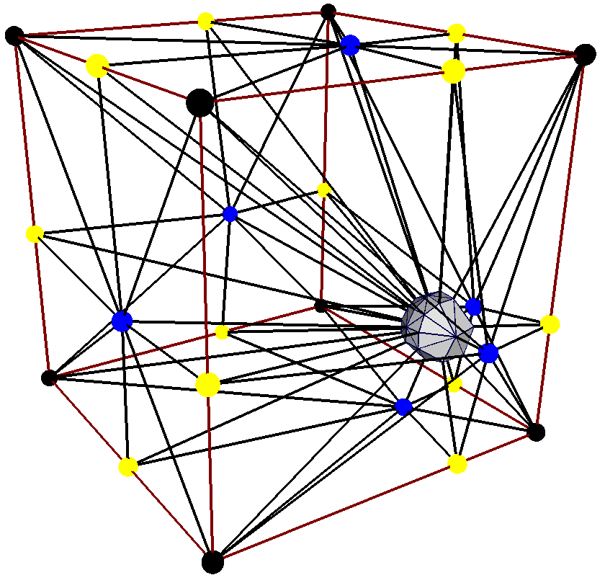
Finding Features

Slide 53
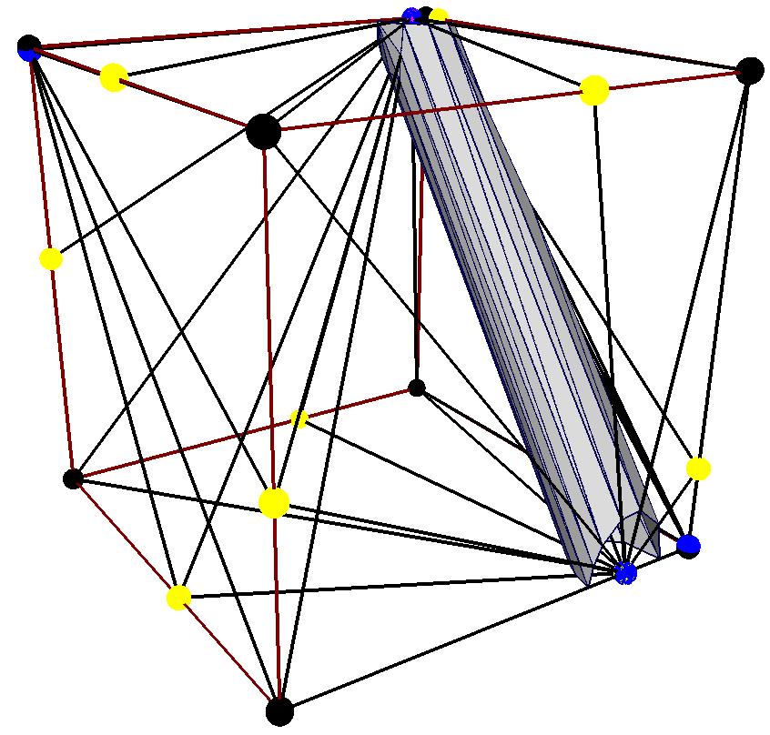
Finding Features

Slide 54
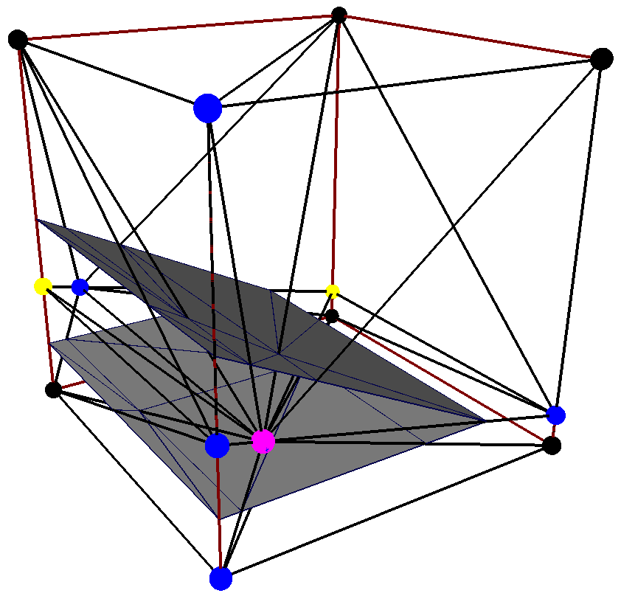
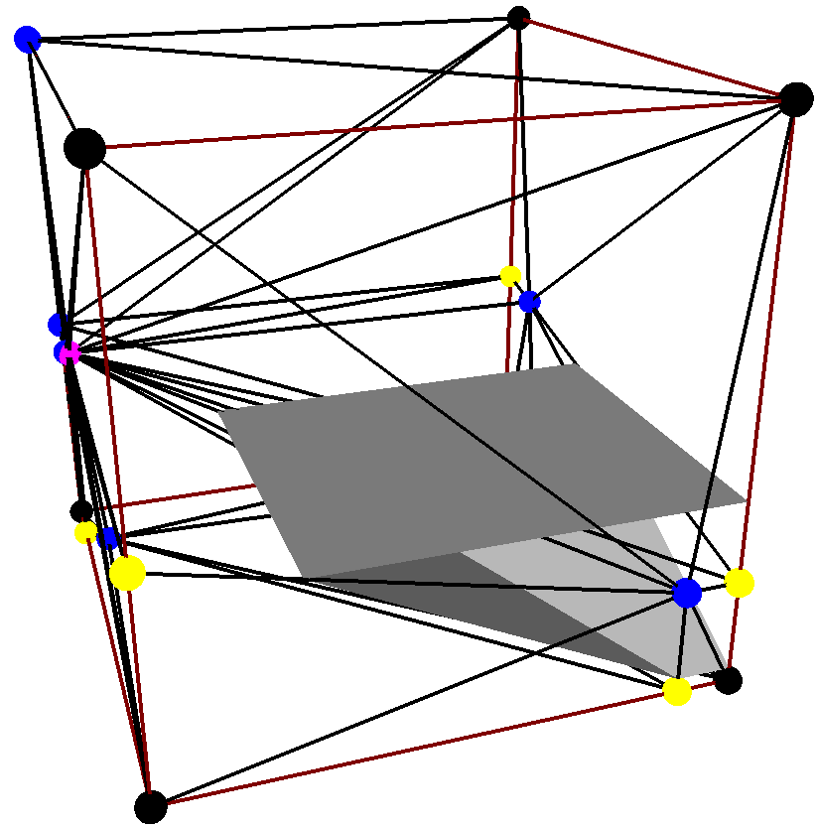
Finding Features

Slide 55
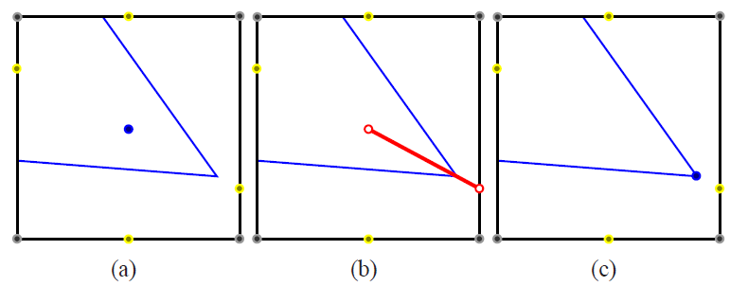
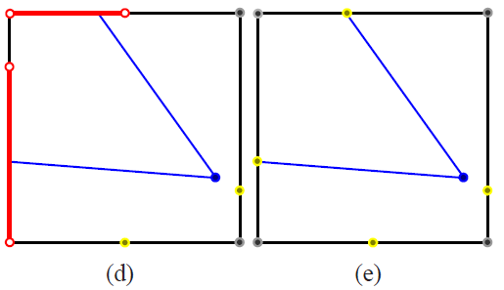
Improving Triangulation
Notes:
Draw partition

Slide 56
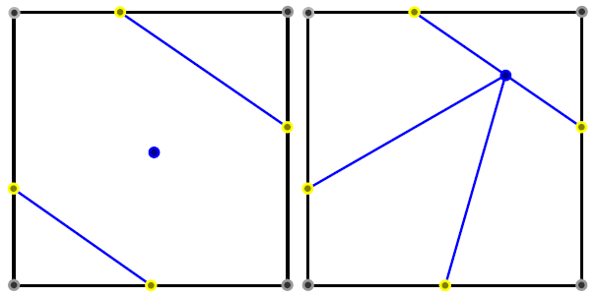
Possible Problem: Face
Before
After

Slide 57
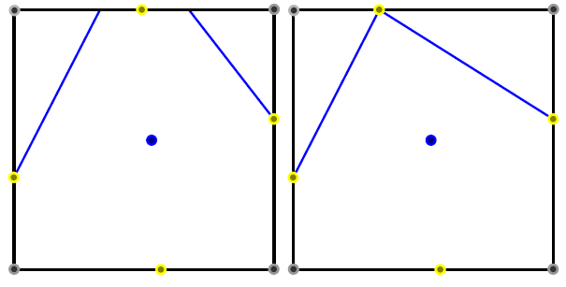
Possible Problem: Edge
Before
After
Notes:
Before/after text

Slide 58
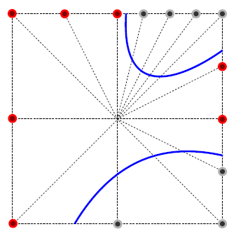
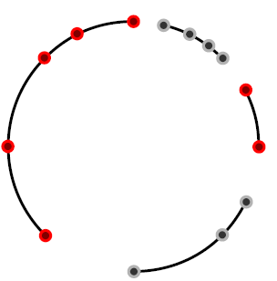
Preserving Topology
Only move vertex to surface if there is a single contour.
Count connected components.

Slide 59
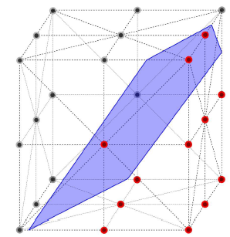
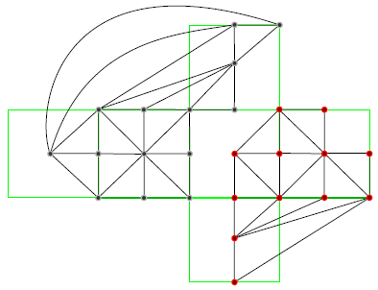
Preserving Topology
Only move vertex to surface if there is a single contour.
Count connected components.

Slide 60
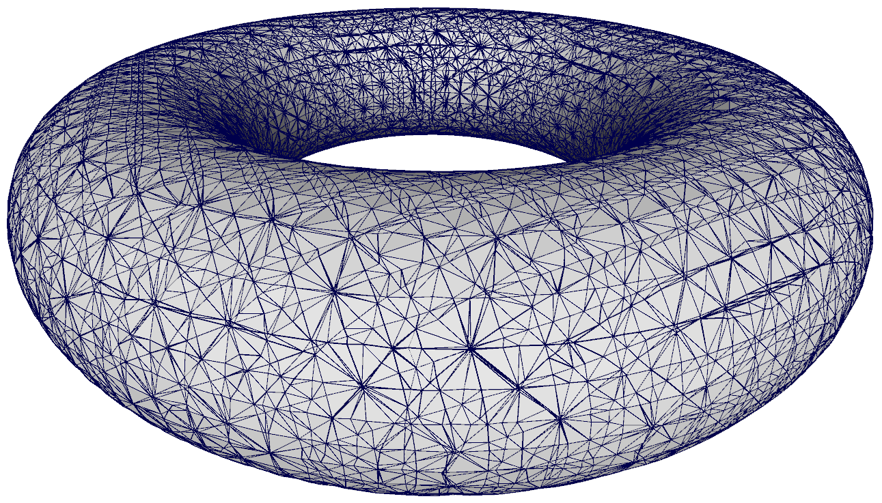
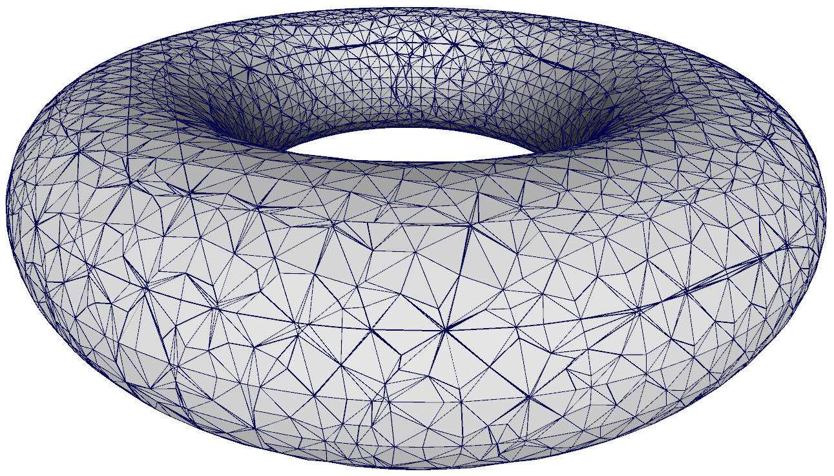
Improving Triangulation
Before
After

Slide 61
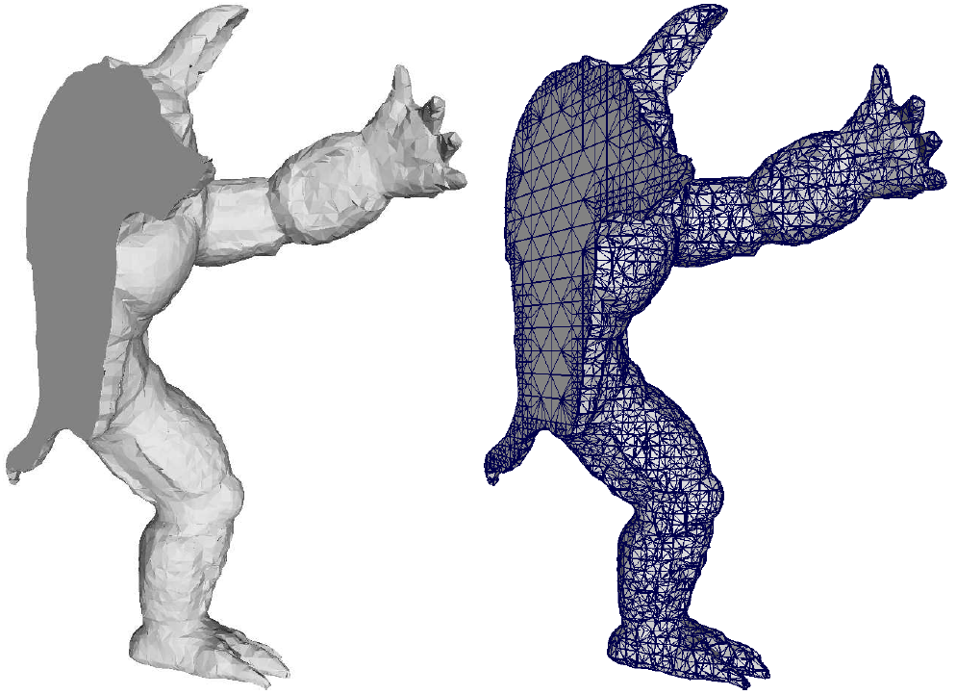
Results

Slide 62
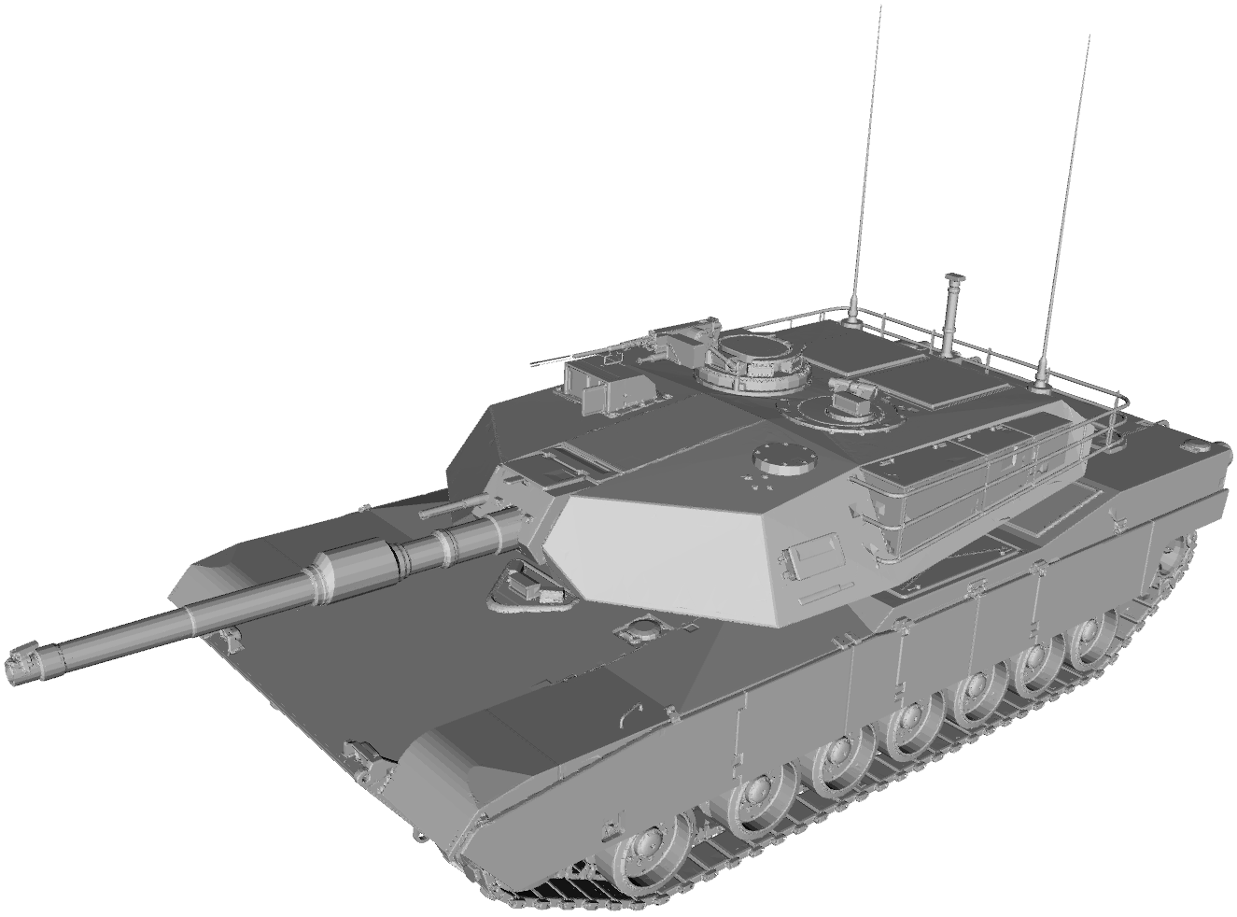
Results

Slide 63
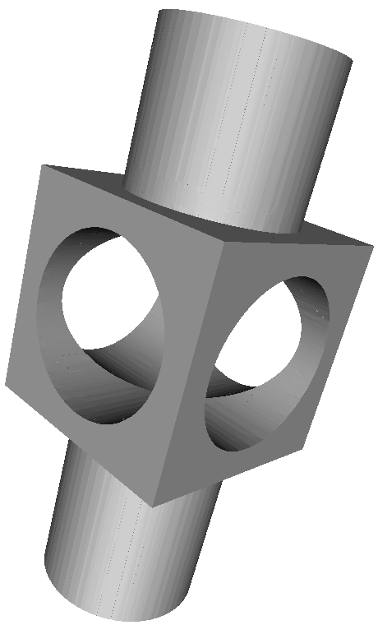
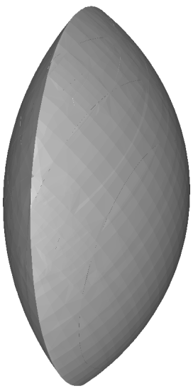

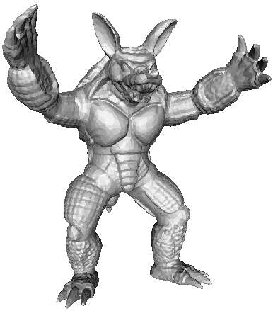
Times
 | Armadillo Man | Mechanical Part | Lens | Tank
Depth | 8 | 9 | 10 | 8
Ours | 2.58s | 4.81s | 9.72s | 8.78s
Ours (Improved Triangles) | 2.69s | 6.80s | 10.35s | 8.19s
Dual Marching Cubes | 1.85s | 3.54s | 6.42s | 5.29s
Dual Contouring | 1.35s | 2.97s | 5.99s | 3.78s
Notes:
pics for models

Slide 64
Conclusions
Calculate isosurfaces over piecewise smooth functions
Guarantee manifold surfaces
Reproduce sharp and thin features
Improved triangulation

Slide 66
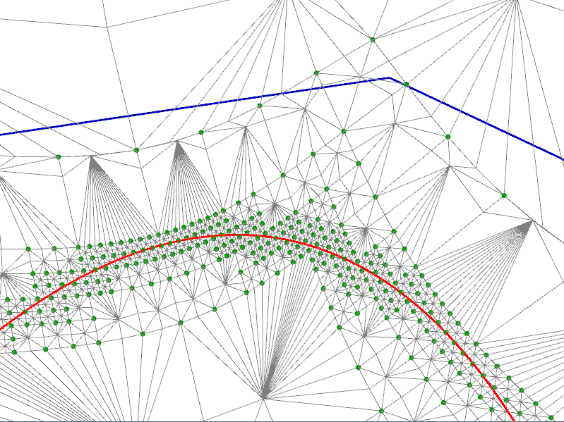
Contour Refinement & Error Metric

Slide 67
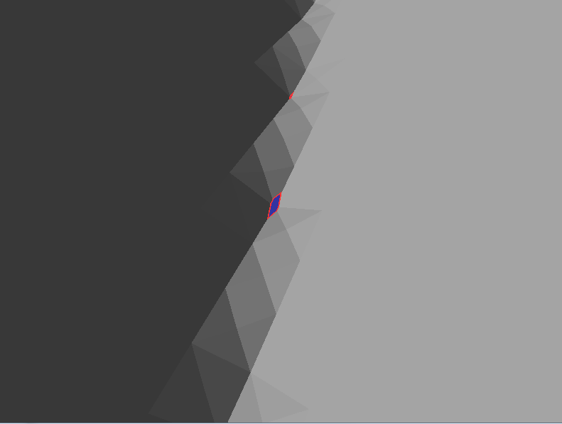

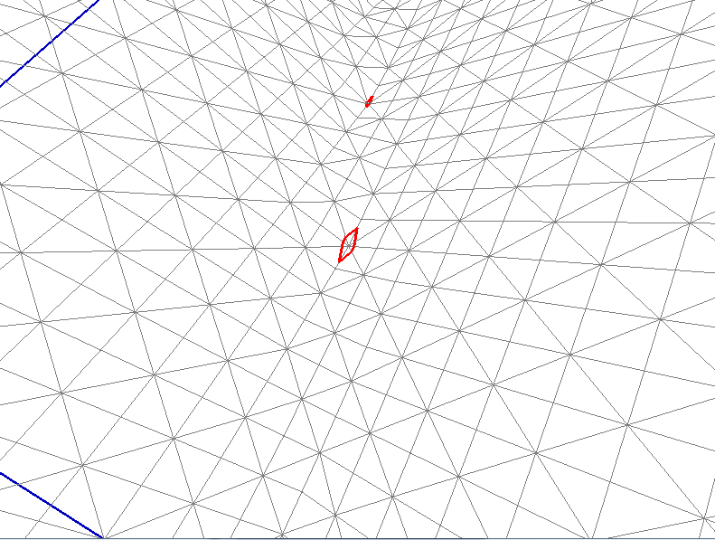
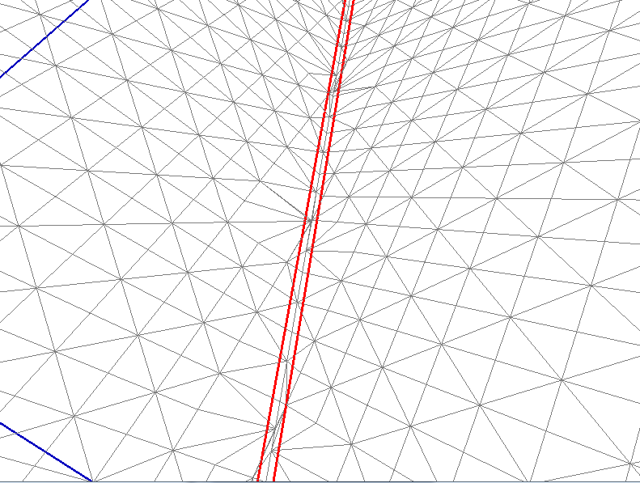
Finding Features

Slide 68
Limitations
Imperfect detection of sharp edges with multiple features
Cube corners cannot move, limiting triangulation improvements
Speed

Slide 69

Times
Time Breakdown of Tank
 | Ours | Ours (Improved Triangles) | DMC | DC
Total Time | 8.78s | 8.19s | 5.29s | 3.78s
Time Tree | 4.02s | 6.13s | 3.41s | 2.69s
Time Extract | 4.77s | 2.06s | 1.88s | 1.09s
Triangles | 3.63M | 1.13M | 1.16M | 727k

Slide 70
Traversing Edges

Slide 71
Traversing Edges

Slide 72
Traversing Edges

Slide 73
Traversing Edges

Slide 74
Traversing Edges

Slide 75
Traversing Edges

Slide 76
Traversing Edges

Slide 77
Traversing Edges

Slide 78
Traversing Edges

Slide 79
Traversing Edges

Slide 80
Traversing Edges

Slide 81
Traversing Edges

Slide 82
Traversing Edges

Slide 83
Traversing Edges

Slide 84
Traversing Edges

Slide 85
Traversing Edges

Slide 86
Traversing Edges

Slide 87
Traversing Edges

Slide 88
Traversing Edges

Slide 89
Traversing Edges

Slide 90
Traversing Edges

Slide 91
Traversing Edges

