Slide 1
Hierarchical Deformation of Locally Rigid Meshes
Josiah Manson and Scott Schaefer
Texas A&M University

Slide 2
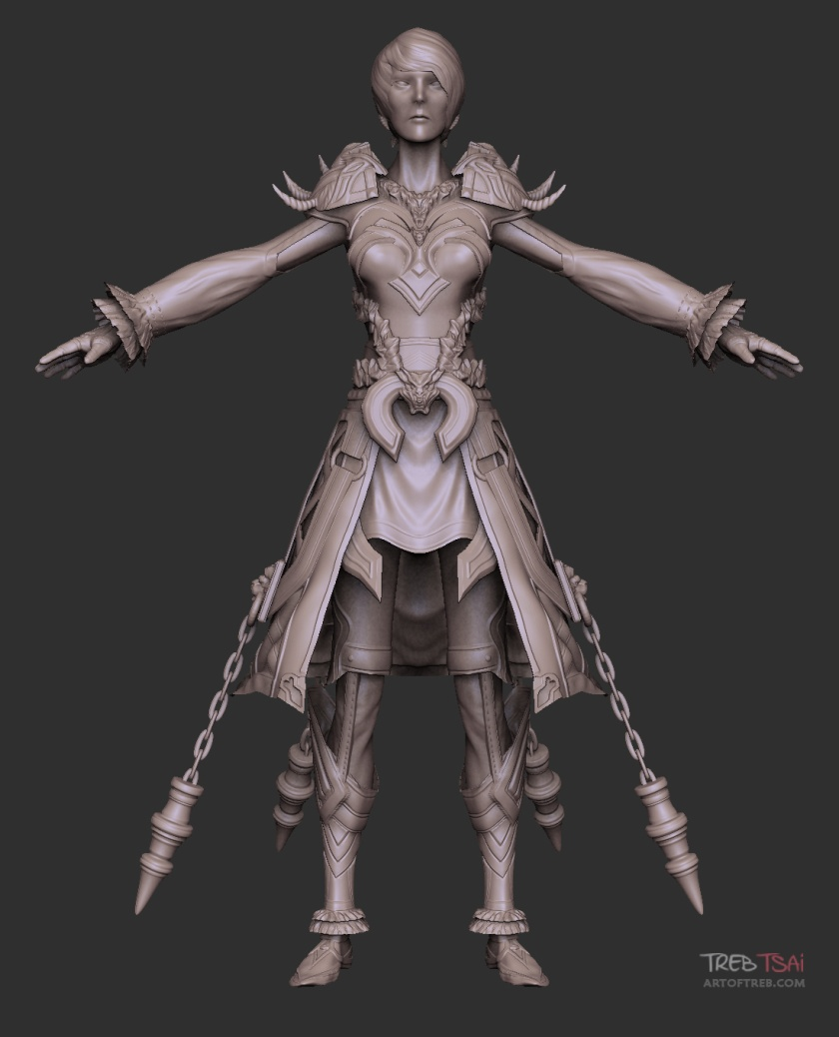
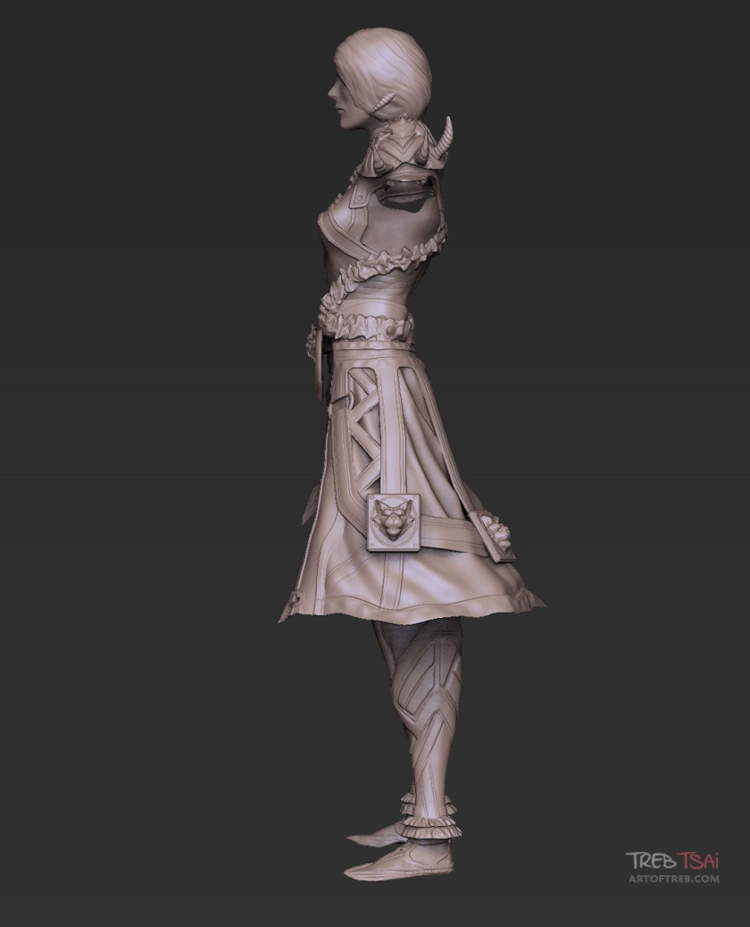
Motivation
Simplified control of deformation

Slide 3
Motivation
Simplified control of deformation

Slide 4
Motivation
Simplified control of deformation
No auxiliary control structures

Slide 5
Motivation
Simplified control of deformation
No auxiliary control structures
Fast feedback

Slide 6
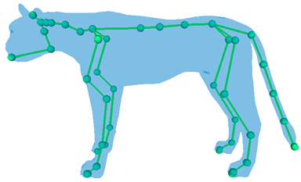
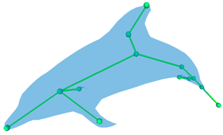
Auxiliary Controls
Skeletons

Slide 7
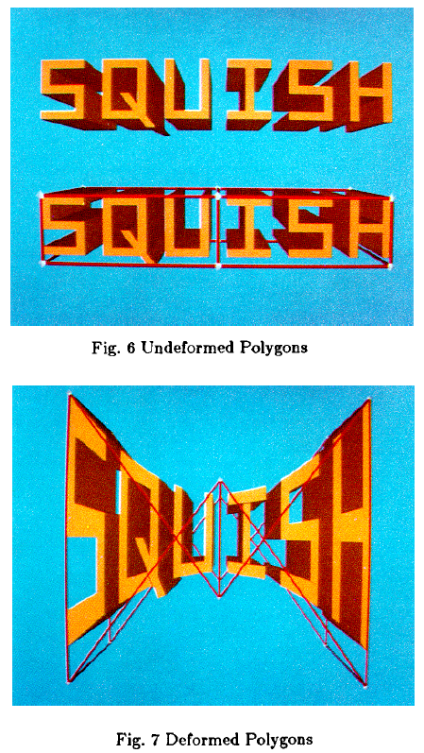
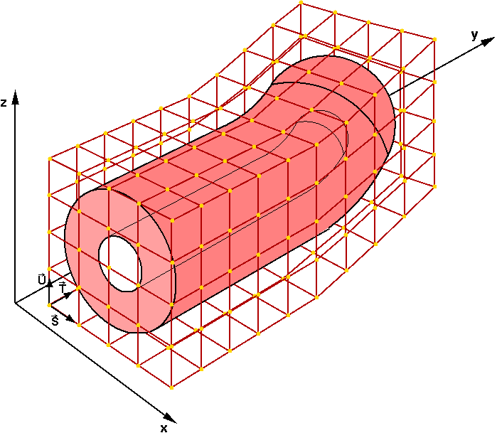
Auxiliary Controls
Grids
[Sederberg and Parry 1986]

Slide 8
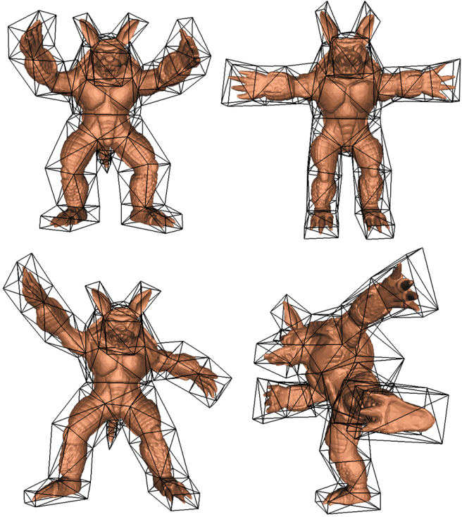
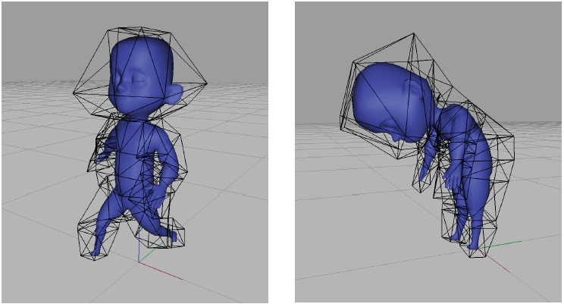
Auxiliary Controls
Cages
[Ju et al. 2005]
[Joshi et al. 2007]

Slide 9
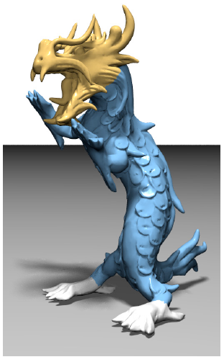
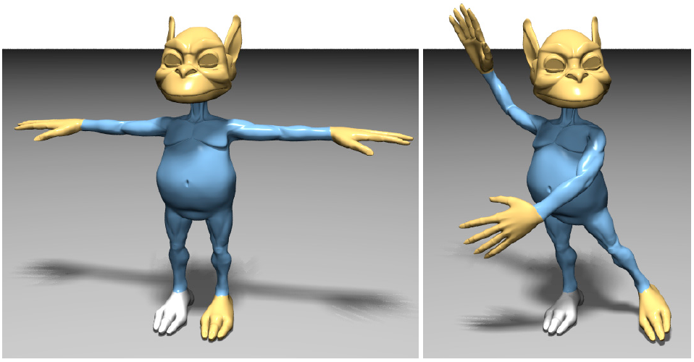
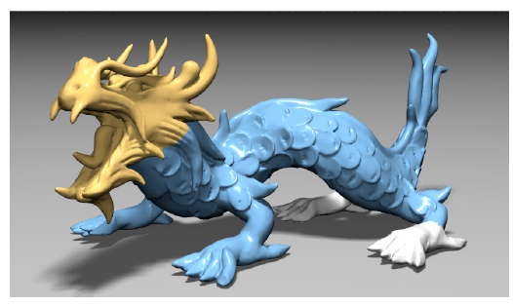
Intrinsic Controls
Thin shell simulation
[Botsch et al. 2006]
[Sorkine and Alexa 2007]

Slide 10
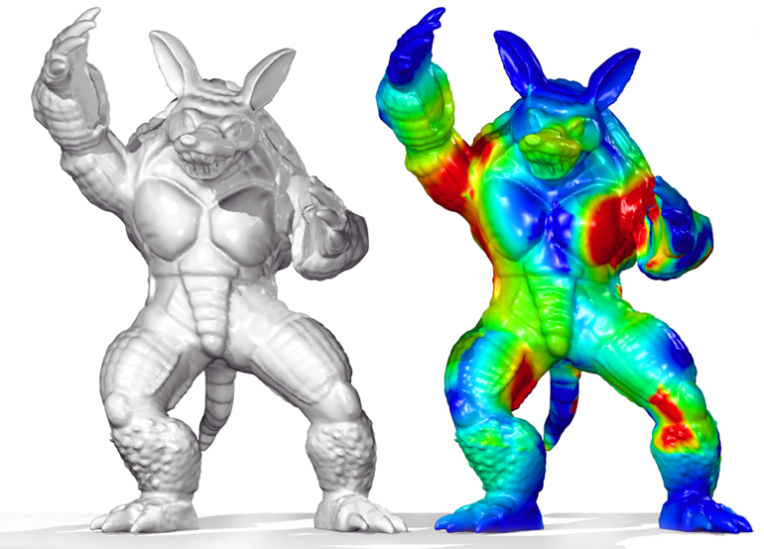
Intrinsic Controls
Volumetric simulation
[Mezger et al. 2007]

Slide 11
Intrinsic Controls
Vibrational modes
[Hildebrandt et al. 2012]

Slide 12
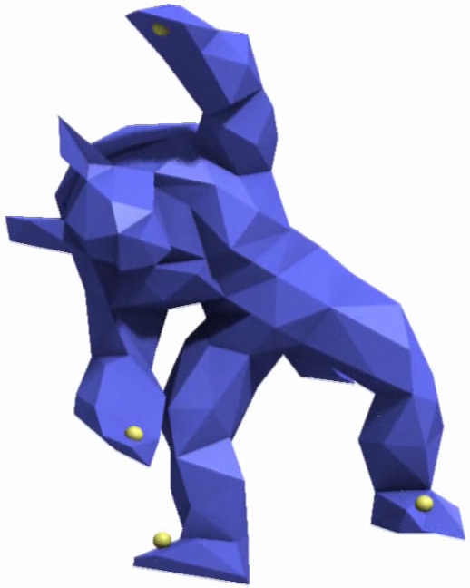
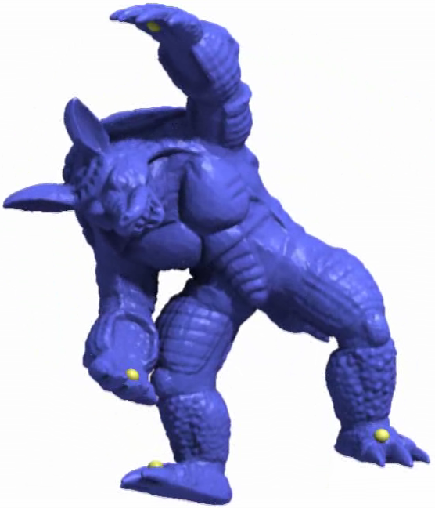
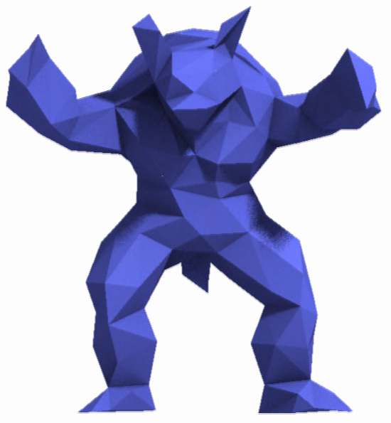
Our Solution
Simplify the mesh
Deform low-resolution mesh
Add details back to the mesh
1
2
3

Slide 14
Mesh Simplification
1

Slide 15
Edge Collapse Metric
Distance to planes
Distance to points

Slide 16
Edge Collapse Metric
Distance to planes
Distance to points

Slide 17
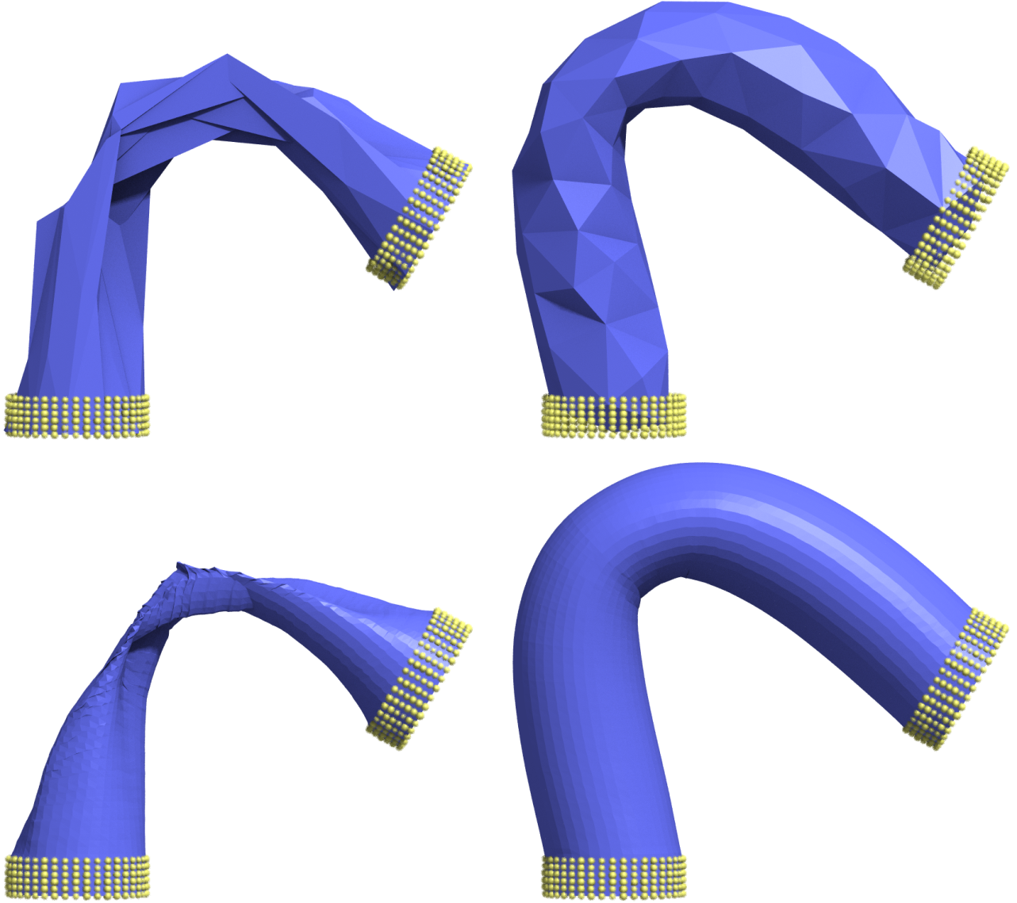
Edge Collapse Metric
Distance to planes
Distance to points

Slide 18
Edge Collapse Metric
Distance to planes
Distance to points

Slide 19
Mesh Deformation
2

Slide 20
As-rigid-as-possible Deformation
As-rigid-as-possible surface modeling
[Sorkine and Alexa 2007]

Slide 21
As-rigid-as-possible Deformation
As-rigid-as-possible surface modeling
[Sorkine and Alexa 2007]
Added ability to satisfy constraints not at mesh vertices

Slide 22
As-rigid-as-possible Deformation

Slide 23
As-rigid-as-possible Deformation

Slide 24
As-rigid-as-possible Deformation

Slide 25
Adding Details
3

Slide 26
Adding Details

Slide 27
Adding Details

Slide 28
Adding Details

Slide 29
Adding Details

Slide 30
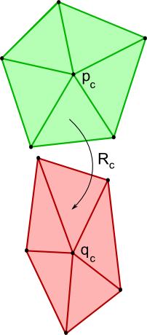
Adding Details

Slide 31
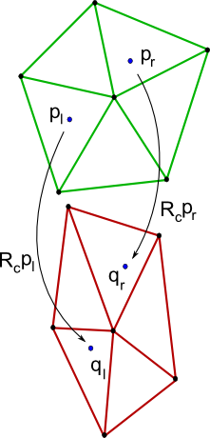
Adding Details

Slide 32
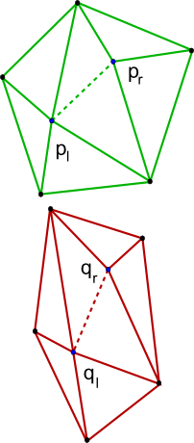
Adding Details

Slide 33
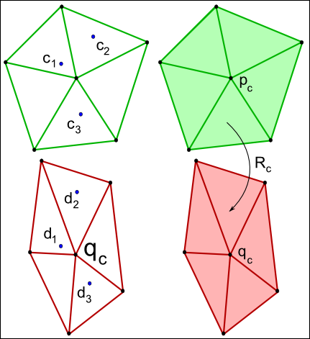
Adding Details Constrained
Deform local neighborhood before expansion

Slide 34
Adding Details Constrained

Slide 35
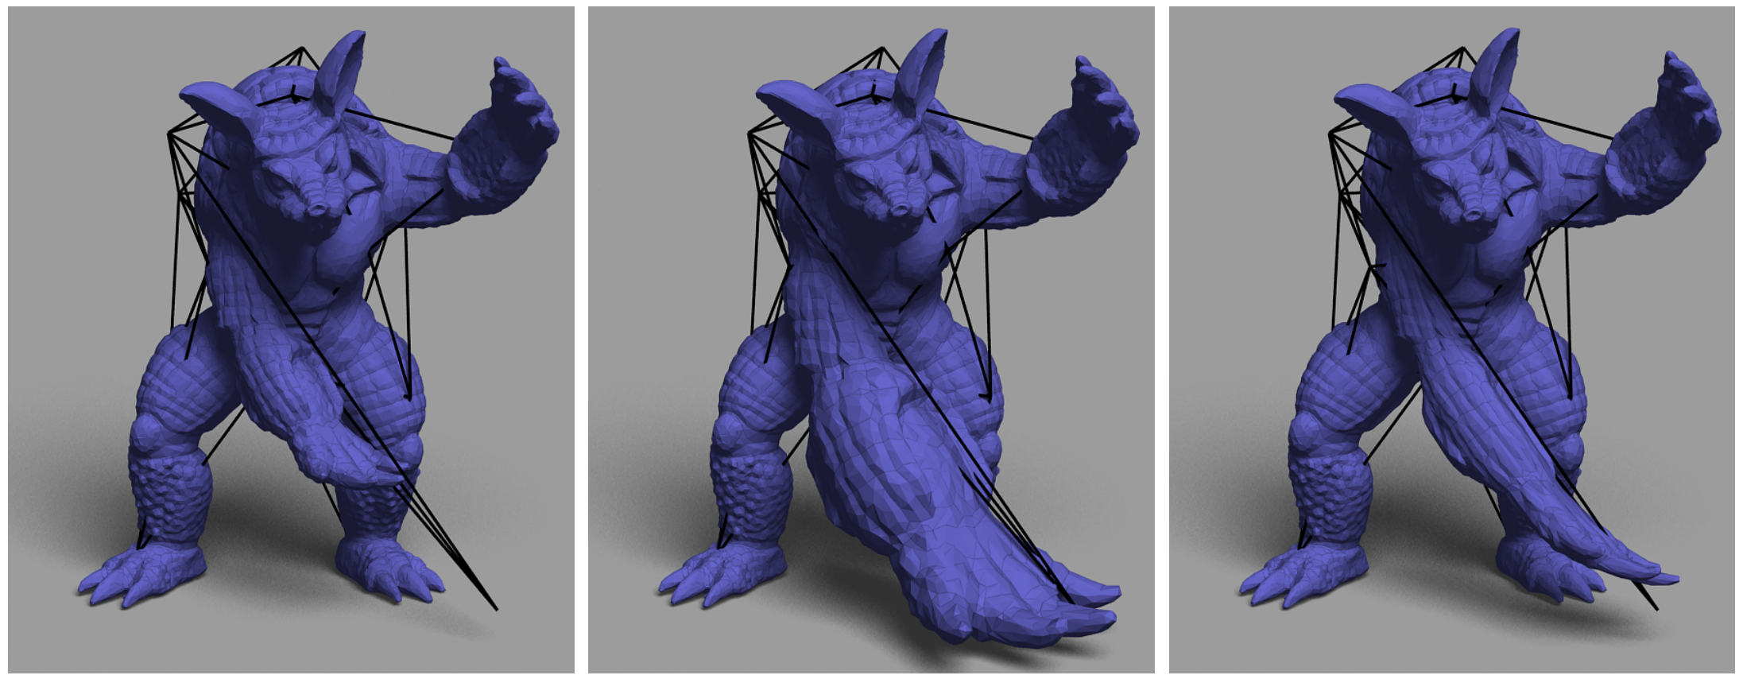
Different Transforms
Rigid
Similarity
Stretch

Slide 36
Different Transforms
Rigid
[Arung et al. 1987]

Slide 37
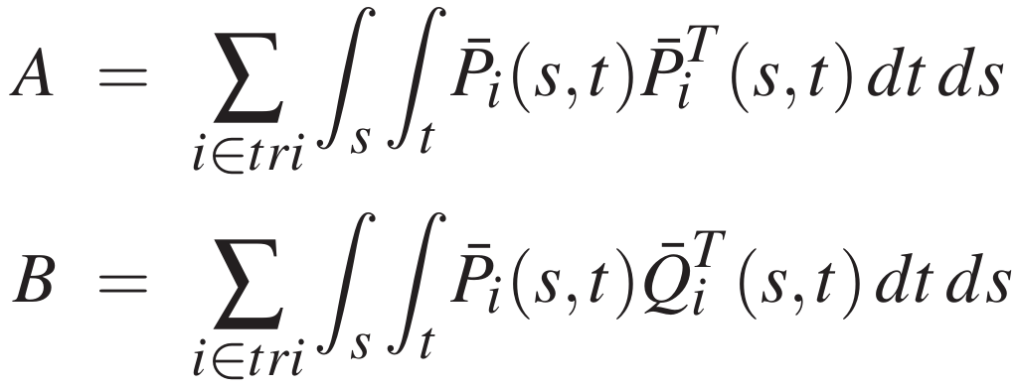
Different Transforms
Rigid
[Arung et al. 1987]

Slide 38
Different Transforms
Rigid
[Arung et al. 1987]

Slide 39
Different Transforms
Rigid
[Arung et al. 1987]

Slide 40
Different Transforms
Similarity
[Horn 1987]

Slide 41
Different Transforms
Stretch

Slide 42
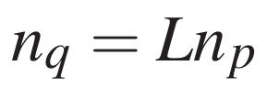
Different Transforms
Stretch

Slide 43
Different Transforms
Stretch

Slide 44
Different Transforms
Stretch

Slide 45
Different Transforms
Stretch

Slide 46
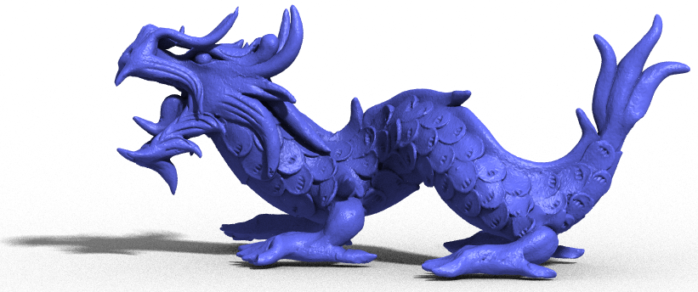
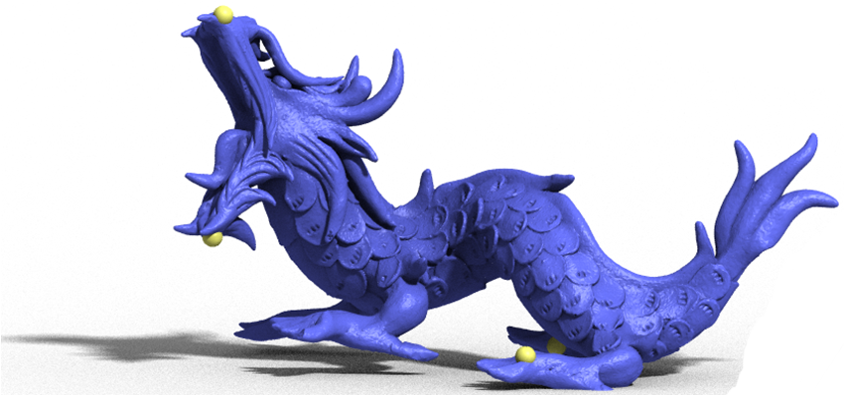
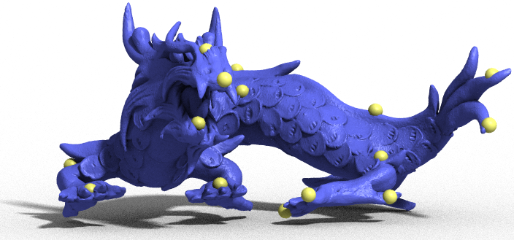
Results

Slide 47
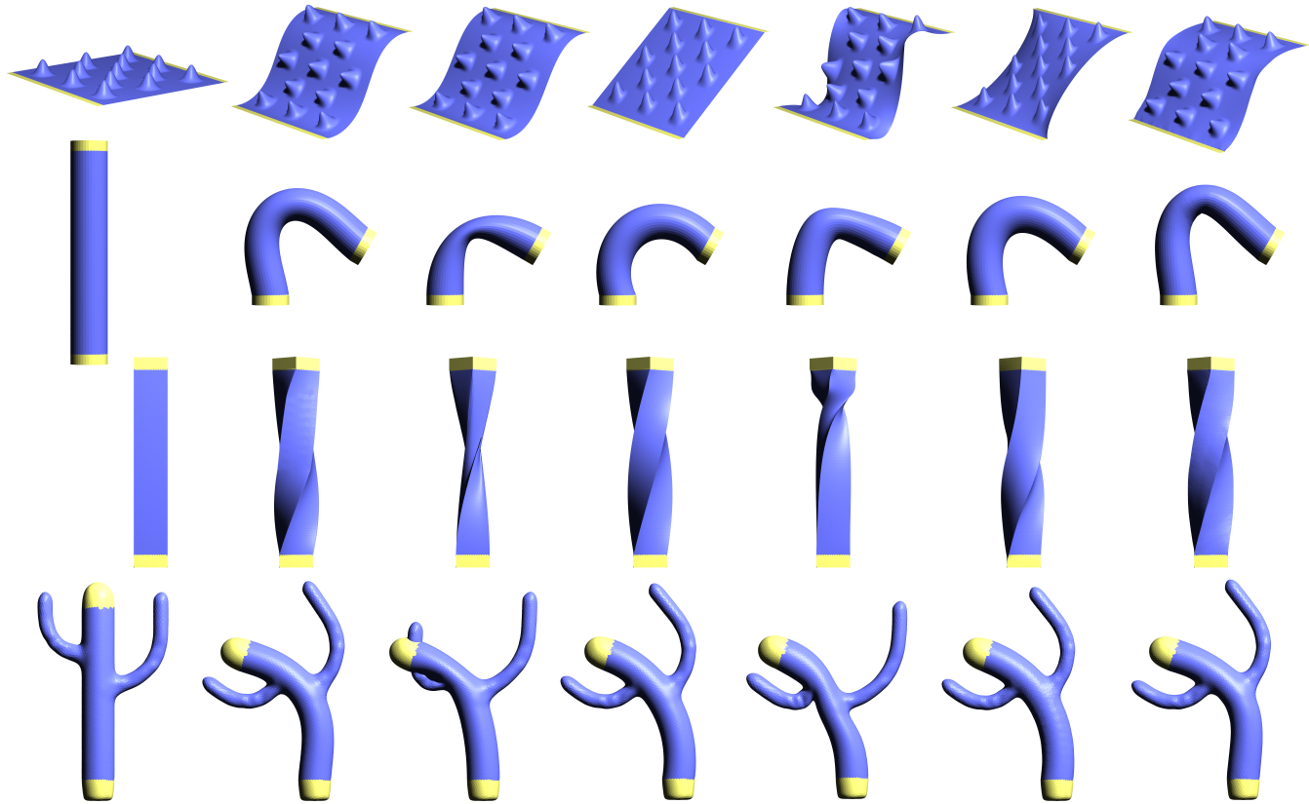
Comparison of Methods
Thin
Shells
Rotation
Invariant
Ours
Original
PriMo
Gradient
Laplacian

Slide 48
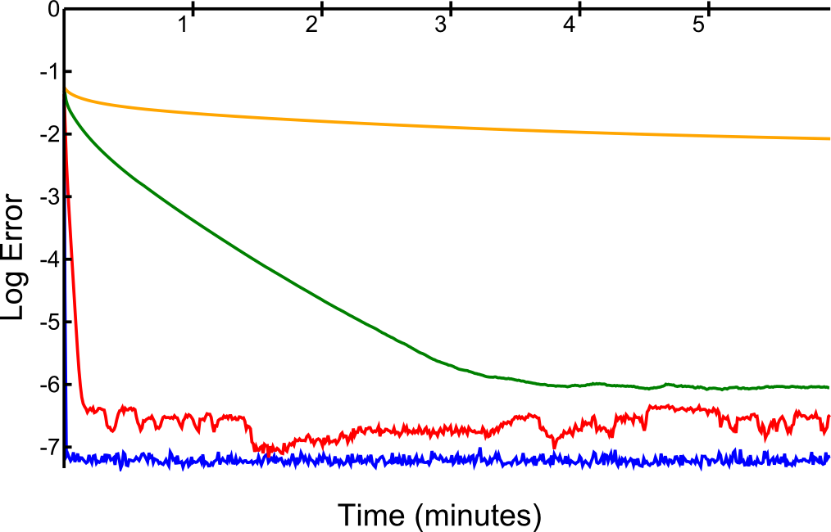
Convergence Time

Slide 49
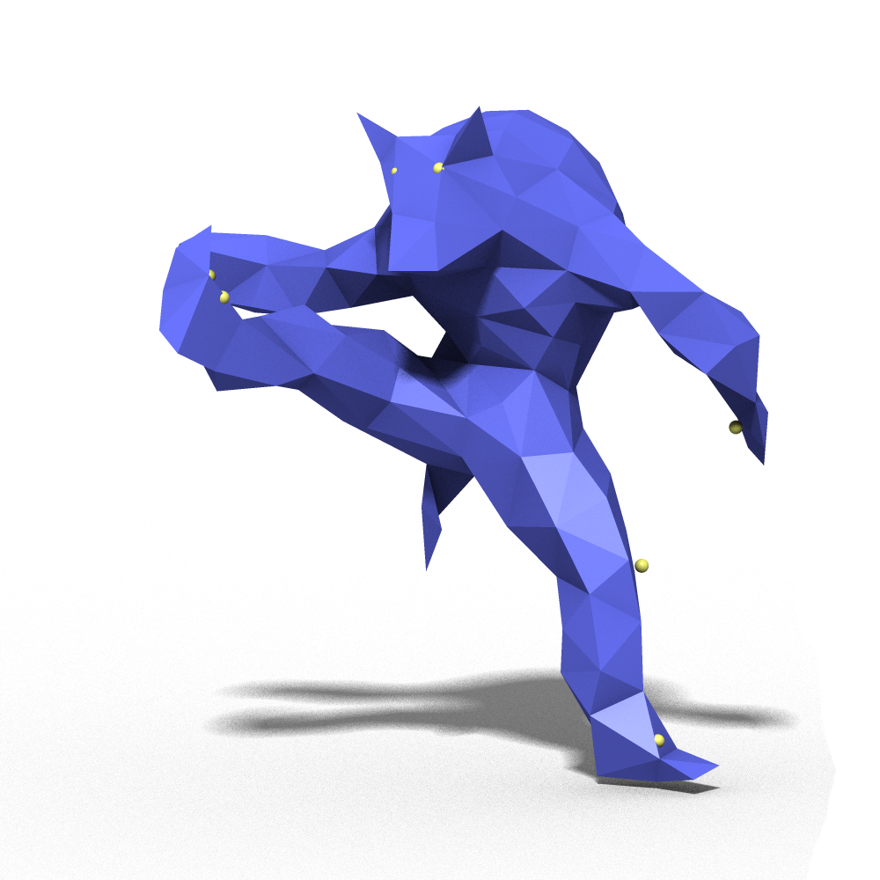
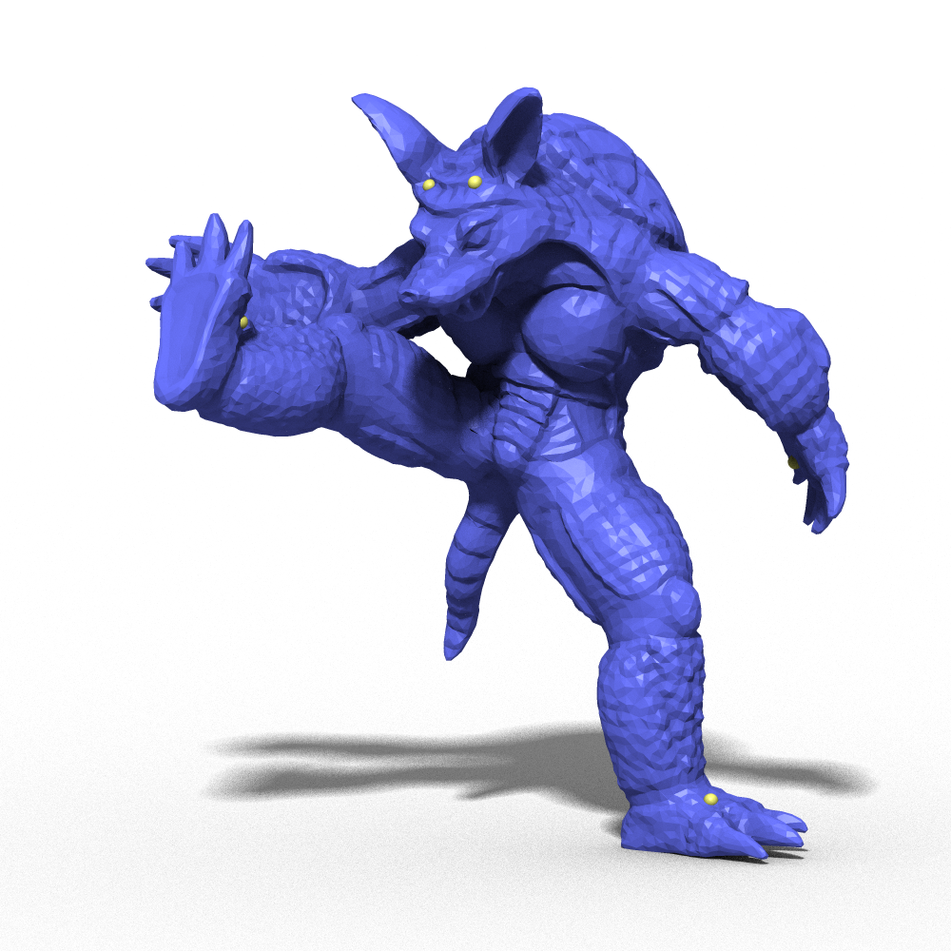
Benefits of Simplification

Slide 50
Benefits of Simplification

Slide 51
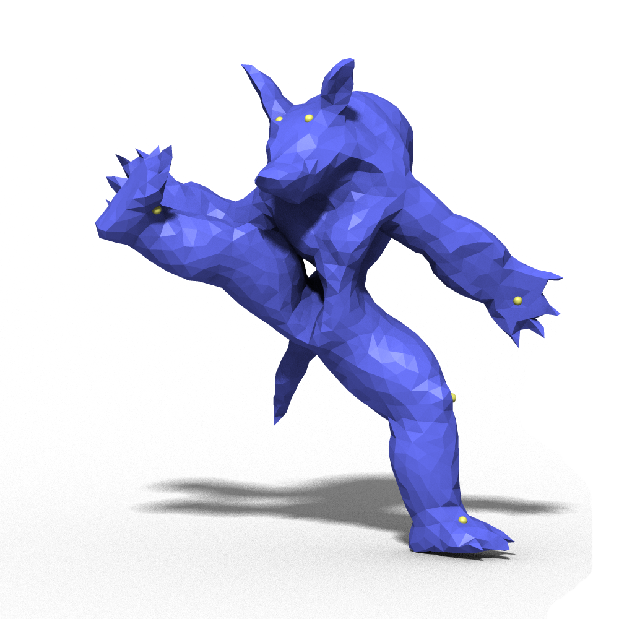
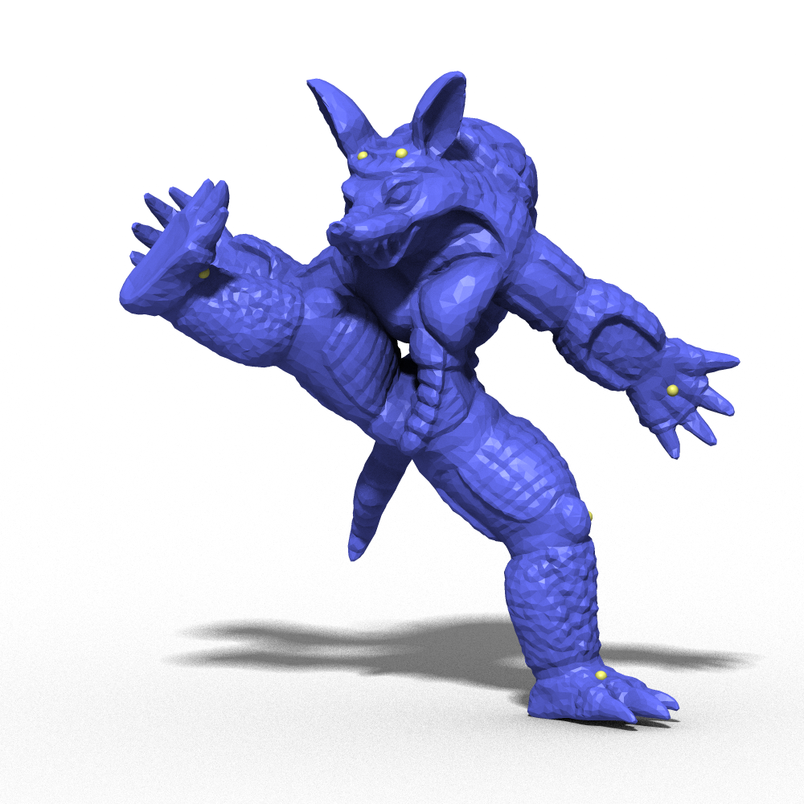
Benefits of Simplification

Slide 52
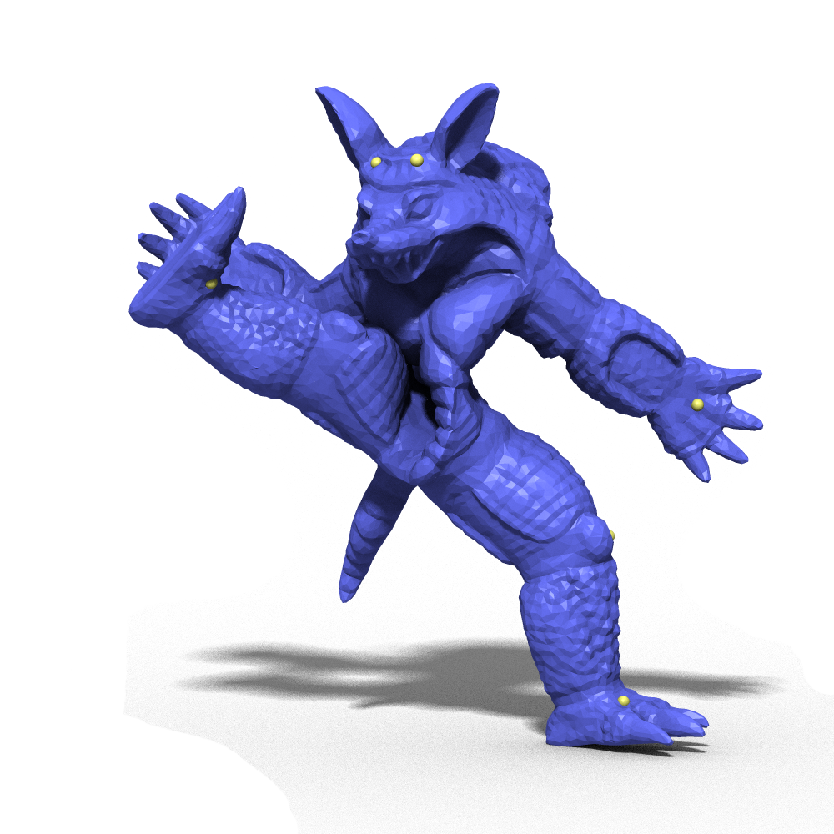
Benefits of Simplification

Slide 54
Conclusion
Calculate deformation at low resolution
Expand to high resolution
As-rigid-as-possible, satisfy constraints
Use a local, symmetric expansion operation
Combine with other methods
Different deformation of base mesh
As-similar-as-possible, stretch

