Slide 1
Positive Gordon–Wixom Coordinates
Josiah Manson¹, Kuiyu Li², Scott Schaefer¹
¹ Texas A&M University
² Intel

Slide 2
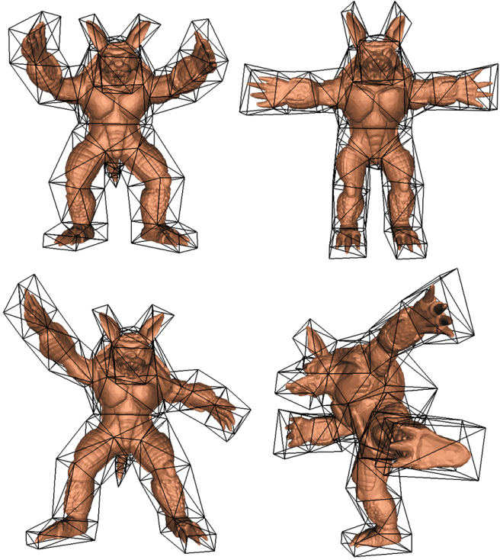
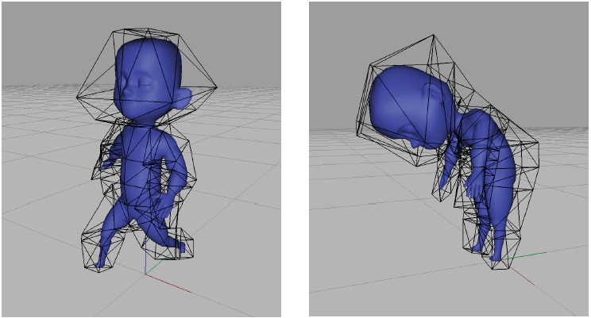
Barycentric Coordinates: Mesh deformation
[Ju et al. 2005]
[Joshi et al. 2007]

Slide 3
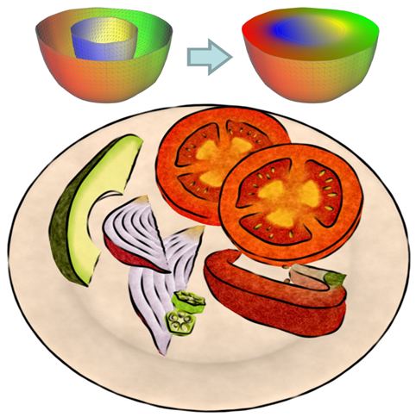
Barycentric Coordinates: Volumetric textures
[Takayama et al. 2010]

Slide 4
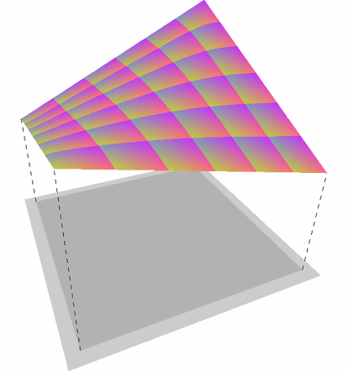
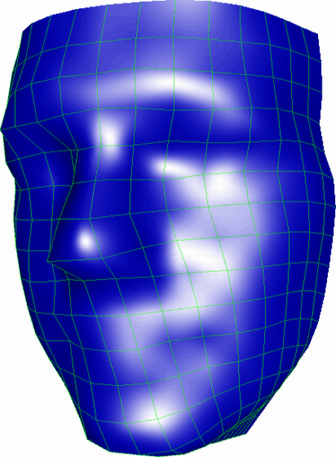
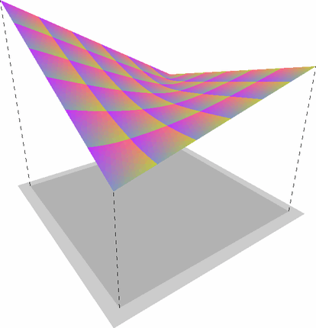
Barycentric Coordinates: Rasterize polygons
[Hormann and Tarini 2004]

Slide 5
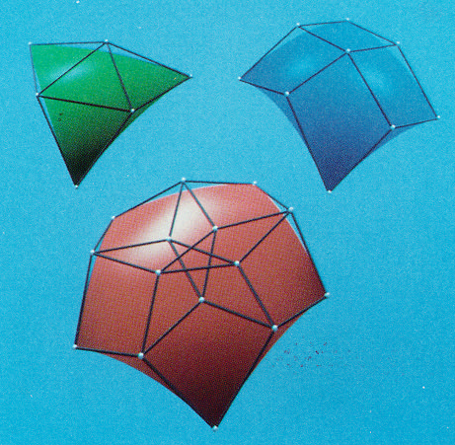
Barycentric Coordinates: Surface representation
[Loop et al. 1989]

Slide 6
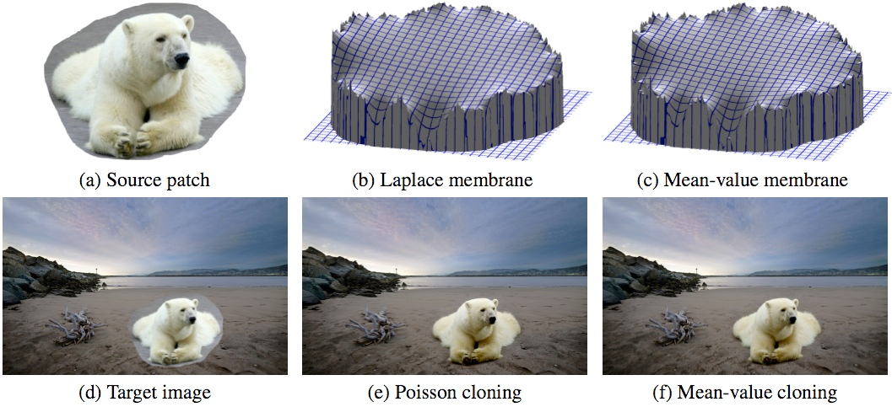
Barycentric Coordinates: Image editing
[Farbman et al. 2009]

Slide 7
Barycentric Interpolant

Slide 8
Barycentric Interpolant
boundary values

Slide 9
Barycentric Interpolant
basis functions
coordinates

Slide 10
Basis Function Constraints
Boundary
interpolation

Slide 11
Basis Function Constraints
Boundary
interpolation
Linear
precision

Slide 12
Basis Function Constraints
Boundary
interpolation
Linear
precision
Smoothness

Slide 13
Basis Function Constraints
Boundary
interpolation
Linear
precision
Smoothness
Positivity

Slide 14
Types of Coordinates
Wachspress [Wachspress 1975]
Only convex domains, obtuse angles bad
Gordon-Wixom [Gordon and Wixom 1974]
Only convex domains
Mean Value [Floater 2003]
Negative, but fast
Moving Least Squares [Manson and Schaefer 2010]
Negative, but less so, slower
Harmonic [Joshi et al. 2007]
Positive, ideal, very slow
Maximum Entropy [Hormann and Sukumar 2008]
Positive, non-linear optimization, probably smooth
Positive Gordon Wixom
Positive, evaluate integral, smooth for smooth boundaries

Slide 15
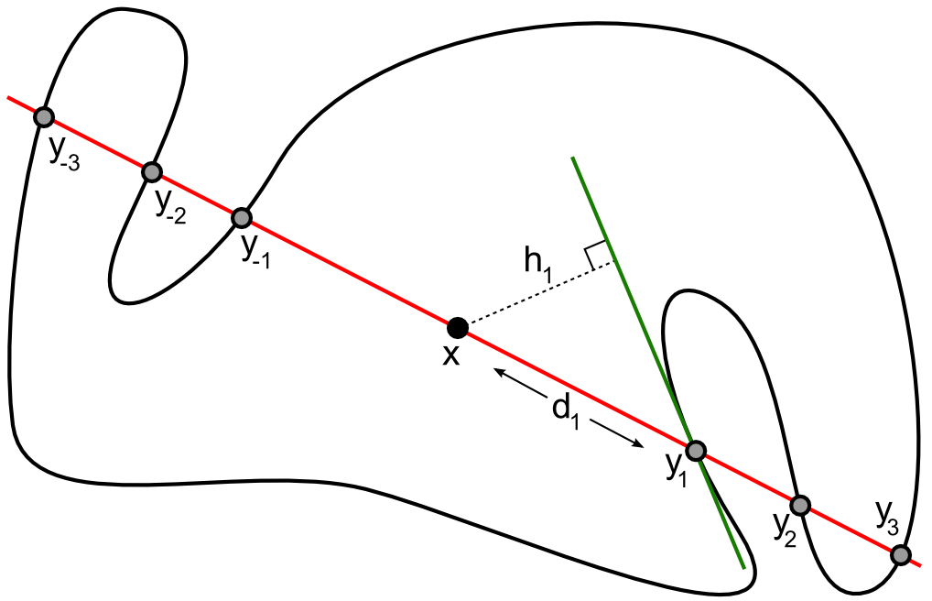
Notation

Slide 16
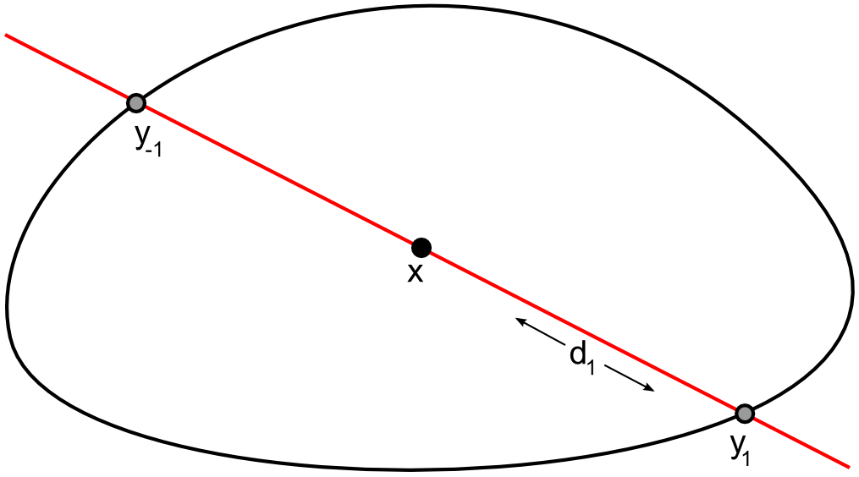
Linear Interpolant

Slide 17
Gordon-Wixom
[Gordon and Wixom 1974]

Slide 18
Weighted Gordon-Wixom
[Belyaev 2006]

Slide 19
Mean Value Coordinates (MVC)
[Floater 2003]

Slide 20
Mean Value Coordinates (MVC)
[Floater 2003]

Slide 21
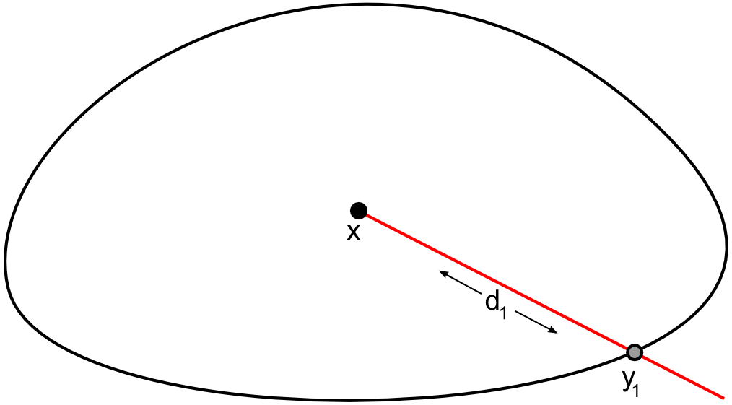
Mean Value Coordinates (MVC)
[Floater 2003]

Slide 22
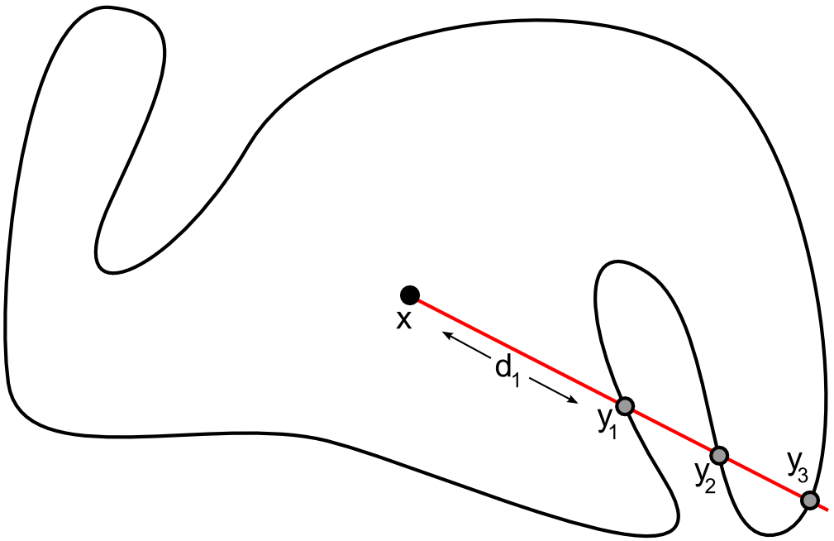
Concave MVC
[Hormann and Floater 2006]

Slide 23
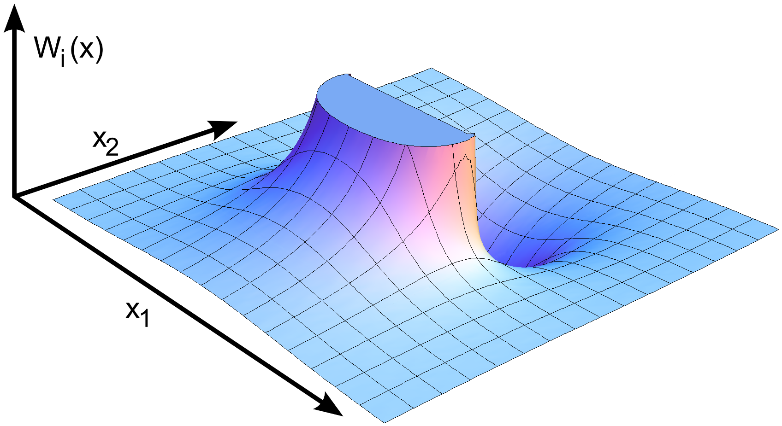
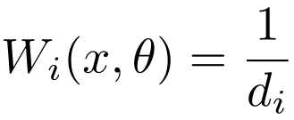
Concave MVC

Slide 24
Our Coordinates

Slide 25
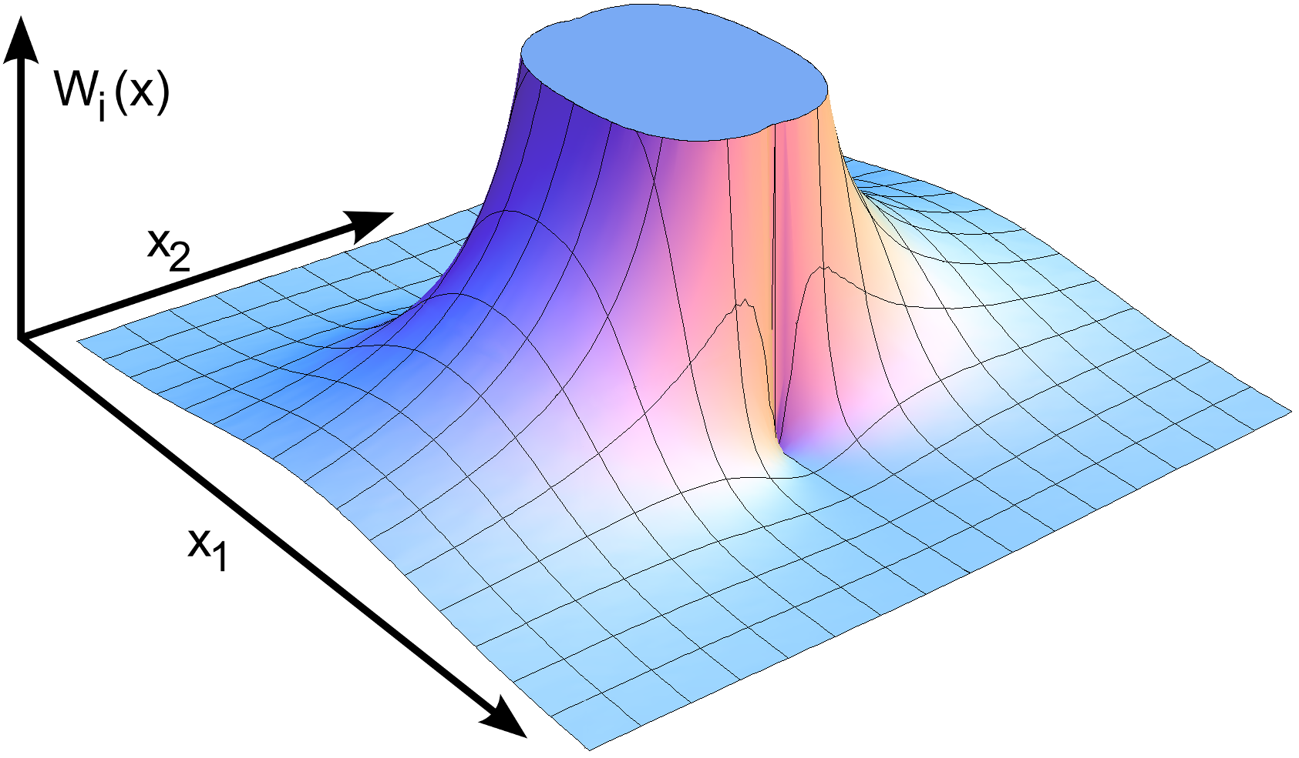
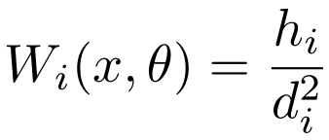
Our Weight Function

Slide 26
Our Weight Function

Slide 27
Our Weight Function

Slide 28
Basis Functions

Slide 29
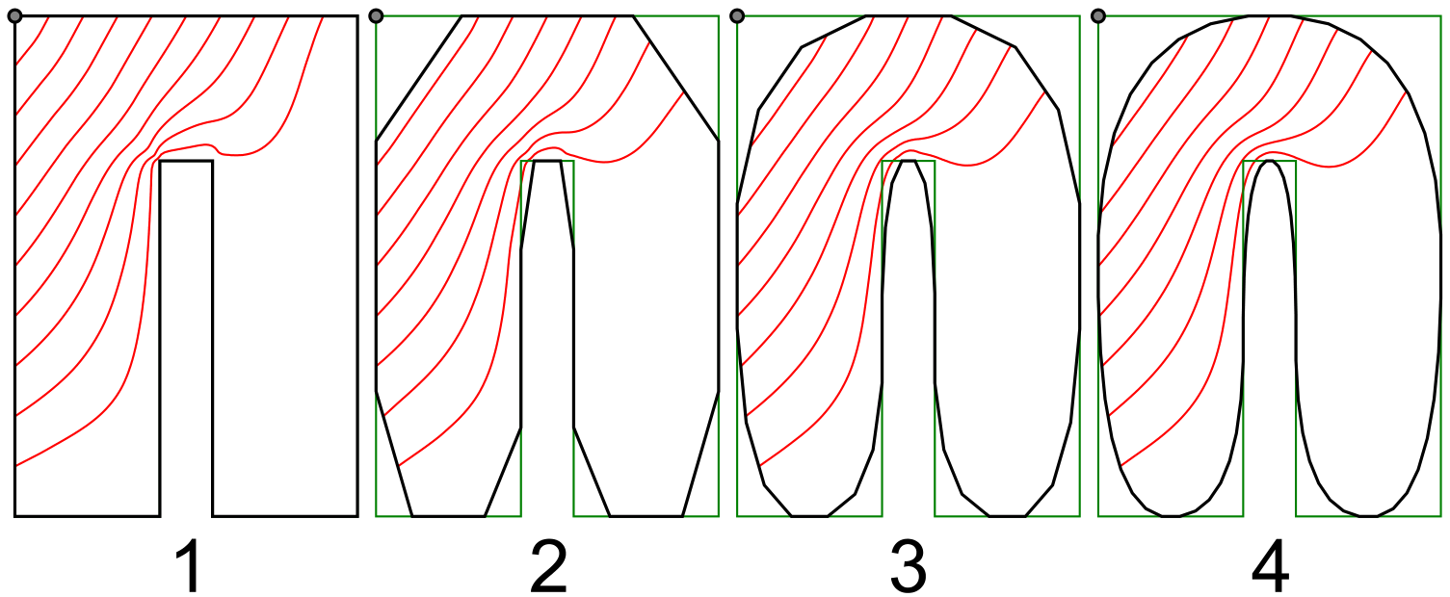
Approximating Smooth Boundaries

Slide 30
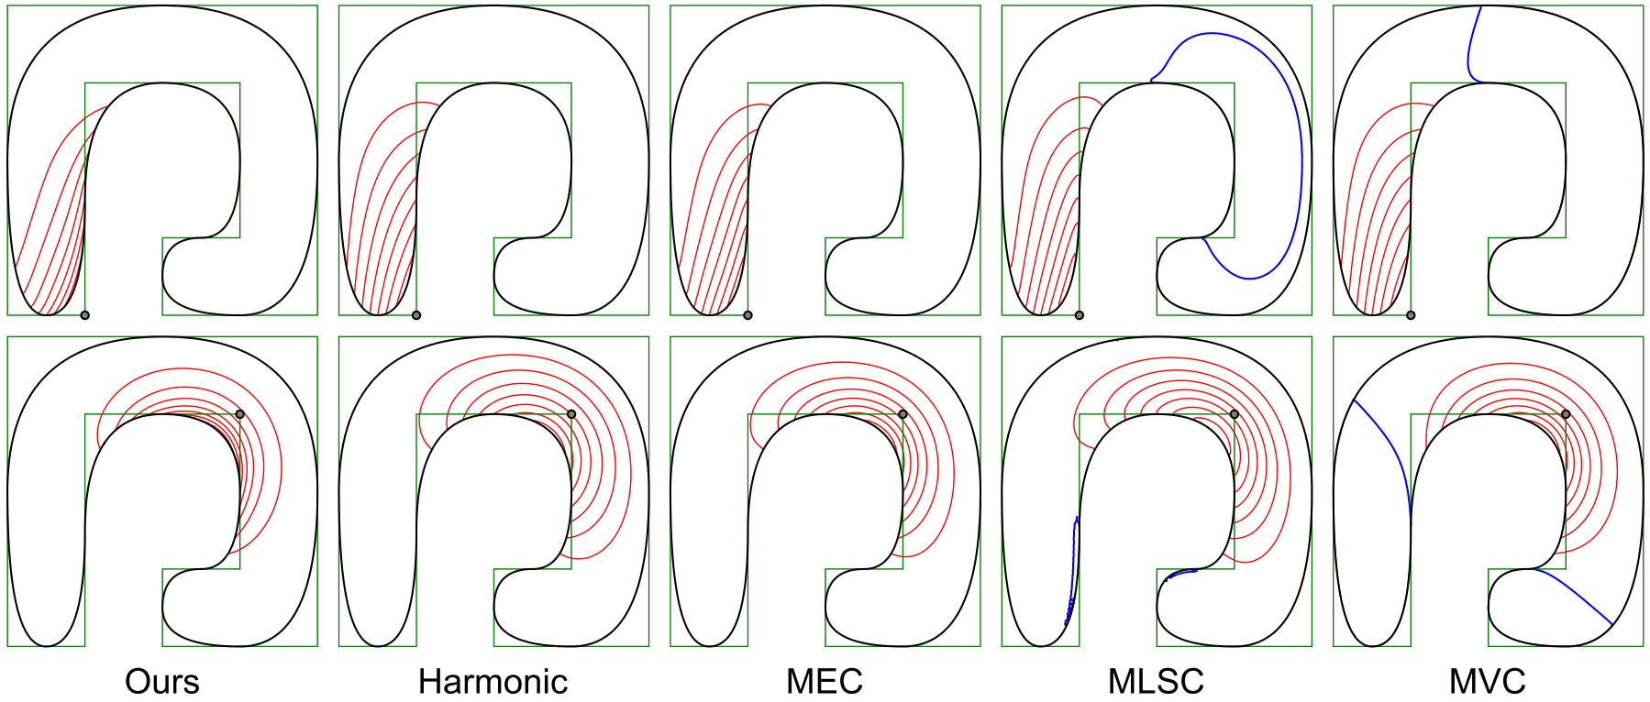
Comparison

Slide 31
Conclusion
Our coordinates are:
Positive
Smooth for smooth boundary
Evaluated through integral
Closed-form for polygons
Need visibility through sample point
Logarithmic lookup
Slows computation
Evidence that closed-form for polygons exists

Slide 33
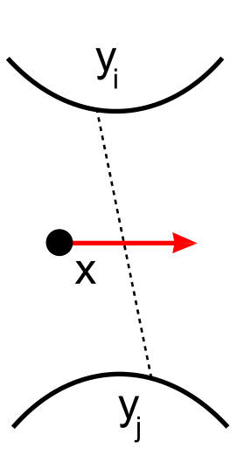
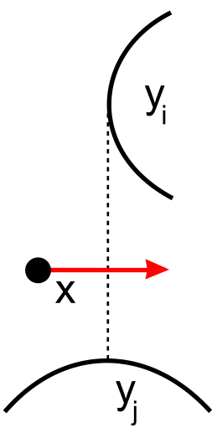
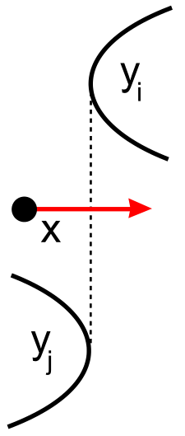
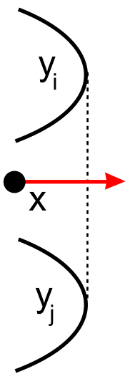
Smoothness of Basis

Slide 34
Smoothness of Basis

Slide 35
Smoothness of Basis

Slide 36
Smoothness of Basis

Slide 37
Smoothness of Basis

Slide 38
Comparison
11.6 s
102 s
5.7 s
3.0 s
0.42 s

