Slide 1
Fast Filtering of Reflection Probes
Josiah Manson and Peter-Pike Sloan
Presented by Josiah Manson

Slide 2
Goal: Glossy reflections
©Peter Sanitra, http://noemotionhdrs.net, Creative Commons License
Notes:
Given an environment, precalculate reflections.

Slide 3
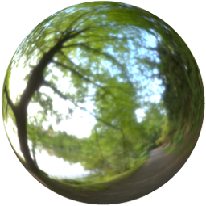
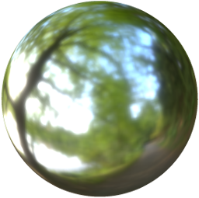
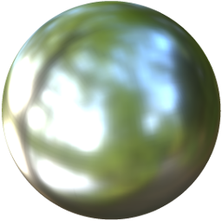
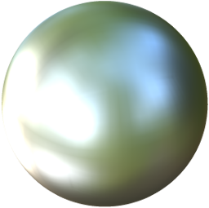
Goal: Glossy reflections
Reflection model [Walter et al., “Microfacet models for refraction through rough surfaces,” 2007]
©Peter Sanitra, http://noemotionhdrs.net, Creative Commons License
Notes:
Multiple material roughness values.
GGX filter.
Mipmap hierarchy.

Slide 4
Goal: Glossy reflections
Reflection model [Walter et al., “Microfacet models for refraction through rough surfaces,” 2007]
Real-time approx. [Karis, “Real shading in unreal engine 4,” 2013 SIGGRAPH Course Notes]
©Peter Sanitra, http://noemotionhdrs.net, Creative Commons License
Notes:
Multiple material roughness values.
GGX filter.
Mipmap hierarchy.

Slide 5
Previous work
[Kautz et al. “A unified approach to prefiltered environment maps,” 2000]
[Ramamoorthi & Hanrahan, “An efficient representation for irradiance environment maps,” 2001]
[Ramamoorthi & Hanrahan, “Frequency space environment map rendering,” 2001]
[Latta & Kolb, “Homomorphic factorization of BRDF-based lighting computation,” 2002]
[Isodoro & Mitchell, “Angular extent filtering with edge fixup for seamless cubemap filtering,” 2005]
[Krivanek & Colbert, “Real-time shading with filtered importance sampling,” 2008]
Notes:
Lots of existing methods.
We compare against the last method: Importance Sampling.

Slide 6
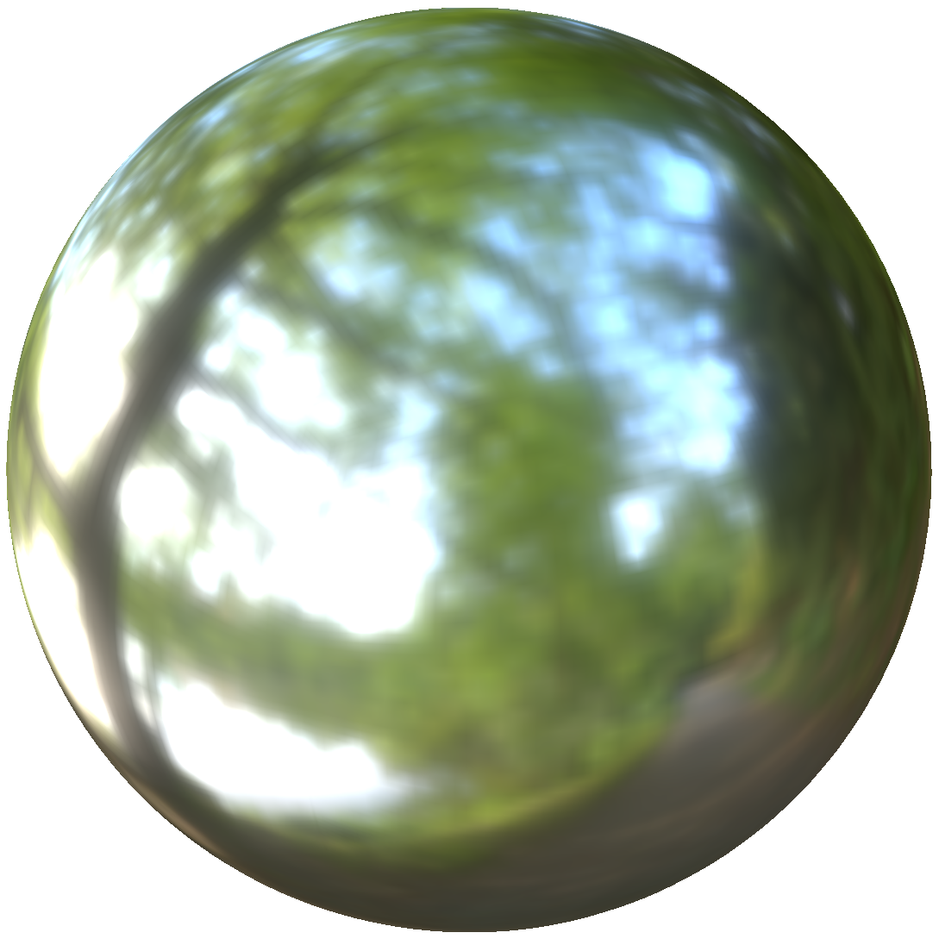
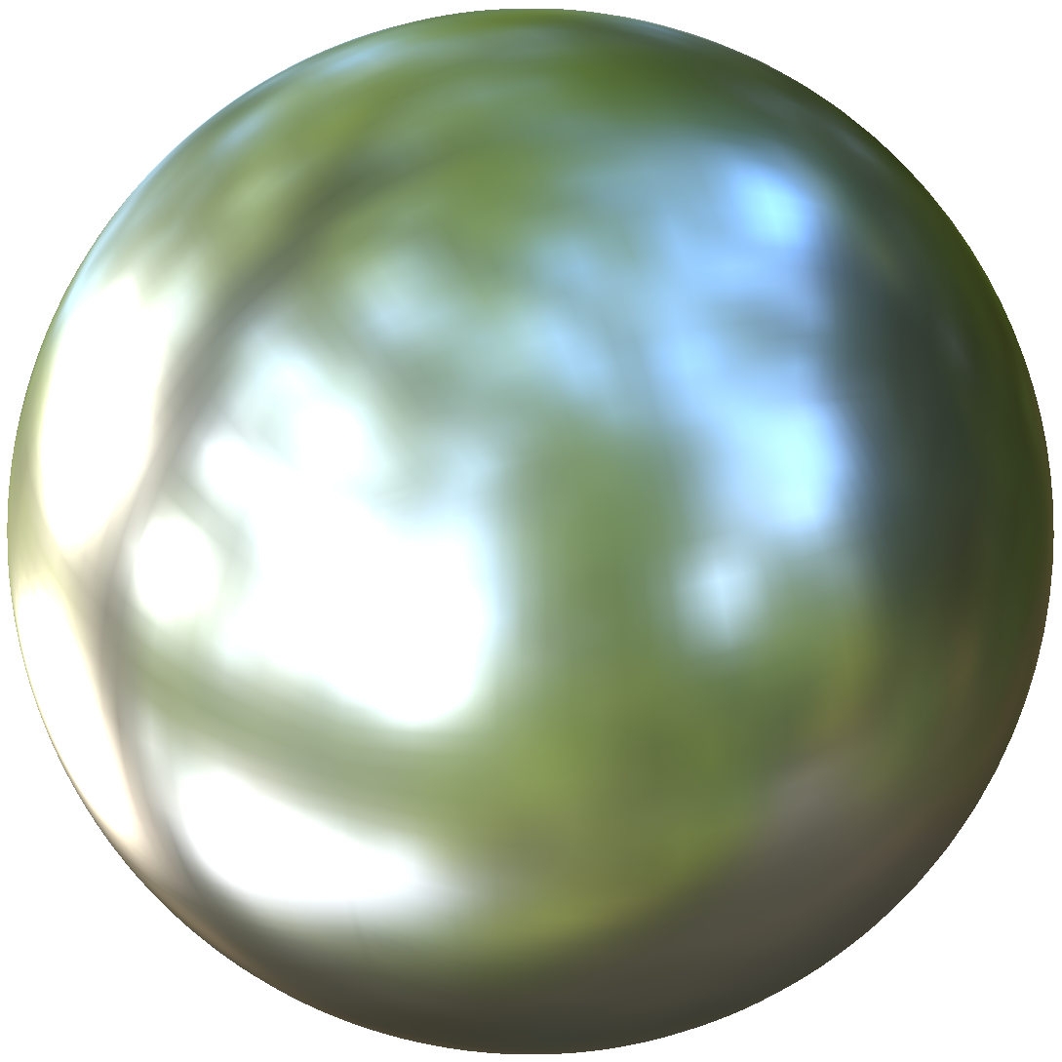
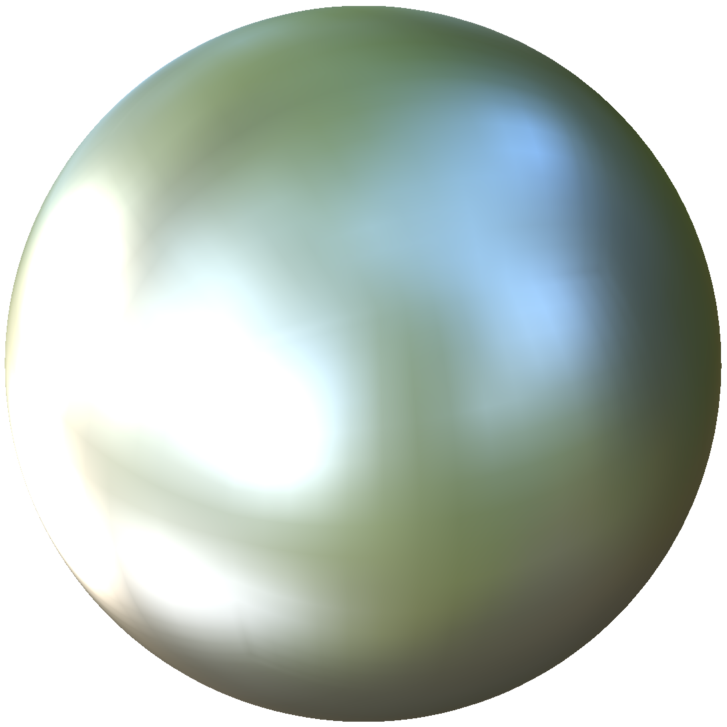
Teaser: Equal times (~200 μs on GTX 980)
Importance Sampling (32)
©Peter Sanitra, http://noemotionhdrs.net, Creative Commons License
Notes:
3 roughnesses.
First I show importance sampling, then reference, then our new method.
Equal time comparison between importance sampling and our method.
Can flip between reference.

Slide 7
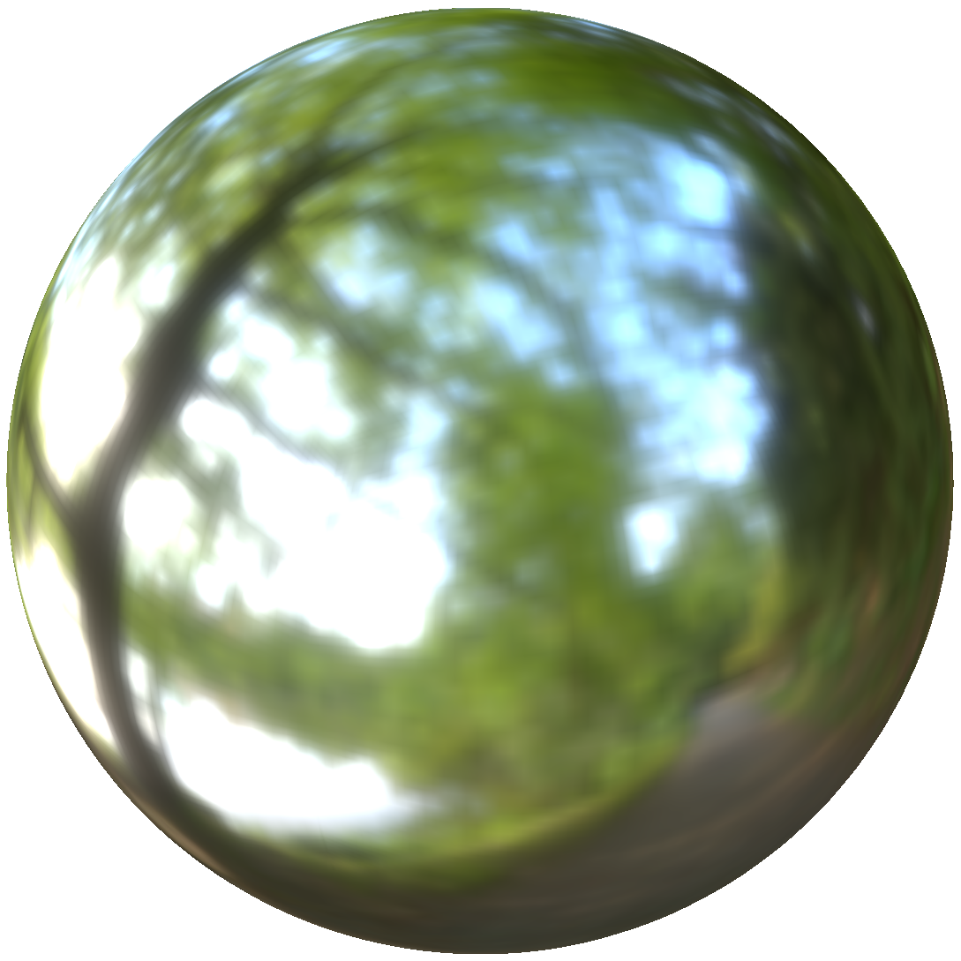
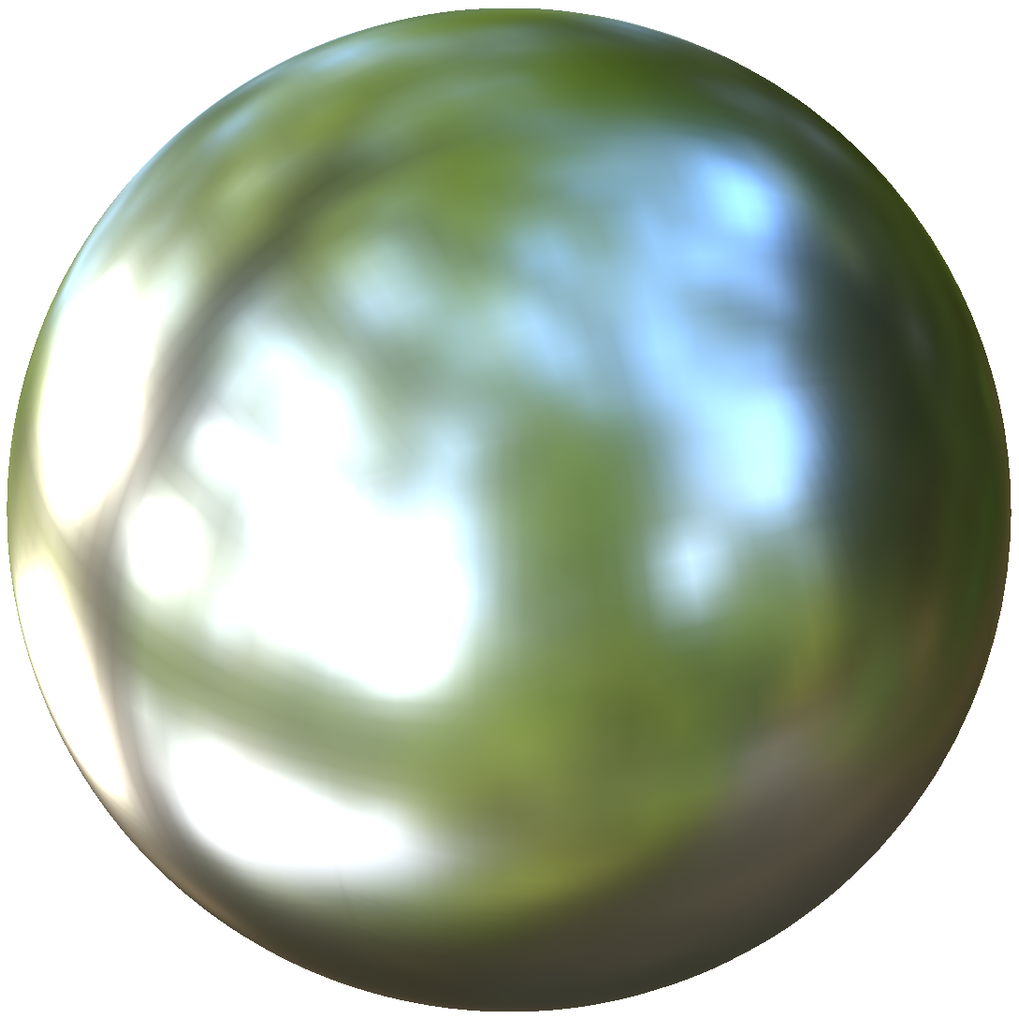
Teaser: Equal times (~200 μs on GTX 980)
Reference
©Peter Sanitra, http://noemotionhdrs.net, Creative Commons License
Notes:
The importance sampled image is much hazier than reference.

Slide 8
Teaser: Equal times (~200 μs on GTX 980)
Our method (quad 8x3)
©Peter Sanitra, http://noemotionhdrs.net, Creative Commons License
Notes:
Our method matches reference quite closely.

Slide 9
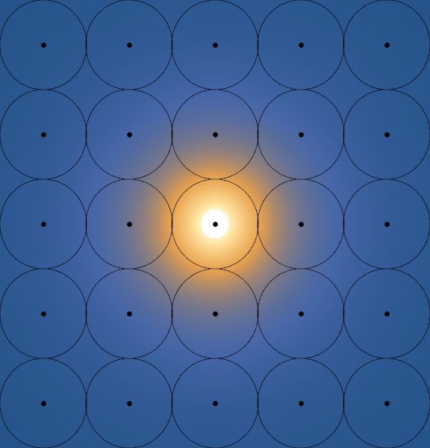
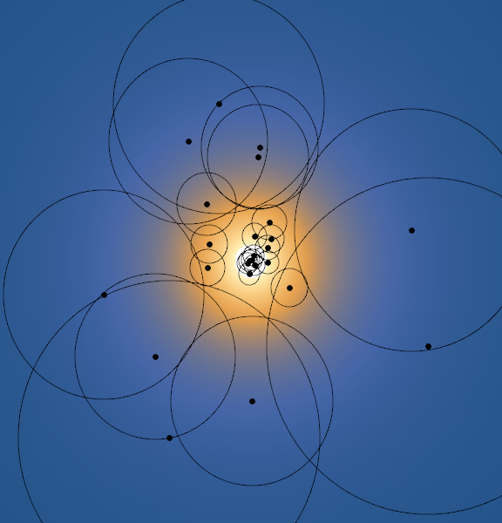
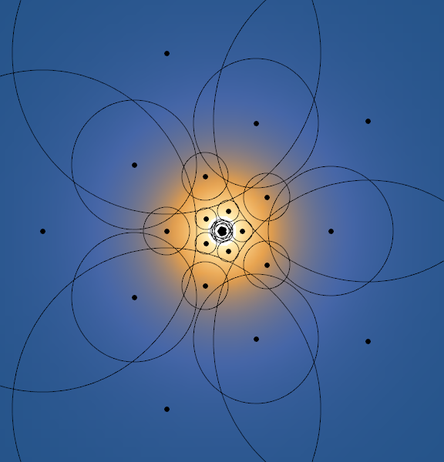
Numerical approximation of integral
Raster
Importance Sample
Optimized
Notes:
Our contribution is to show that you can do a better job by optimizing for the best sample positions, sizes, and weights.

Slide 10
Optimization

Slide 11
Optimization
Notes:
Texels in the mipmap.
Integral of light-field L times texel basis functions b_i.

Slide 12
Optimization
are a function of the tabulated sampling parameters.
Notes:
Coefficients of texels are determined indirectly as a function of the sampling parameters and trilinear interpolation.

Slide 13
Optimization
We optimize sampling parameters to minimize the error.
Notes:
We factor out the light field, because we need a solution that is independent of the input data.
Light-field is just a weighting function, so our simplification is that all input texels have equal importance. Same as CCTF.

Slide 14
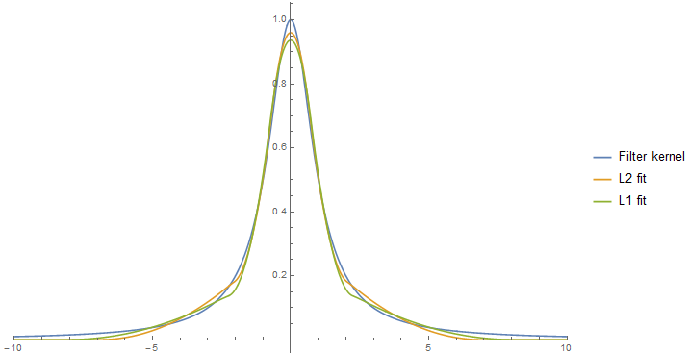
Tail is important: L₁ vs L₂
Notes:
Show fitting of 2 basis functions with scale and weight as free parameters.
L_2 matches peak more accurately.
L_1 matches tail.
We found that fitting the tail is hardest and most important.
L_1 also makes most sense perceptually. It doesn’t matter how the error is distributed. Just what the total amount is to the texel color.

Slide 15
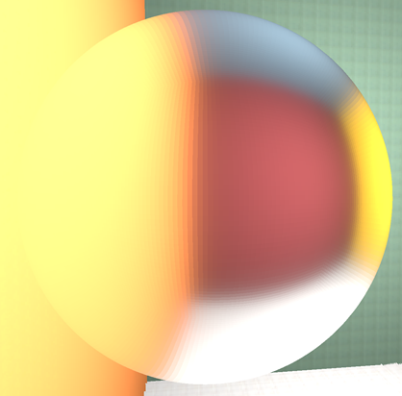
Lessons learned: Independent texels are bad
Reference
Independently solved texels
Notes:
Some examples of things that seem like they should work, but didn’t.
This room with big flat patches of color is almost a worst case scenario, because it reveals problems in approximating the tail of a filter.

Slide 16
Lessons learned: Independent texels are bad
Reference
Independently solved texels
Notes:
Some examples of things that seem like they should work, but didn’t.
This room with big flat patches of color is almost a worst case scenario, because it reveals problems in approximating the tail of a filter.

Slide 17
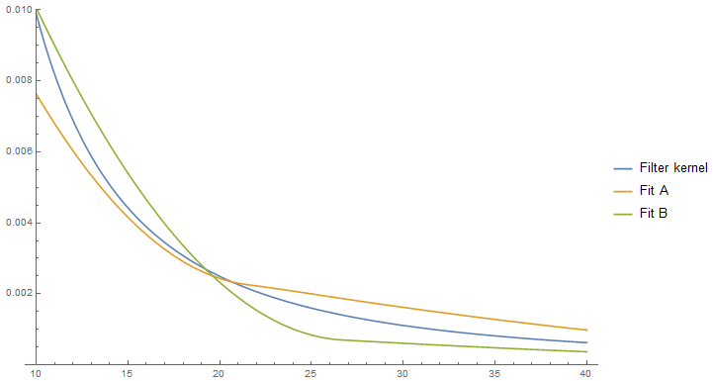
Lessons learned: Independent texels are bad
Notes:
Example of two fits that have very different characteristics, but approximately equal error.

Slide 18
Two-pass algorithm
Downsample intermediate mipmap
Evaluate GGX by sampling mipmap
Precalculated table of samples
Notes:
Structure of talk follows structure of algorithm.
At the end I show some results and lessons learned.

Slide 19
Pass 1: Create mipmap

Slide 20
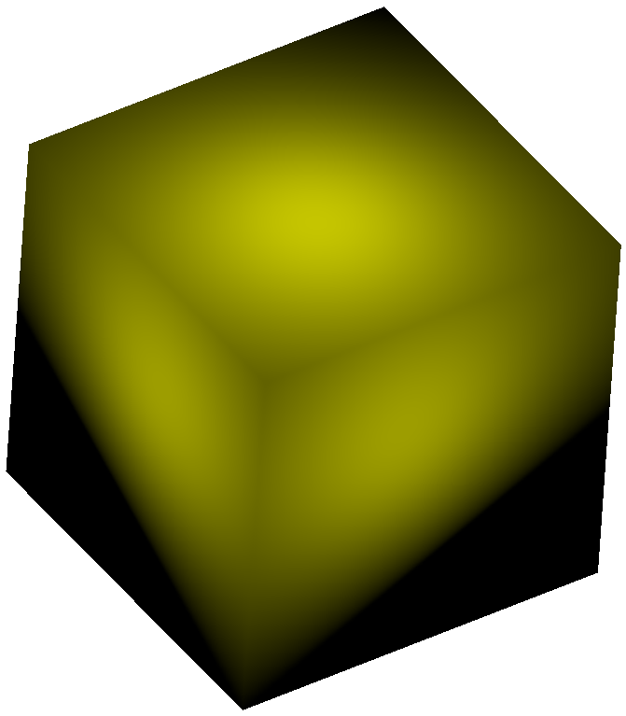
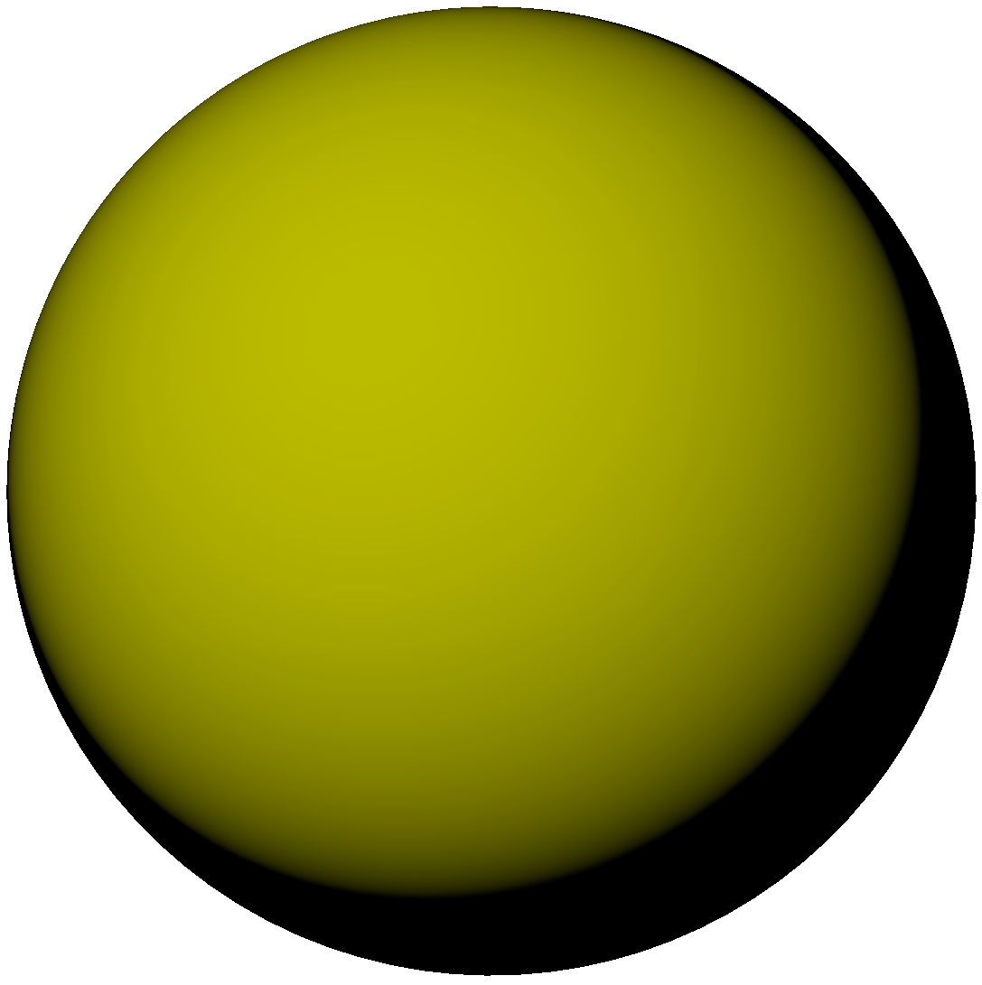
Reconstructions of cosine lobe on cube
Reference
Reference on sphere
Notes:
Reproduction of a reference cosine lobe.
Box basis sucks.

Slide 21
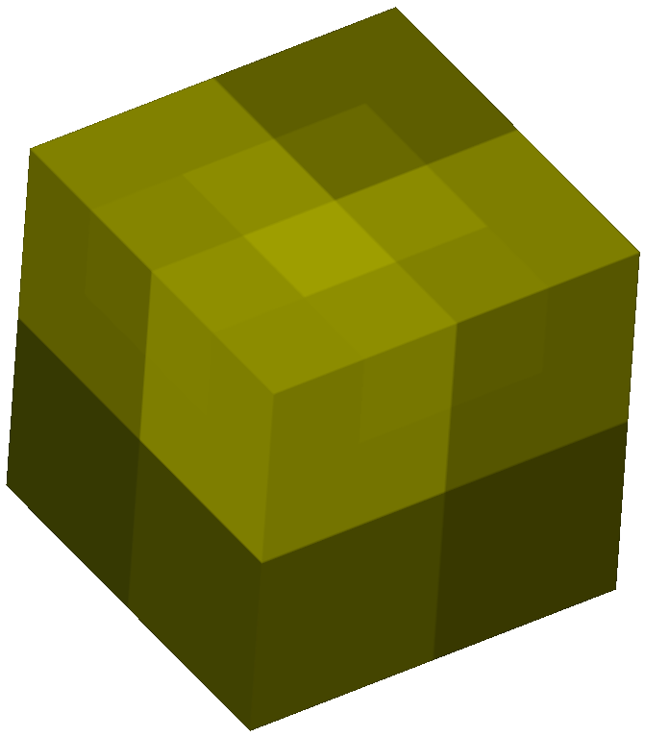
Reconstructions of cosine lobe on cube
Reference
Box
Notes:
Reproduction of a reference cosine lobe.
Box basis sucks.

Slide 22
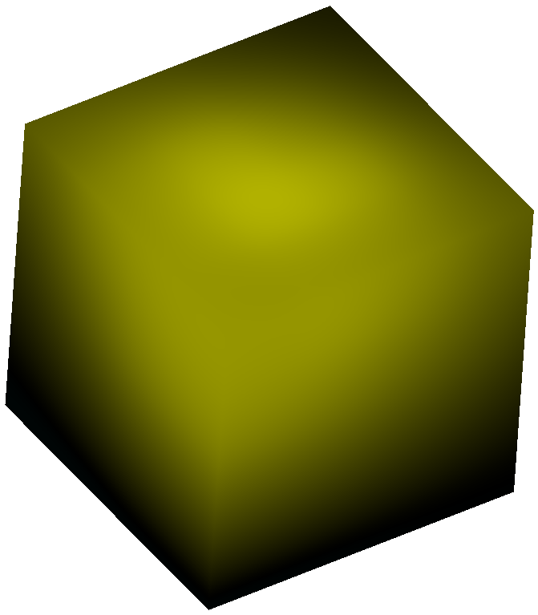
Reconstructions of cosine lobe on cube
Reference
Quadratic b-spline
Notes:
Quadratic is smooth and much better than box.
Doesn’t capture dark edges well.

Slide 23
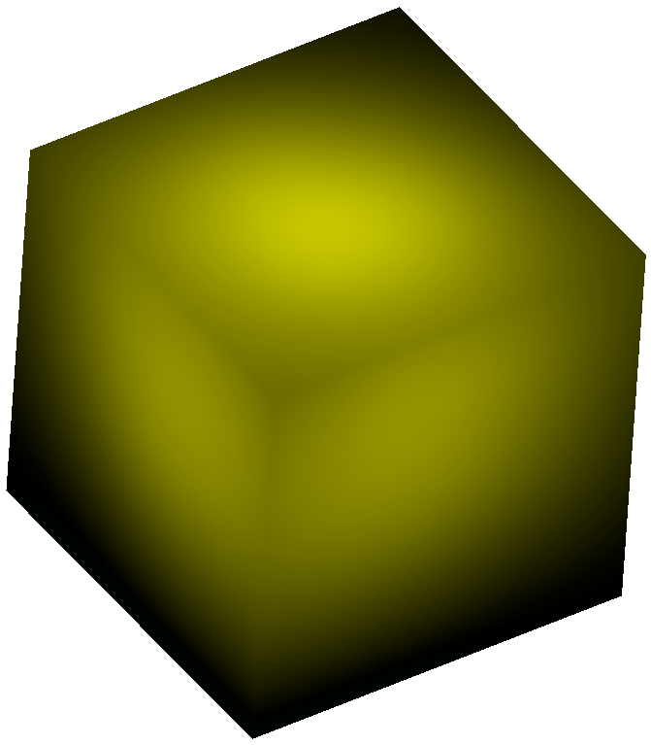
Reconstructions of cosine lobe on cube
Reference
Weighted b-spline
Notes:
Weighted b-spline looks really good.
Too expensive.

Slide 24
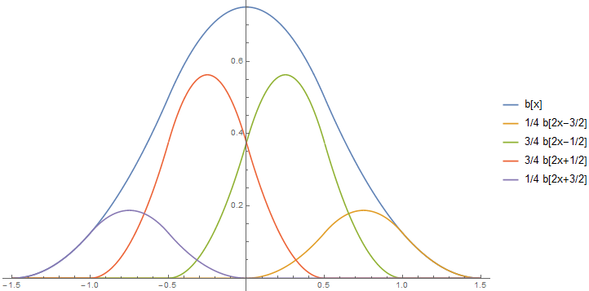
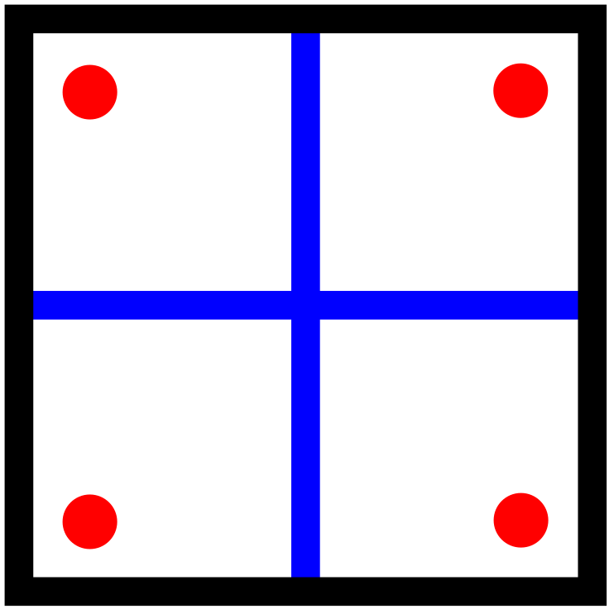
Mipmap recurrence: Quadratic b-spline
Notes:
The next higher order b-spline that works on a power-of-2 grid is the quadratic b-spline.
Also has a recurrence relation, which is shown.

Slide 25
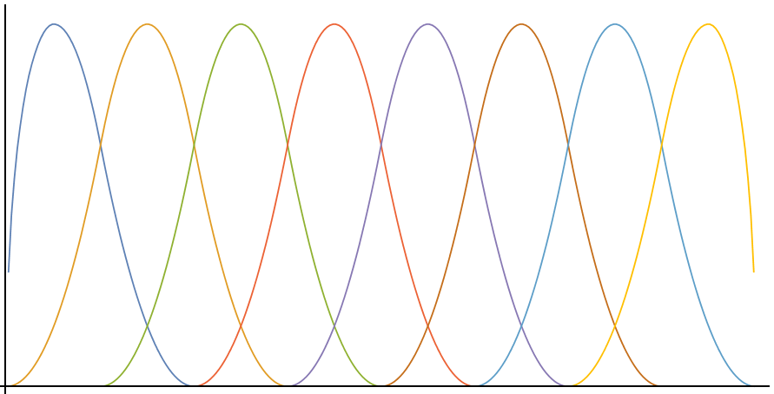
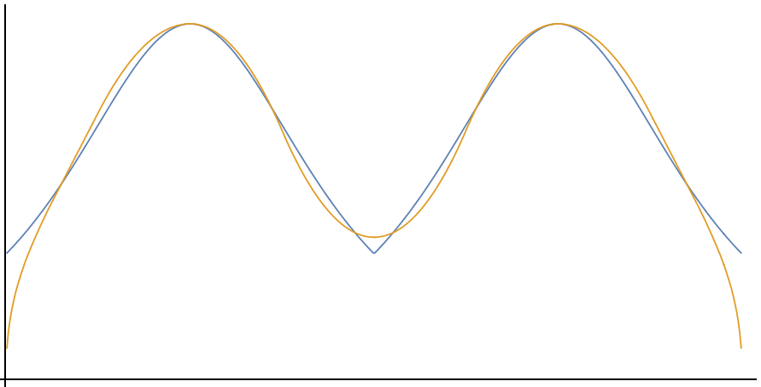
Quadratic b-spline
Notes:
Here I show a quadratic b-spline basis.
Ignore the edges.

Slide 26
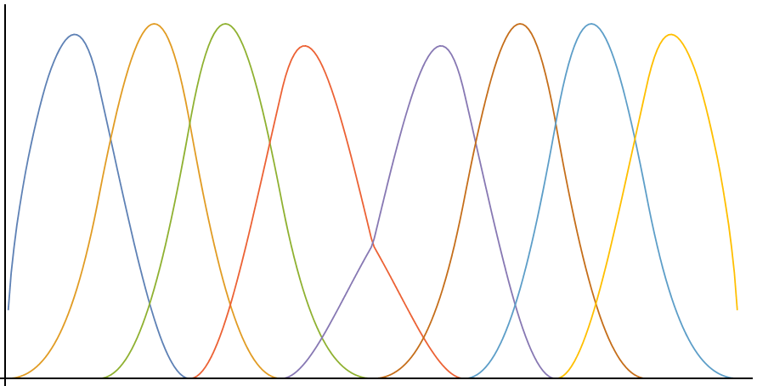
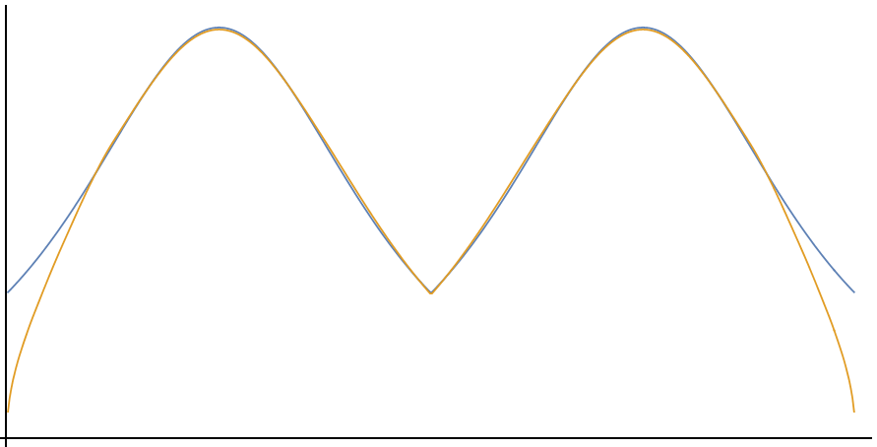
Weighted quadratic b-spline
Notes:
We can modify the recurrence relation.
Weight points in the recurrence by the Jacobian.
Creates a kink in the basis functions that correspond to the kink in the Jacobian.

Slide 27
Pass 2: Sample from mipmap

Slide 28
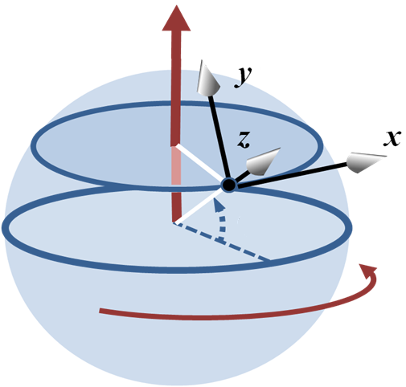
Generating output texels
Table = (N taps)×(3 frames)×(5 parameters)×(3 polynomial coefficients)
5 parameters per tap
float3: <x,y,z> coordinate
Polar tangent frame
float: mip-level
Implicit bias from Jacobian
float: weight
Polynomial expression for each parameter
P(θ,Ф) = a + bθ² + cФ²
John R. Brews, http://en.citizendium.org/wiki/File:Earth_coordinates.png, Creative Commons License
Notes:
Offset defined in a polar frame shown on the right.
Bias from jacobian is factored out and added later. Fitting to a large difference from Jacobian would reduce accuracy of other differences. Want as close to constant as possible.
Weights are normalized in the shader, so don’t need to sum to 1 in the table. Normalization is difficult to do without introducing asymmetry.

Slide 29
Parameterization of polynomials on a cube
Notes:
We define the polynomials on the cube faces.
Each face is parameterized from -1 to 1 in Theta.
Sum of odd monomials == 0 for continuity.
Phi is -1 to 1 on the sides, and goes to 0 at the poles. Causes a reflection and is continuous (but not smooth) at top and bottom.
Hack to avoid needing an extra degree of freedom. Not very important because top and bottom have very little weight, as you will see.

Slide 30
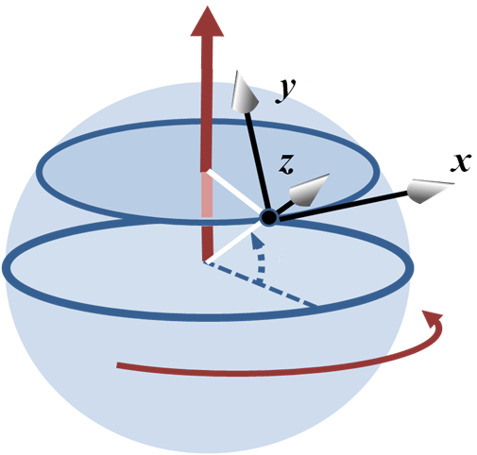
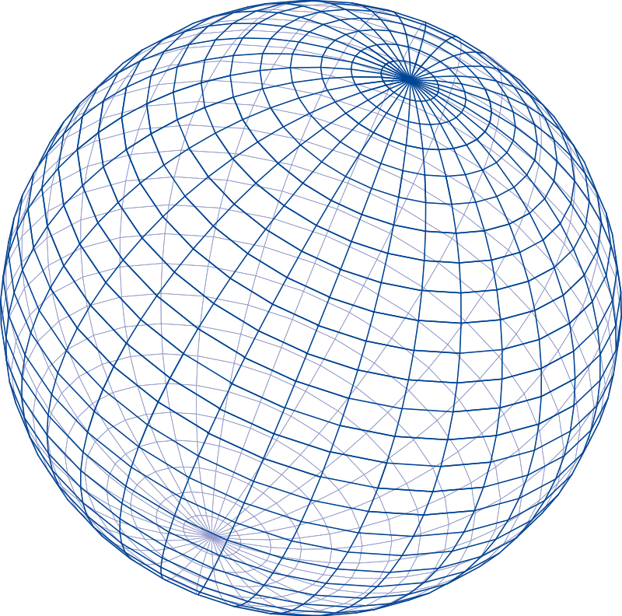
Singularities at poles
John R. Brews, http://en.citizendium.org/wiki/File:Earth_coordinates.png, Creative Commons License
http://clipartfreefor.com/files/1/29695_sphere-clipart.html
Notes:
Most important thing is for solutions to change smoothly.
Approaching poles, the tangent frame changes very quickly, and has a singularity at the poles themselves.
Want to remove the singularities.

Slide 31
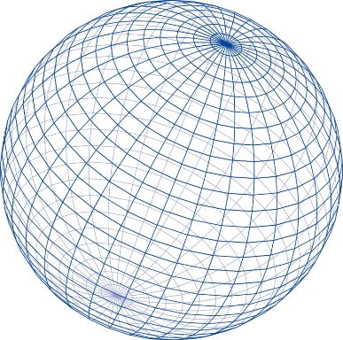
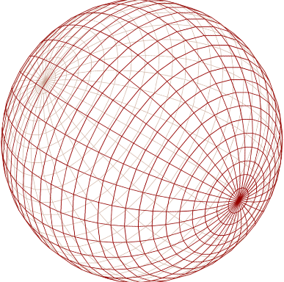
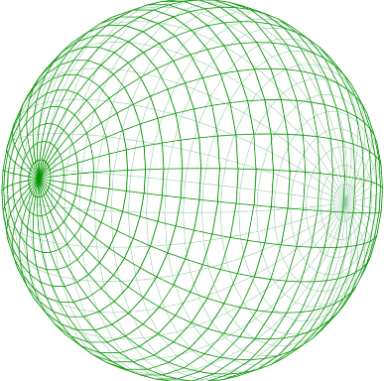
Singularity at poles: Blend 3 frames
Notes:
Solution: use multiple overlapping tangent frames.
2 would be enough to get rid of singularities, but would not be symmetric.
3 is symmetric, one for each cardinal axis.
Small transition region for continuity.

Slide 32
Results

Slide 33
Impulse response
Importance Sampling (32)
Center
Edge
Corner

Slide 34
Impulse response
Reference
Center
Edge
Corner

Slide 35
Impulse response
Our method (quad 8x3)
Center
Edge
Corner

Slide 36
GGX L₁ error & time vs. importance sampling
Notes:
Notation is that Nx3 means N samples in each of the 3 frames.
Some of those samples have no contribution, so on average about 2.5 times N samples are used.

Slide 37
GGX L₁ error & time vs. importance sampling
Equal times
Notes:
All of our example images comparing IS to our method use quad 8x3 and IS 32.
These methods take equal time and high enough error that the differences are easily visible.

Slide 38
GGX L₁ error & time vs. importance sampling
Equal errors

Slide 39
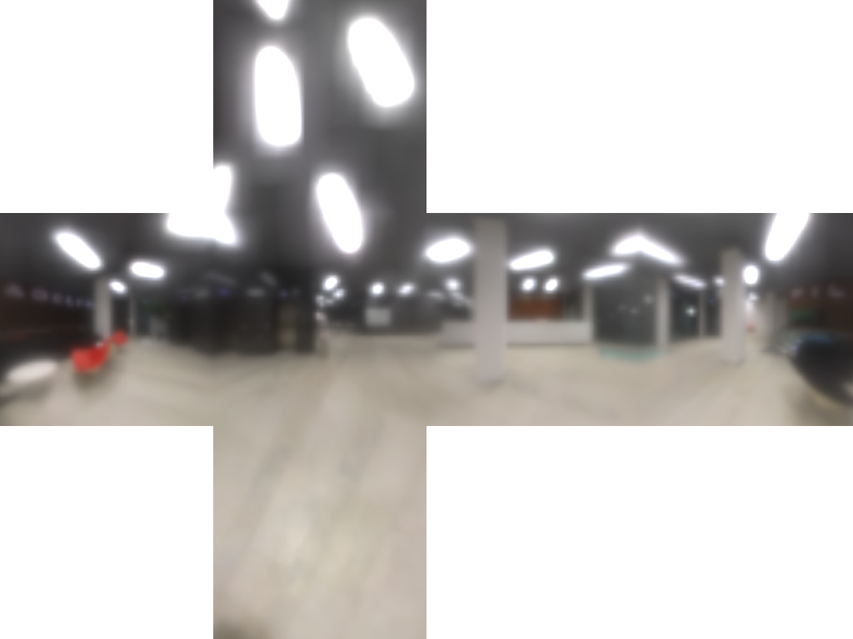
Importance sampling (32)
©Peter Sanitra, http://noemotionhdrs.net, Creative Commons License

Slide 40
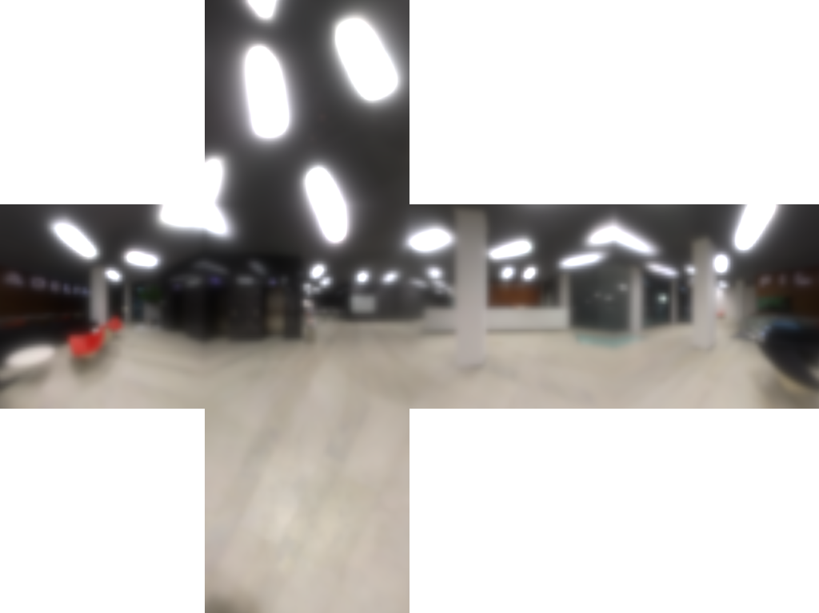
Reference
©Peter Sanitra, http://noemotionhdrs.net, Creative Commons License

Slide 41
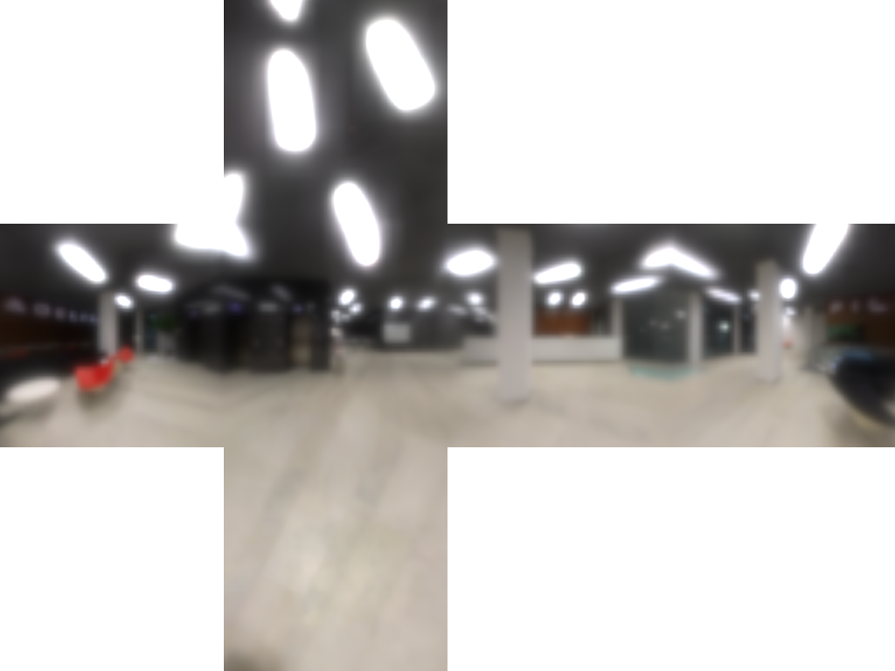
Our method (quad 8x3)
©Peter Sanitra, http://noemotionhdrs.net, Creative Commons License

Slide 42
Importance sampling (32)
©Peter Sanitra, http://noemotionhdrs.net, Creative Commons License

Slide 43
Reference
©Peter Sanitra, http://noemotionhdrs.net, Creative Commons License

Slide 44
Our method (quad 8x3)
©Peter Sanitra, http://noemotionhdrs.net, Creative Commons License

Slide 45
Questions?
Acknowledgements
Thanks to Dimitar Lazarov, Padraic Hennessy, Paul Malin, Bruce Wilkie, and Michał Iwanicki for discussions and help. Thanks to Peter Sanitra for HDR images from http://noemotionhdrs.net and permission to modify them.

Slide 46
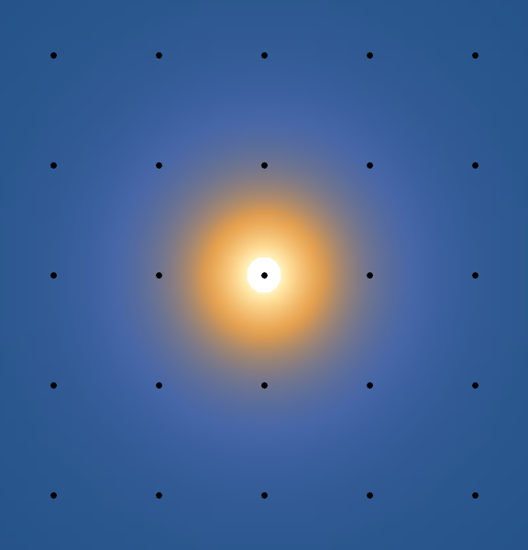
Numerical approximation of integral
Raster
Notes:
Simplest numeric integration is a regular grid.
Too many samples in areas of function with low contribution.

Slide 47
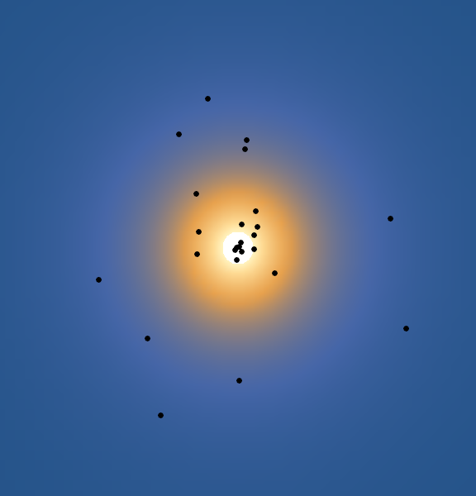
Numerical approximation of integral
Raster
Importance Sample
Notes:
Importance sampling has sampling probability proportional to value of the function.
Quasi-Monte-Carlo distribution.
At low sample counts the center is shifted.

Slide 48
Numerical approximation of integral
[Krivanek & Colbert, “Real-time shading with filtered importance sampling,” 2008]
Raster
Importance Sample
Notes:
Instead of point samples, want samples to cover an area.
Krivanek and Colbert suggest trilinear sampling a mip-mapped texture to control sample size.

Slide 49
Optimization
Reflection model [Walter et al., “Microfacet models for refraction through rough surfaces,” 2007]
Notes:
The equation for reflected light in the GGX reflection model.

Slide 50
Optimization
Reflection model [Walter et al., “Microfacet models for refraction through rough surfaces,” 2007]
Real-time approx. [Karis, “Real shading in unreal engine 4,” 2013 SIGGRAPH Course Notes]
Notes:
Games cheat hardcore with a “split-sum approximation”

Slide 51
Optimization
Reflection model [Walter et al., “Microfacet models for refraction through rough surfaces,” 2007]
Real-time approx. [Karis, “Real shading in unreal engine 4,” 2013 SIGGRAPH Course Notes]
Notes:
Point is that we only need to evaluate the integral of the light-field L times the microfacet normal distribution D.

Slide 52
Irradiance errors & time vs. spherical harmonics
The SH basis is really good at representing irradiance!
Notes:
Having error at very low resolutions is okay, because interpolation smooths things out.
Normalizing high-resolutions needs a smooth function. We use SH in one title to normalize by irradiance.

Slide 53
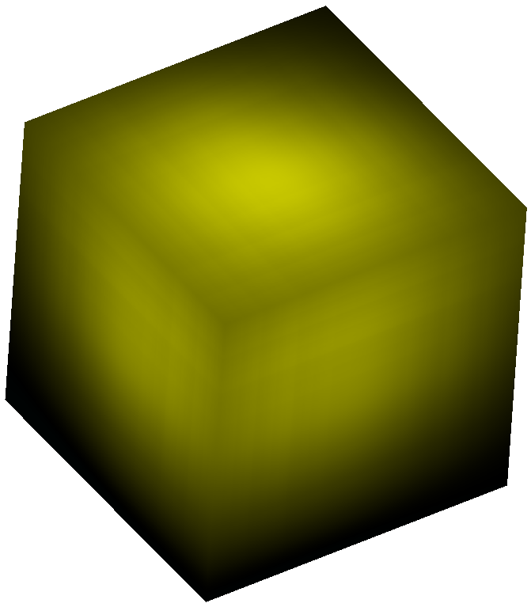
Reconstructions of cosine lobe on cube
Reference
Cheap weighted b-spline
Notes:
Coarser approximation has some artifacts, but basically has the same shape as weighted.
Being smooth is not important. Need to capture total energy and be consistent between neighbors.

Slide 54
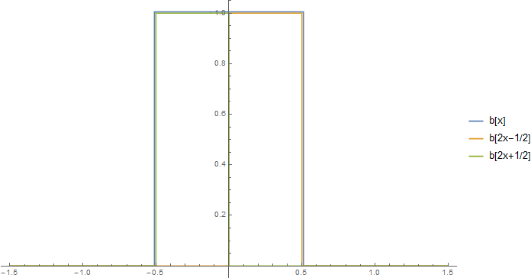
Mipmap recurrence: Box function
Notes:
Typically, mipmaps are generated with a box function.
Uses the fact that box functions are 0-order b-splines and have a recurrence relation.
Box functions are not very good because they don’t match the shape of the filter very well. Not smooth.

Slide 55
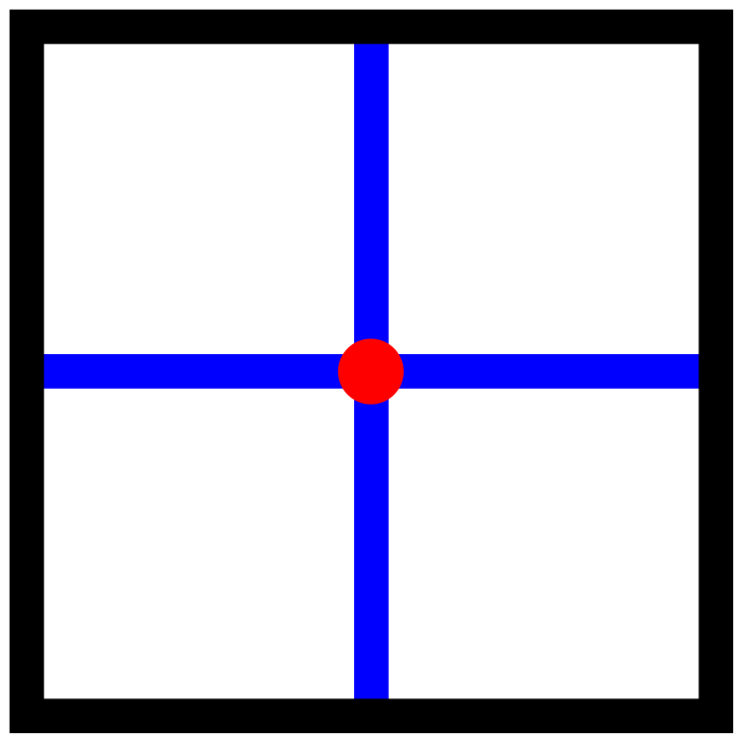
Mipmap recurrence: Box function
Notes:
Fast to evaluate in a shader.
4 bilinear samples (shown in red).
Hardware takes care of sampling over cube face boundaries (shown in green).

Slide 56
Research questions
What does “filter size” mean?
Trilinear interpolation
Not translation invariant even for a plane
[Manson and Schaefer, “Cardinality-Constrained Texture Filtering”, 2013]
What are good basis functions on a cube?
Where to place samples?
Anisotropic projection (that crosses cube edges)
Different projections for different texels
Cube or sphere-centric reasoning?
Spheres are symmetric and invariant
Cubes are what shaders actually sample from
Mix and match?
Notes:
…
The rest of my talk shows how we answered those questions.

