Slide 1
Contouring Discrete Indicator Functions
Jason Smith, Josiah Manson, and Scott Schaefer
Texas A&M University

Slide 2
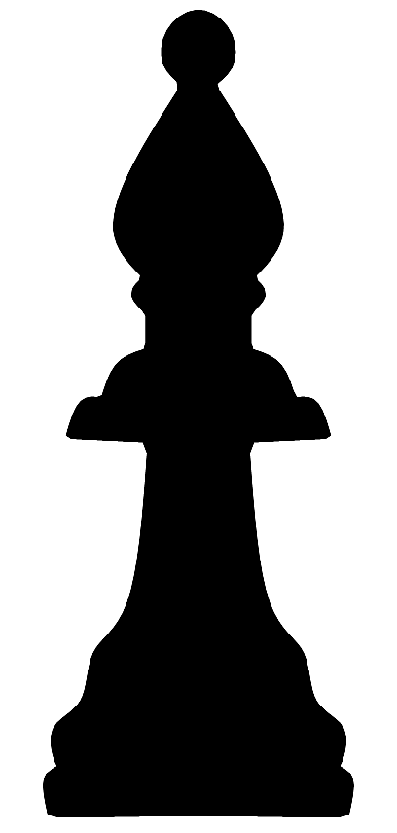
Indicator Functions

Slide 3
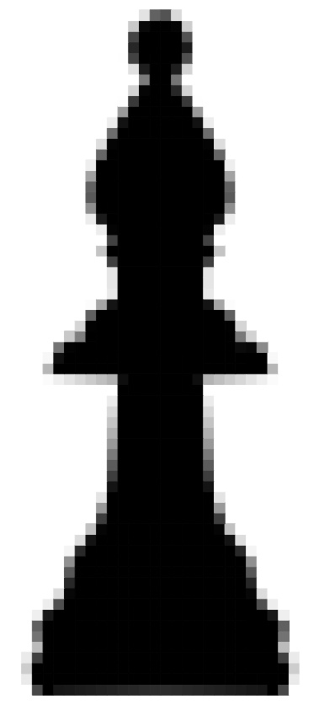
Discrete Indicator Functions (DIF)

Slide 4
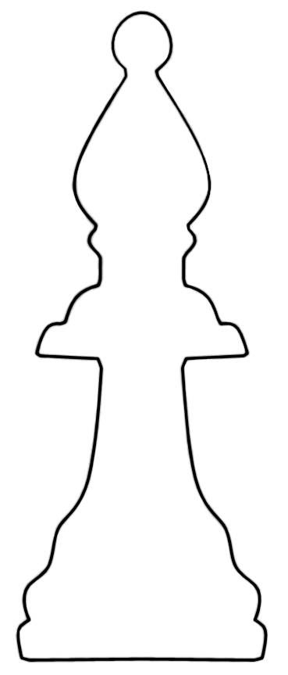
Extracted Surface

Slide 5
Motivation
[Green 2007]

Slide 6
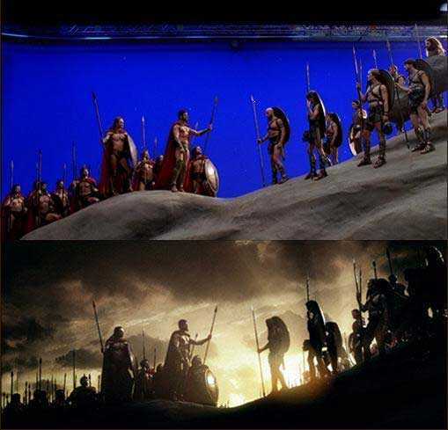
Motivation
[Warner Bros Pictures 2007]

Slide 7
Motivation

Slide 8
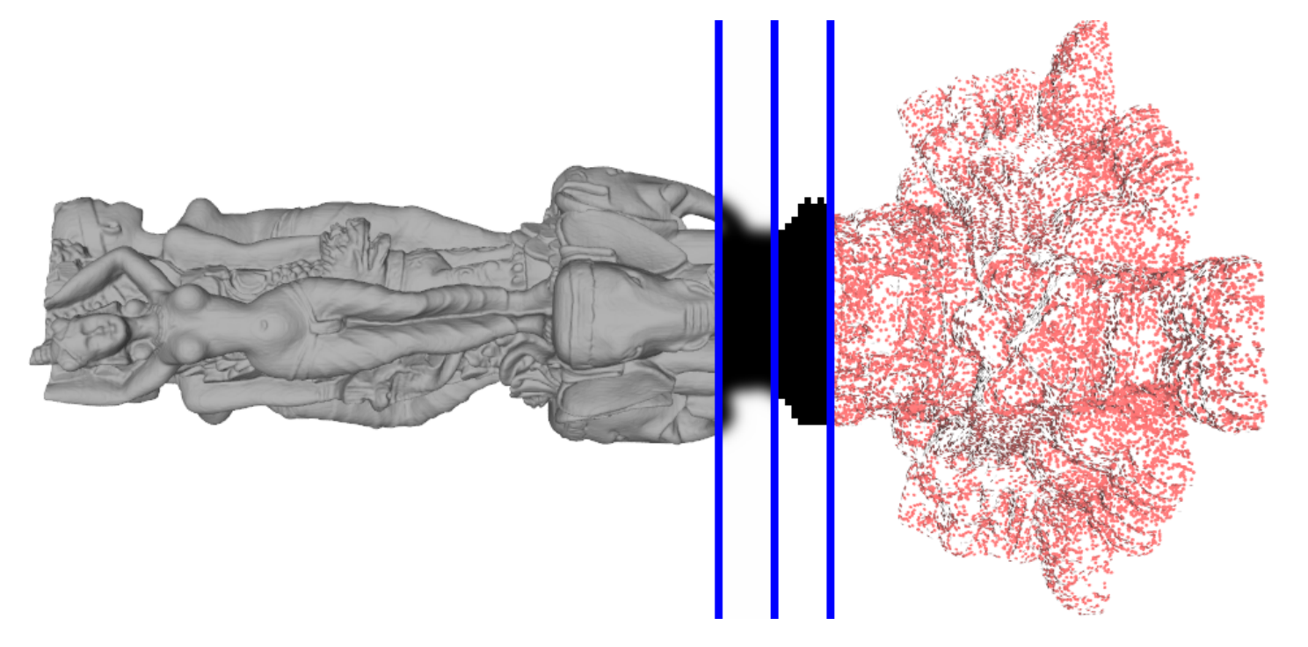
Motivation
[Manson et al. 2008]

Slide 9
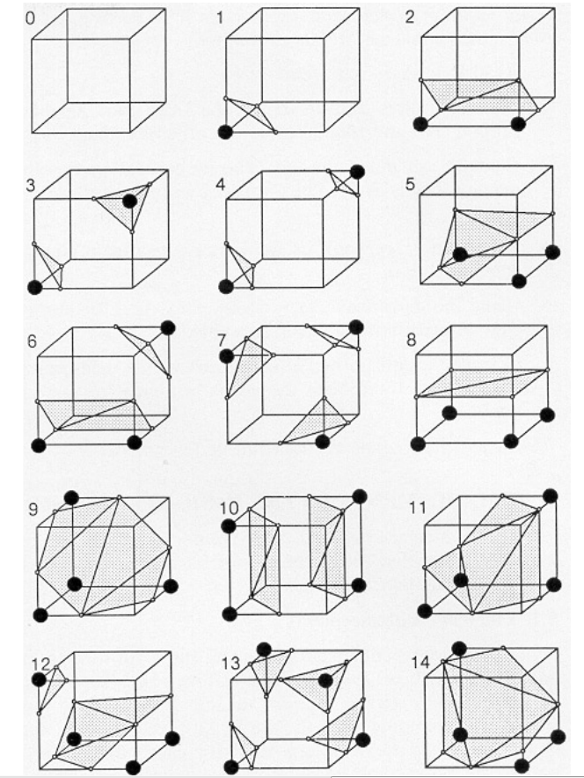
Marching Cubes
[Wyvill et al. 1986]
[Lorensen and Cline 1987]

Slide 10
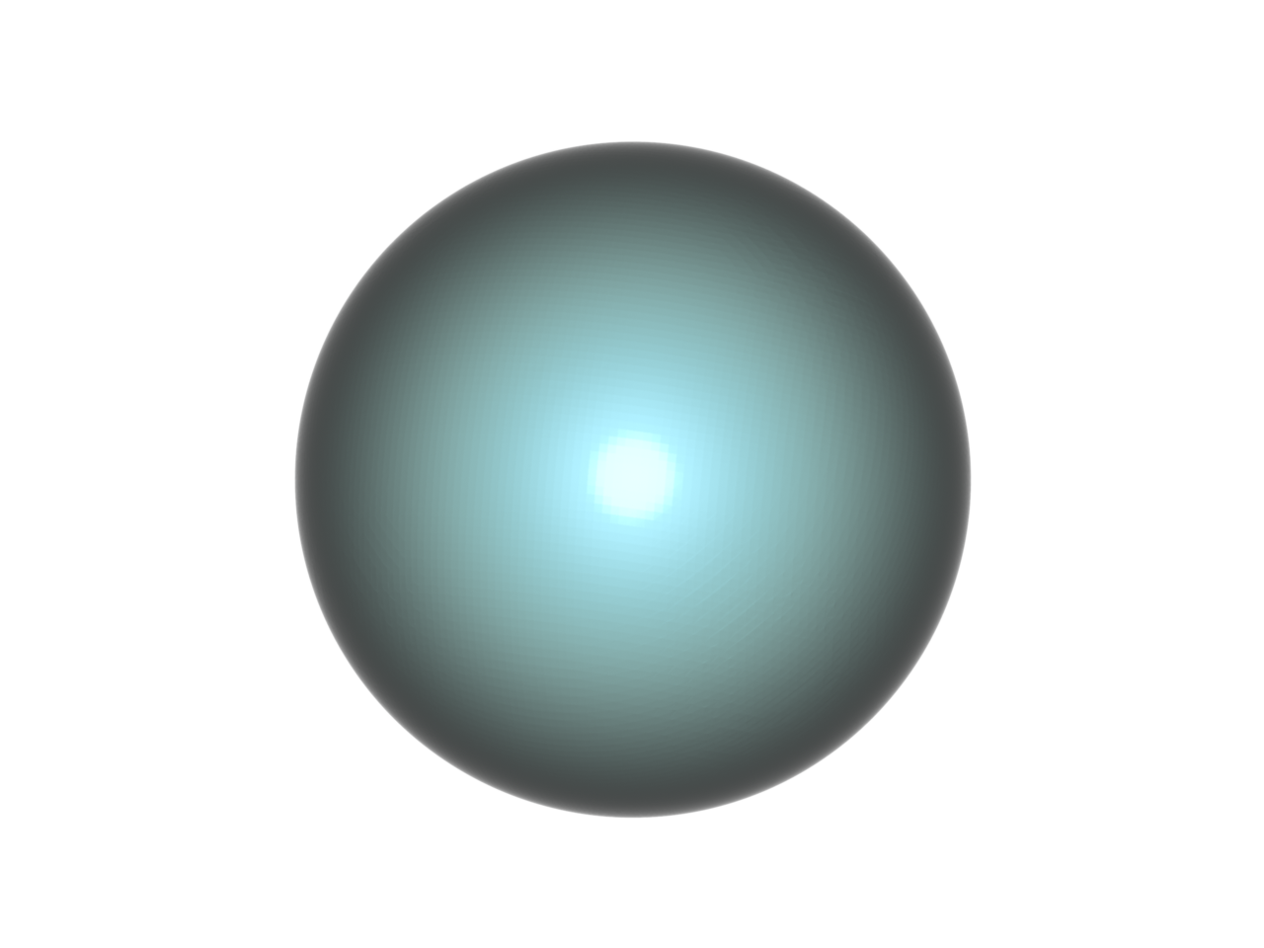
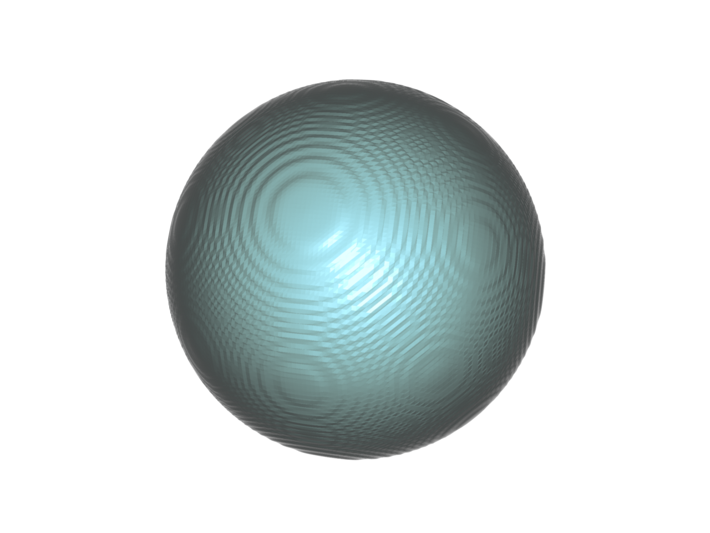
Marching Cubes
Perfect Sphere
MC

Slide 11
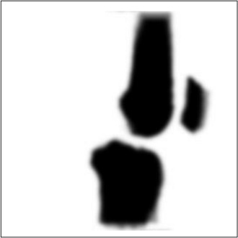
Related Work
[Mor et al. 1996]
[Wu and Sullivan 2003]
[Reitinger et al. 2005]

Slide 12
Related Work
[Gibson and Frisken 1998]
[Chica et al. 2007]

Slide 13
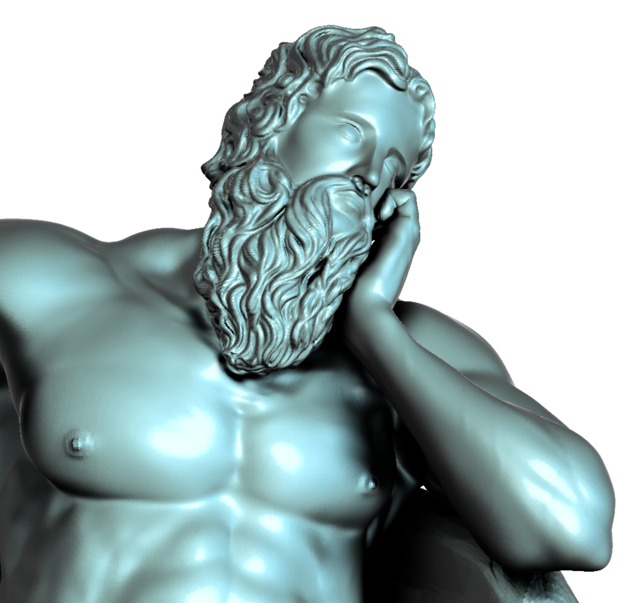
Gaussian Blur
Poseidon

Slide 14
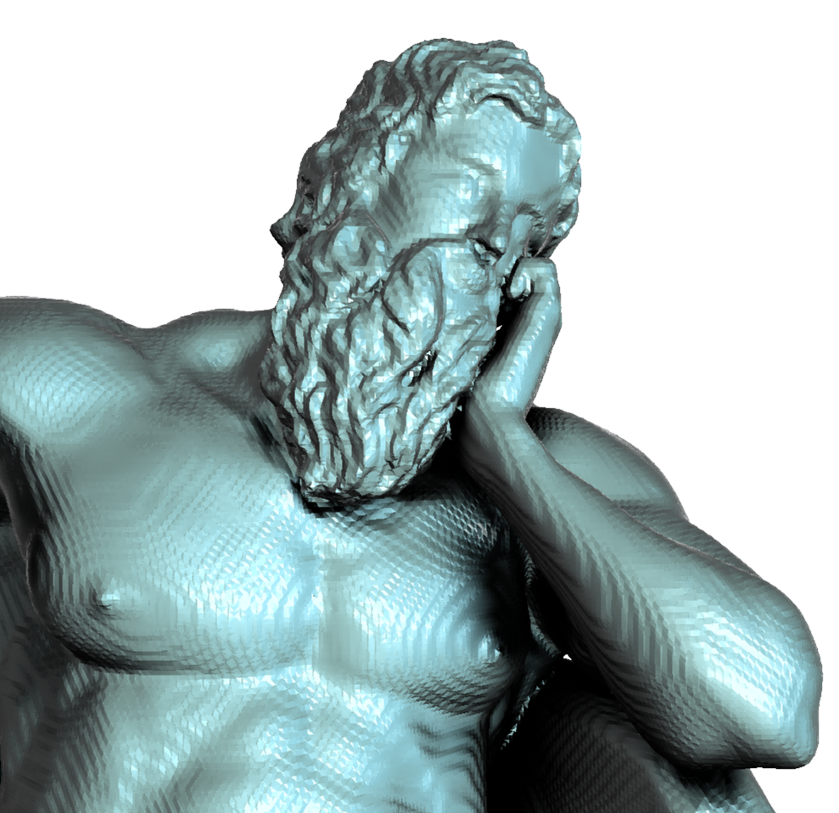
Gaussian Blur
MC

Slide 15
Gaussian Blur
Blur size 3

Slide 16
Gaussian Blur
Blur size 7

Slide 17
Gaussian Blur
MC Blur
Ours

Slide 18
Gaussian Blur
MC
Ours

Slide 19
Contributions
Simple and easy to implement modification to the MC algorithm
Replaces the linear interpolant in MC
Computationally inexpensive
Greatly reduces surface contouring artifacts

Slide 20
Contouring

Slide 21
DIF

Slide 22
Dual Grid

Slide 23
Dual Grid

Slide 24
2D MC change
t
0
1

Slide 25
2D MC change
a₁
a₂

Slide 26
Side - Side
a₁
a₂

Slide 27
Bottom - Top
a₁
a₂

Slide 28
Bottom - Side
a₁
a₂

Slide 29
Side- Top
a₁
a₂

Slide 30
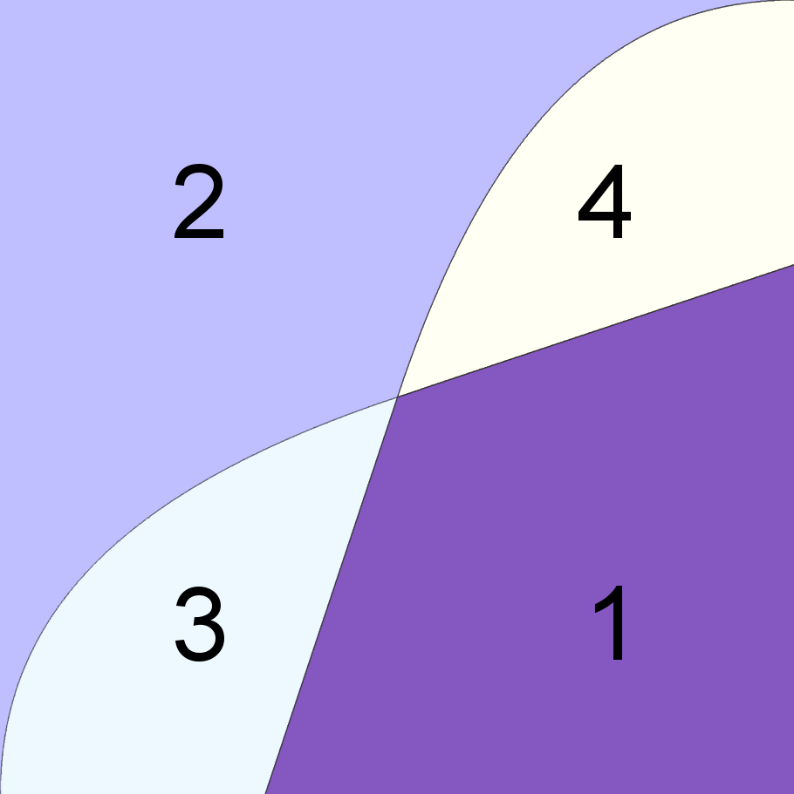
Parameter Space
1
a₂
.5
0
a₁
.5

Slide 31
Parameter Space

Slide 32
Parameter Space

Slide 33
Parameter Space

Slide 34
Parameter Space

Slide 35
Parameter Space
1
a₂
.5
0
a₁
.5

Slide 36
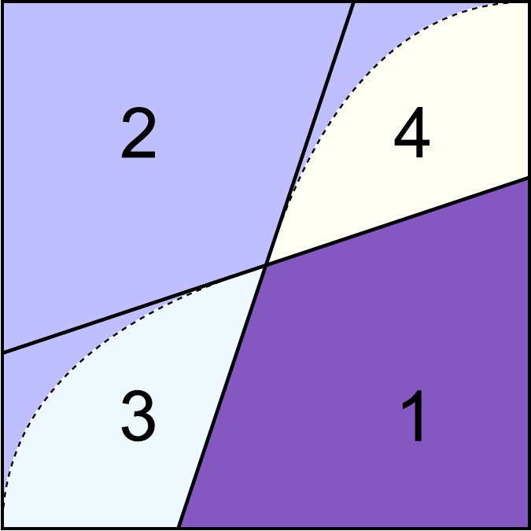
Parameter Space

Slide 37
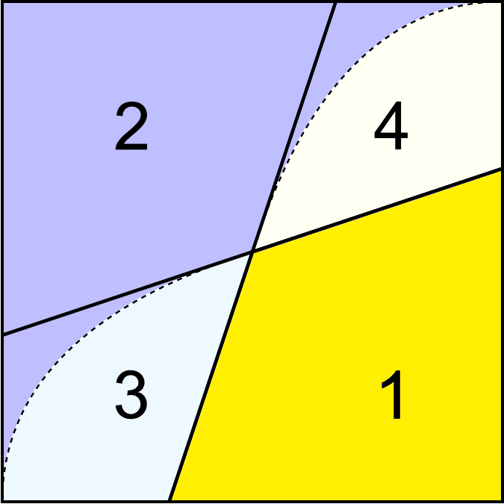
Parameter Space

Slide 38
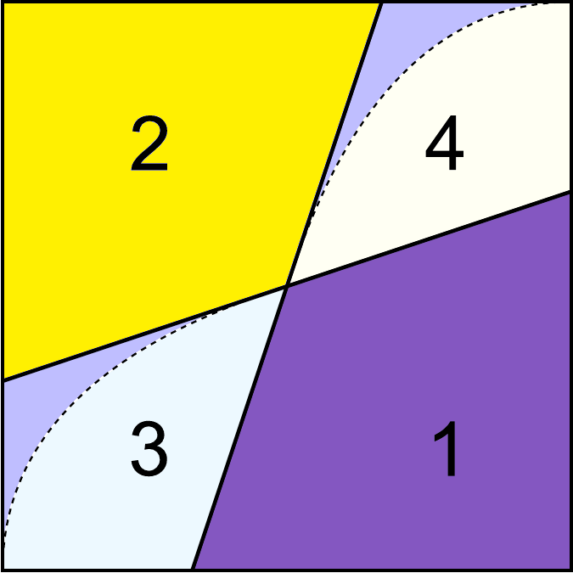
Parameter Space

Slide 39
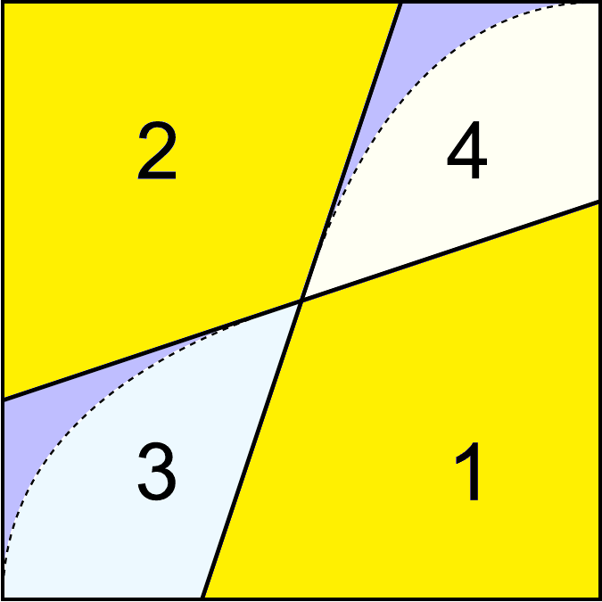
Parameter Space

Slide 40
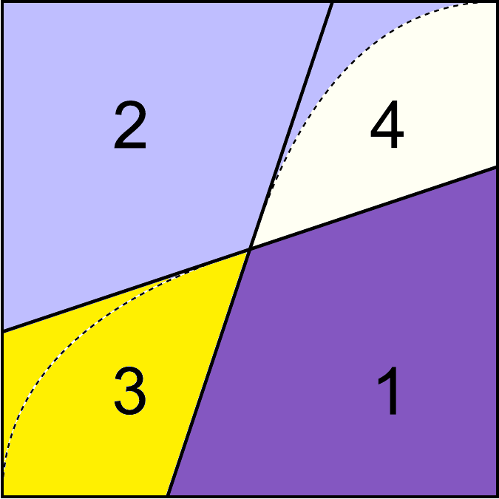
Parameter Space

Slide 41
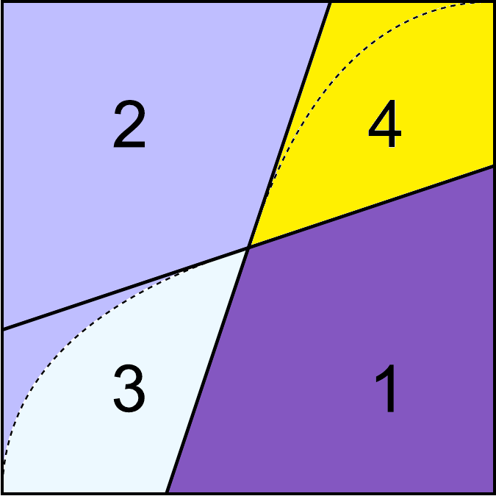
Parameter Space

Slide 42
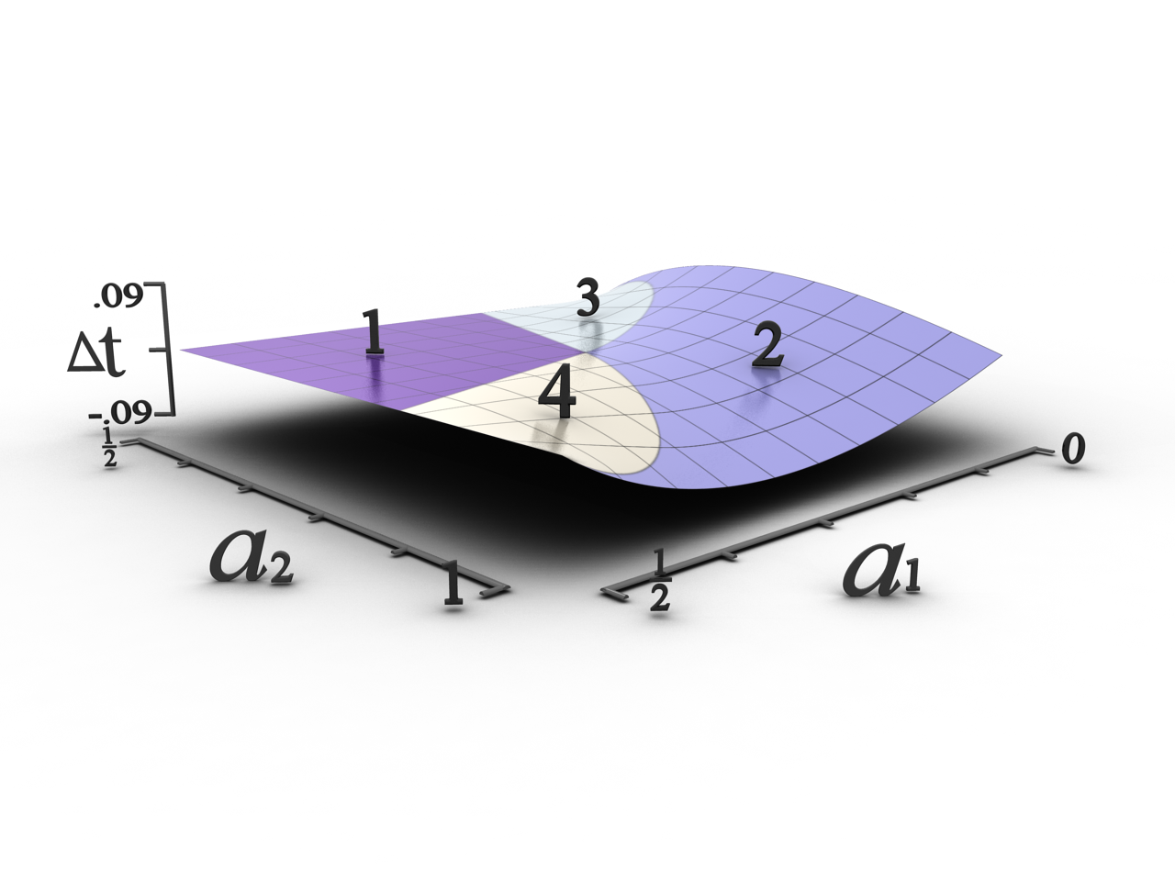
Difference from Linear Interp.

Slide 43
Linear functions

Slide 44
Linear functions

Slide 45
Linear functions

Slide 46
Expanding to 3D

Slide 47
Expanding to 3D

Slide 48
Expanding to 3D

Slide 49
Expanding to 3D

Slide 50
Expanding to 3D

Slide 51
Expanding to 3D
MC

Slide 52
Expanding to 3D
Ours

Slide 53
Expanding to 3D
MC
Ours

Slide 54
Perfect Sphere

Slide 55
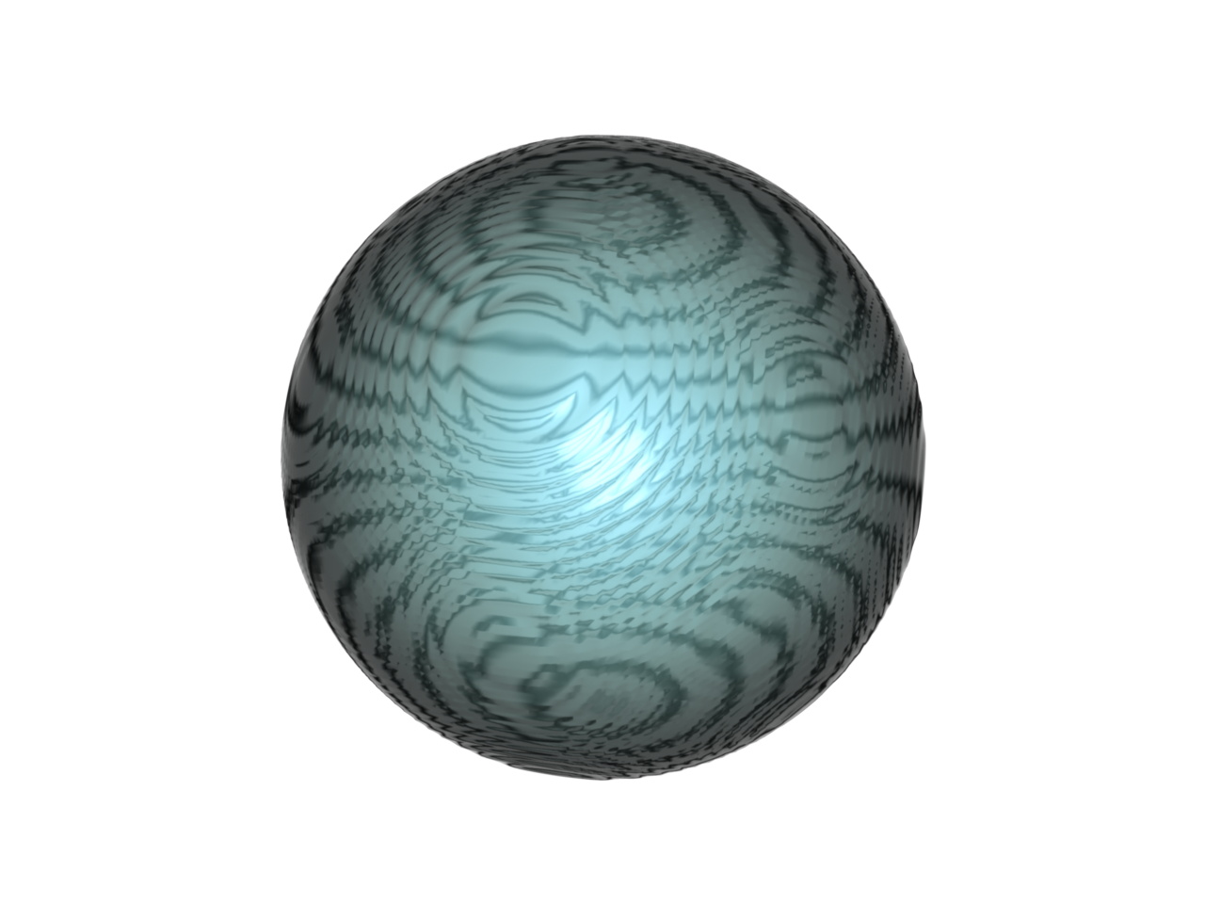
MC

Slide 56
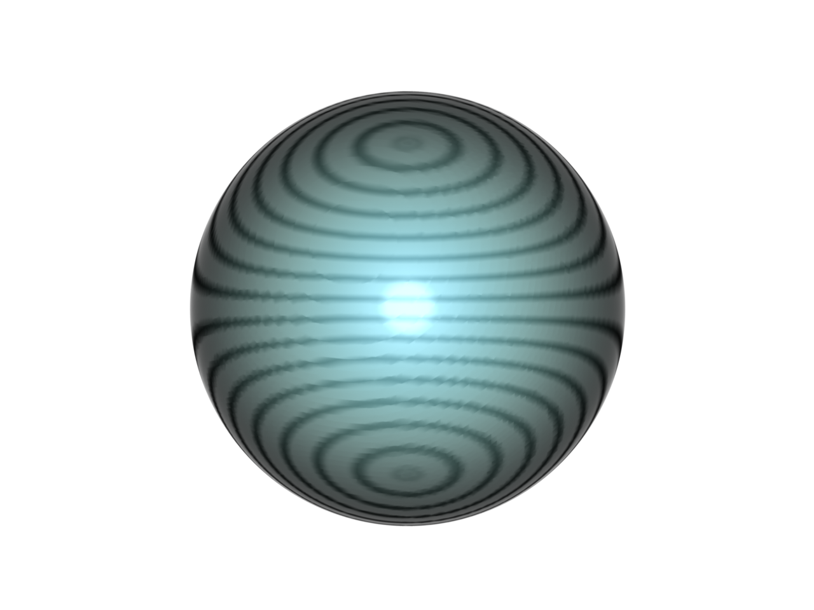
Ours

Slide 57
MC
Ours

Slide 58
Sphere Normal Error

Slide 59
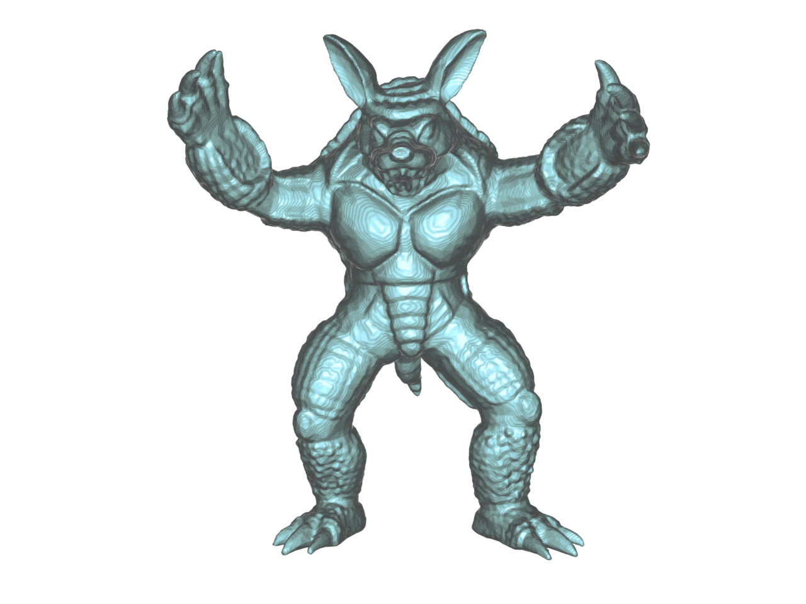
MC

Slide 60
Ours

Slide 61
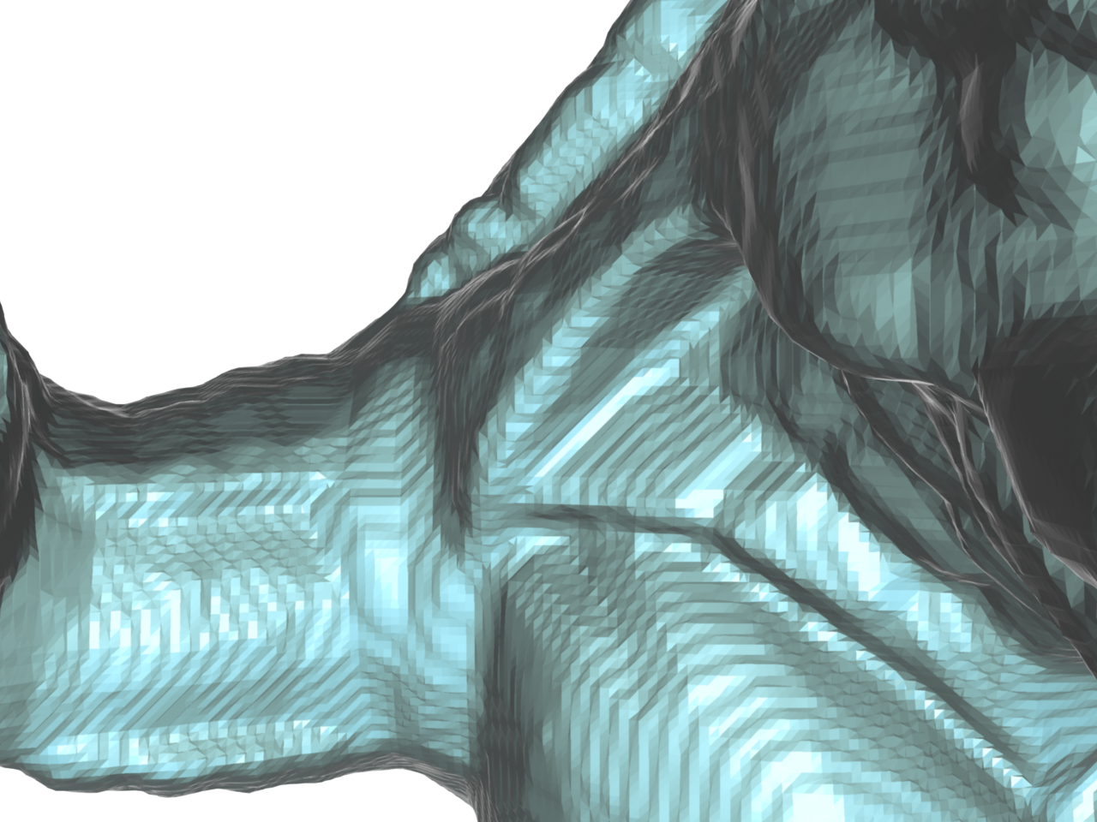
MC

Slide 62
Ours

Slide 63
Limitations?

Slide 64
Conclusion
Replaced Linear Interpolation of Marching Cubes.
Oscillation artifacts removed from surface contours while preserving details.
Inexpensive method not requiring any pre processing of function values, or post processing of output mesh.

Slide 65
Related Work
Adaptive Grid Contouring
[Schaefer and Warren 2004]
[Lorensen and Cline 1987]

