Slide 1
Cardinality-Constrained
Texture Filtering
Josiah Manson and Scott Schaefer
Texas A&M University
Notes:
Hi. I’m going to present a method for improving the quality of texture filtering.

Slide 2
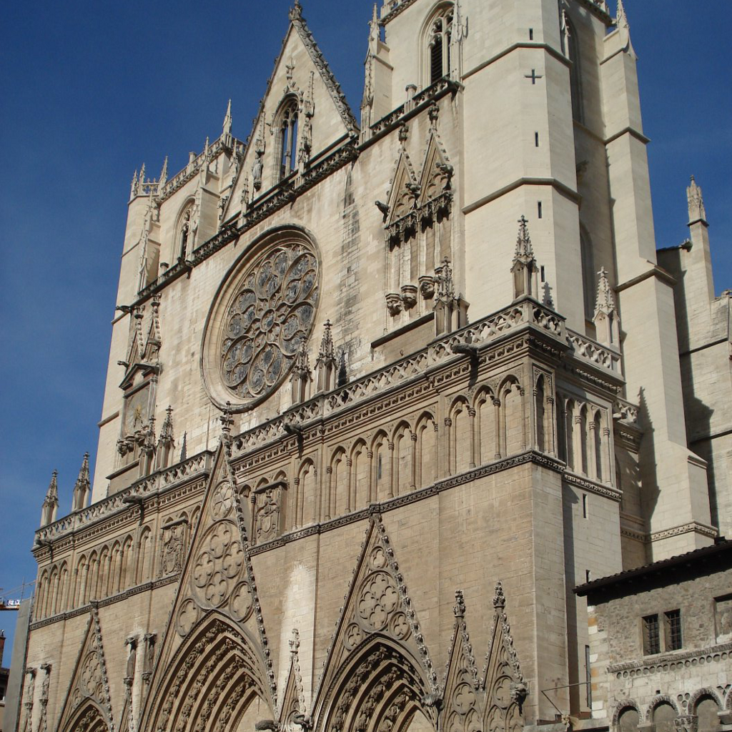
Image Sampling
Input
Downsampled
Notes:
Texture filtering can be thought of as a form of signal processing, where we downsample a high-frequency input signal such as this image of a cathedral.

Slide 3
Image Sampling
Input
Downsampled
Notes:
In order to prevent aliasing artifacts, each pixel in the downsampled image takes a contribution from many pixels in the input image. The higher quality the filter is, the more pixels are used. In this example I show the size of a Lanczos 2 filter in the input for a pixel in the downsampled image.

Slide 4
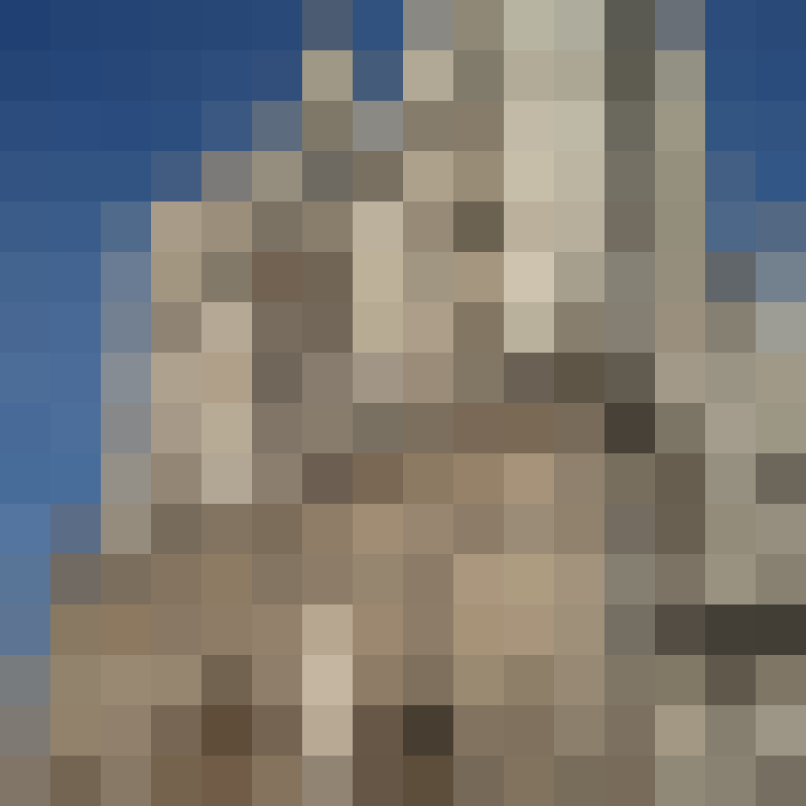
Image Sampling
Input
Downsampled
Notes:
As the samples get sparser, the size of the filter increases. For real-time rendering, it is completely impractical to integrate over so many pixels in the input image.

Slide 5
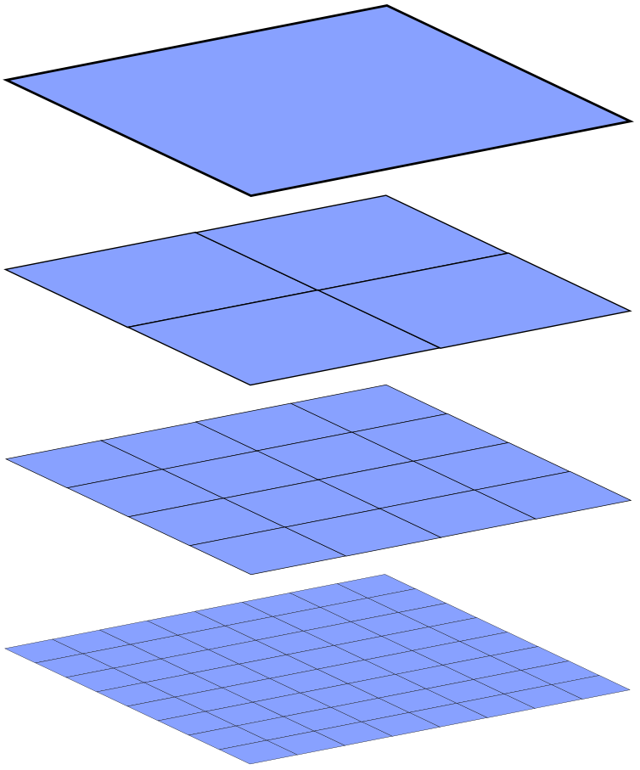
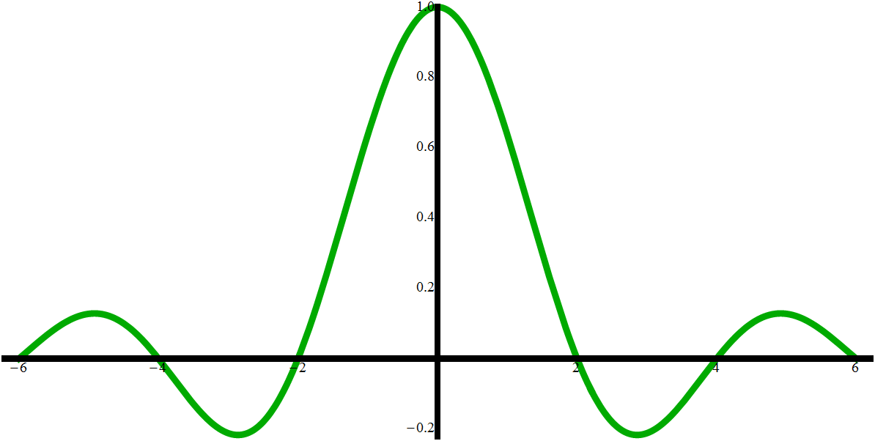
Mipmapping
Notes:
In order to keep the cost constant, people employ a trick called mipmapping, where we precalculate textures that are downsampled by powers of two. The lower the resolution the larger the filter that is used.

Slide 6
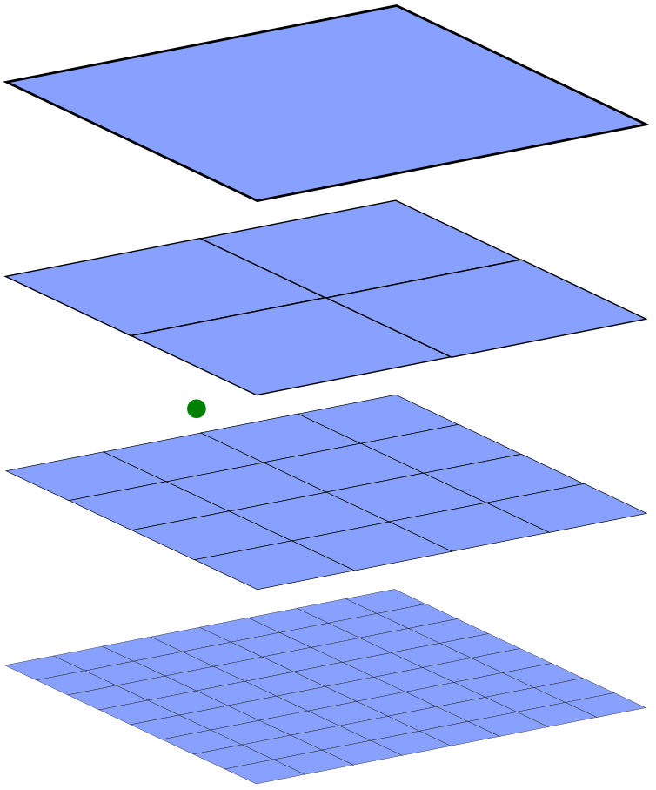
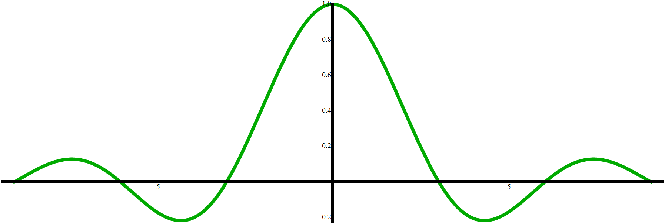
Mipmapping
Notes:
The question is then: how do we sample an arbitrary filter? The answer is usually trilinear interpolation.

Slide 7
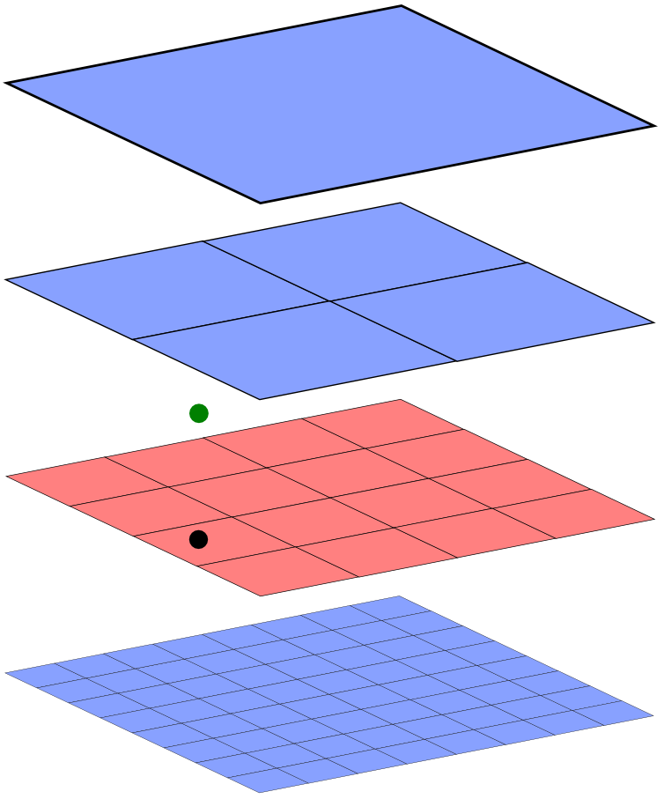
Mipmapping
Notes:
This means that we bilinearly interpolate a sample from the next higher resolution

Slide 8
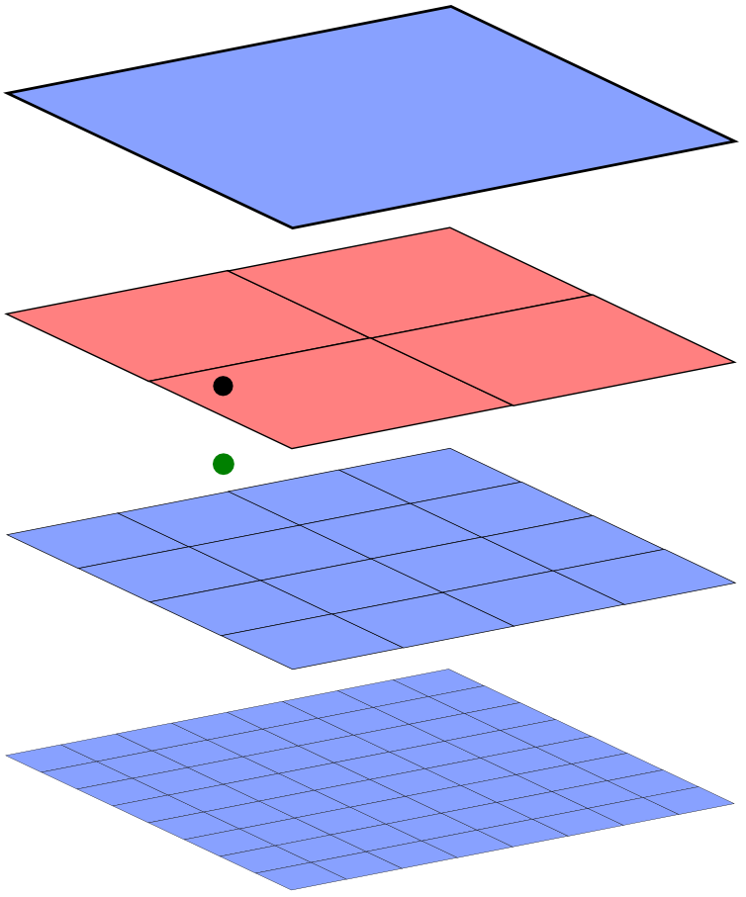
Mipmapping
Notes:
And from the next lower resolution.

Slide 9
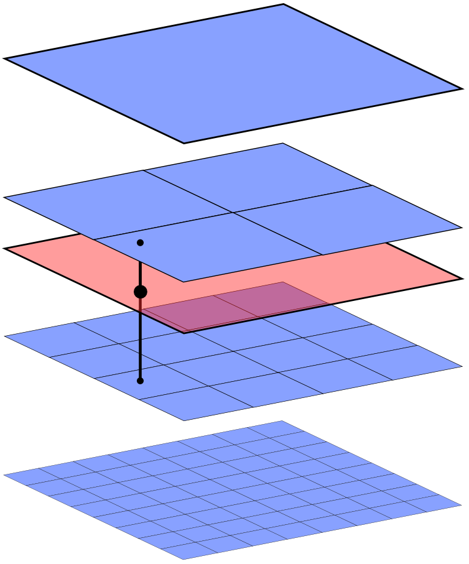
Mipmapping
Notes:
We then linearly interpolate between those samples to give our final color value.

Slide 10
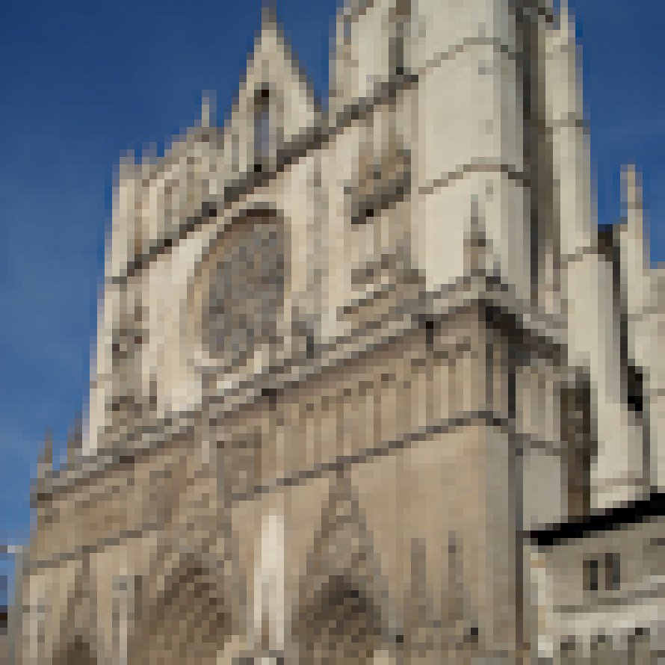
Image Sampling
Input
Exact
Notes:
So what does this look like in practice? Here I show an image that is downsampled using an exact Lanczos 2 filter. Now I will show the result of trilinear interpolation.

Slide 11
Image Sampling
Input
Trilinear
Notes:
You can see that compared to the exact filter, the image looks blurry. I’ll flip back so that you can see the difference again. Now, if you compare against our method,

Slide 12
Image Sampling
Input
Our Method
Notes:
You can see that while using the same texture bandwidth our method is much clearer than trilinear interpolation.

Slide 13
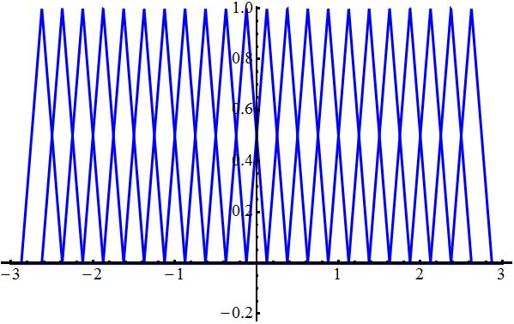
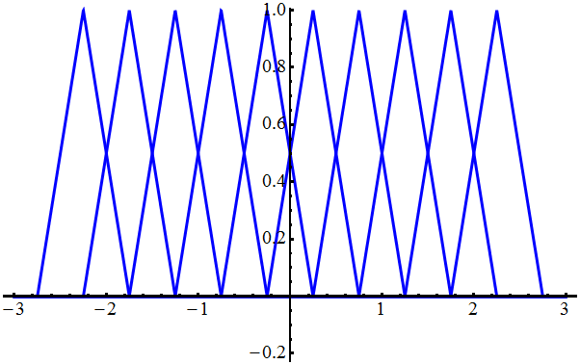
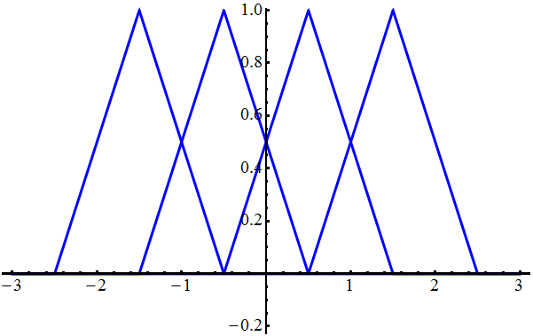
Image Sampling
Notes:
Each sample in a mipmap is generated by a scaled and translated filter, which means that we can imagine a mipmap in terms of the filters used to sample the image. In the graph under each image I show the tent filters used to sample the image. Each texel corresponds to one filter function.

Slide 14
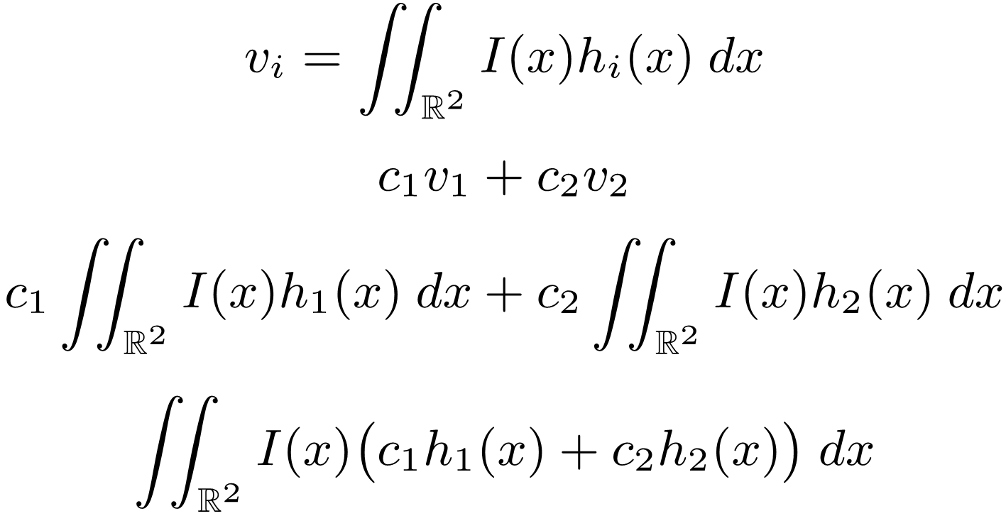
Filter Approximation
Notes:
If we take some combination of the texels in a mipmap, that is equivalent to sampling using a new filter that is composed of the texel filters. I will demonstrate why this is the case. Consider if a texel color v_i is calculated by sampling the image I with a filter h_i.

Slide 15
Filter Approximation
Notes:
If we take a weighted combination of some texels v_1 and v_2 with weights c_1 and c_2

Slide 16
Filter Approximation
Notes:
We can expand the expression by substituting the definition of v_i for each of the texel values.

Slide 17
Filter Approximation
Notes:
Because integration is a linear operator, we can rewrite the expression as a weighted combination of filters.

Slide 18
Filter Approximation
Notes:
It is now clear that combining texels is equivalent to sampling the image by a new filter that is a combination of the texel filters.

Slide 19
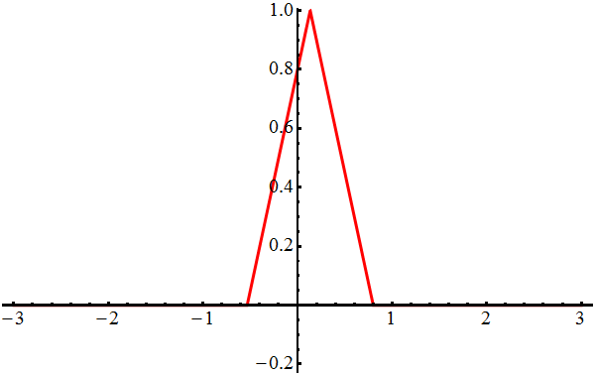
Filter Approximation
Notes:
Given a filter on the left with some translation and scale the question is: What basis functions should we choose from the mipmap shown on the right, and how should we combine them together to produce the best approximation of the filter?

Slide 20
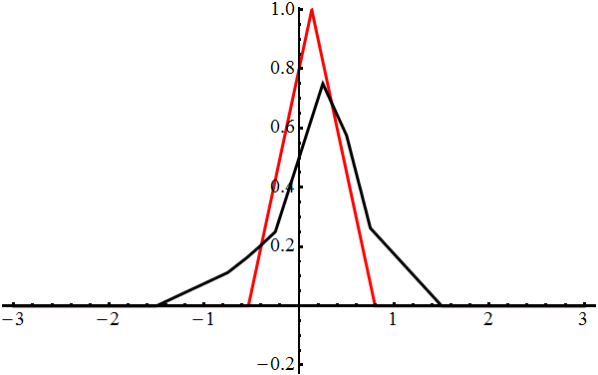
Filter Approximation
Interpolation of 4 samples
Notes:
For several decades, the answer has been trilinear interpolation. The advantage of this method is that it’s simple and only uses a maximum of 8 samples. However, this method does not give the best possible approximation of the filter. I show the basis functions that are used highlighted on the right, and the their weighted sum on the left in black. You can see that the approximate filter is too wide and is a poor fit.

Slide 21
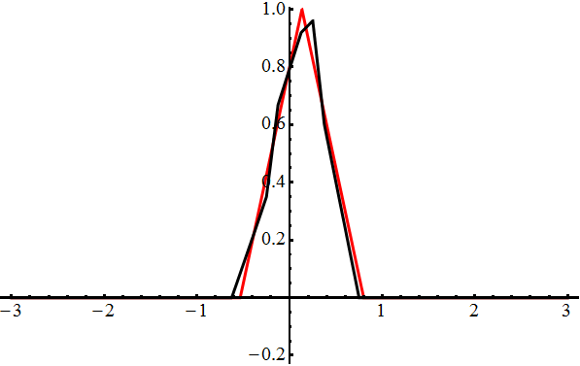
Filter Approximation
Best fit using 4 samples
Notes:
Using the same number of basis functions it is possible to fit the filter better. You can see in this example that many of the basis functions are taken from a higher resolution than used by trilinear interpolation.

Slide 22
Filter Approximation
Notes:
We can formulate texture filtering as an optimization problem

Slide 23
Filter Approximation
Notes:
Where we fit the input filter h_{s,t} as well as possible

Slide 24
Filter Approximation
Notes:
Using a weighted combination of basis functions in the mipmap.

Slide 25
Filter Approximation
Notes:
The optimization is also subject to a number of constraints. First, the coefficients must sum to one so that the filter has a unit integral.

Slide 26
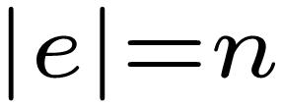
Filter Approximation
Notes:
There is also a cardinality constraint that we can only use a fixed number n of basis functions. This cardinality constraint makes the optimization discrete and is proven to be NP-hard because there are many choices of possible basis functions such as this

Slide 27
Filter Approximation
Notes:
this

Slide 28
Filter Approximation
Notes:
Or this. You can only be sure of the best set after checking all sets. However, we can quickly find good approximations after checking relatively few combinations. We use the heuristic of checking basis functions that are similar to the filter before checking functions that are less similar to the filter.

Slide 29
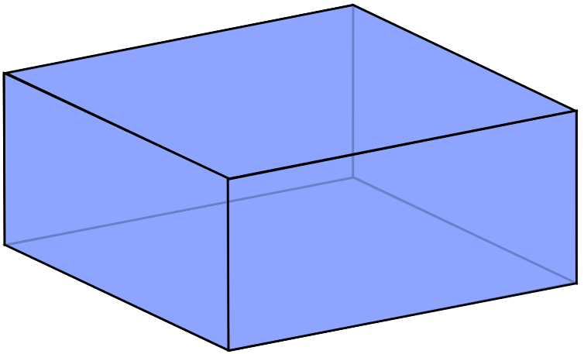
Filter Approximation
Notes:
Additionally, it is infeasible to perform a separate optimization for every possible translation and scale of the filter. If we parameterize the unit domain of translations t_0 and t_1 between texels and scale s between mipmap levels,

Slide 30
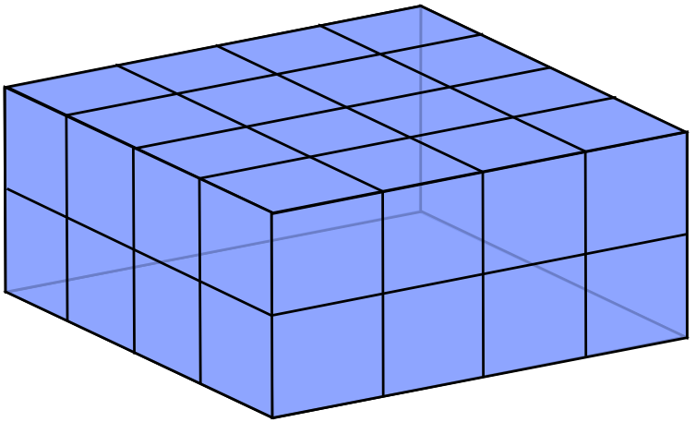
Filter Approximation
Notes:
We can subdivide the domain

Slide 31
Filter Approximation
Notes:
And fit a polynomial for the coefficients within each subdomain.

Slide 32
Filter Approximation
Notes:
The polynomials can be linear, quadratic, etc. In this example I show a linear polynomial with one constant component and three linear components for the three dimensions.

Slide 33
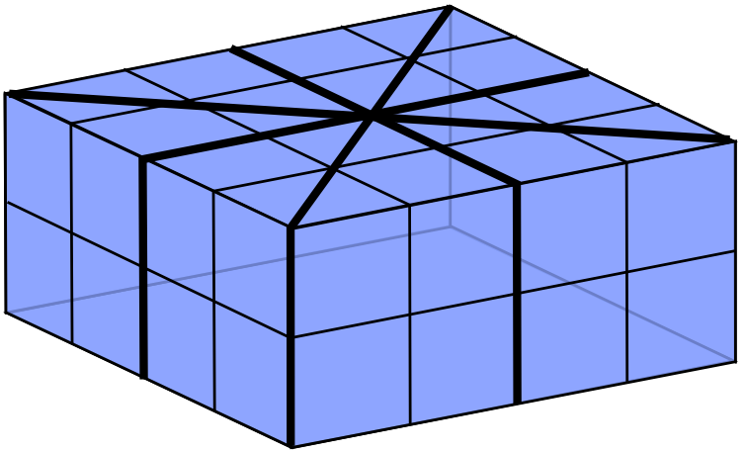
Filter Approximation
Notes:
We can simplify our optimization by taking into account the 8-fold symmetry of our problem

Slide 34
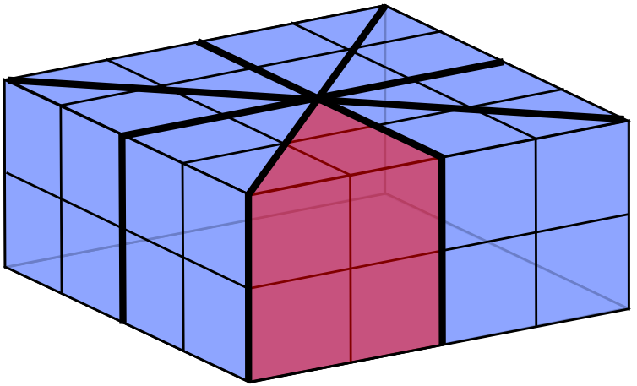
Filter Approximation
Notes:
To optimize and store the components for only one of the symmetric pieces.

Slide 35
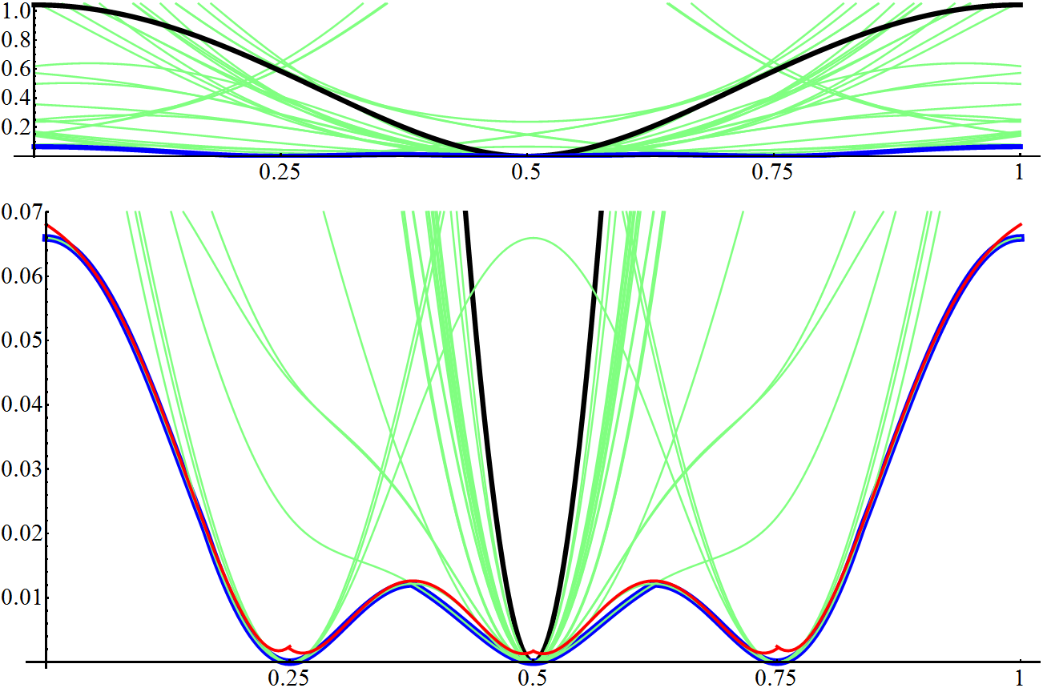
Fitting Error
Notes:
Here I show the error of our approximation in a one-dimensional example. The black curve is the error of trilinear interpolation, and the green curves are the errors for any one set of texels. The blue curve is the optimal error, which is the minimum of all the green lines.

Slide 36
Fitting Error
Notes:
If I zoom in by a factor of 30, you can see more clearly. Here I have also drawn the errors of our polynomial approximation in red, where the domain is subdivided into four pieces. You can also see some of the symmetry that I mentioned earlier.

Slide 37
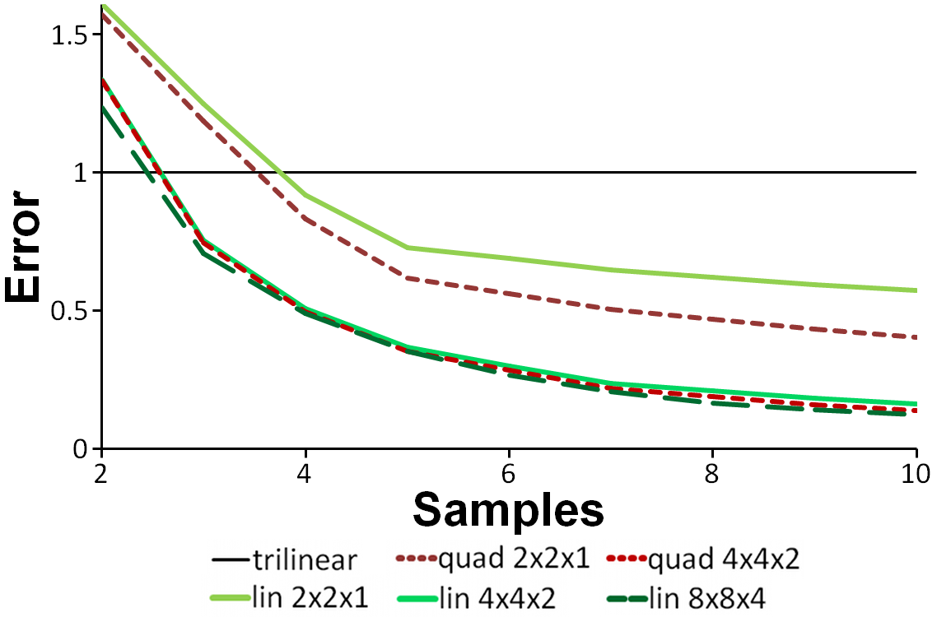
Fitting Error
Notes:
This graph shows filter approximation error of our method. Our method has a couple of parameters that include the order of the polynomials that we fit, the number of times we subdivide the domain, and the number of basis functions that we use, which is shown in the horizontal axis. Notice that three of the options shown have nearly identical error. We use the cheapest of those options, which is linear functions fit over a 4x4x2 subdivision of the domain. Even using only four samples, we have significantly lower error than trilinear interpolation.

Slide 38
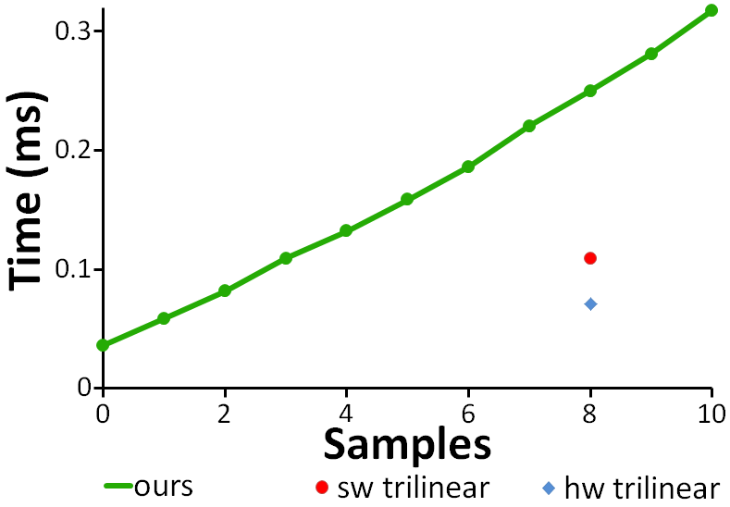
Speed
Notes:
This graph shows the time of our method as a function of samples on a GPU. We also show the times of trilinear interpolation directly evaluated by the hardware and in our shader implementation. Unfortunately, our cost per texel read is about double that of trilinear interpolation.

Slide 39
Sampling Patterns
Notes:
We believe this may be because GPUs are optimized for trilinear texture reads and that our memory accesses are less coherent than trilinear interpolation. Here we show which texels are fetched for one of the subdomains. You can see we read texels that are scattered across 3 different resolutions.

Slide 40
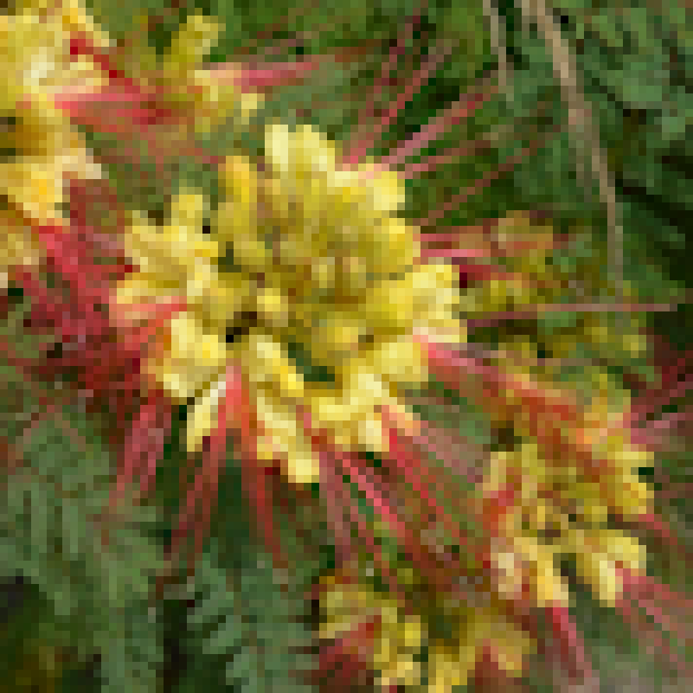
Lánczos 2 Approximation
Exact
Trilinear
Notes:
I have talked about quantitative error of our method, but how does it actually look? On the left, I show the ground truth of downsampling an image using a Lánczos 2 filter and on the right I show the result from trilinear interpolation of a mipmap that was calculated using a Lánczos 2 filter. Notice when I change the image

Slide 41
Lánczos 2 Approximation
Exact
8 Samples
Notes:
To our method using the same number of samples as trilinear interpolation that the image is much clearer and almost the same as the ground truth. I’ll flip so you can compare… Even when we use half as many texels

Slide 42
Lánczos 2 Approximation
Exact
4 Samples
Notes:
Our result is still quite good.

Slide 43
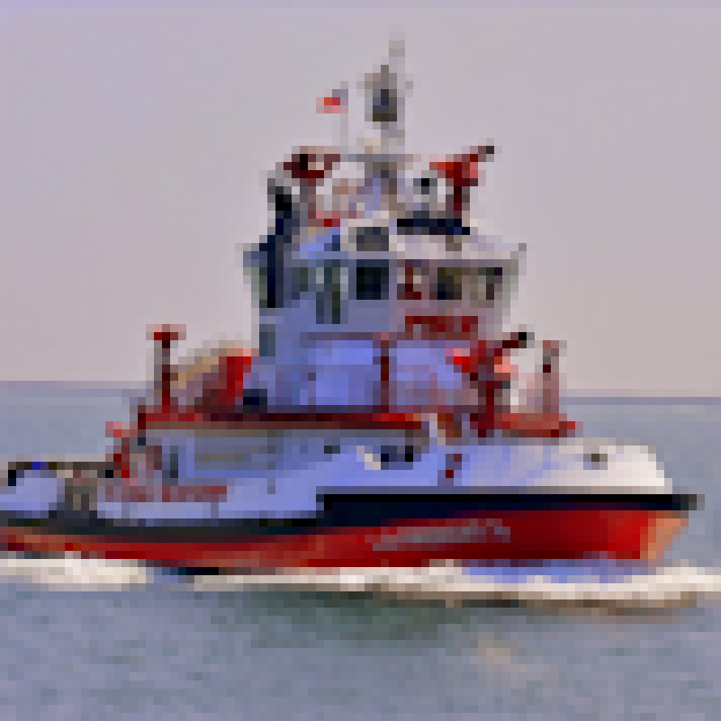
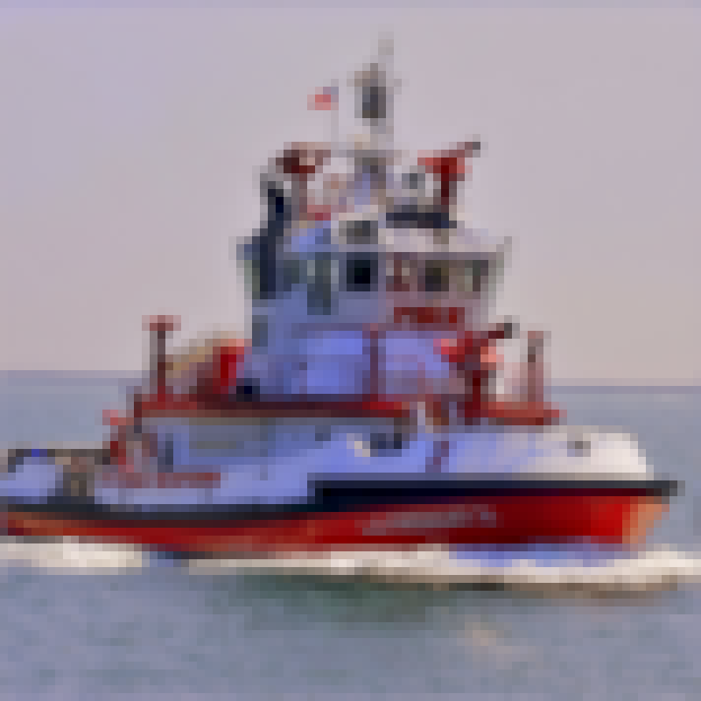
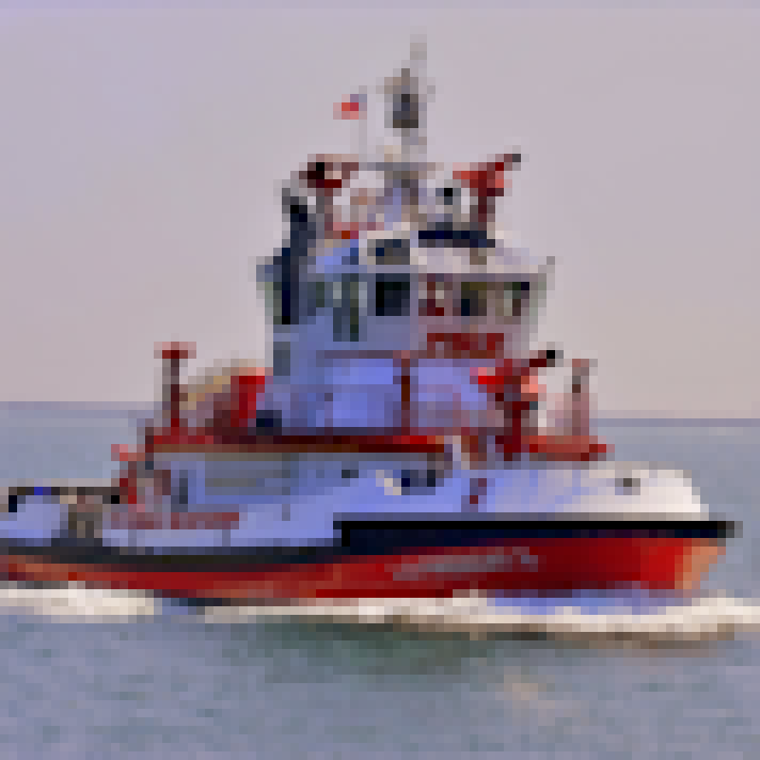
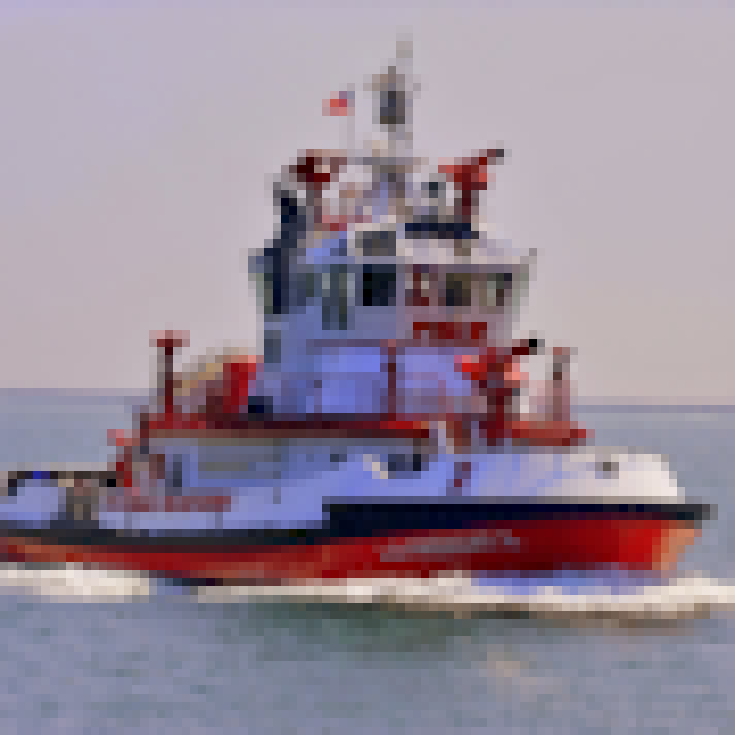
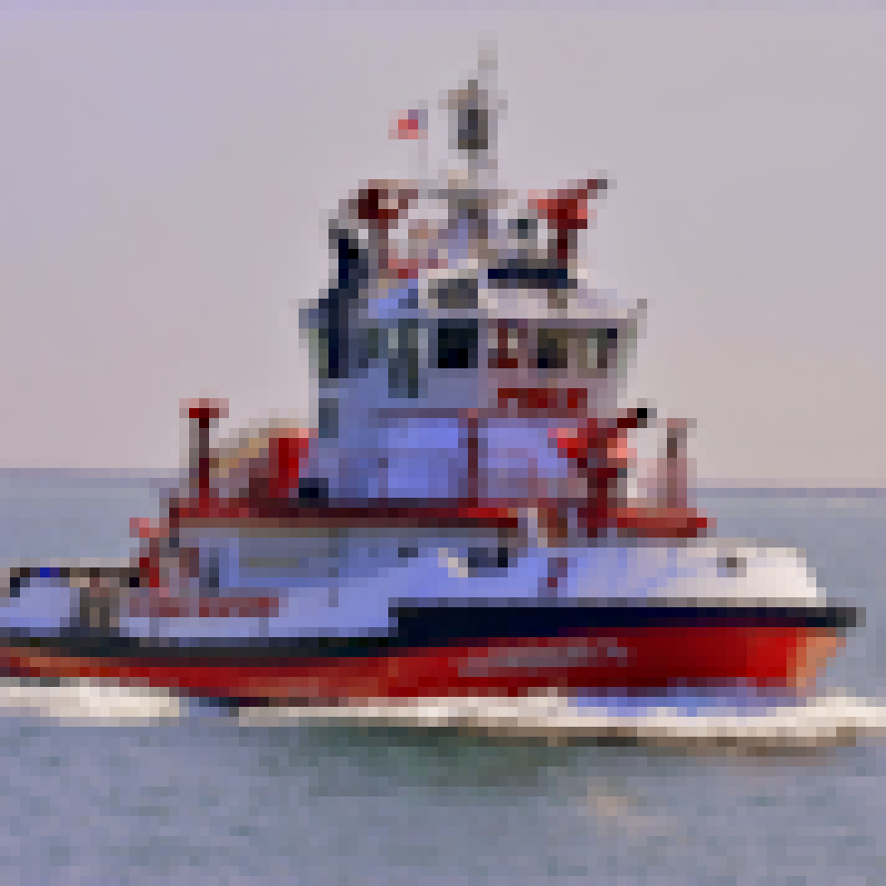
Scalable Bandwidth
Exact
Trilinear
8 Samples
7 Samples
6 Samples
5 Samples
4 Samples
3 Samples
Notes:
Our method also has more freedom in how many samples to use compared against traditional texture filtering. This means that it is possible to make small adjustments to reduce bandwidth consumption as needed without degrading image quality very much. Notice that as we reduce the number of samples that we use, the image remains clear and high-quality compared to trilinear filtering.

Slide 44
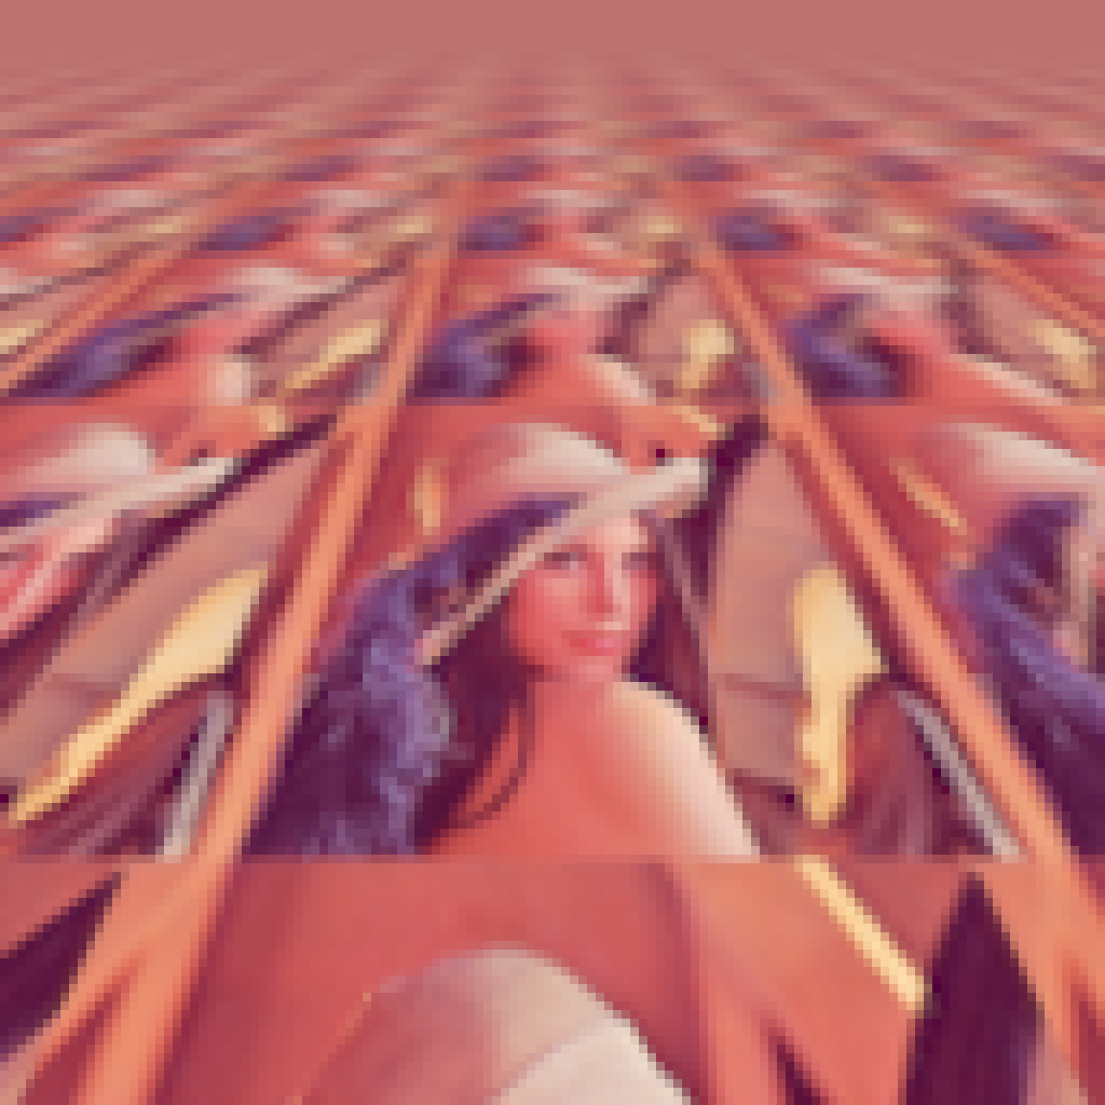
Isotropic Lánczos 2 Approximation
Trilinear
Notes:
Here, I show the difference between using trilinear interpolation and our method on an image that is tiled over an infinite 3D plane. When I switch from trilinear interpolation to our method

Slide 45
Isotropic Lánczos 2 Approximation
8 Samples
Notes:
You can see that the image becomes clearer…

Slide 46
Anisotropic Filtering
Notes:
When sampling textures from surfaces that are seen from oblique angles, the sampling filter stretches and shears nonuniformly in texture space. Given a radial filter such as a Gaussian, this will change the filter’s profile to an ellipse.

Slide 47
Anisotropic Filtering
Notes:
The approach that is usually used to estimate this stretched filter is to calculate the major and minor axes of the ellipse.

Slide 48
Anisotropic Filtering
Notes:
And to then take several isotropic samples along the major axis. This means that by improving the quality of isotropic filters, we automatically improve the quality of anisotropic filters also.

Slide 49
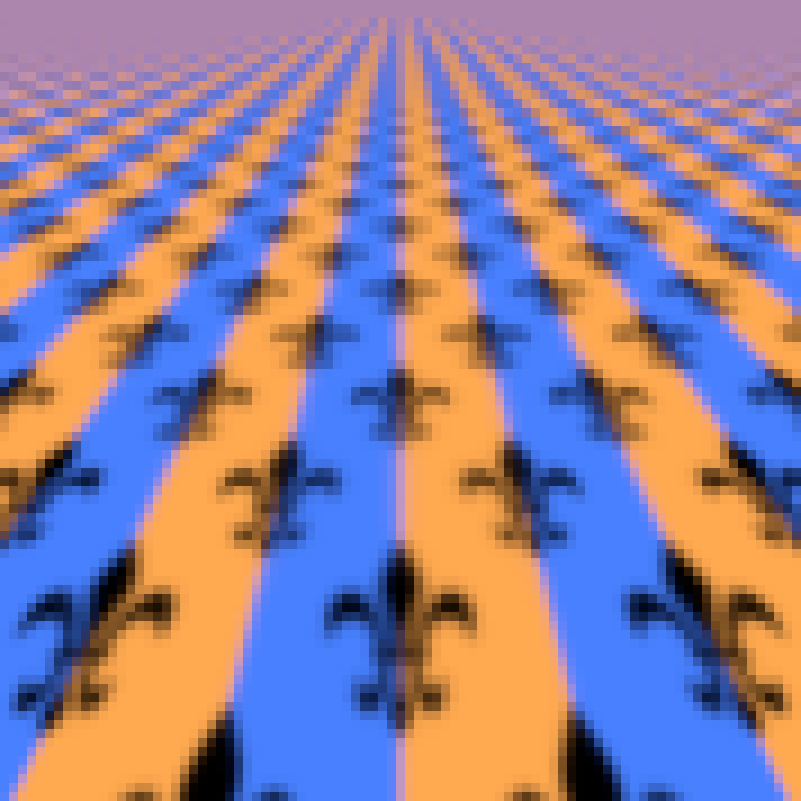
Anisotropic Gaussian Approximation
Feline
Notes:
Here is an example of an algorithm representative of what is done in hardware. Multiple trilinear samples are combined into anisotropic samples. I will now show the result of replacing trilinear probes with our method.

Slide 50
Anisotropic Gaussian Approximation
8 Samples with Feline
Notes:
You can see that the image is clearer both in the distance and up close. I’ll switch back and forth so that you can compare. Now, because our filter is an approximation of a Gaussian filter in screen-space, we can compare against the ground truth of a high-res rendering that is downsampled using a Gaussian filter.

Slide 51
Anisotropic Gaussian Approximation
Exact
Notes:
Our results are nearly identical to the ground truth. I will flip back and forth again so that you can compare.

Slide 52
Conclusions
Higher quality using less bandwidth
Scattered reads cost performance
Approximate filters with few samples
Cost is only in preprocessing
Small lookup tables
Easily fits in local memory
GPU implementation
http://josiahmanson.com/research/cardinality_constrained/
Notes:
In conclusion, the images we produce are higher quality while using less bandwidth, but scattered reads cost performance. Our method approximates filters using only a few samples and the cost is only in preprocessing. These preprocessed results can then be stored in small lookup tables that easily fit into local memory on a GPU. If you are interested, we provide a GPU implementation as well as other materials on the project web page.

